Slide 2
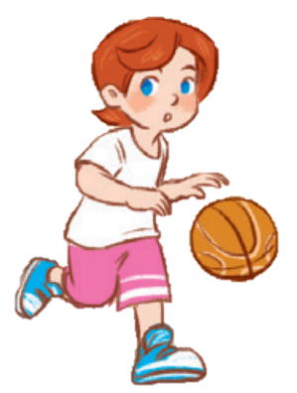
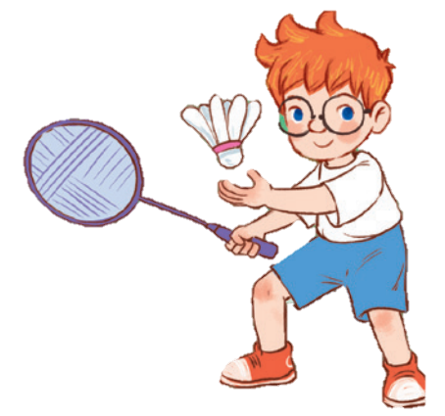
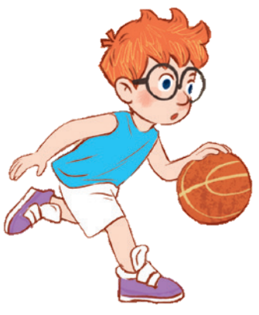
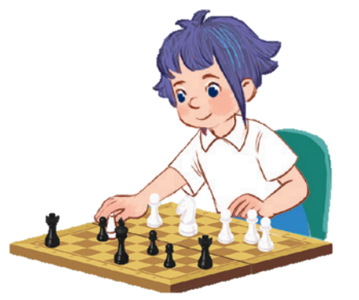
10
Period 6

Slide 3
Contents
1
5
Fun corner and wrap-up
Warm-up and review
4
2
3
Project
Read and tick.
Let’s write.

Slide 4
Warm-up and review
Notes:
Game: Picking flowers
- Teacher divides the class into groups of 4-5.
- Teacher lets the pupils choose the question numbers 1 - 8 (click to the flowers next to the numbers).
- When the members of groups answer correctly, they will get points by spinning the wheel (click to the big wheel) (points they can get: 1-4)
- Click on the 3-flower at the bottom to go back the WHEEL

Slide 5
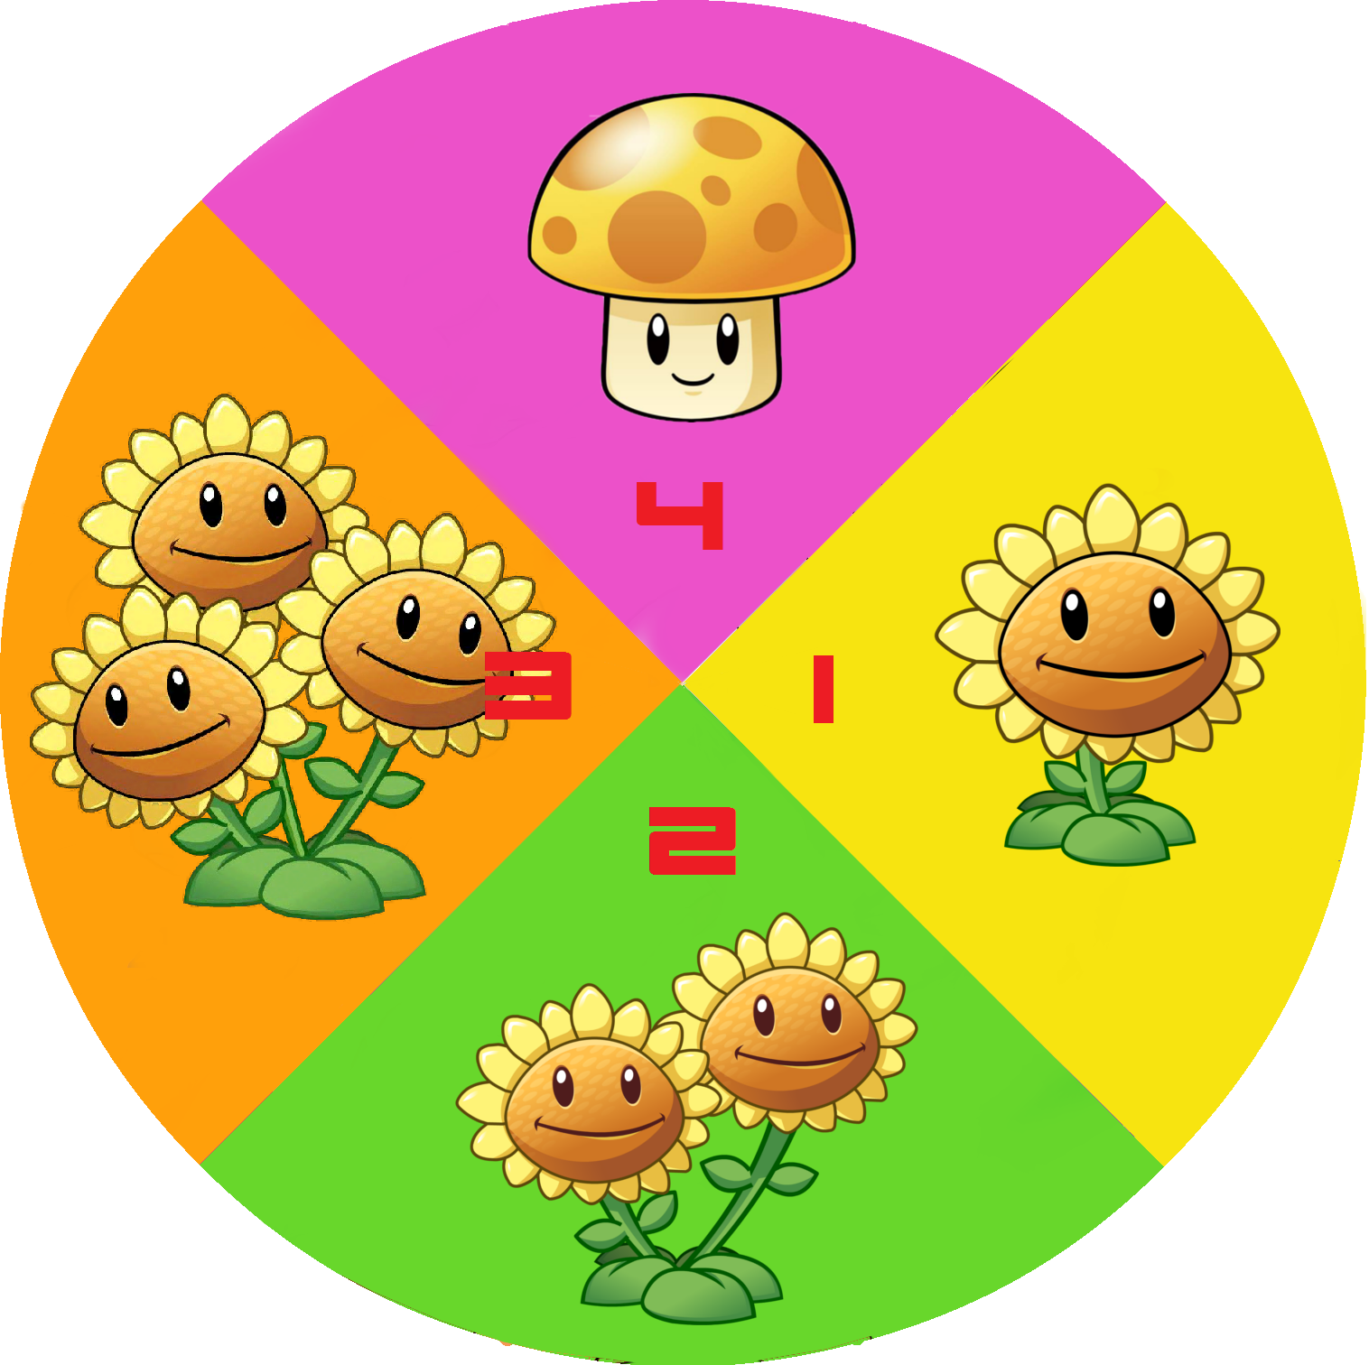
1
5
2
6
3
7
4
8
Notes:
Game: Picking flowers
- Teacher divides the class into groups of 4-5.
- Teacher lets the pupils choose the question numbers 1- 8 (click on the flowers next to the numbers).
- When the members of a group answer correctly, they will get points by spinning the wheel(click to the big wheel)(points they can get: 1-4).
- Click on the 3-flower to go back to the WHEEL.

Slide 6
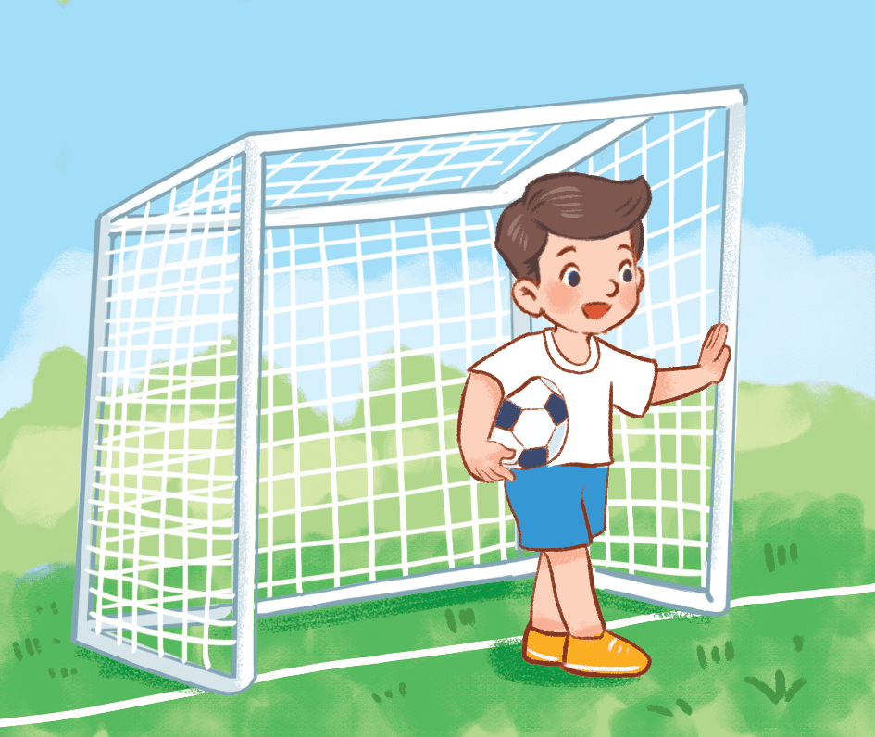
What do you do at break time?
I play football at break time.
Notes:
Click on the three flowers at the top right corner to go back to the WHEEL.

Slide 7
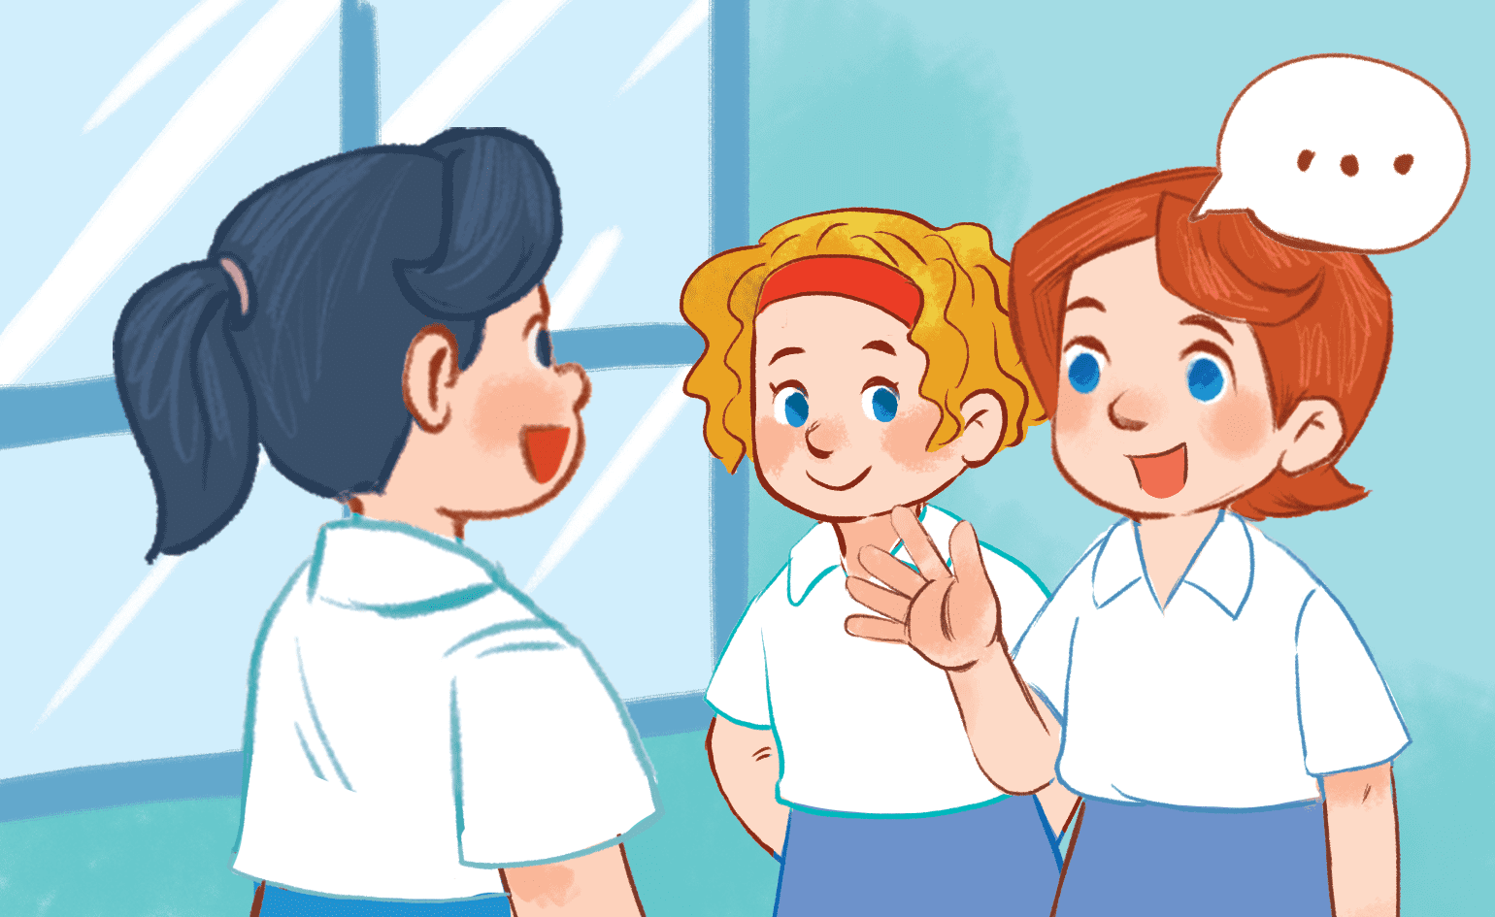
What do you do at break time?
I chat with my friends at break time.
Notes:
- Click on the three flowers at the top right corner to go back to the WHEEL.

Slide 8
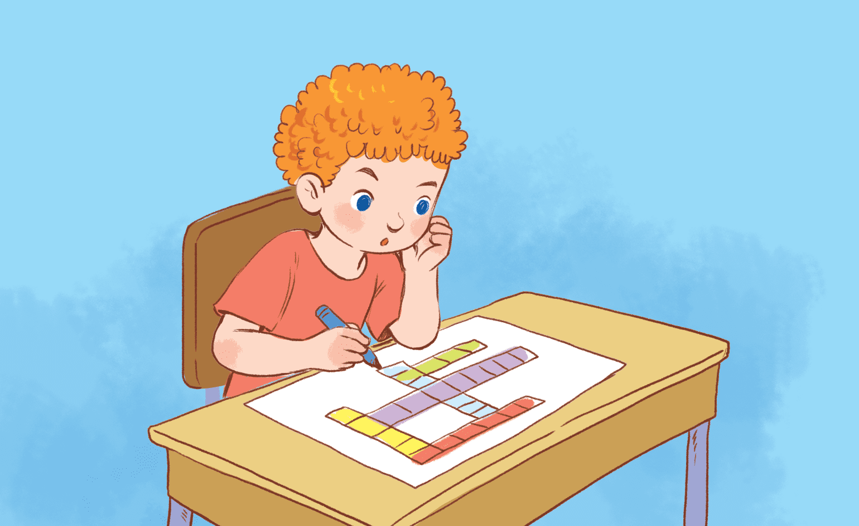
What do you do at break time?
I do word puzzles at break time.
Notes:
- Click on the 3-flower to go back to the WHEEL.

Slide 9
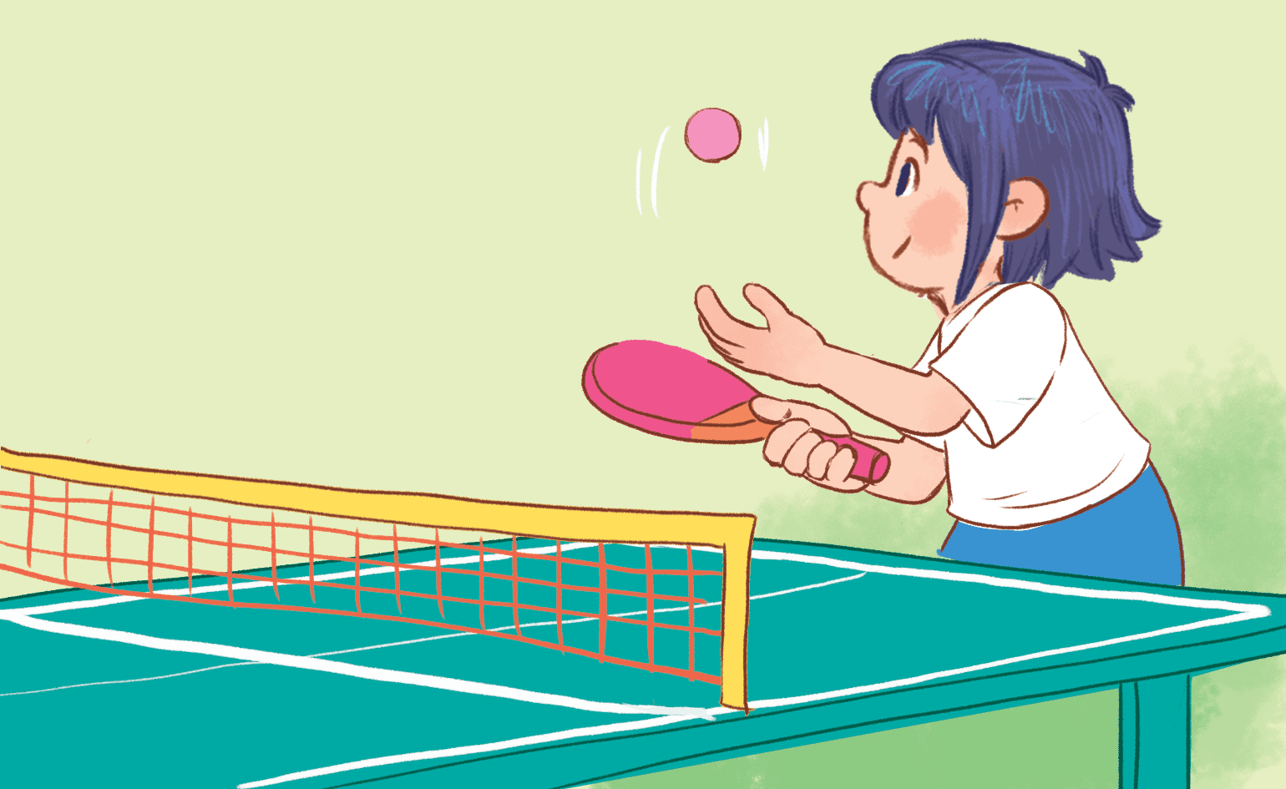
What do you do at break time?
I play table tennis at break time.
Notes:
Click on the three flowers at the top right corner to go back to the WHEEL.

Slide 10
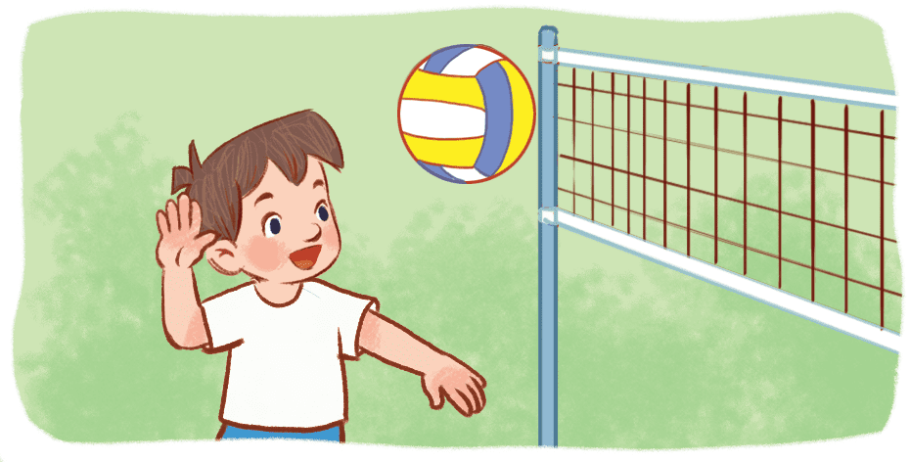
What do you do at break time?
I play volleyball at break time.
Notes:
Click on the three flowers at the top right corner to go back to the WHEEL.

Slide 11
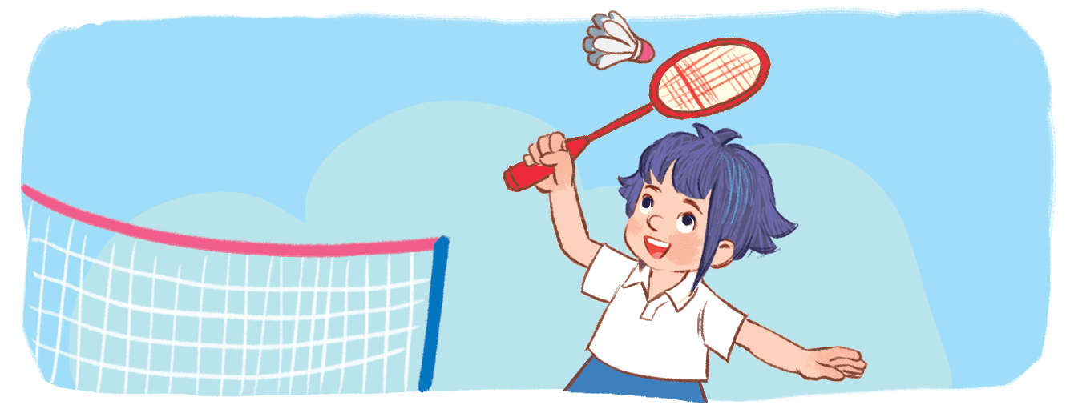
What do you do at break time?
I play badminton at break time.
Notes:
Click on the three flowers at the top right corner to go back to the WHEEL.

Slide 12
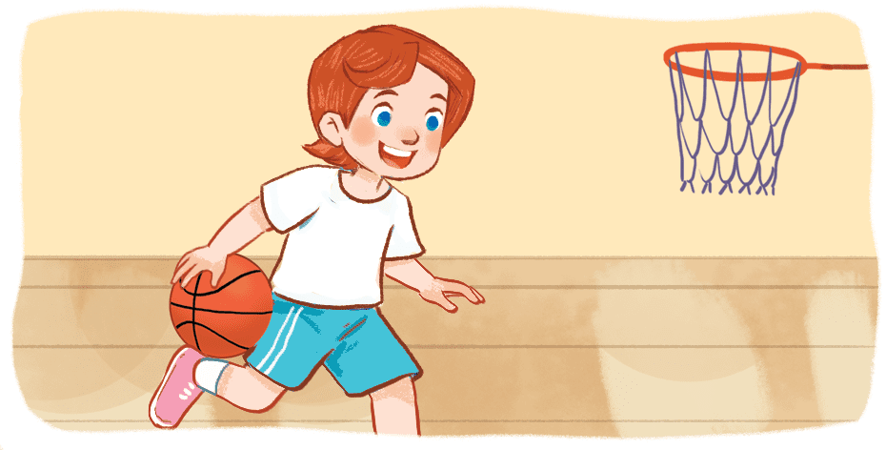
What do you do at break time?
I play basketball at break time.
Notes:
Click on the three flowers at the top right corner to go back to the WHEEL.

Slide 13
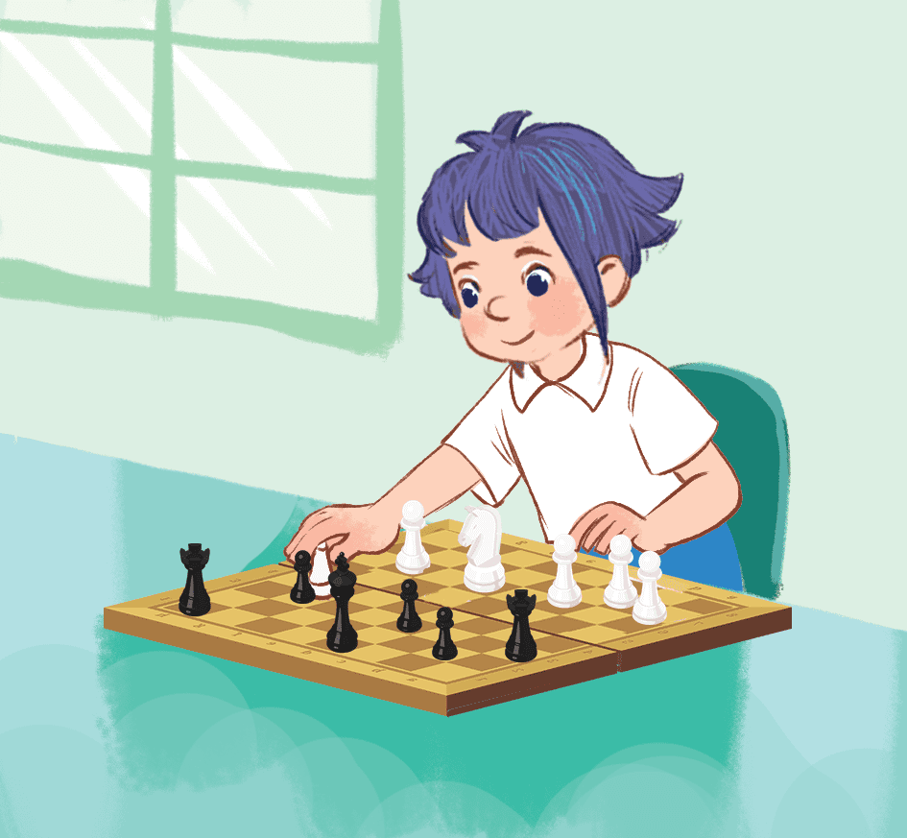
What do you do at break time?
I play chess at break time.
Notes:
Click on the three flowers at the top right corner to go back to the WHEEL.

Slide 14
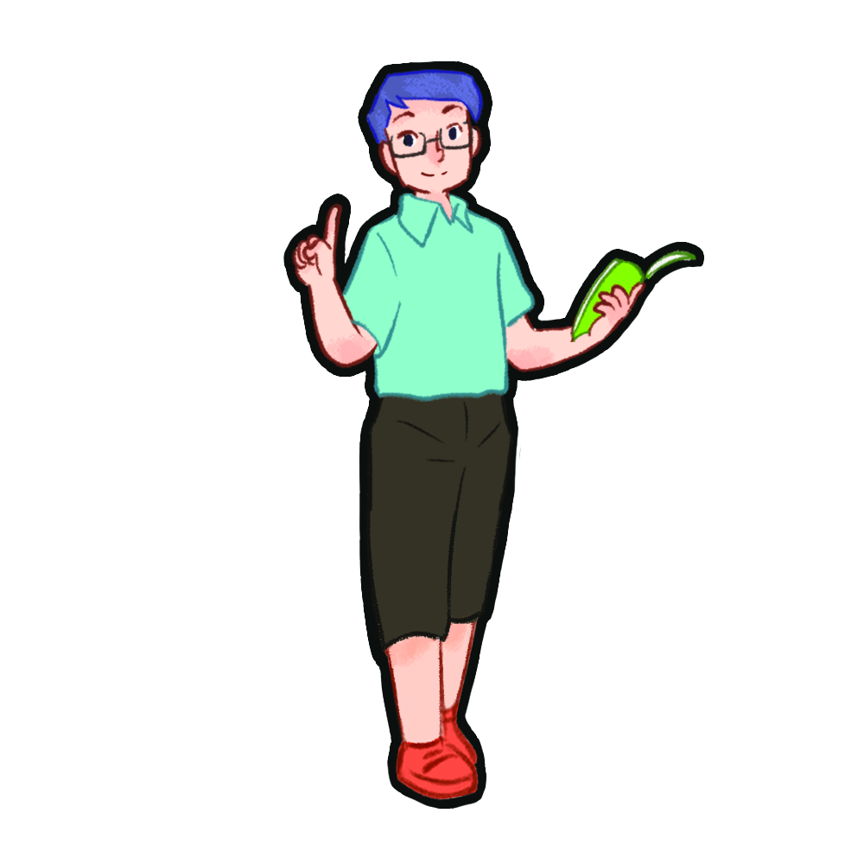
read and tick.

Slide 16
let’s write.

Slide 17
playground
chess
chess

Slide 18
project

Slide 19
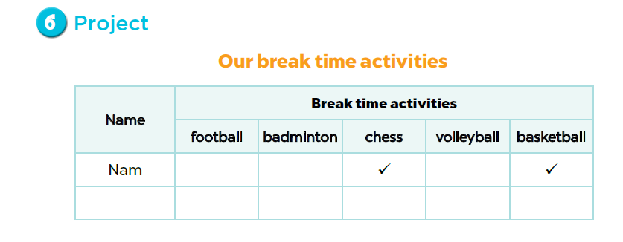

Slide 20
Fun corner and wrap-up

Slide 21
Who says fast?
Notes:
Game:
- Divide the class into 2 groups.
- Have pupils in each group take turns to stand up and say out loud their break time activities.
- Show the picture on the screen with 4 answers (there’s only one correct answer). Who can say the correct answer quickly will get points for his/her group.

Slide 22
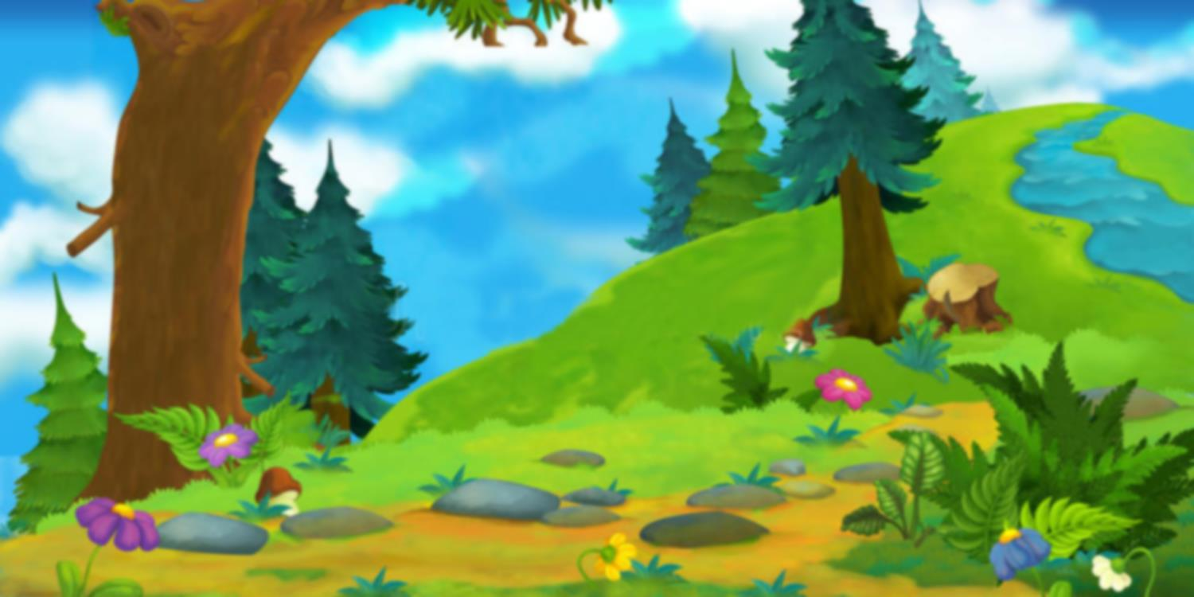
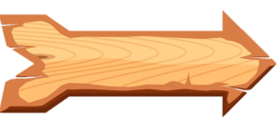
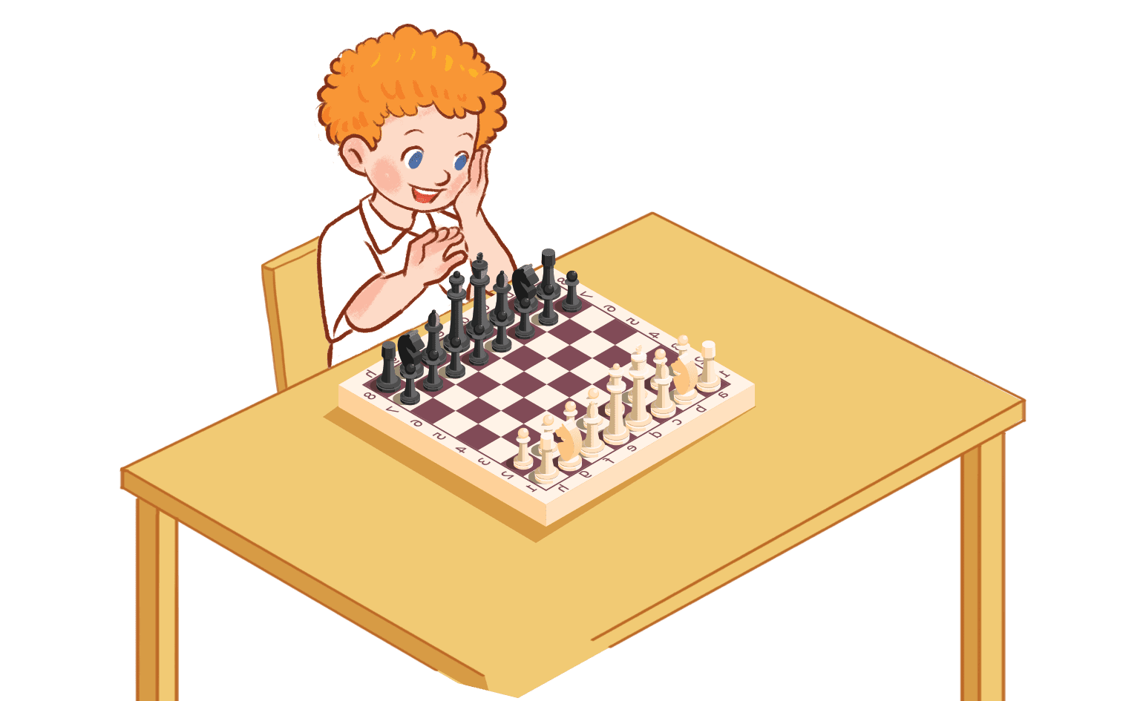
play volleyball
play basketball
play badminton
play chess
TIME OUT
YES

Slide 23
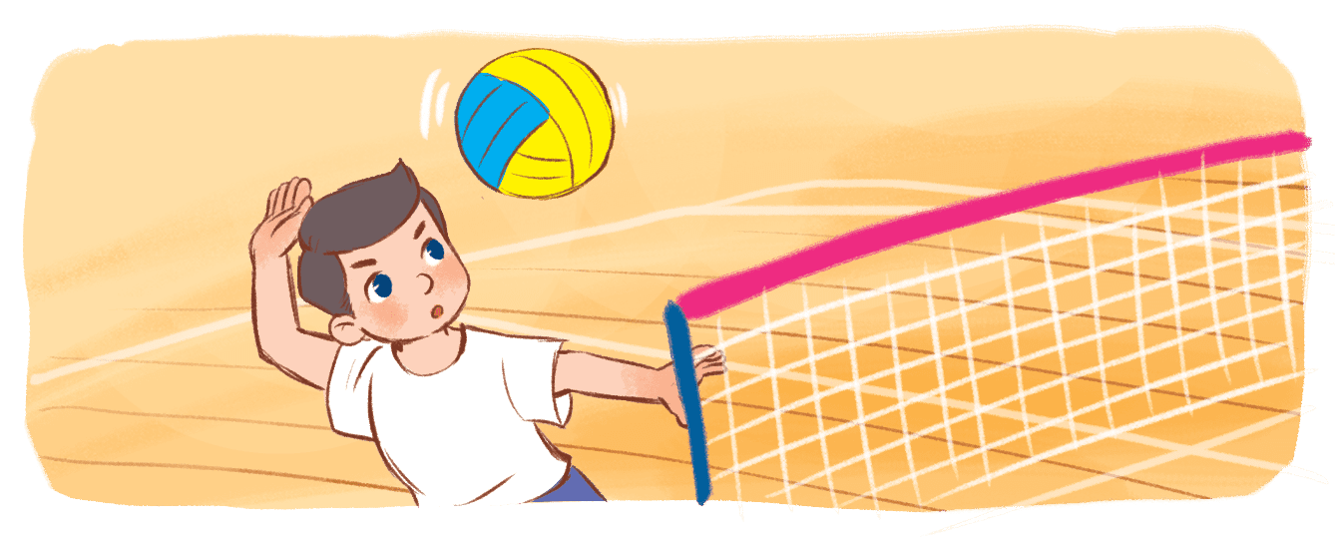
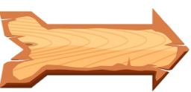
Play basketball
play volleyball
play chess
play badminton
TIME OUT
YES

Slide 24
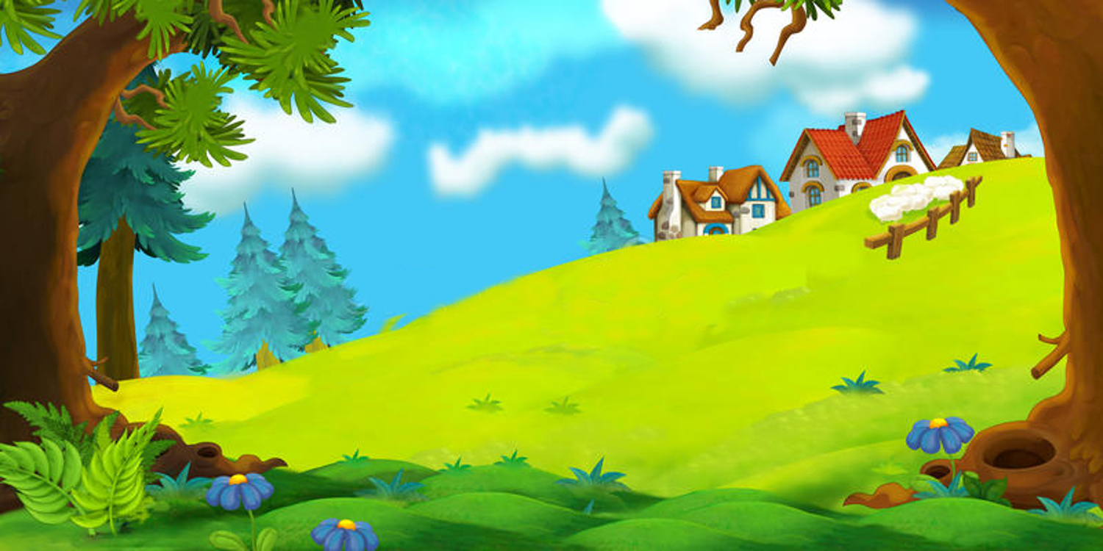
play badminton
play volleyball
play chess
play basketball
YES
TIME OUT

Slide 25
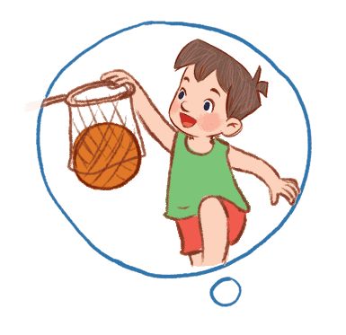
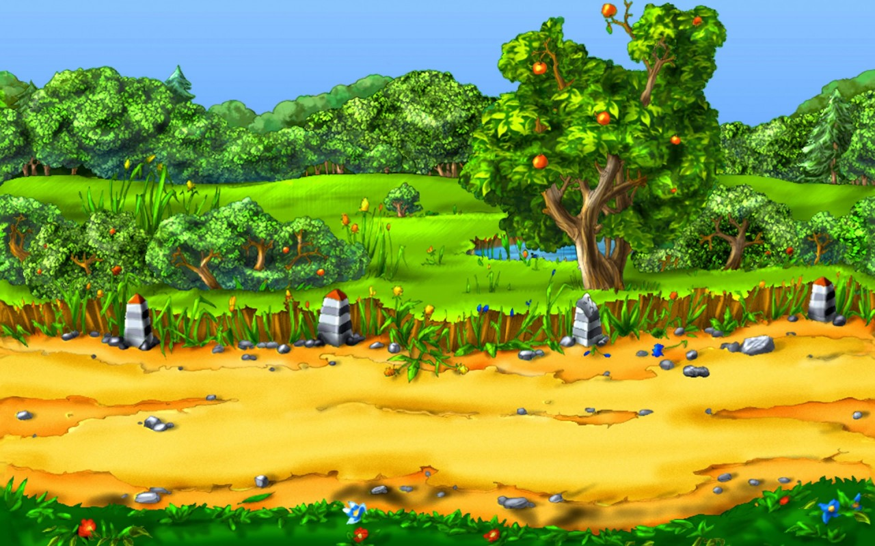
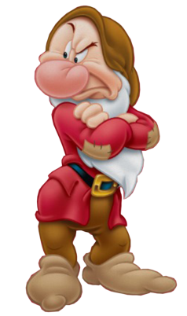
table tennis
play volleybal
play basketball
play football
TIME OUT
YES

Slide 26
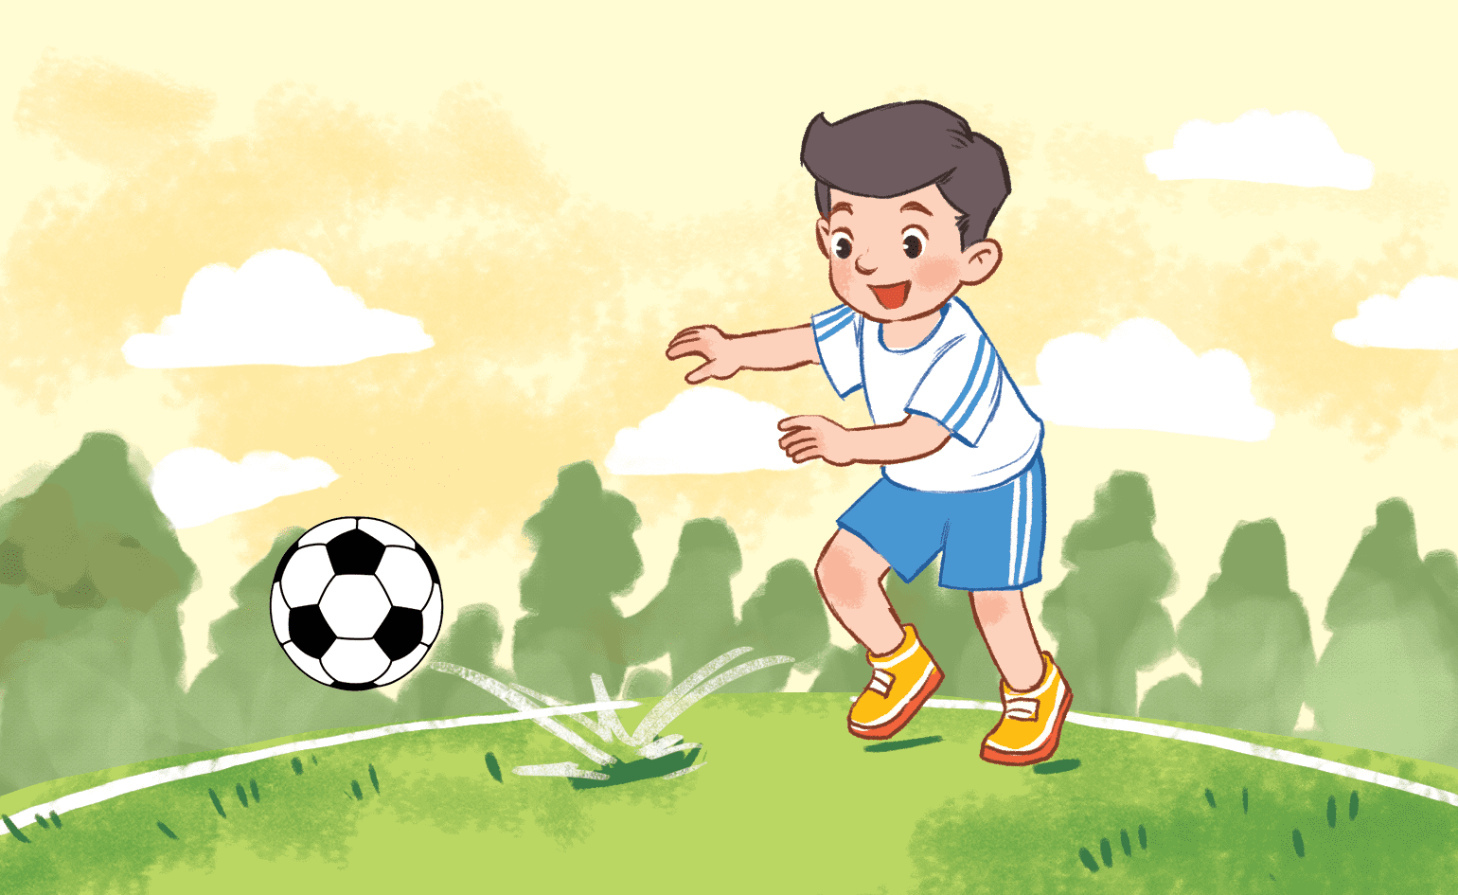
play volleyball
play basketball
play badminton
play football
TIME OUT
YES

Slide 27
Website: sachmem.vn
Fanpage: www.facebook.com/sachmem.vn

