Slide 2
Review 4
LESSON 1
Period 1

Slide 3
Contents
Warm-up and review
Listen and number.
1
3
Listen and tick.
2
4
Fun corner and wrap-up

Slide 4
1
Warm-up and review
Game: Polygraph
Notes:
Review the previous lesson by having the class play the game, using the words in Unit 20.
- Divide the class into 4 teams.
- Invite each pupil from the groups to go to the board and look at the screen, then choose true or false and say aloud the name of the animal. The fastest pupil gets one point for the team.
- Encourage pupils to join in the game.
- Give points to pupils.

Slide 6
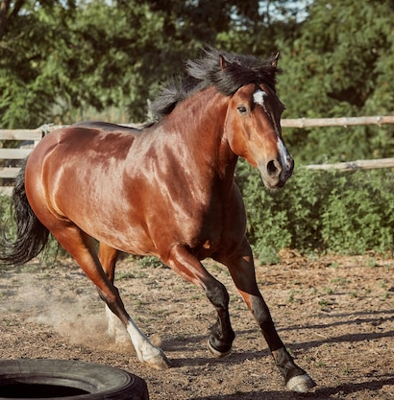
TRUE
FALSE
house
horse
- What can you see?
- I can see a __________.
horse

Slide 7
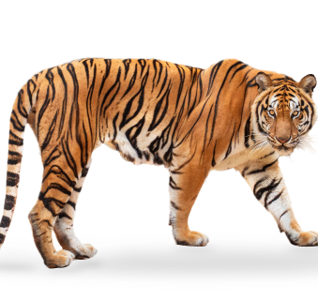
TRUE
FALSE
tiger
tigger
- What can you see?
- I can see a __________.
tiger

Slide 8
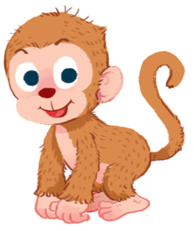
TRUE
FALSE
monkey
donkey
- What can you see?
- I can see a __________.
monkey

Slide 9
TRUE
FALSE
parot
parrot
- What can you see?
- I can see a __________.
parrot

Slide 10
TRUE
FALSE
octobus
octopus
- What can you see?
- I can see an __________.
octopus

Slide 11
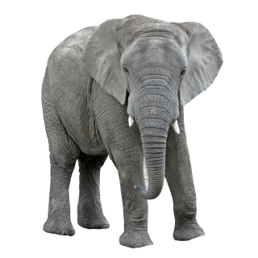
TRUE
FALSE
elephant
ellephan
- What can you see?
- I can see an __________.
elephant

Slide 12
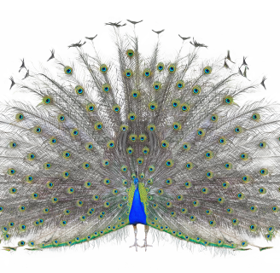
TRUE
FALSE
peacocks
peacock
- What can you see?
- I can see a __________.
peacock

Slide 13
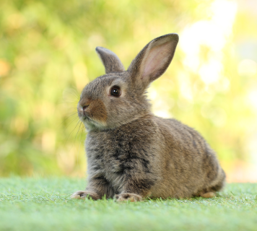
TRUE
FALSE
rabbit
rabit
- What can you see?
- I can see a __________.
rabbit

Slide 14
2
Listen and tick.

Slide 15
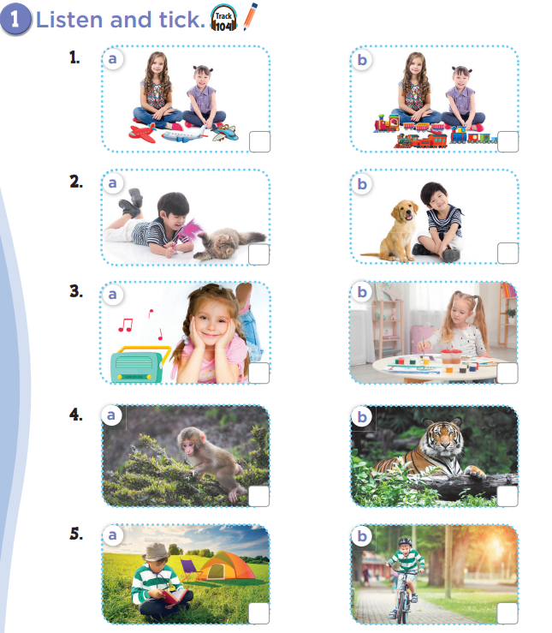

Slide 16
Let’s check!

Slide 21
Who’s faster?
Notes:
- Divide the class into 4 teams.
- Invite 1 pupil from each team go to the monitor and touch. The fastest pupil to have the correct answer will get 1 point for team.
- Encourage pupils join in the game to practise speaking English.
- Give points to the teams.

Slide 22
a kite
kites
two kites
kite
She has _________.

Slide 23
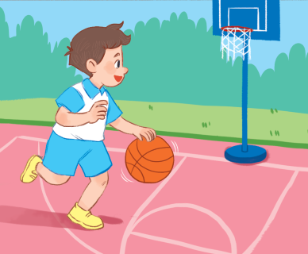
basketball
football
swimming
reading
He’s playing ____________.

Slide 24
ships
planes
buses
trains
They have three _________.

Slide 25
drawing
dancing
cycling
reading
She’s _________.

Slide 26
cars
a car
a cars
She has _________.
two car

Slide 27
riding
He’s ___________.
sleeping
swimming
singing

Slide 28
dolls
two dolls
a dolls
doll
They have __________.

Slide 29
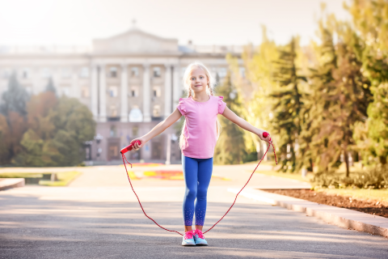
She’s __________.
drawing
playing
reading
skipping

Slide 30
3
Listen and number.

Slide 32
2
4
3
1

Slide 33
Chinese whisper
Notes:
Step 1: Divide the class into 4 teams.
Step 2: Invite 4 pupils to line up. The first pupil gets a card. Pupils then whisper the sentence to each other. The last pupil says the sentence aloud.
Step 3: Encourage pupils to join in the game to practice speaking English.
Step 4: Give points to the teams.

Slide 34
She has a teddy bear.
She has a teddy bear.
She has a teddy bear.
She has a teddy bear.
She has a teddy bear.

Slide 35
I can see a monkey.
I can see a monkey.
I can see a monkey.
I can see a monkey.
I can see a monkey.

Slide 36
They have three cars.
They have three cars.
They have three cars.
They have three cars.
They have three cars.

Slide 37
He’s flying a kite.
He’s flying a kite.
He’s flying a kite.
He’s flying a kite.
He’s flying a kite.

Slide 38
She’s dancing.
She’s dancing.
She’s dancing.
She’s dancing.
She’s dancing.

Slide 39
I can see an elephant.
I can see an elephant.
I can see an elephant.
I can see an elephant.
I can see an elephant.

Slide 40
The parrot is counting.
The parrot is counting.
The parrot is counting.
The parrot is counting.
The parrot is counting.

Slide 41
Lan is playing badminton.
Lan is playing badminton.
Lan is playing badminton.
Lan is playing badminton.
Lan is playing badminton.

Slide 42
4
Fun corner and wrap-up

Slide 43
PLAY
Notes:
- Divide the class into 4 teams.
- Set the rules: Invite 1 pupil from each team to go to the board and spin the machine, then say aloud the answer (with unscramble words). If correct, one point goes for the team.
- Encourage pupils to practise speaking English.
- Give points toe the pupils.

Slide 44
Click on the SPIN button and guess the word which is referred.

Slide 45
monkey
Which word is it?
NEXT
ey
ar
fast
dr
nk
mo
nvs
br
mo
st
nk
mes
ak
ey
mo
Check

Slide 46
running
Which word is it?
NEXT
ing
nd
fast
dr
fa
nn
nhs
br
bre
st
ru
ms
ak
fast
br
Check

Slide 47
parrot
Which word is it?
NEXT
ot
nd
fht
dr
fa
par
nhs
hd
moe
st
ro
ms
as
ning
br
Check

Slide 48
train
Which word is it?
NEXT
i
nd
fat
af
fa
tra
ter
yue
btere
st
n
noo
ak
hđh
br
Check

Slide 49
plane
Which word is it?
NEXT
a
n
hd
dr
fa
ne
th
u
nie
st
pl
ig
ik
igt
br
Check

Slide 50
painting
Which word is it?
NEXT
int
oo
buy
bye
fa
ing
dh
goo
goo
st
pa
buy
d
dd
br
Check

Slide 51
truck
Which word is it?
NEXT
r
dad
d
rea
fa
uck
he
ea
d
st
t
d
dm
n
br
Check

Slide 52
goldfish
Which word is it?
NEXT
ldf
h
ad
oo
fa
go
oo
o
d
st
ish
s
m
m
br
Check

Slide 53
Website: hoclieu.vn
Fanpage: facebook.com/www.tienganhglobalsuccess.vn

