Slide 1
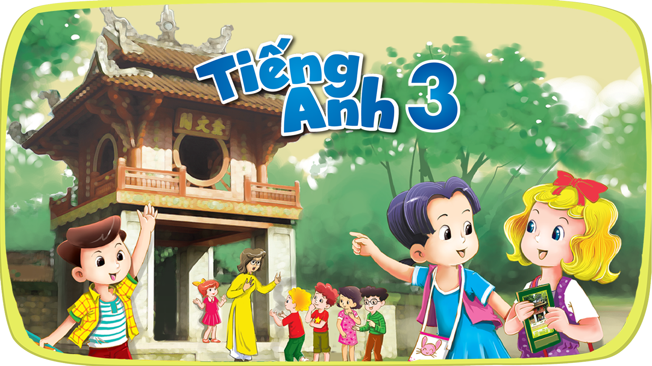


Slide 2
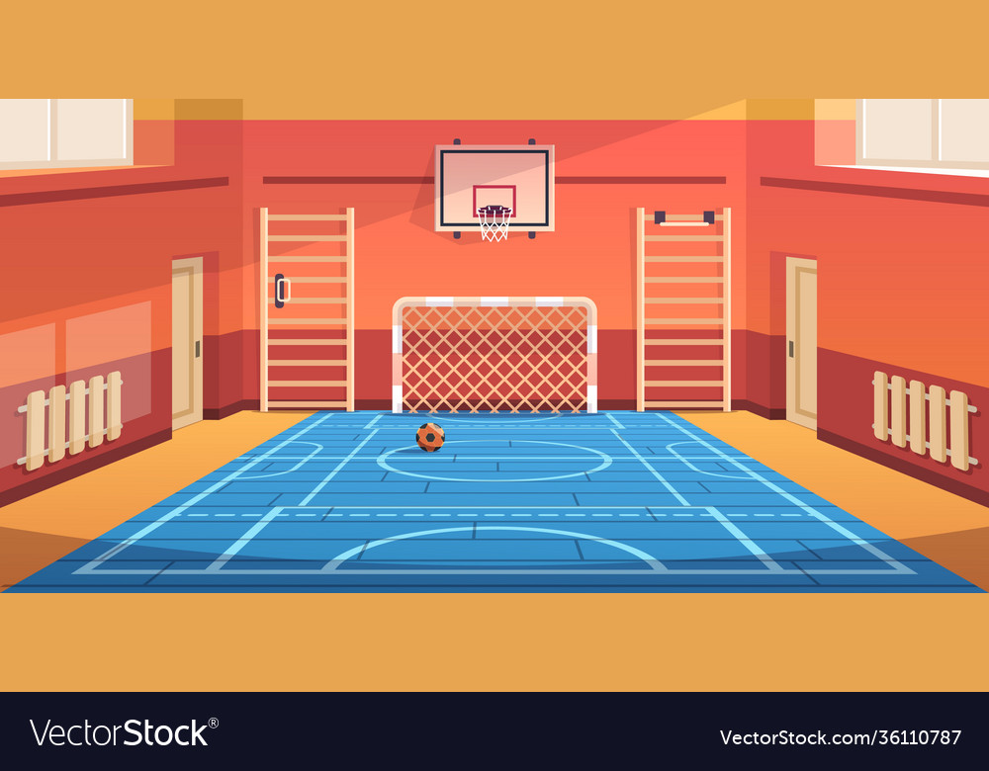




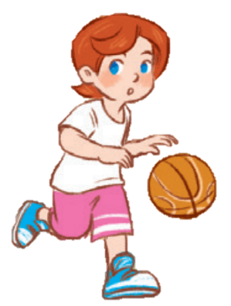
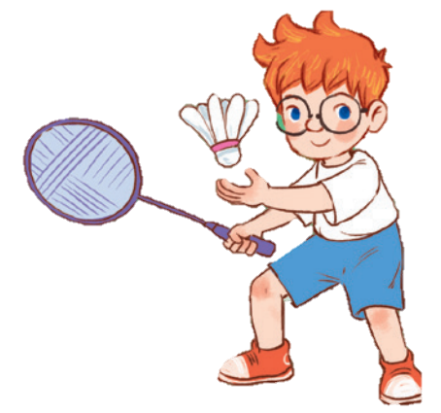
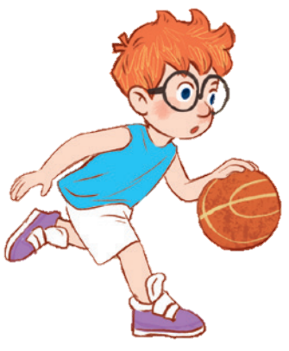
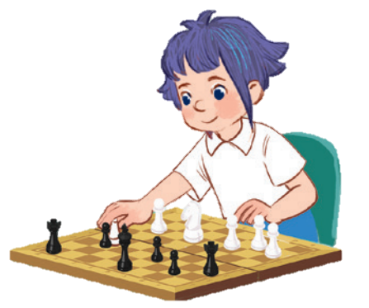
10
Period 5

Slide 3
Contents
1
5
Fun corner and wrap-up
Warm-up and review
4
2
3
Listen and repeat.
Let’s chant.
Listen and circle.

Slide 4
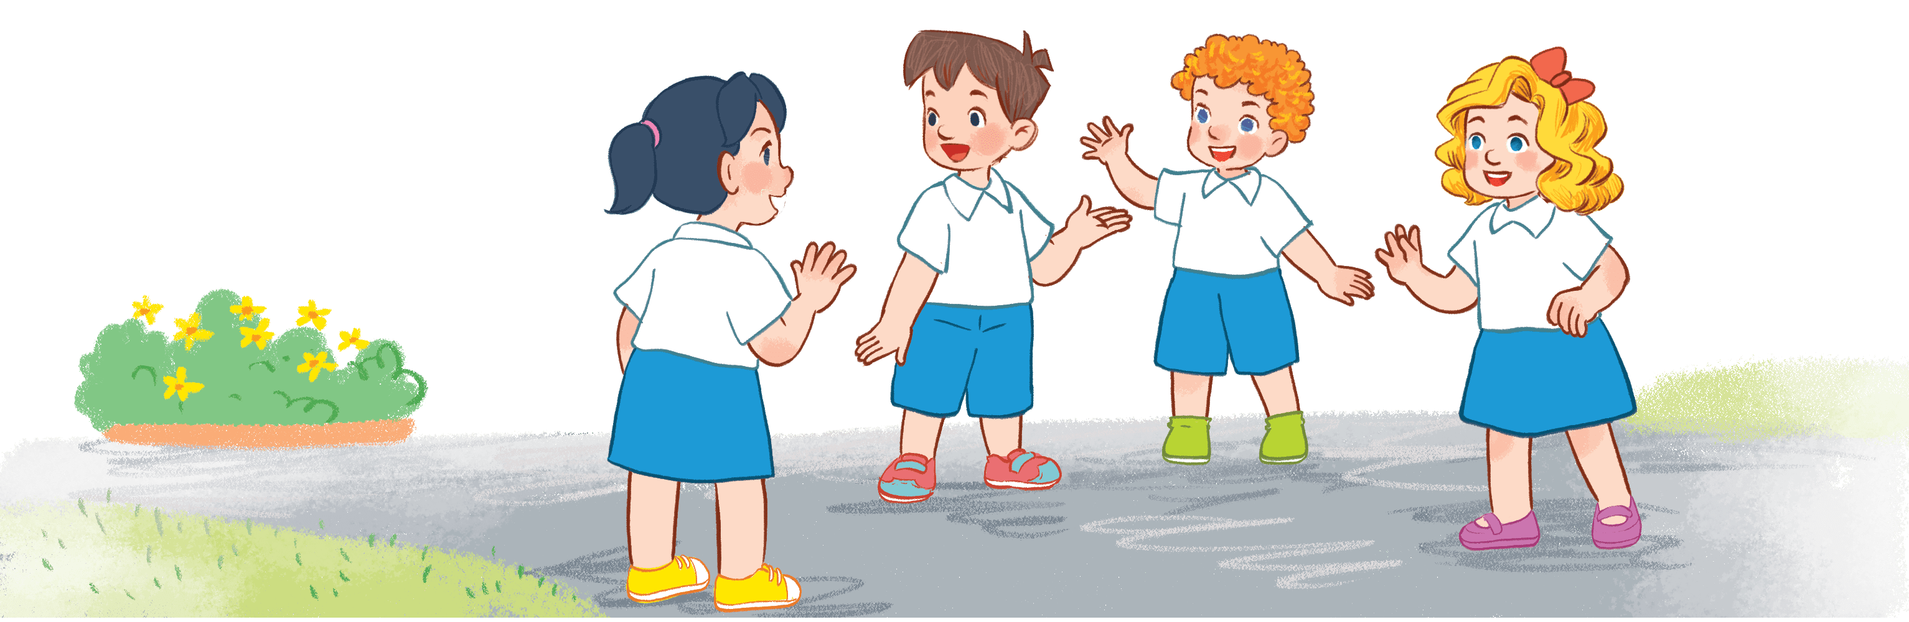
Warm-up and review
Notes:
Game: Who’s faster?
- Teacher divides the class into 2 teams (Boys and Girls).
- 1 pupil in each team comes to the board, look at the question and choose a, b, c, or d.
- The first one to choose the correct answers will get the points.
- The ones that can’t get the points will go back to their seats and other pupils will play.

Slide 5
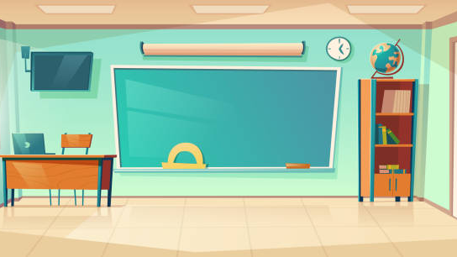
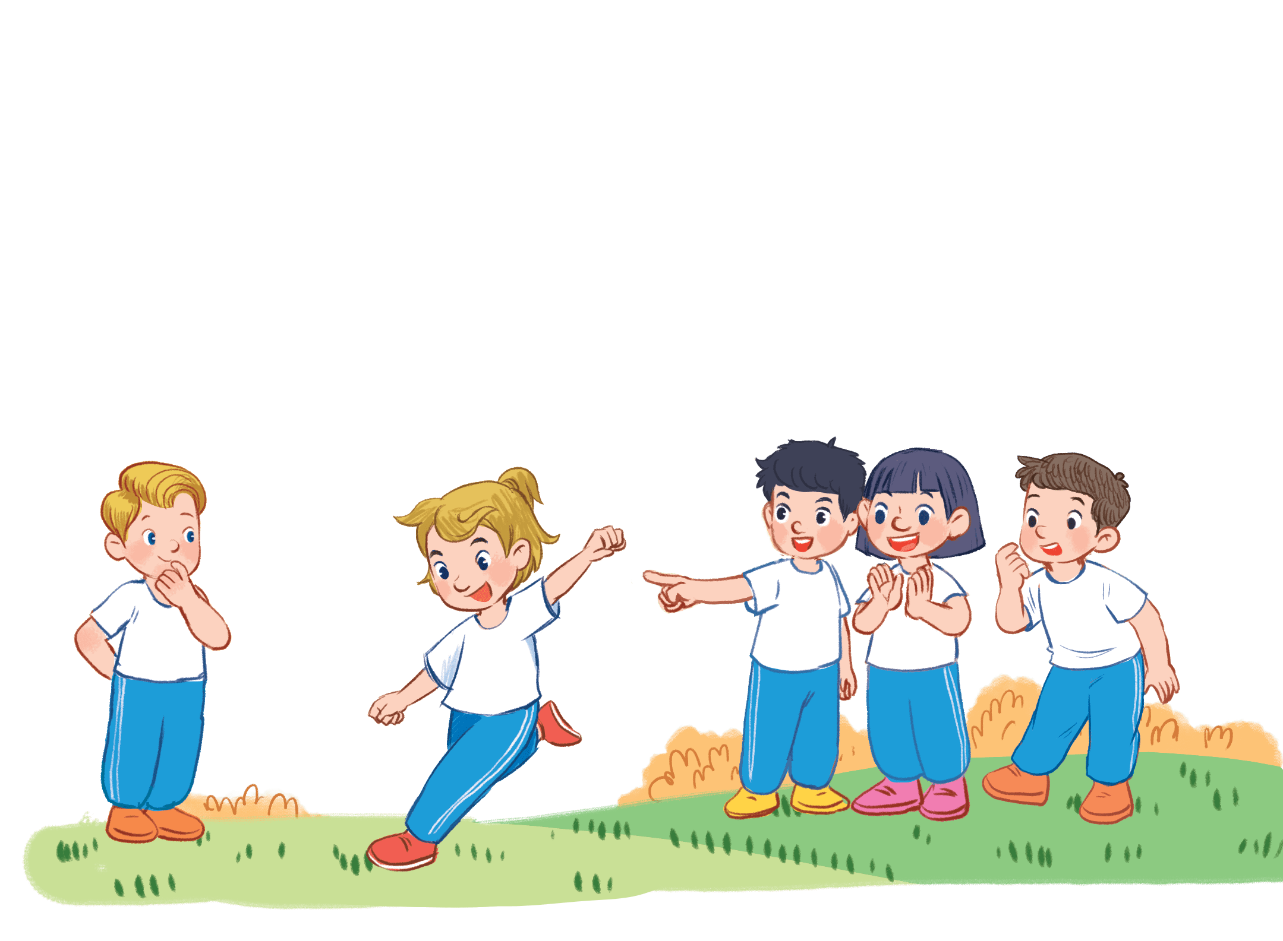
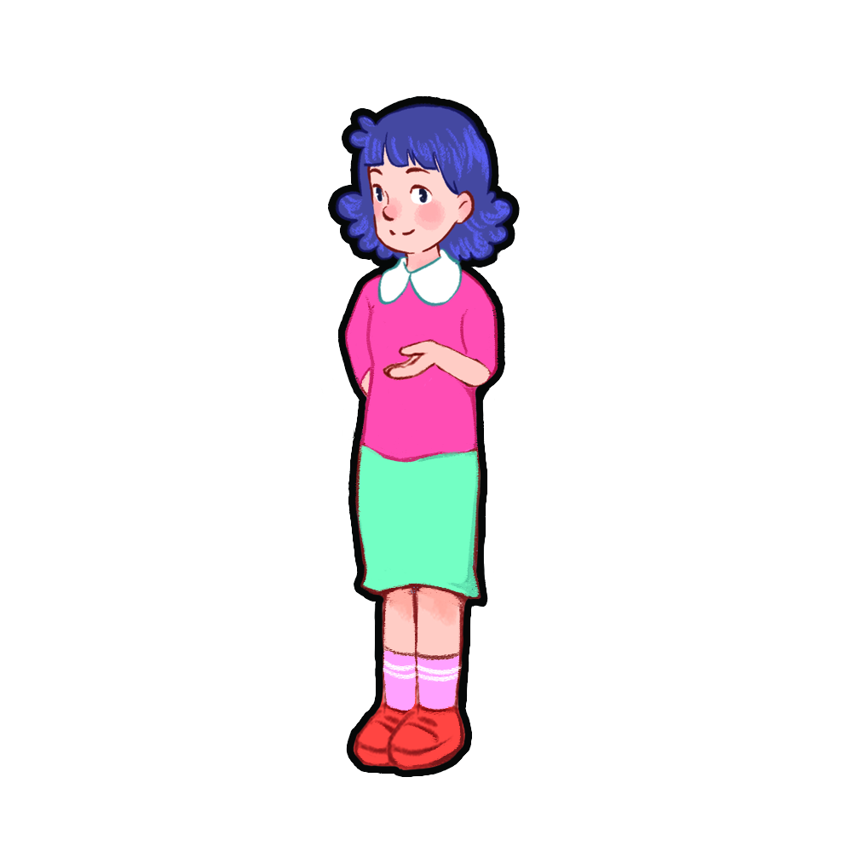
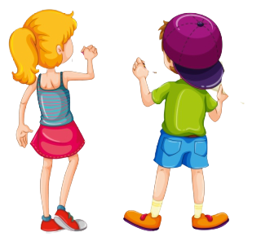
Game time
A

Slide 6
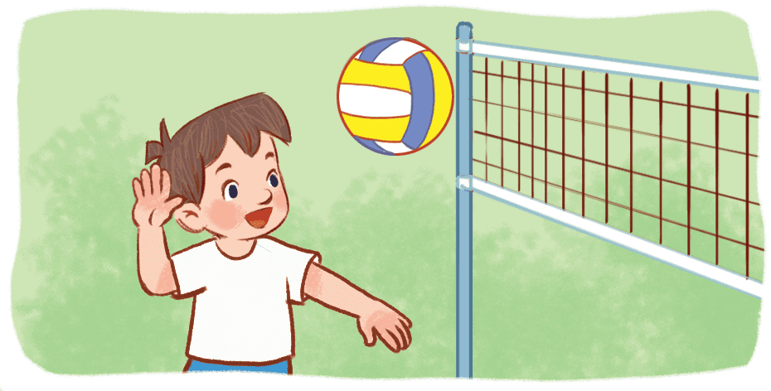
What do you do at break time?
Question 1
5
3
1
4
6
9
7
2
0
10
8
Time out
a) I play basketball at break time.
b) I play volleyball at break time.
c) I play badminton at break time.
d) I play table tennis at break time.
Notes:
- Click the clock to start the timer.

Slide 7
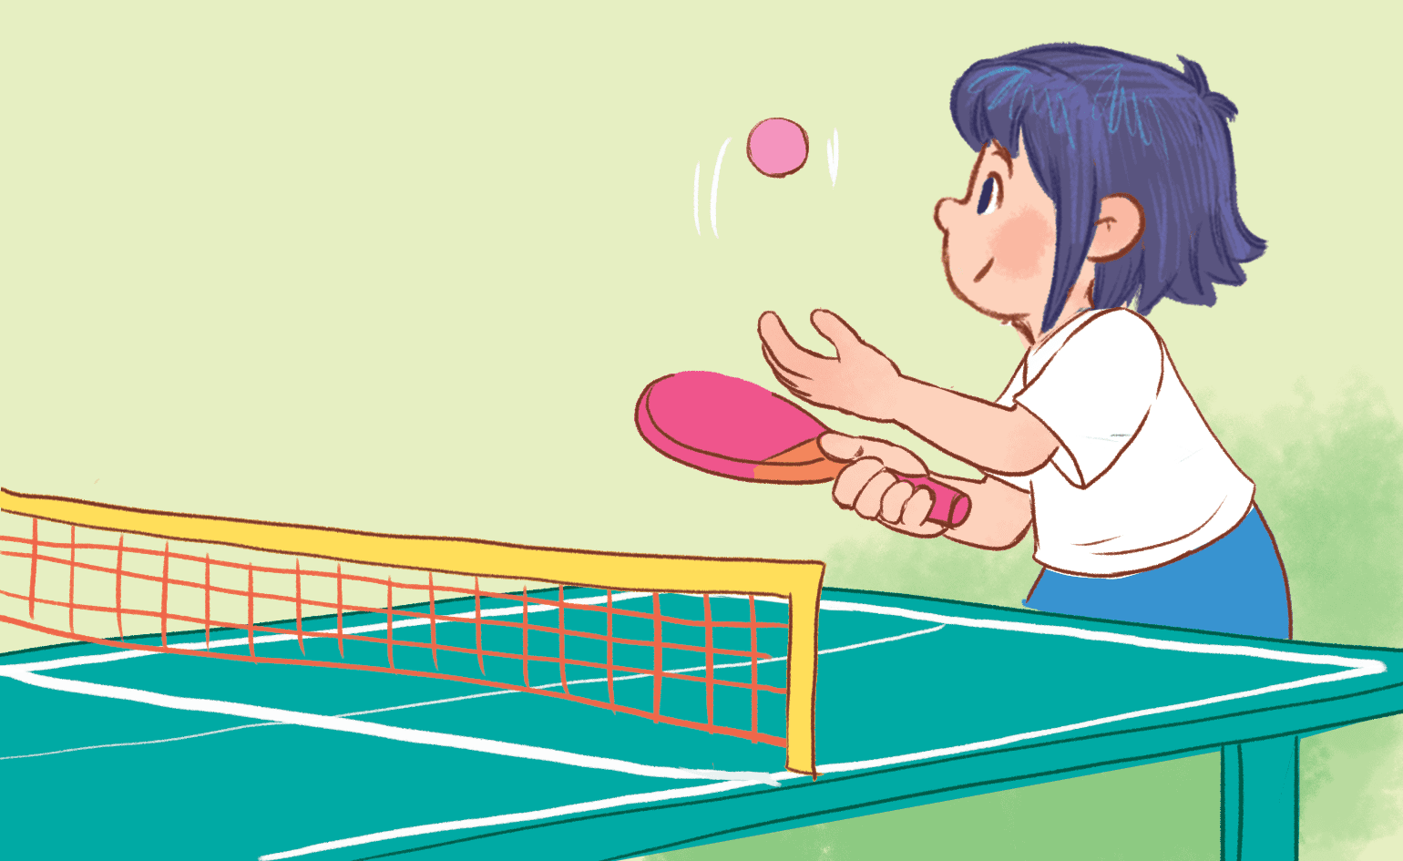
What do you do at break time?
Question 2
5
3
1
4
6
9
7
2
0
10
8
Time out
a) I play chess at break time.
b) I play table tennis at break time.
c) I chat with my friends at break time.
d) I play football at break time.
Notes:
Click the clock to start the timer.

Slide 8
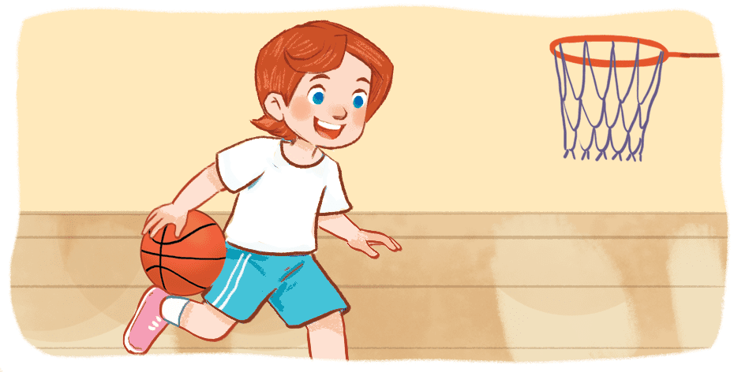
Question 3
What do you do at break time?
5
3
1
4
6
9
7
2
0
10
8
Time out
a) I do word puzzles at break time.
b) I play badminton at break time.
c) I play basketball at break time.
d) I play volleyball at break time.
Notes:
Click the clock to start the timer.

Slide 9
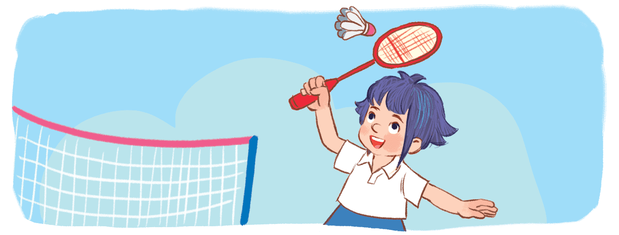
What do you do at break time?
Question 4
5
3
1
4
6
9
7
2
0
10
8
Time out
a) I play football at break time.
b) I chat with my friends at break time.
c) I do word puzzles at break time.
d) I play badminton at break time.
Notes:
Click the clock to start the timer.

Slide 10
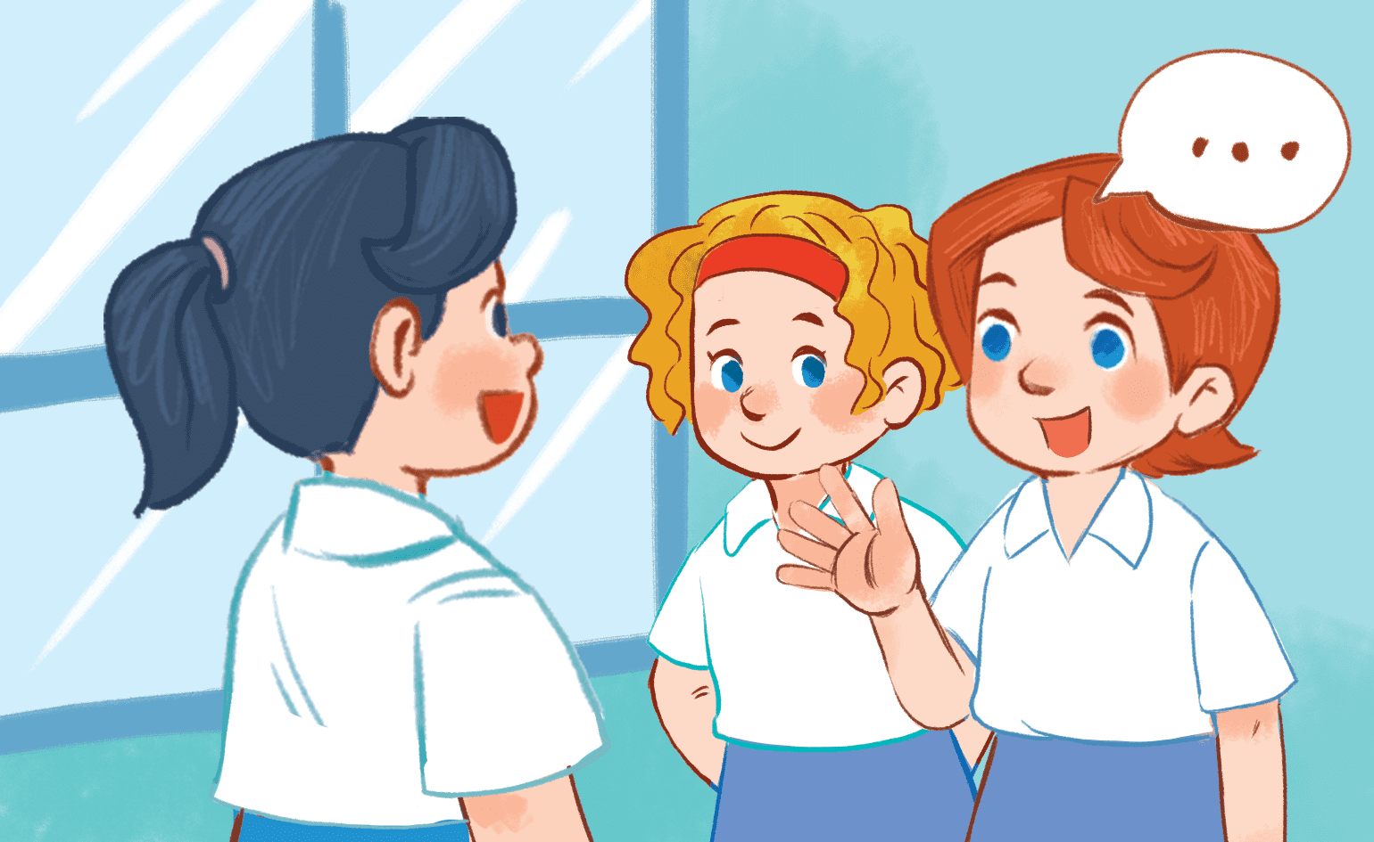
Question 5
What do you do at break time?
5
3
1
4
6
9
7
2
0
10
8
Time out
a) I play table tennis at break time.
b) I play chess at break time.
c) I play volleyball at break time.
d) I chat with my friends at break time.
Notes:
Click the clock to start the timer.

Slide 11
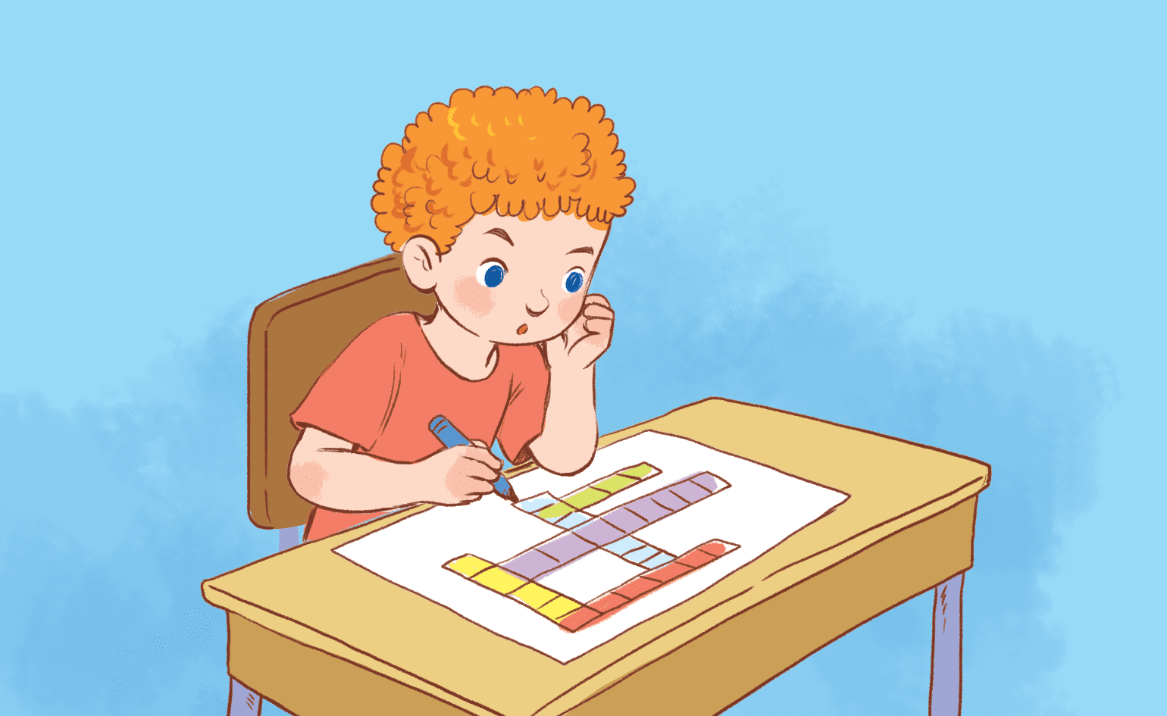
Question 6
What do you do at break time?
5
3
1
4
6
9
7
2
0
10
8
Time out
a) I play badminton at break time.
b) I do word puzzles at break time.
c) I play basketball at break time.
d) I play chess at break time.
Notes:
Click the clock to start the timer.

Slide 12
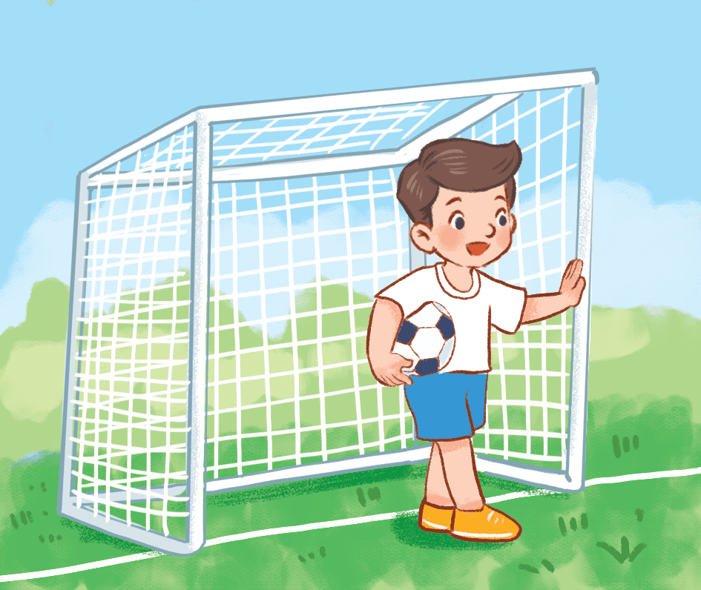
Question 7
What do you do at break time?
5
3
1
4
6
9
7
2
0
10
8
Time out
a) I chat with my friends at break time.
b) I play badminton at break time.
c) I play football at break time.
d) I play table tennis at break time.
Notes:
Click the clock to start the timer.

Slide 13
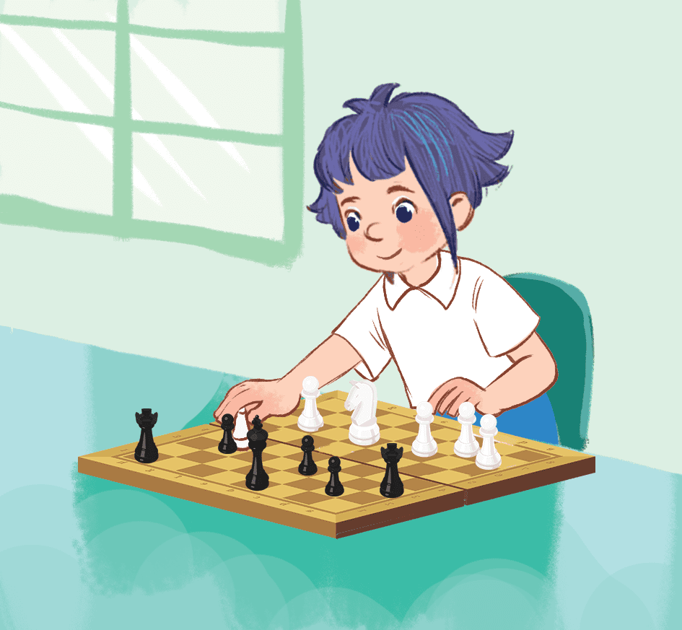
What do you do at break time?
Question 8
5
3
1
4
6
9
7
2
0
10
8
Time out
a) I play volleyball at break time.
b) I play basketball at break time.
c) I play chess at break time.
d) I chat with my friends at break time.
Notes:
Click the clock to start the timer.

Slide 14
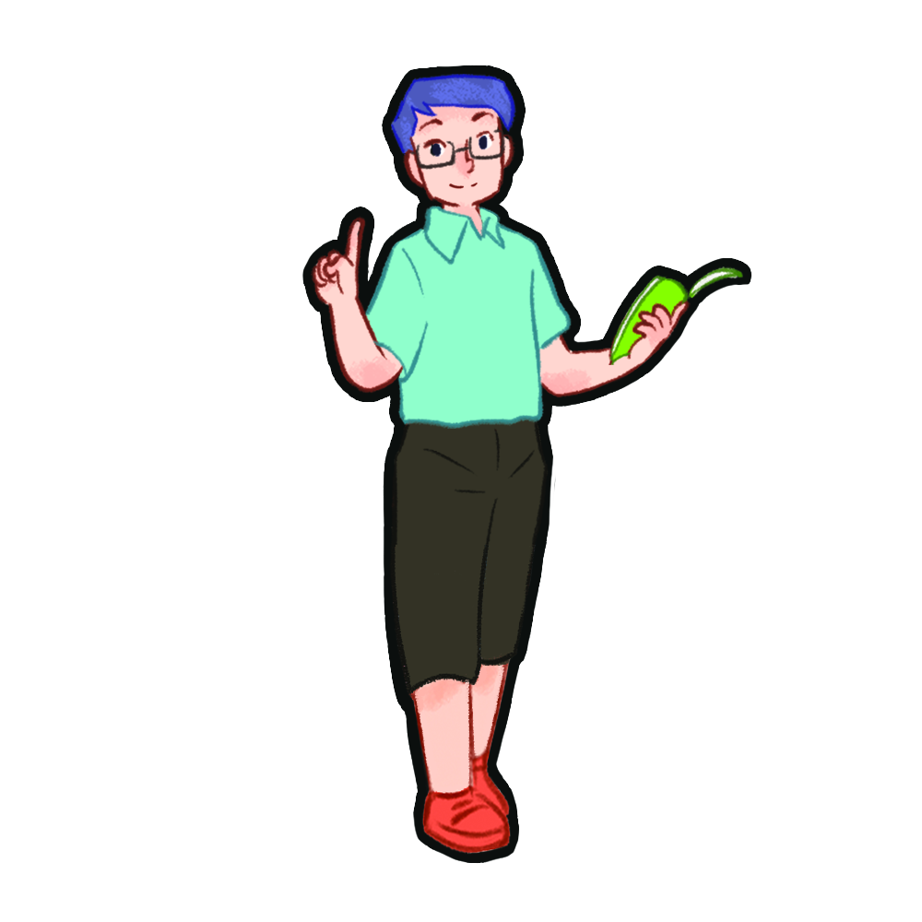
Listen and repeat.

Slide 15
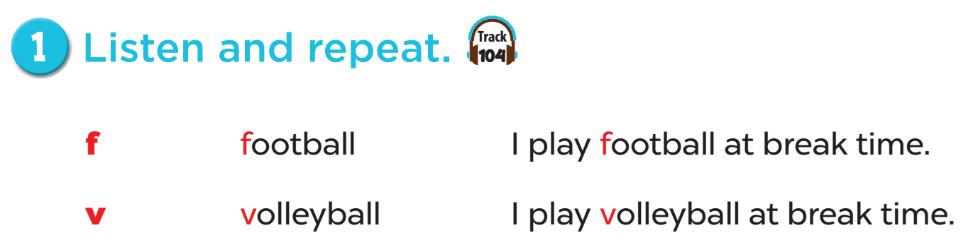


Slide 16
listen and circle.

Slide 17
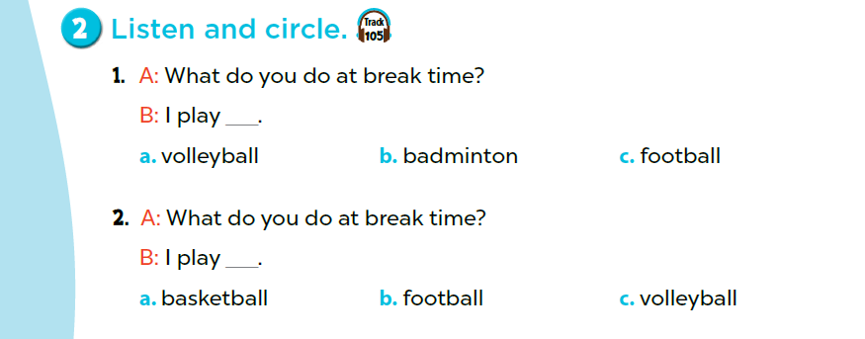

Slide 18
Game time
Notes:
Game: Bang Bang
Teacher calls many pairs to the board, lets them stand back to back,
When they turn back to look at the pictures, they have to say out loud the words of those picture + Bang Bang.
- The first one to say correctly will get the points.

Slide 19
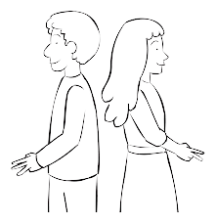
Notes:
Game: Bang Bang
Teacher calls many pairs to the board, lets them stand back to back
When they turn back to look at the pictures, they have to say out loud the phrases corresponding to those pictures + Bang Bang.
- The first one to say correctly will get the points.

Slide 20
Let’s chant.

Slide 21
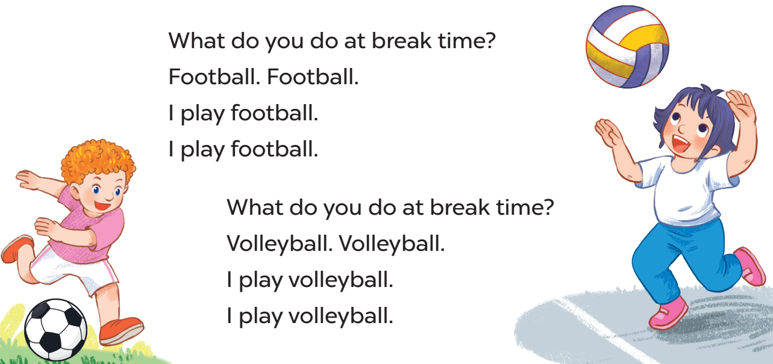

Slide 22
Fun corner and
Wrap-up
Notes:
Game: Racing car
- Teacher divides the class into 4 teams (4 cars).
- Teacher shows the pictures of break time activities and asks pupils in each team to make sentences with pictures using “I …………….at break time”.
- When pupils give the correct sentences, the car will move 1 step.
- The first team to finish the race will be the winner.

Slide 23

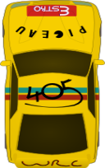



GO
GO
GO
GO
Notes:
Game: Racing car
- Teacher divides the class into 4 teams (4 cars).
- Teacher shows the pictures of break time activities and asks pupils in each team to make sentences with pictures using “I …………….at break time”.
- When pupils give the correct sentences, the car will move 1 step.
- The first team to finish the race will be the winner.

Slide 24
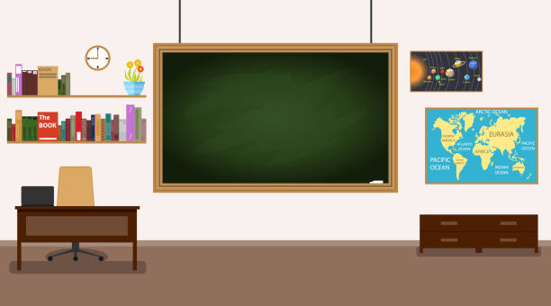
play
football
chat with
my friends
do word
puzzles
play
table tennis
play volleyball
play badminton
play basketball
play
chess
Notes:
T shows pictures of break time activities on the board and asks pupils to make sentences using the model structure.

Slide 25

Website: sachmem.vn
Fanpage: www.facebook.com/sachmem.vn

