Slide 1



Slide 2




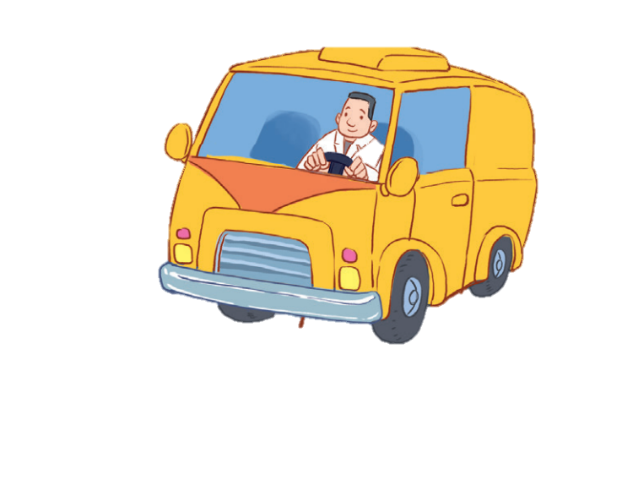


12
LESSON 2 – Period 4

Slide 3
Contents
Warm-up and review
Listen and number.
Look, complete and read.
Let’s play.
1
2
3
4
5
Fun corner and wrap-up

Slide 4
1
Warm-up and review

Slide 5

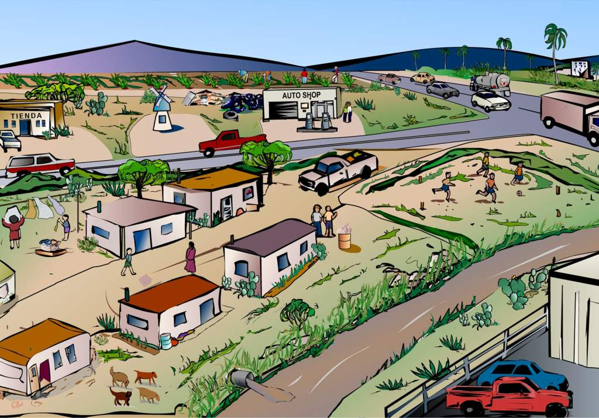

WHAT Do they do?
Notes:
Step 1: Divide the class into 4 teams.
Step 2: One pupil from each team will go to the front, look at the picture then answer the question. The fastest pupil will get points. After that, each of them has to say the word aloud 3 times.
Step 3: Encourage pupils to join in the game.
Step 4: Give points for pupils.

Slide 6


What’s her job?
GREAT
She’s a teacher.
She’s a nurse.
She’s a doctor.

Slide 7


What’s his job?
GREAT
He’s a cook.
He’s a teacher.
He’s a farmer.

Slide 8


What’s her job?
GREAT
She’s a doctor.
She’s a nurse.
She’s a singer.

Slide 9

What’s his job?
GREAT
He’s a doctor.
He’s a cook.
He’s a worker.

Slide 10
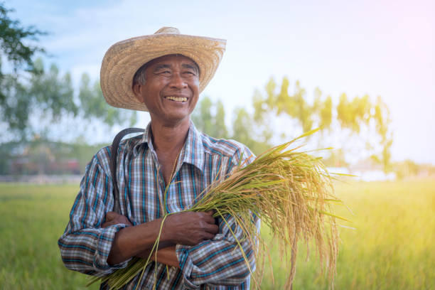

What’s his job?
GREAT
He’s a teacher.
He’s a farmer.
He’s a doctor.

Slide 11

What’s her job?
GREAT
She’s a teacher.
She’s a worker.
She’s a farmer.

Slide 12

What’s his job?
GREAT
He’s a doctor.
He’s a driver.
He’s a teacher.

Slide 13

What’s her job?
GREAT
She’s a doctor.
She’s a teacher.
She’s a driver.

Slide 14
2
Listen and number.

Slide 15


Notes:
Step 1: Have pupils look at the pictures. Point at each picture to elicit the job.
Play the recording twice so that pupils can do the task. Play the recording the third time to give pupils another listening opportunity.
Step 2: Check answers together as a class. Play the recording again for pupils to correct their answers.
Extension: If time allows, play the recording sentence by sentence for the class to listen and repeat in chorus. Correct their pronunciation if necessary.

Slide 16

3
2
4
1

Slide 17
3
Look, complete and read.

Slide 18
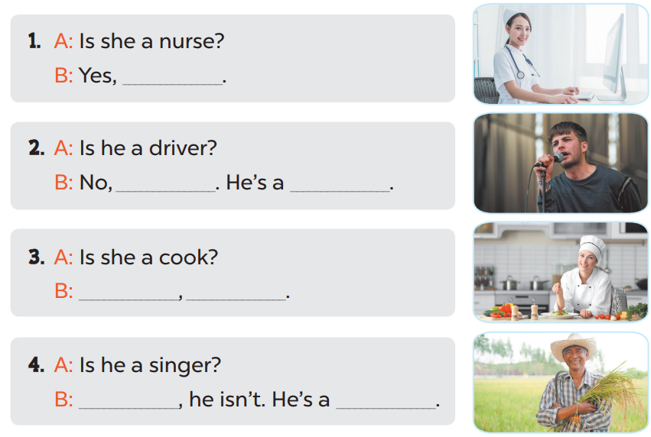

Slide 19
she is
he isn’t
singer
Yes
she is
No
farmer

Slide 20

Game time!!!
Role play
Choose a number!
1
2
3
4
5
6
7
8
9
10
Next activity
Notes:
Step 1: Divide the class into 2 teams.
Step 2: Invite each pupil from each team to go to the board and practice “Is she/ he a _____? – yes, she/ he is. No, she/ he is.”
Step 3: Encourage pupils to practice speaking.
Step 4: Give points for pupils.

Slide 21
- Is she a farmer?
- No, she isn’t.
+10

Slide 22

- Is he a farmer?
- Yes, he is.
+5

Slide 23
- Is he a cook?
- No, he isn’t.
+5

Slide 24

- Is he a teacher?
- Yes, he is.
+5

Slide 25

- Is she a doctor?
- Yes, she is.
+10

Slide 26
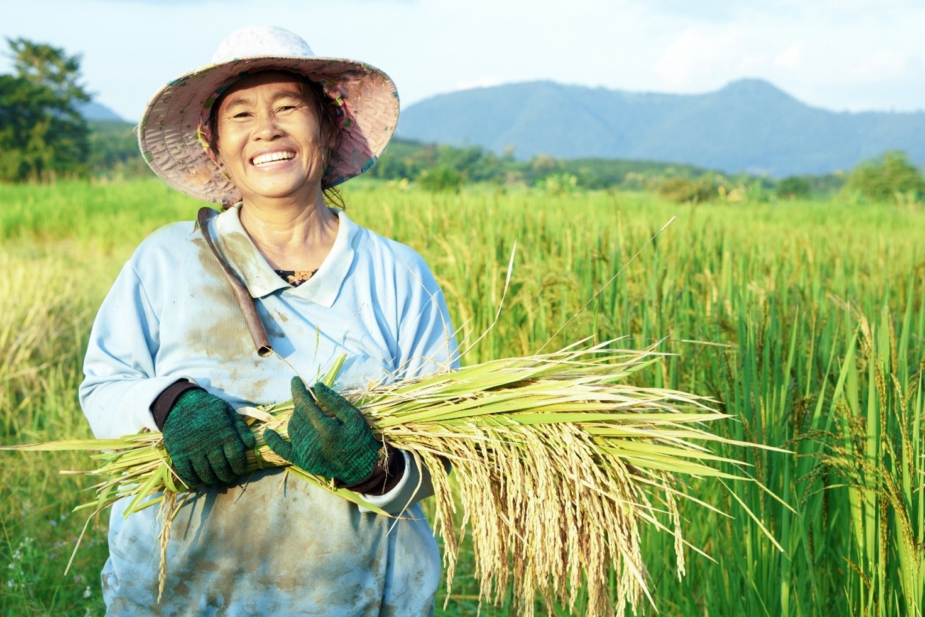
- Is she a driver?
- No, she isn’t.
+15

Slide 27

- Is she a singer?
- No, she isn’t.
+5

Slide 28

- Is he a singer?
- Yes, he is.
+5

Slide 29

- Is she a driver?
- Yes, she is.
+10

Slide 30
- Is he a driver?
- No, he isn’t.
+5

Slide 31
4
Let’s play.

Slide 32
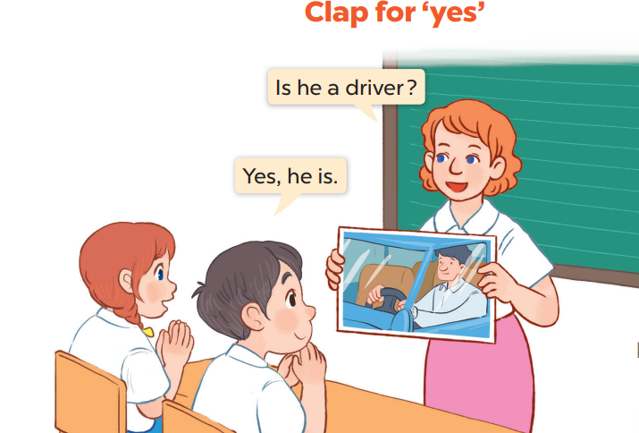

Slide 33
5
Fun corner and wrap-up

Slide 34
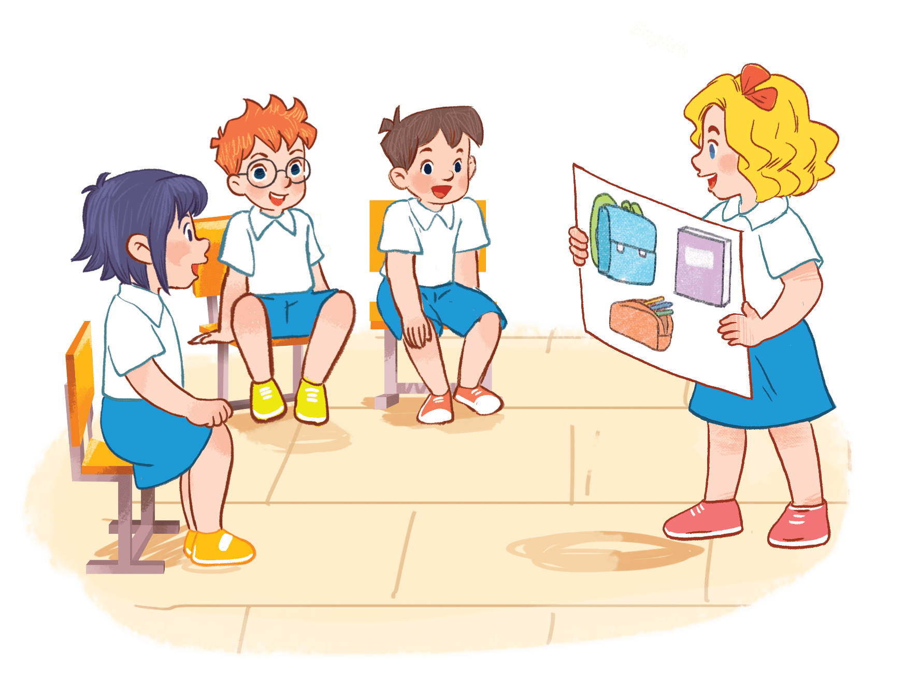

Guessing
- Is she a nurse?
- No, she isn’t.
Great job!
She’s a cook.
Notes:
Step 1: Ask pupils to sit in a circle.
Step 2: A pupil shows a flashcard for the whole class, then pupils will ask and answer “Is he/she ______? Yes, he/ she is. No, he/she isn’t.”
Step 3: Students who answer correctly will stand up and hold another flashcard. Encourage pupils to practice speaking English.

Slide 35
Game time!!!
Guessing
- Is he a driver?
- Yes, he is.
Excellent!

Slide 36
Game time!!!
Guessing
- Is she a teacher?
- No, she isn’t.
Bravo!
She’s a nurse.

Slide 37
Game time!!!
Guessing
- Is he a farmer?
- No, he isn’t.
He’s a teacher.
Great!

Slide 38
Game time!!!
Guessing
- Is he a worker?
- Yes, he is
Nice job!

Slide 39

Game time!!!
Guessing
- Is he a cook?
- No, he isn’t.
Well done!
He’s a farmer.

Slide 40

Website: hoclieu.vn
Fanpage: facebook.com/www.tienganhglobalsuccess.vn

