Slide 2
My pets Lesson 2 - Period 3
16

Slide 3
1
2
3
Warm-up and review
4
5
Fun corner and wrap-up.
Look, listen and repeat.
Listen, point and say.
Let’s talk.

Slide 4
1
Warm-up and review

Slide 6
2
Look, listen and repeat.

Slide 7
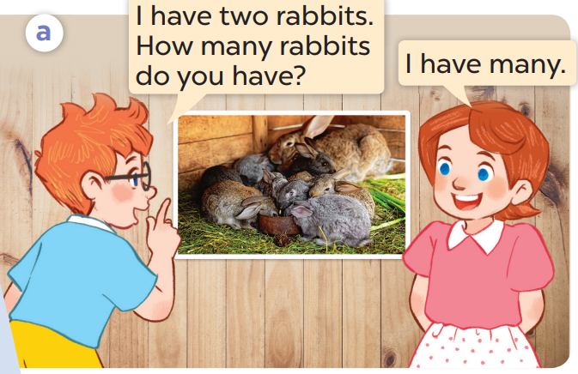
What pets does Ben have?
Now listen and repeat.
Who are they?
He has 2 rabbits.
They’re Ben and Lucy.

Slide 8
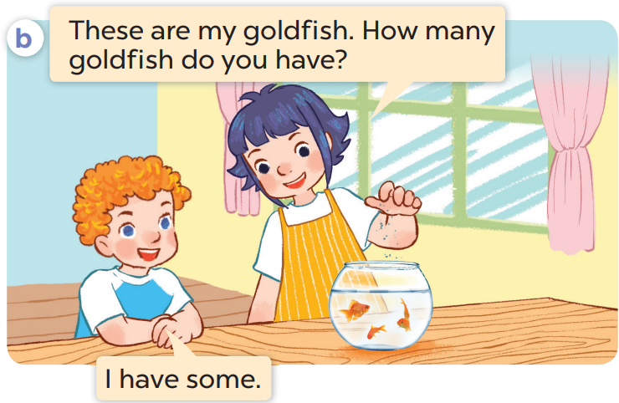
Whose goldfish are they?
What pets can you see?
Who are they?
I can see ….goldfish.
They’re Linh and Bill.
They are Linh’s.

Slide 9
Listen again and repeat.

Slide 10
Work in pairs. Act and say.

Slide 11
3
Listen, point and say.

Slide 12
a bird

Slide 13
2 birds

Slide 14
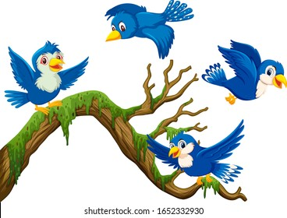
some birds

Slide 15
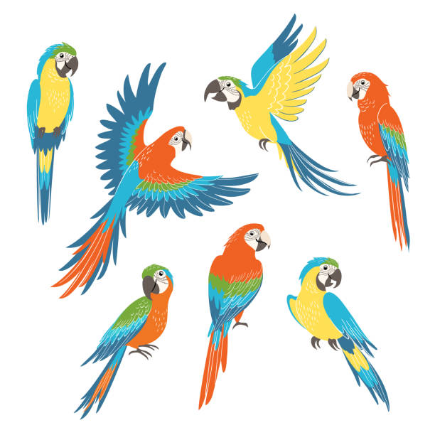
many birds

Slide 16
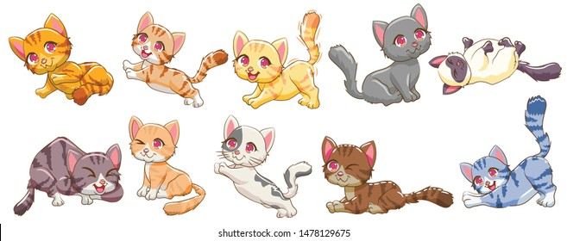
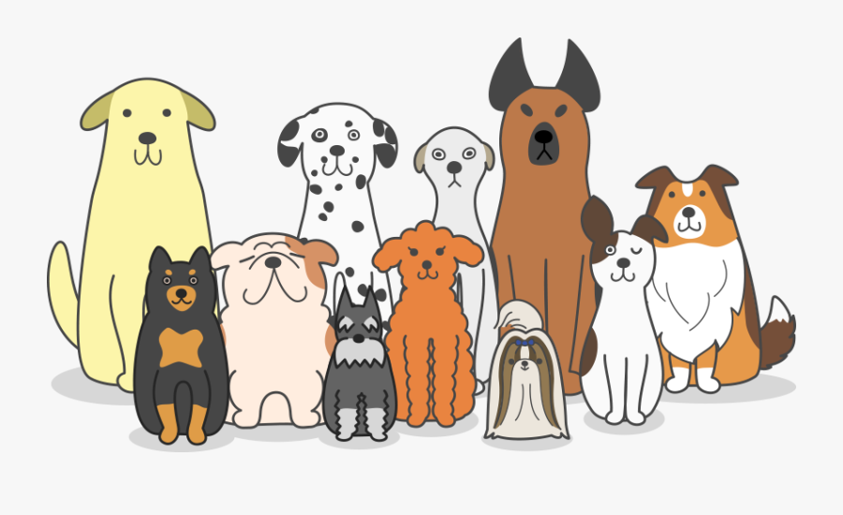
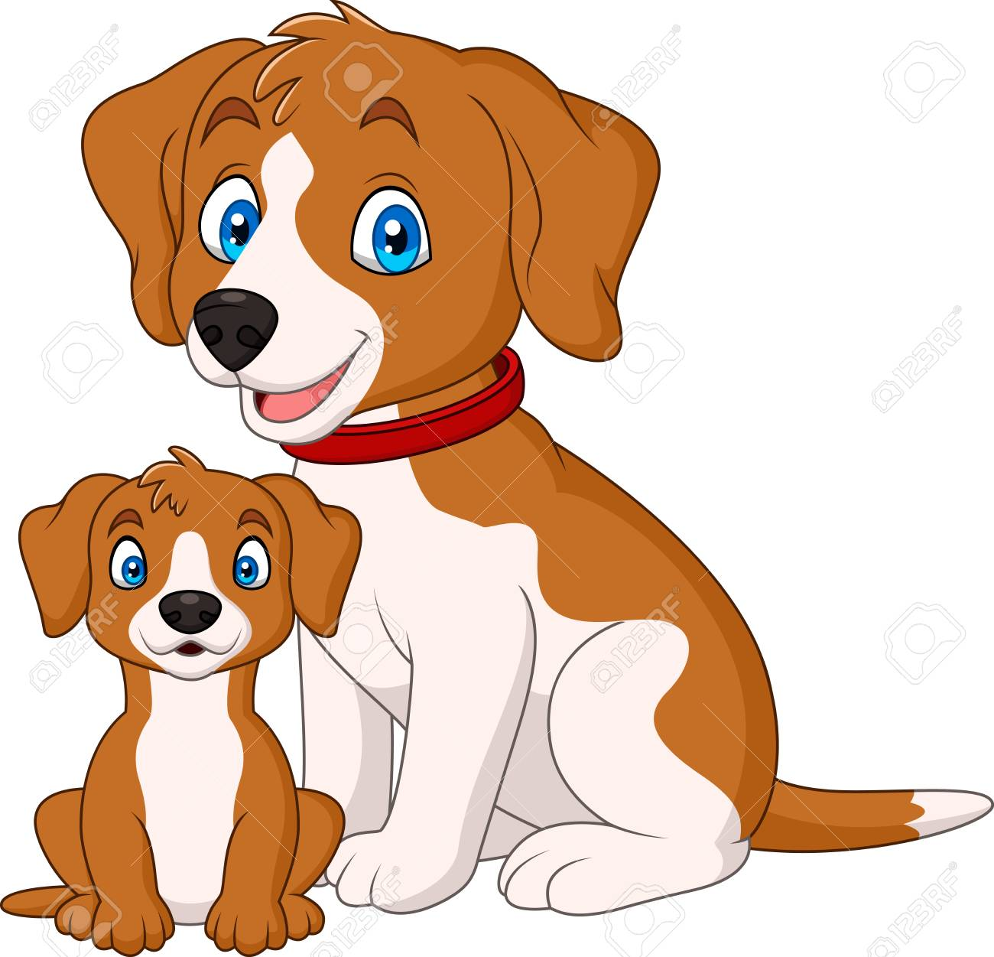
a cat
2 cats
some cats
many cats
a dog
2 dogs
some dogs
many dogs

Slide 17
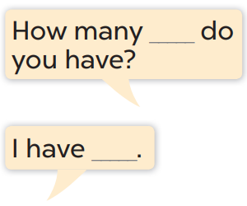
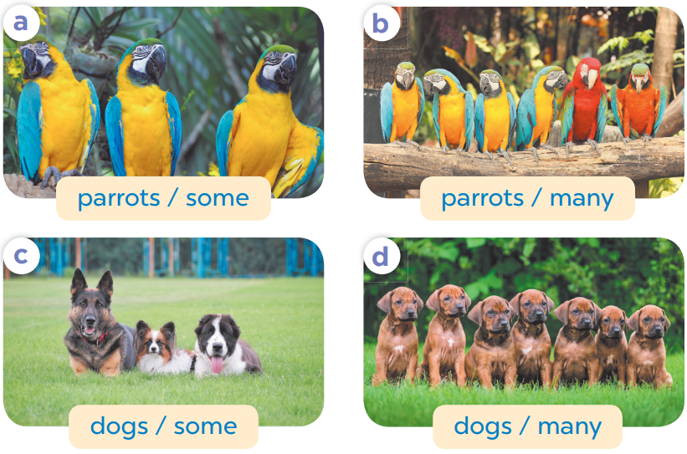

Slide 18
4
Let’s talk.

Slide 19
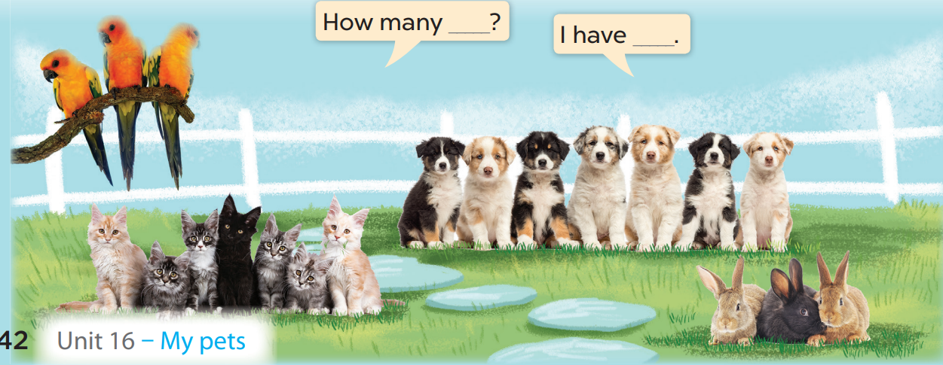

Slide 20
5
Fun corner and wrap-up

Slide 21
- How many …. do you have?
- I have ….
1
2
3
4
A
B
-1
Choose 1 box to open. Beware of bombs or dynamites.
Green Gem +1pt
Purple Gem +5pts
Trophy +10pts
Crying face -3 pts
C
-5
D
-2

Slide 22
Website: hoclieu.vn
Fanpage: facebook.com/www.tienganhglobalsuccess.vn

