Slide 2
Our toys
17
LESSON 2
Period 4

Slide 3
Contents
2
1
3
Listen and tick.
Look, complete and read.
Warm-up and review
5
4
Let’s play.
Fun corner and wrap-up

Slide 4
Warm-up and review
1
1
Game: What is missing?

Slide 5
Toys
WHAT IS MISSING?
START
Notes:
Step 1: Divide the class into 4 teams.
Step 2: Look at the pictures and find out what is missing. Invite pupils to find out which one is missing. The fastest students to have the correct answer get points.
Step 3: Encourage pupils to join in the game.
Step 4: Give points for pupils.

Slide 6
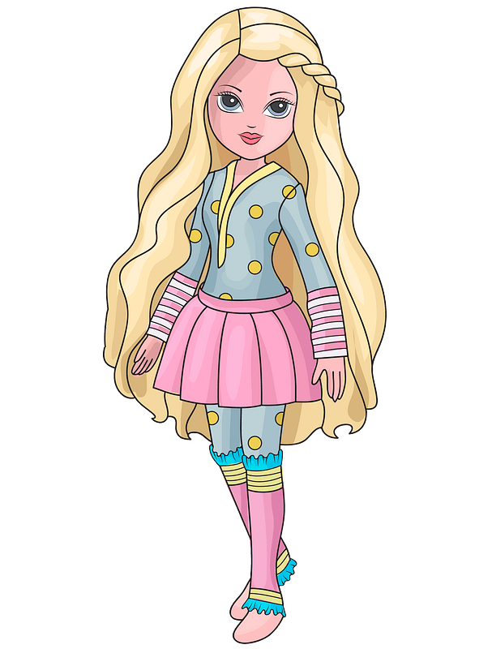
c
Toys
Look and say what toys are missing.

Slide 7
What is missing?

Slide 8
c
Toys

Slide 9
c
Toys

Slide 10
c
Toys

Slide 11
What is missing?

Slide 12
c
Toys

Slide 13
c
Toys

Slide 14
c
Toys

Slide 15
What is missing?

Slide 16
c
Toys

Slide 17
c
Toys

Slide 18
c
Toys

Slide 19
What is missing?

Slide 20
c
Toys

Slide 21
c
Toys

Slide 22
c
Toys

Slide 23
What is missing?

Slide 24
c
Toys

Slide 25
c
Toys

Slide 26
c
Toys

Slide 27
Thank you!
Toys

Slide 28
Listen and tick.
2
2

Slide 30
✓
✓

Slide 31
Look, complete and read.
3
3

Slide 32
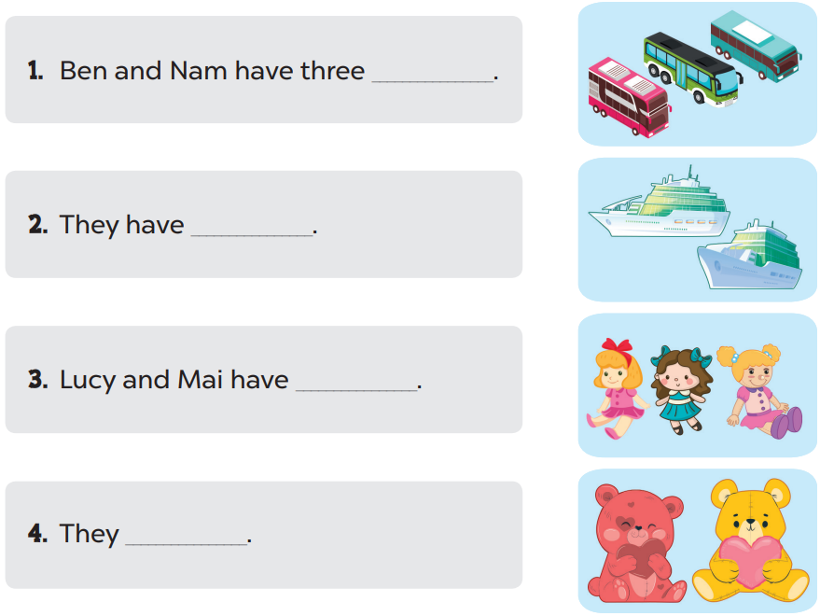

Slide 33
buses
two ships
three dolls
have two teddy bears

Slide 34
a. buses
b. cars
c. bikes

Slide 35
2. They have three ______.
a. planes
b. kites
c. dolls

Slide 36
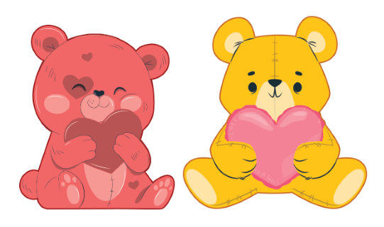
3. Mary and Lucy have ______.
a. two cars
b. two teddy bears
c. two buses

Slide 37
4. Nam and Ba have two _______.
a. ships
b. dolls
c. cars

Slide 38
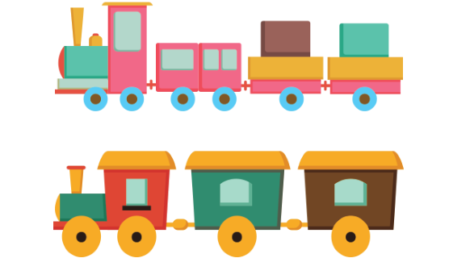
5. They have two ______.
a. planes
b. kites
c. trains

Slide 39
6. Minh and Ben have ____.
a. three cars
b. two cars
c. a car

Slide 40
7. They have three ____.
a. trains
b. planes
c. kites

Slide 41
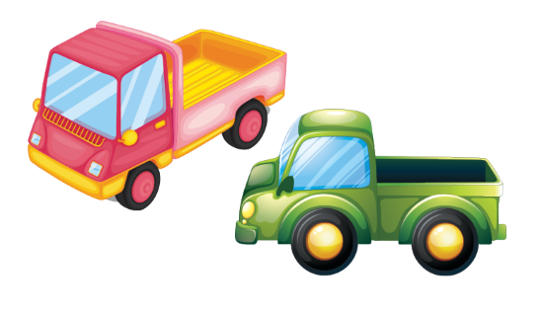
8. Peter and Laura have ___.
a. two ships
b. two cars
c. two trucks

Slide 42
4
4
Let’s play.

Slide 44
5
5
Fun corner and wrap-up

Slide 45
Game time!!!
Making sentences
Notes:
Step 1: Divide the class into 4 teams.
Step 2: Invite 1 pupil from each team to come to the front, look at the scrambled sentence then rearrange the words in order to make a sentence, then say it aloud. If he/she says it correctly, his/her team will have points.
Step 3: Encourage pupils to practice speaking English.
Step 4: Give points for pupils.

Slide 46
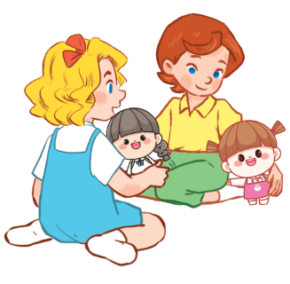
They
two
have
dolls
+2
___ ___ __ ____.
They have two dolls

Slide 47
She
a
has
kite
+2
___ __ __ ____.
She has a kite

Slide 48
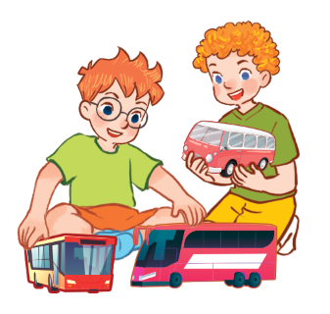
three
They
have
buses
+2
___ ___ ____ ____.
They have three buses

Slide 49
She
has
trains
two
+2
___ __ ___ ____.
She has two trains

Slide 50
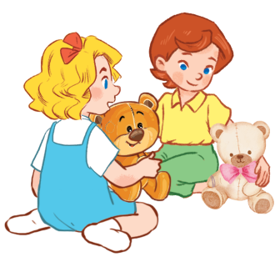
two
They
have
teddy bears
+2
___ ___ ___ ________.
They have two teddy bears

Slide 51
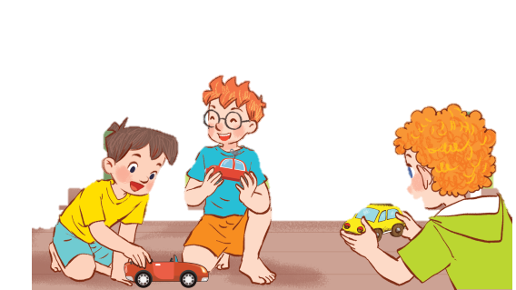
have
They
cars
three
+7
____ ___ ____ ____.
They have three cars

Slide 52
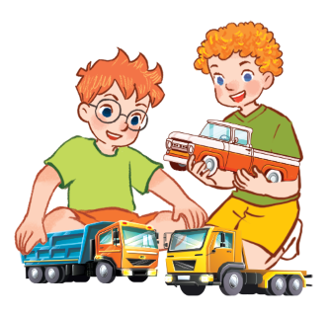
They
have
trucks
three
+10
____ ____ ____ _____.
They have three trucks

Slide 53
Website: hoclieu.vn
Fanpage: https://www.facebook.com/tienganhglobalsuccess.vn/

