Slide 2




Our toys
17
LESSON 2
Period 3

Slide 3
Contents
2
1
3
Look, listen and repeat.
Listen, point and say.
Warm-up and review
5
4
Let’s talk.
Fun corner and wrap-up

Slide 4
Warm-up and review
1
1
Game: Toys game

Slide 5




Notes:
Step 1: Divide the class into 4 teams.
Step 2: Look at the pictures on the screen and say aloud the word. The fastest students with the correct answer will get points for their team.
Step 3: Encourage pupils to participate in the game.
Step 4: Give points for pupils.

Slide 6


TRAIN

Slide 7

CAR

Slide 8




Slide 9


DOLL

Slide 10


KITE

Slide 11
Look, listen and repeat.
2
2

Slide 12
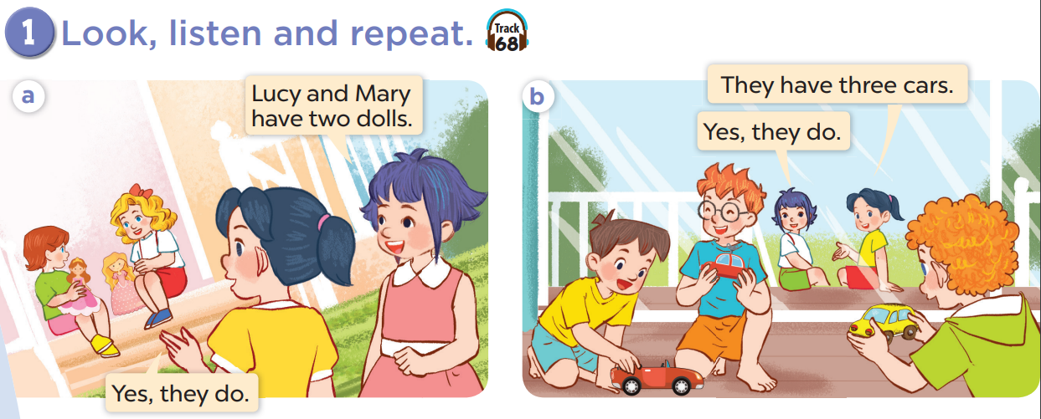

Slide 14
Listen, point and say.
3
3

Slide 15
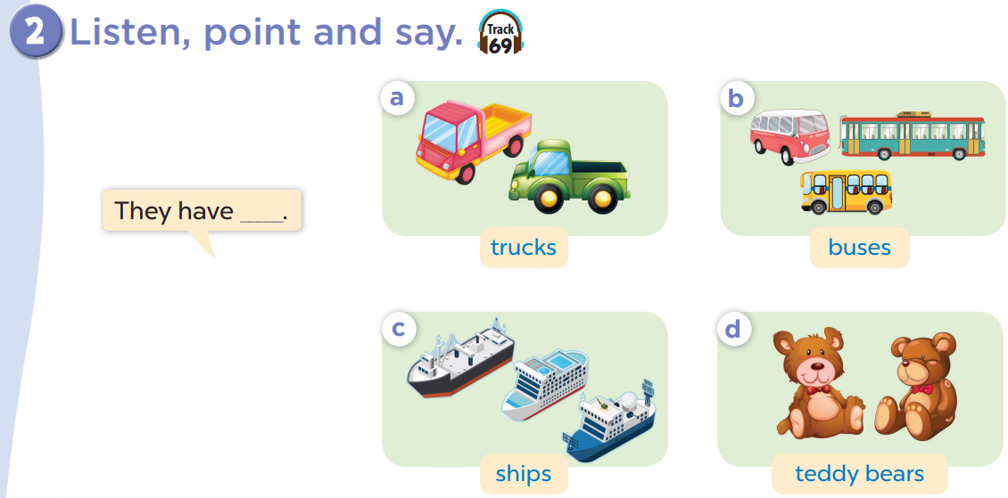

Slide 16


Slide 17


Listen and choose
Notes:
Step 1: Divide the class into four teams.
Step 2: Invite each pupil from each team to go to the board, listen to the recording then choose A or B. The fastest one with correct answer gets one point for their team.
Step 3: Encourage pupils to take part in the game.
Step 4: Give point for pupils.

Slide 18

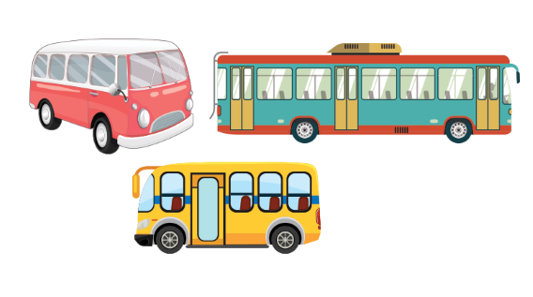
Listen and choose

Slide 19


Listen and choose

Slide 20

Listen and choose

Slide 21

Listen and choose

Slide 22
Listen and choose

Slide 23
Listen and choose

Slide 24
Listen and choose

Slide 25

Let’s talk
4
4

Slide 26
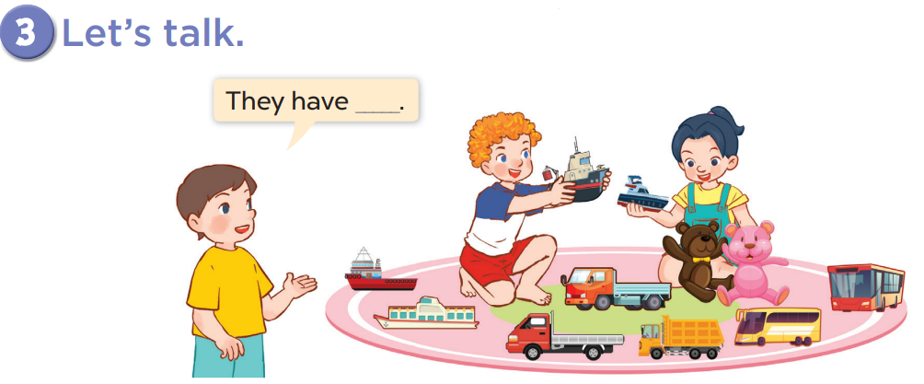

Slide 27


They have ____________.
three buses
+5

Slide 28

They have _________________.
two teddy bears
+3

Slide 29


They have ____________.
two dolls
+7

Slide 30

They have ____________.
three trucks
+4

Slide 31

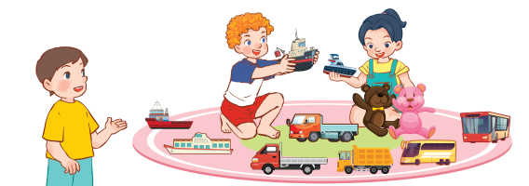
They have ____________.
two ships
+4

Slide 32
Fun corner and wrap-up
5
5

Slide 33

Game time!!!
What comes next?
Notes:
Step 1: Divide the class into 4 teams.
Step 2: Invite 1 pupil from each team to come to the board, look and choose the correct answer. If it is correct, give points for the teams.
Step 3: Encourage pupils to practice speaking English.
Step 4: Give points for pupils.

Slide 34

?

Slide 35


?

Slide 36

?

Slide 37


?

Slide 38
?

Slide 39

Website: hoclieu.vn
Fanpage: https://www.facebook.com/tienganhglobalsuccess.vn/

