Slide 2





Our toys
17
LESSON 3
Period 6

Slide 3
Contents
1
Warm-up and review
2
Read and circle.
3
Let’s write.
4
Project
5
Fun corner and wrap-up

Slide 4
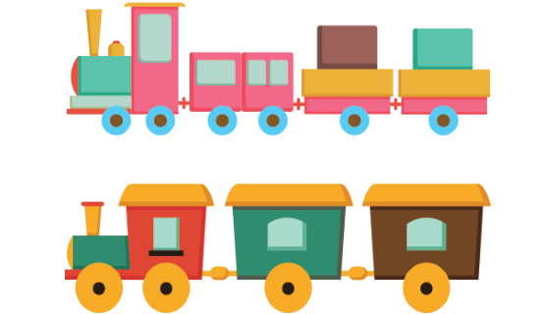
Warm-up and review
1
1
Game: What’s in the box?
4
4

Slide 5


What’s in the box?
Notes:
Game: What’s in the box?
Step 1: Divide the class into 4 teams.
Step 2: Invite 1 pupil from each team to go to the board and look at the toy, then scramble the words by writing on the board and say aloud what the toy is. The fastest will get more points than the rest.
Step 3: Encourage pupils to join in the game.
Step 4: Give points for the teams.

Slide 6


trains
i s a t r n
NEXT
Click on the box to check.

Slide 7

car
a c
r
NEXT
Click on the box to check.

Slide 8

kite
t i
k e
NEXT
Click on the box to check.

Slide 9
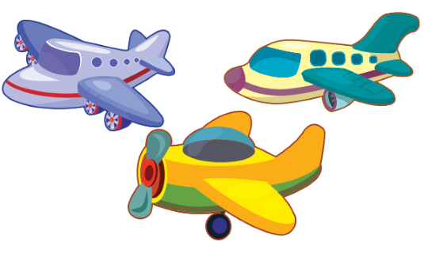
planes
l a p e n s
NEXT
Click on the box to check.

Slide 10

ships
h p i s s
NEXT
Click on the box to check.

Slide 11

teddy bears
t e d
y d s b
e a r
NEXT
Click on the box to check.

Slide 12
Read and circle.
2
2

Slide 13
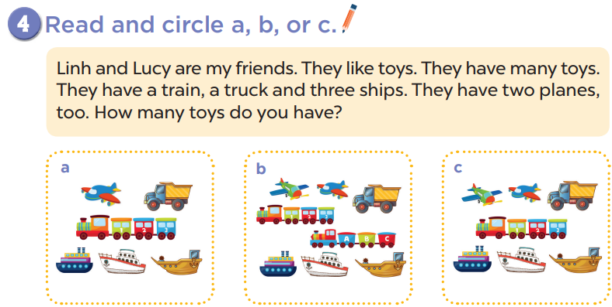
c
b
a

Slide 14
c
b
a

Slide 15
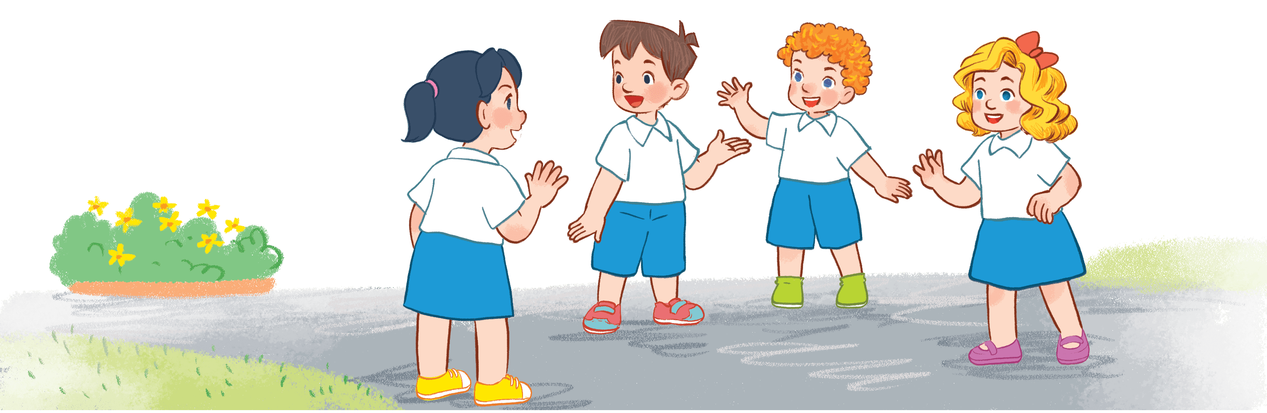
Let’s write.
3
3

Slide 16
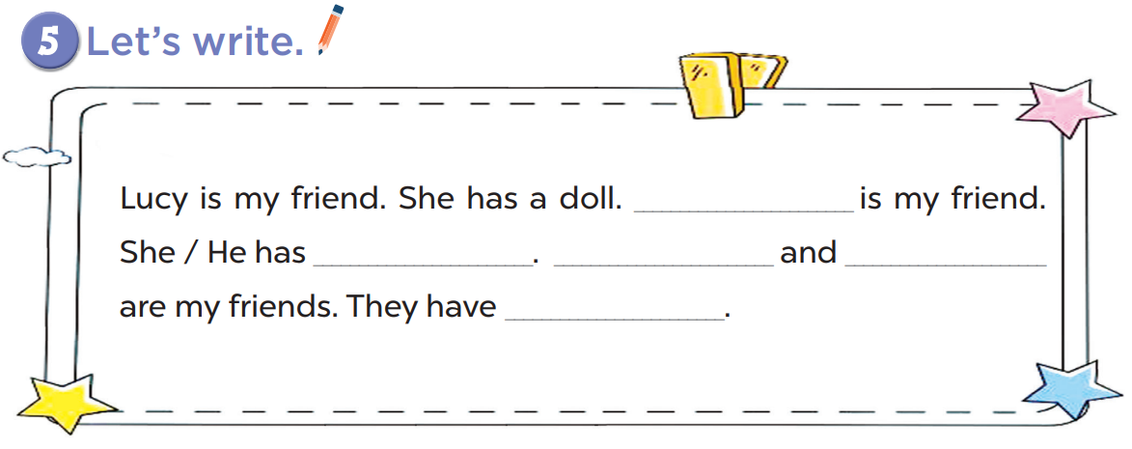

Slide 17

1. Lucy is my ____.
a. sister
b. friend

Slide 18
2. She has a ____.
a. car
b. doll

Slide 19
3. Minh is my ____.
a. friend
b. mom

Slide 20
4. He has a ____.
a. plane
b. kites

Slide 21
5. Lucy and Minh are my ____.
a. friend
b. friends

Slide 22
6. They have ____.
A. a plane and a kite
B. a car

Slide 23
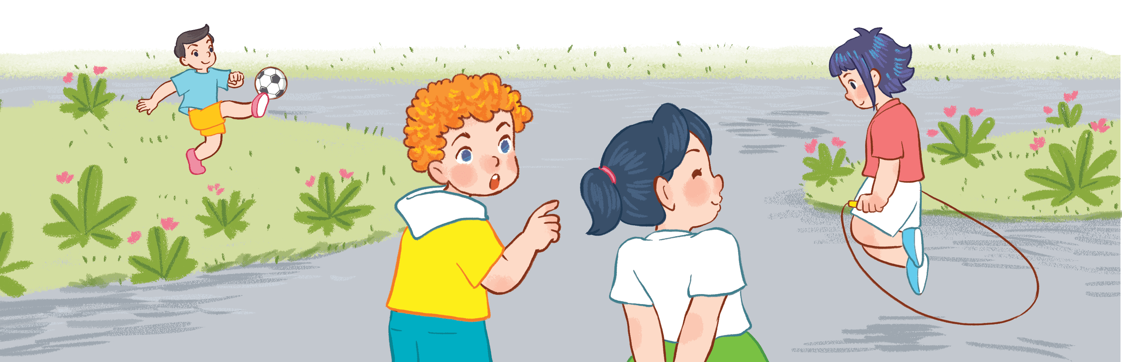
Project
5
5

Slide 24
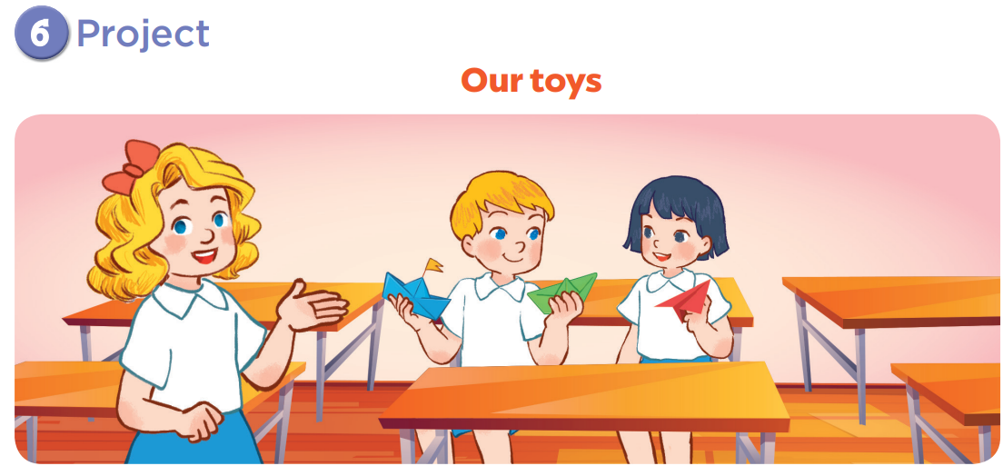

Slide 25

He has …

Slide 26
He has two boats.

Slide 27
She has …

Slide 28
She has a plane.

Slide 29
Fun corner and wrap-up
5
5

Slide 30
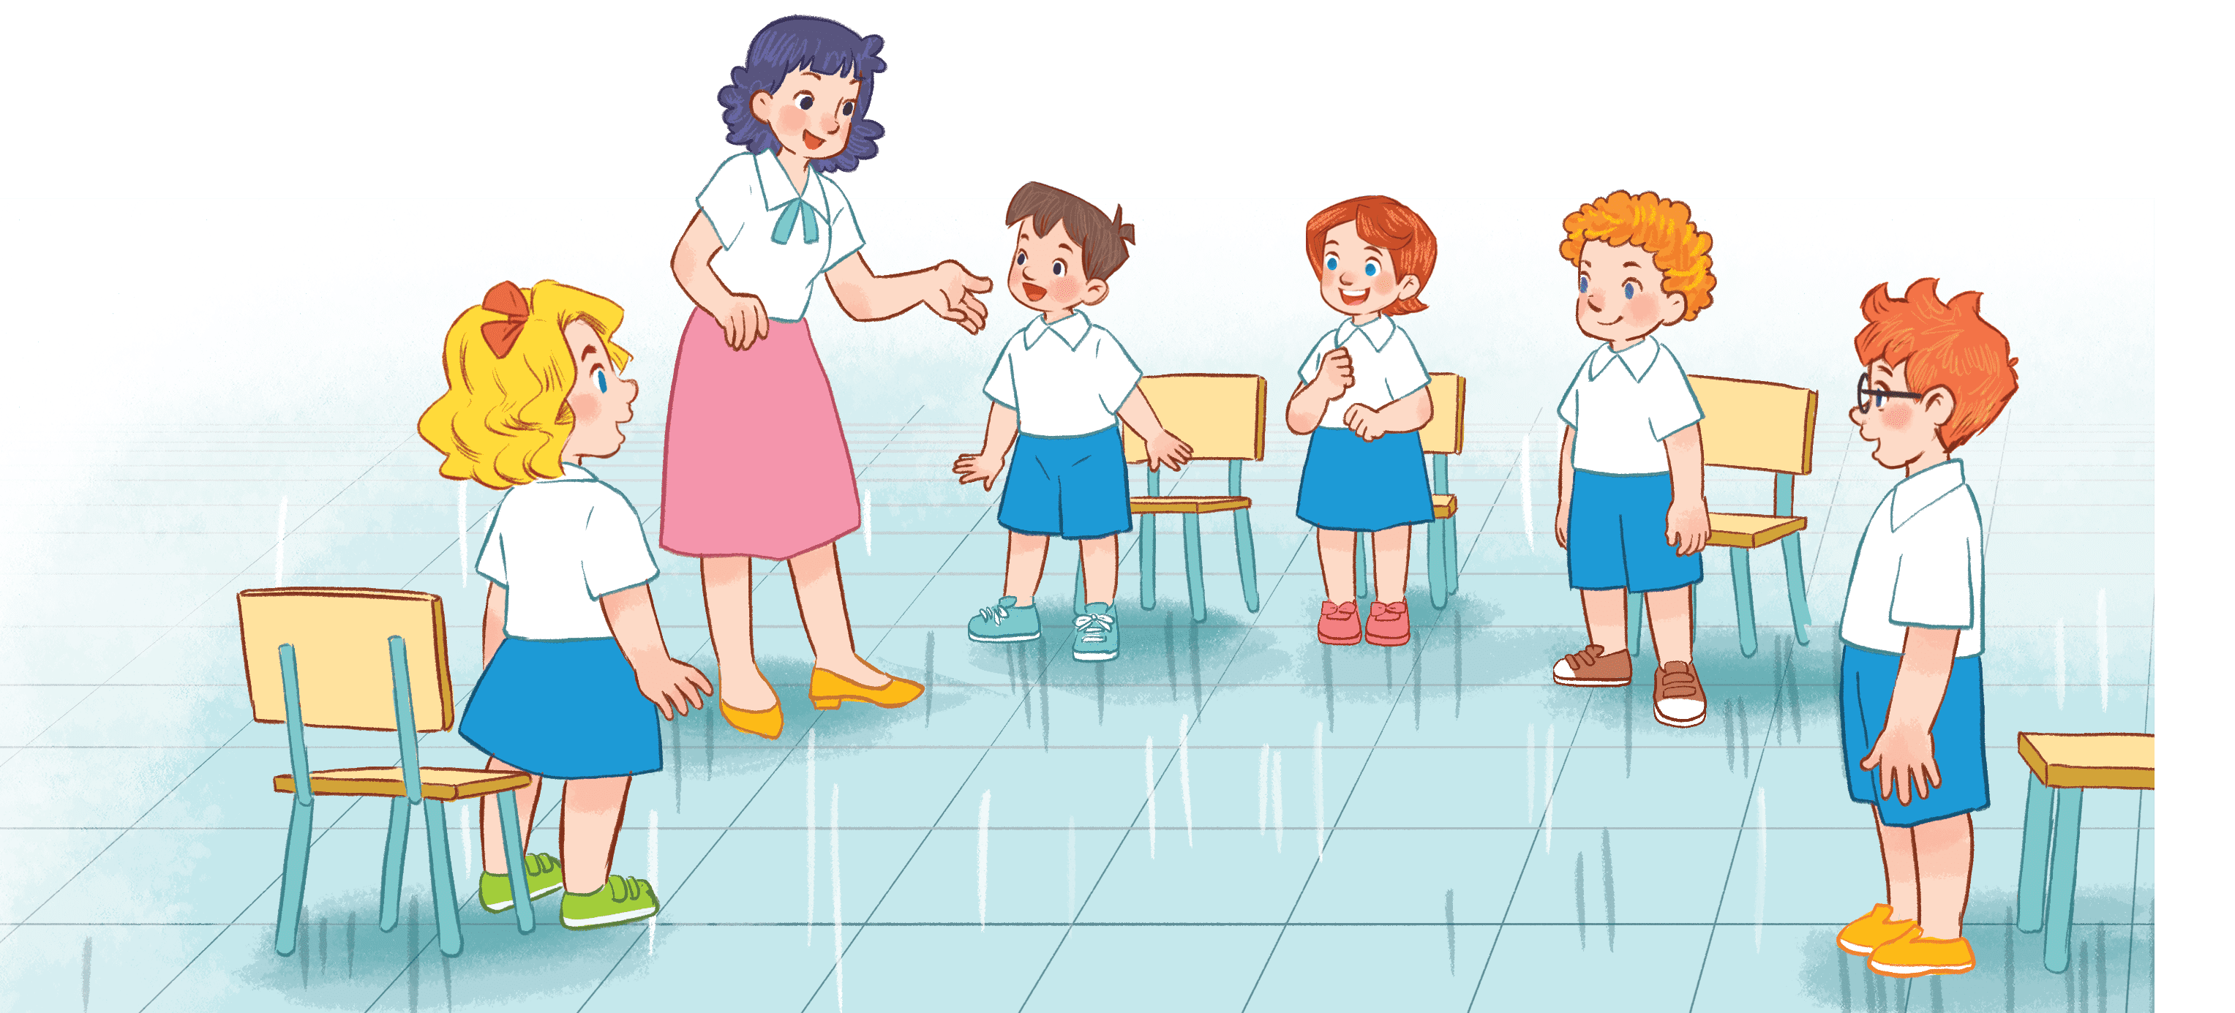
Game time
Look and say!
Notes:
Step 1: Divide the class into 4 teams.
Step 2: Invite 1 pupil from each team look at the picture and say aloud 3 times. The fastest one with the correct answer will have points for his/her team.
Step 3: Encourage pupils to practice speaking English.
Step 4: Give points for pupils.

Slide 31
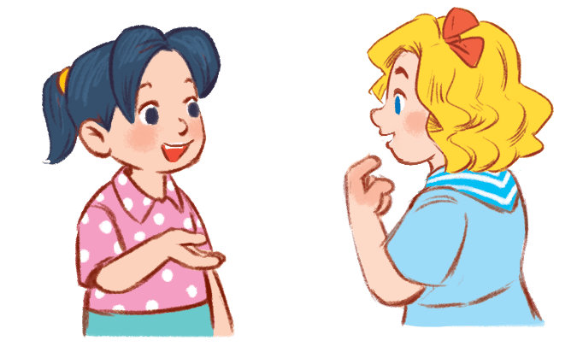
She has three boats.
She has ….

Slide 32
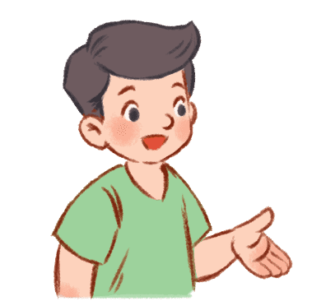
He has ….
He has a car.

Slide 33
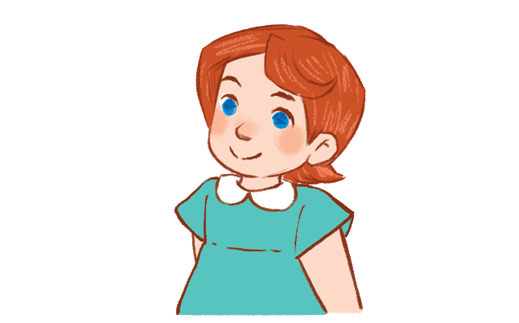
She has ….
She has two teddy bears.

Slide 34


She has two boats.
She has ….

Slide 35
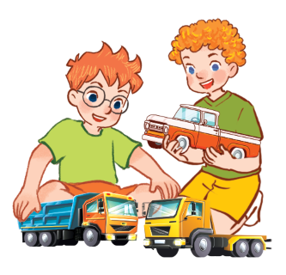
They have…
They have three trucks.

Slide 36


She has a kite.
She has ….

Slide 37
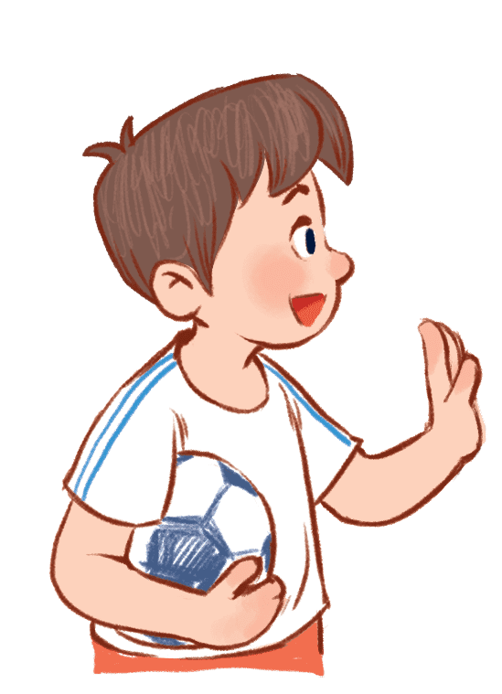
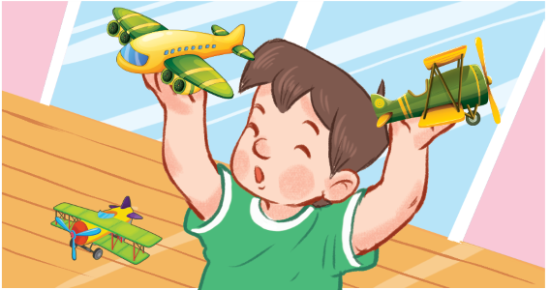
He has three planes.
He has ….

Slide 38
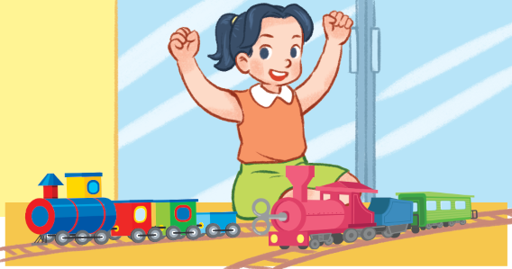
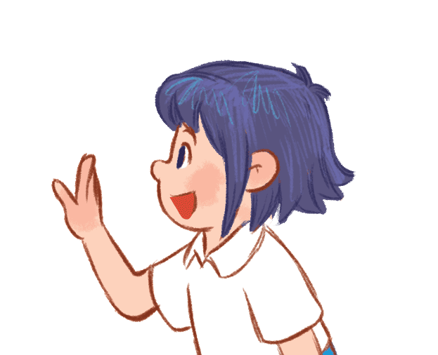
She has two trains.
She has ….

Slide 39
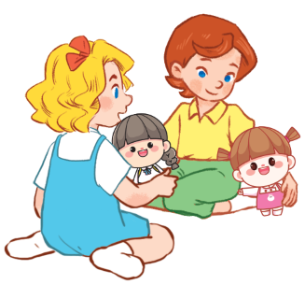

They have two dolls.
They have…

Slide 40
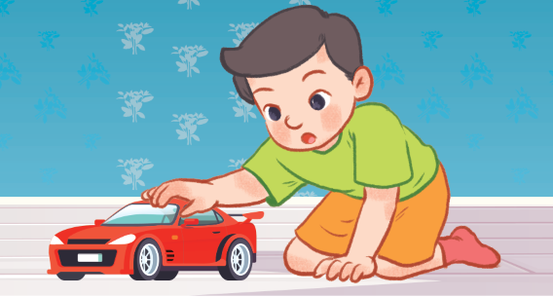
He has ….
He has a car.

Slide 41

Website: hoclieu.vn
Fanpage: https://www.facebook.com/tienganhglobalsuccess.vn/

