Slide 2
At the shopping centre Lesson 2 - Period 4

Slide 3
Table of contents
01
Warm-up and review
02
Listen and number.
03
04
Look, complete and read.
Let’s play.
05
Fun corner and wrap-up

Slide 4
01
Warm-up

Slide 5
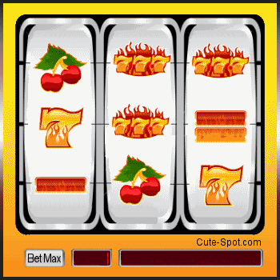
PLAY
READ THE NUMBER

Slide 6
NEXT
How much?
1/8
20
000
đ
TIME’S UP
TWENTY THOUSAND DONG
CHECK

Slide 7
NEXT
How much?
2/8
70
000
đ
TIME’S UP
SEVENTY THOUSAND DONG
CHECK

Slide 8
NEXT
How much?
3/8
50
000
đ
TIME’S UP
FIFTY THOUSAND DONG
CHECK

Slide 9
NEXT
How much?
4/8
40
000
đ
TIME’S UP
FORTY THOUSAND DONG
CHECK

Slide 10
NEXT
How much?
5/8
60
000
đ
TIME’S UP
SIXTY THOUSAND DONG
CHECK

Slide 11
NEXT
How much?
6/8
90
000
đ
TIME’S UP
NINETY THOUSAND DONG
CHECK

Slide 12
NEXT
How much?
7/8
80
000
đ
TIME’S UP
EIGHTY THOUSAND DONG
CHECK

Slide 13
NEXT
How much?
8/8
30
000
đ
TIME’S UP
THIRTY THOUSAND DONG
CHECK

Slide 14
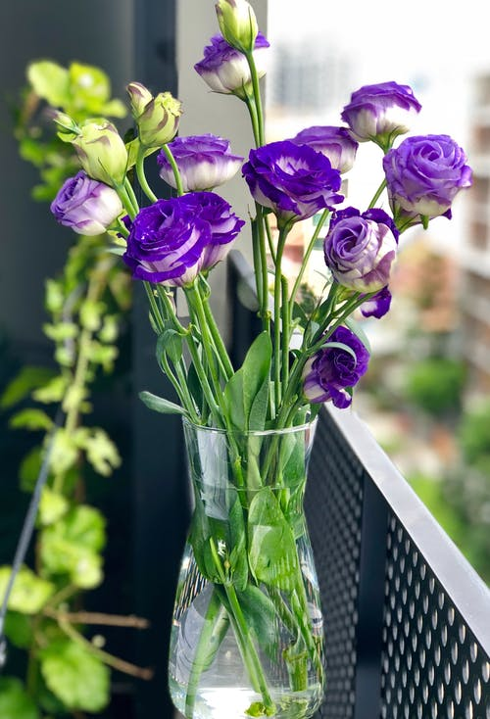
02
Listen and number.
Pupil’s book page 55

Slide 15
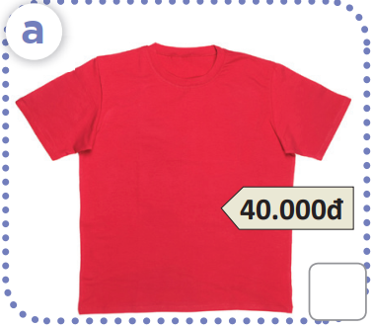
What is this?
How much is this?

Slide 16
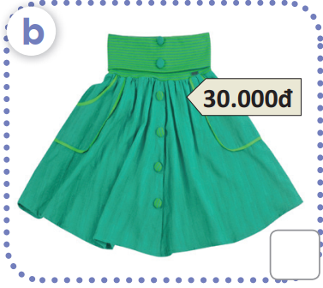
What is this?
How much is this?

Slide 17
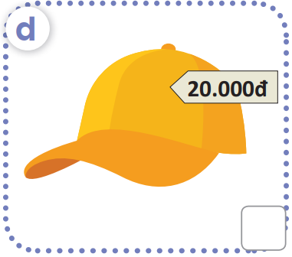
What is this?
How much is this?

Slide 18
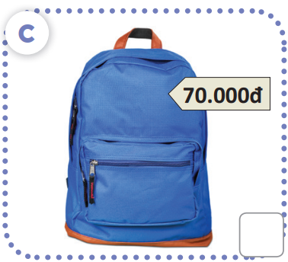
What is this?
How much is this?

Slide 19
Work in pairs.
Ask and answer

Slide 20
2
4
1
3

Slide 21
03
Look, complete and read.

Slide 22
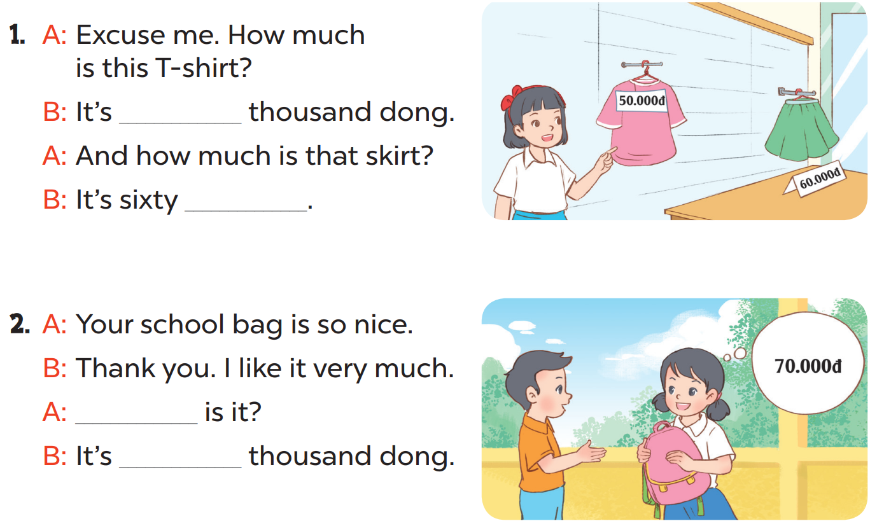
fifty
thousand dong
How much
seventy

Slide 23
04
Let’s play!

Slide 24
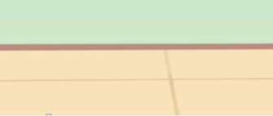

Slide 25
05
Fun corner

Slide 26
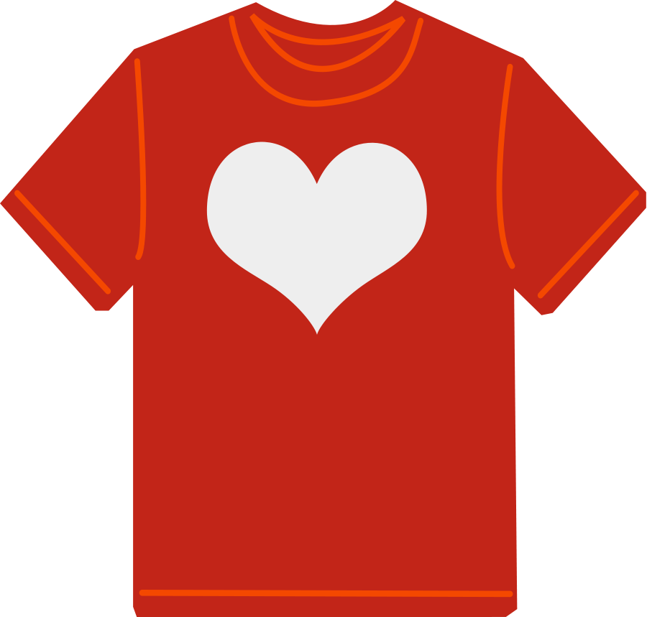
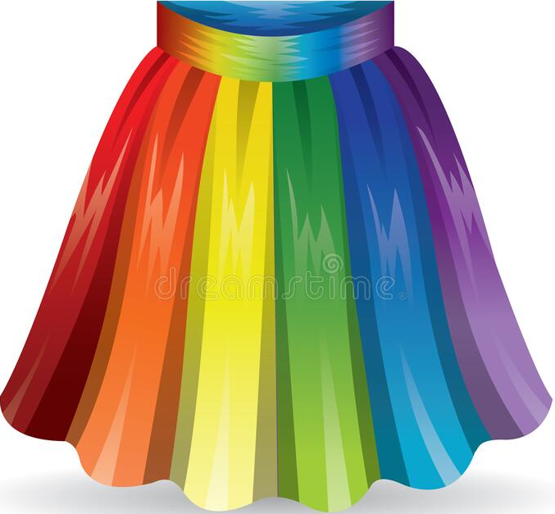
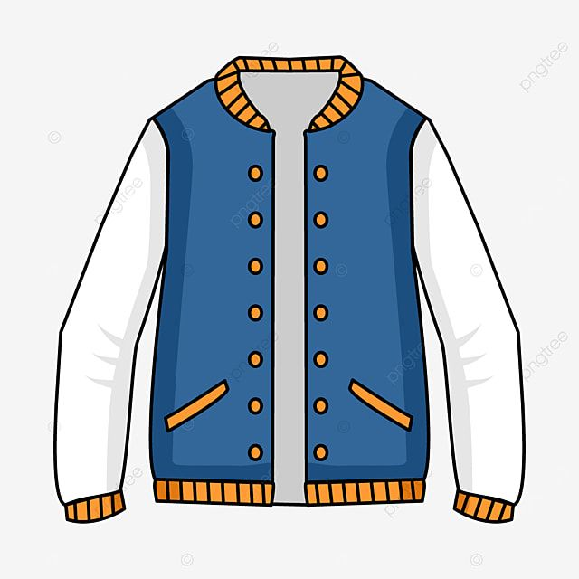
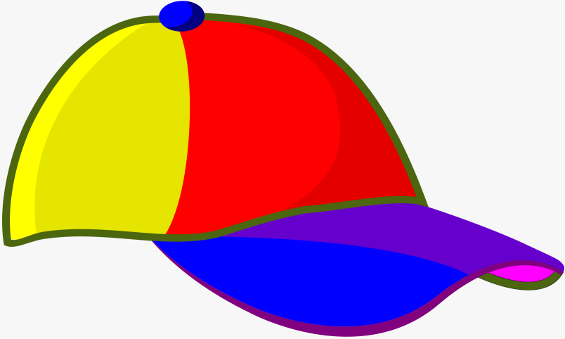
Shopping centre
40.000 đ
70.000 đ
50.000 đ
90.000 đ
30.000 đ
40.000 đ
80.000 đ
60.000 đ
It’s ninety thousand dong.
How much is the jacket?



Slide 27
Shopping centre
40.000 đ
70.000 đ
50.000 đ
90.000 đ
30.000 đ
40.000 đ
80.000 đ
60.000 đ
It’s forty thousand dong.
How much is the cap?



Slide 28
Shopping centre
40.000 đ
70.000 đ
50.000 đ
90.000 đ
30.000 đ
40.000 đ
80.000 đ
60.000 đ
How much is the T-shirt?
It’s forty thousand dong.



Slide 29
Shopping centre
40.000 đ
70.000 đ
50.000 đ
90.000 đ
30.000 đ
40.000 đ
80.000 đ
60.000 đ
It’s sixty thousand dong.
How much is the school bag?



Slide 30
Shopping centre
40.000 đ
70.000 đ
50.000 đ
90.000 đ
30.000 đ
40.000 đ
80.000 đ
60.000 đ
It’s seventy thousand dong.
How much is the dress?



Slide 31
Shopping centre
40.000 đ
70.000 đ
50.000 đ
90.000 đ
30.000 đ
40.000 đ
80.000 đ
60.000 đ
How much is the handbag?
It’s eighty thousand dong.



Slide 32
Shopping centre
40.000 đ
70.000 đ
50.000 đ
90.000 đ
30.000 đ
40.000 đ
80.000 đ
60.000 đ
It’s fifty thousand dong.
How much is the skirt?



Slide 33
Shopping centre
40.000 đ
70.000 đ
50.000 đ
90.000 đ
30.000 đ
40.000 đ
80.000 đ
60.000 đ
How much is the hat?
It’s thirty thousand dong.



Slide 34
THANK YOU
Website: hoclieu.vn
Fanpage: facebook.com/www.tienganhglobalsuccess.vn
Website: sachmem.vn; hoclieu.vn
Fanpage: www.facebook.com/sachmem.vn

