Slide 1



Slide 2


Our names
2
9
LESSON 1 – PERIOD 2

Slide 3
TABLE OF CONTENTS
01
02
03
04
05
SING WITH ME
REVIEW
PRACTICE
LET’S PLAY
FUN TIME

Slide 4

SING with ME
01

Slide 5
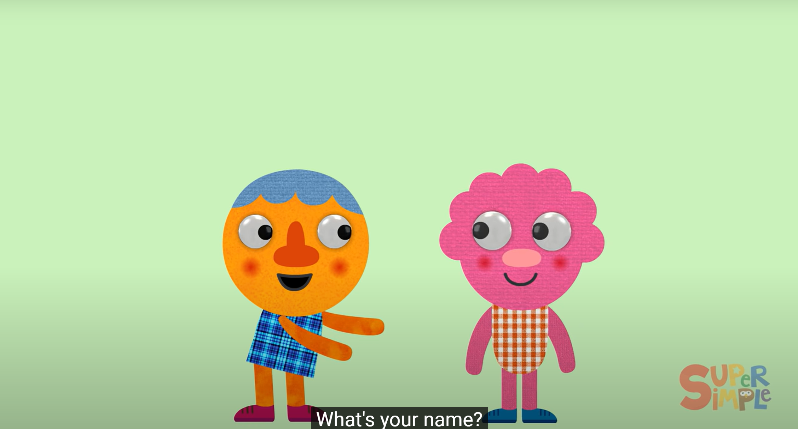
Notes:
https://www.youtube.com/watch?v=zMdq9jSaNLg

Slide 6
REVIEW
02

Slide 7


I’m Nam.
What’s your name?
Hello!
My name’s Lucy.
Hi!

Slide 8
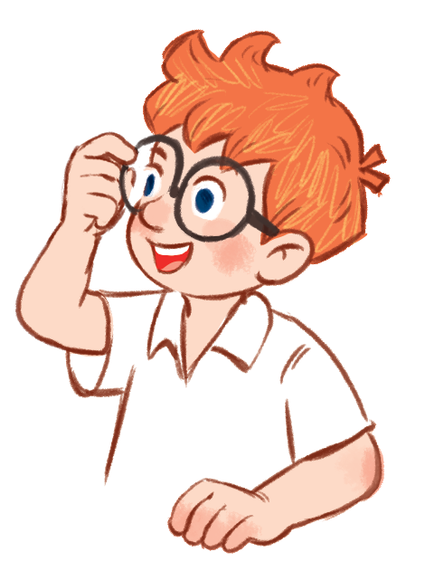

I’m Nam.
What’s your name?
My name’s …….
Mai
Ben

Slide 9

Pair work
What’s your name?
My name’s …….
Work in pairs, ask and answer about names, using the model sentences.

Slide 10
PRACTICE
03

Slide 11
ACTIVITY 4

Slide 12
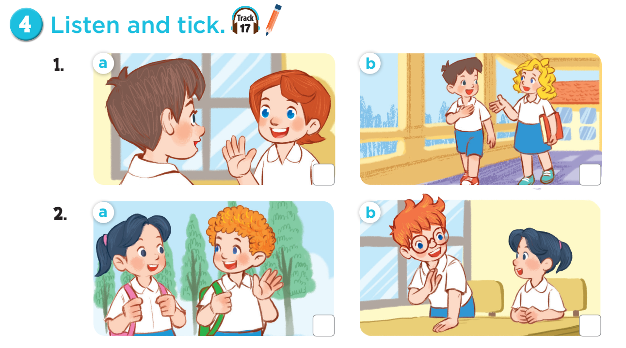

Slide 13
Ask and answer questions.
Notes:
Ask pupils some questions about Activity: How many pictures are there? Who can you see? What are they doing?

Slide 14



Slide 15
ACTIVITY 5

Slide 16
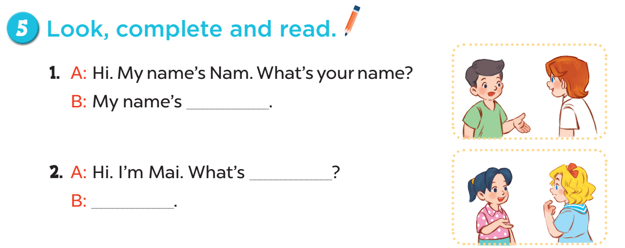
Lucy
your name
My name’s Mary

Slide 17
LET’S PLAY
04

Slide 18
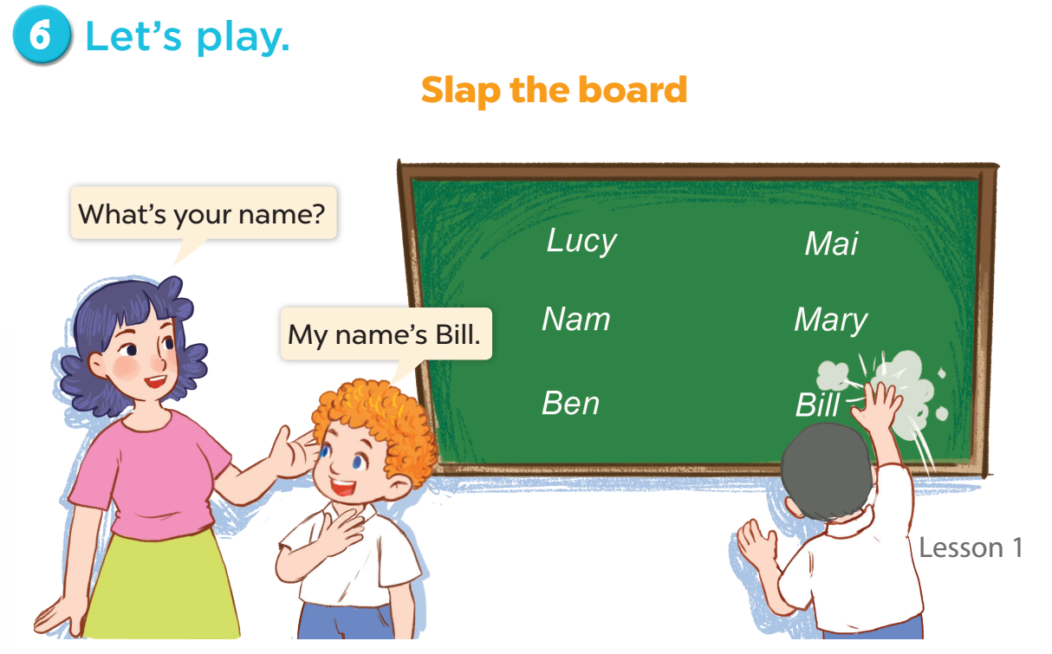

Slide 19
FUN TIME
05

Slide 20

Hello.
My name’s …….
5
2
1
8
-3
SPIN
10
10
9
3
1
7
-5
Notes:
12 Segments

Slide 21

Website: sachmem.vn
Fanpage: www.facebook.com/sachmem.vn
Youtube: Sách Mềm

