Slide 1



Slide 2




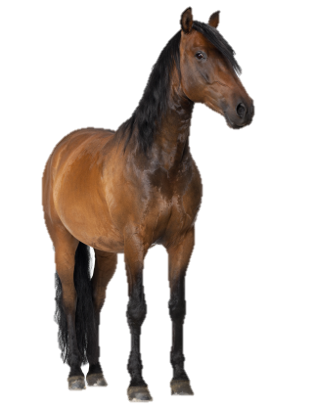
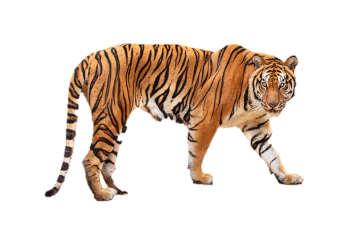


At the zoo
20
LESSON 2
Period 4

Slide 3










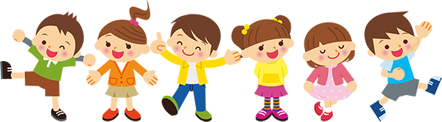

01
Warm-up and review

Slide 4


Notes:
Game: Guess me!
- Divide the class into 4 groups.
- Pupils try to identify different body parts of an animal (colour/body/legs,...). Then guess which animal it is.
- Then the teacher shows the last picture, asks the winning group: What is the ... doing?

Slide 5
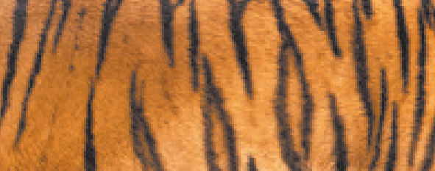
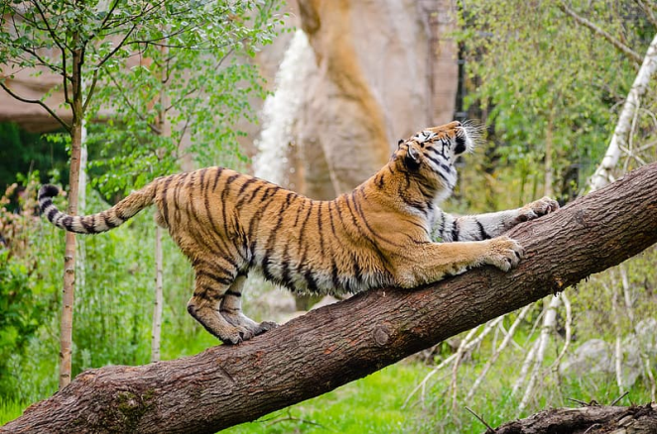
a tiger…
Notes:
Tiger
The tiger is climbing the tree.

Slide 6
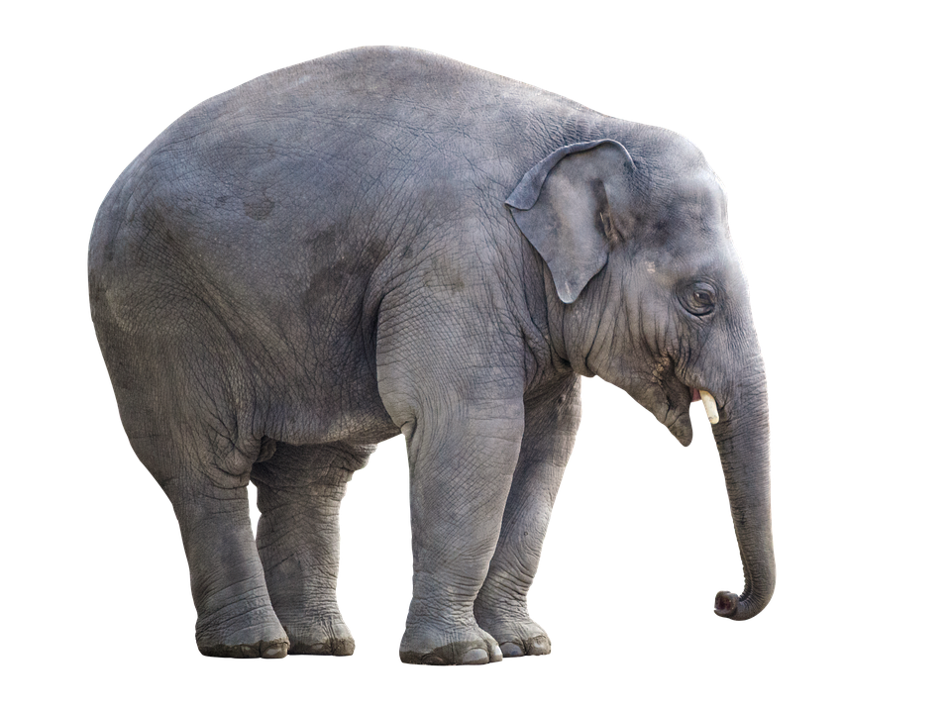
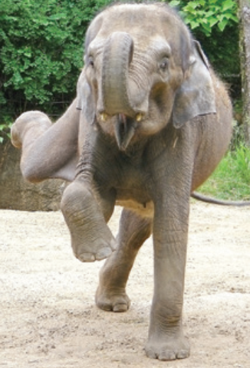
an elephant…
Notes:
Elephant
The elephant is dancing.

Slide 7
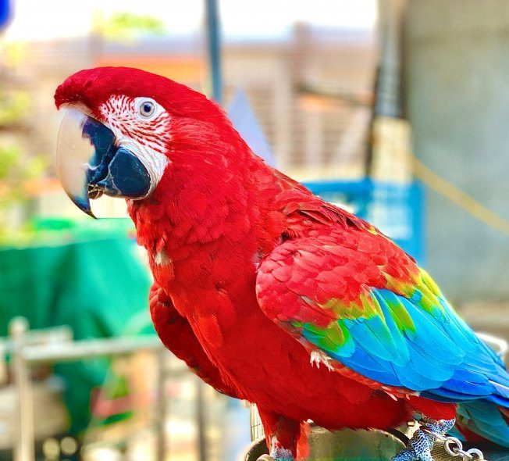
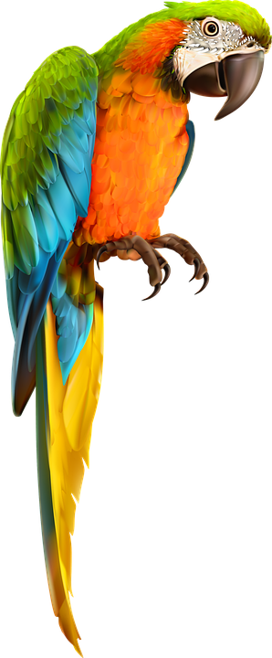
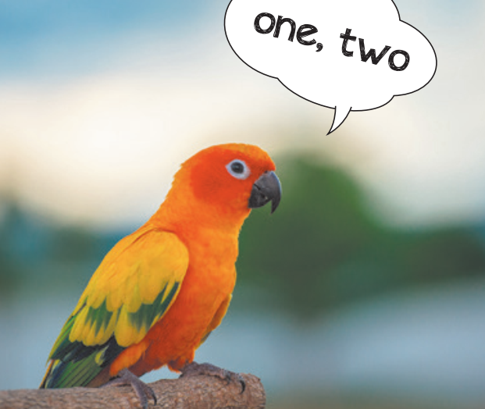
a parrot
/bird…
Notes:
Parrot
The parrot is couting.

Slide 8
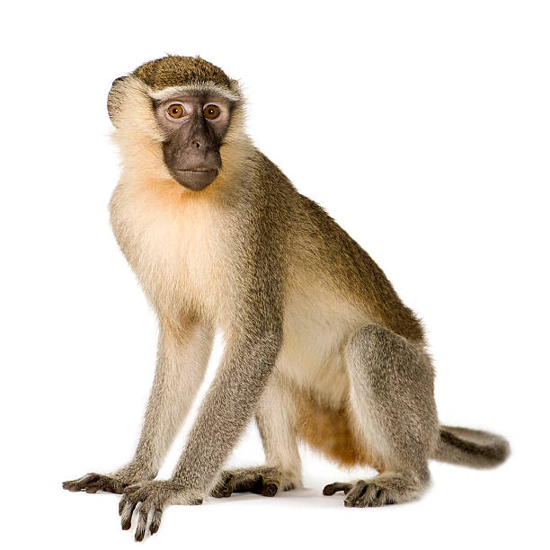
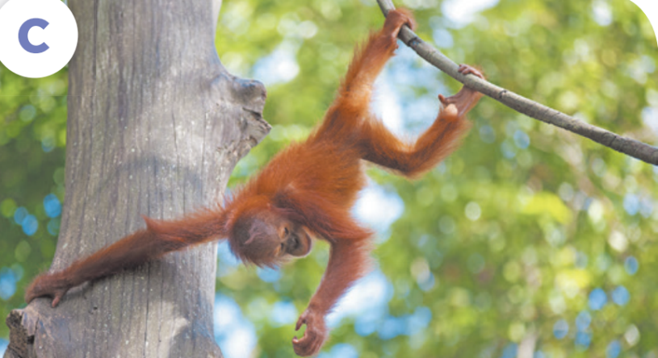
a monkey…

Slide 9
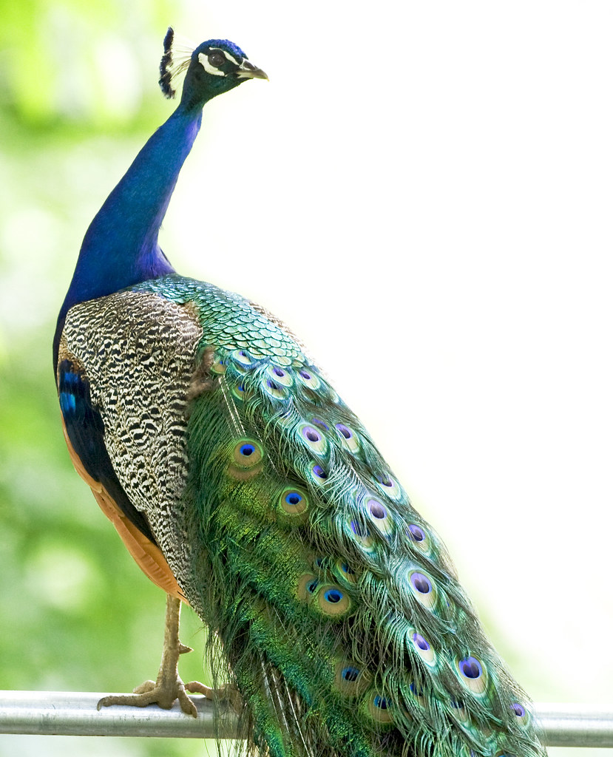
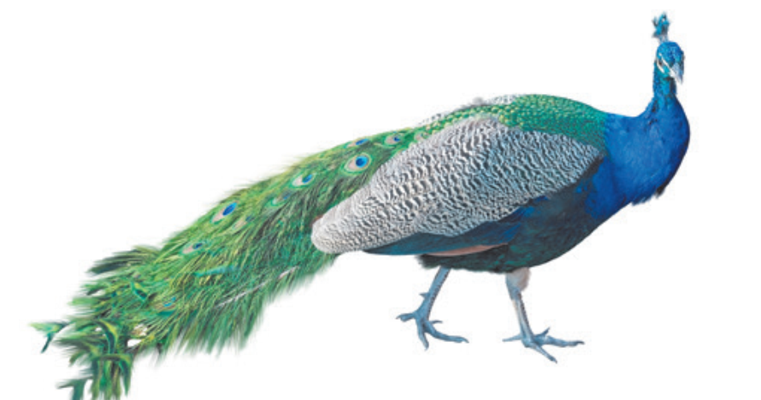
a peacock…
Notes:
Peacock
The peacock is dancing.

Slide 10

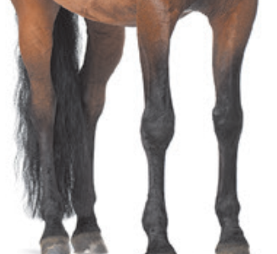
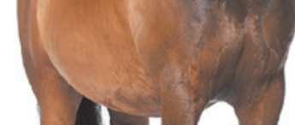
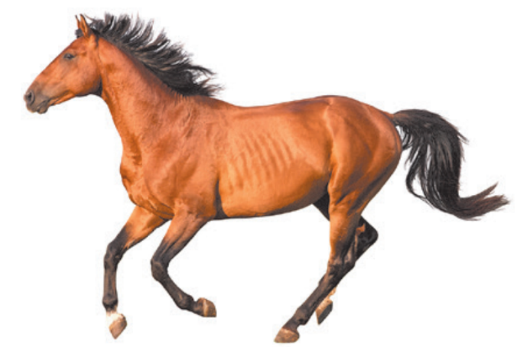
a horse…
Notes:
Horse
The horse is running.

Slide 11
02
Listen and tick.

Slide 12
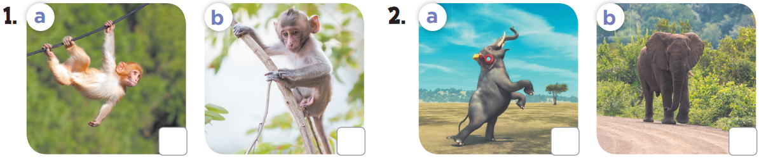


Slide 13
03
Look, complete and read.

Slide 14
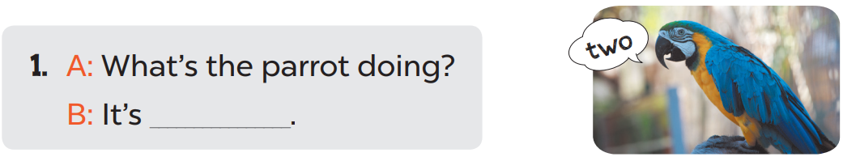
counting

Slide 15
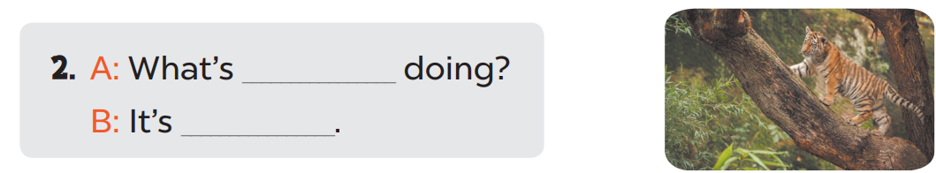
the tiger
climbing

Slide 16
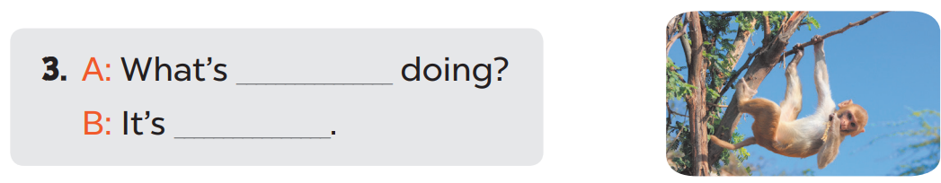
the monkey
swinging

Slide 17
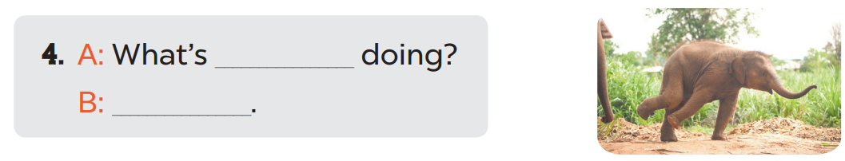
the elephant
It’s dancing.

Slide 18
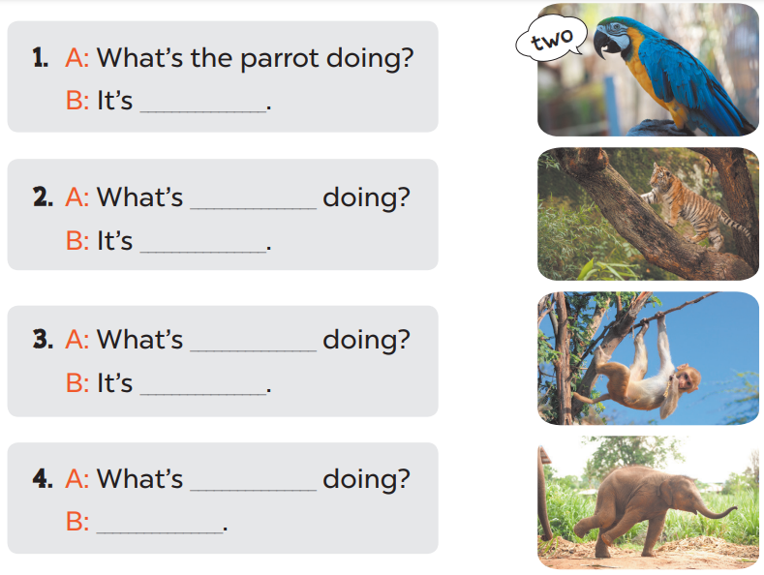
counting.
the tiger
climbing.
the monkey
swinging.
the elephant
It’s dancing.

Slide 19

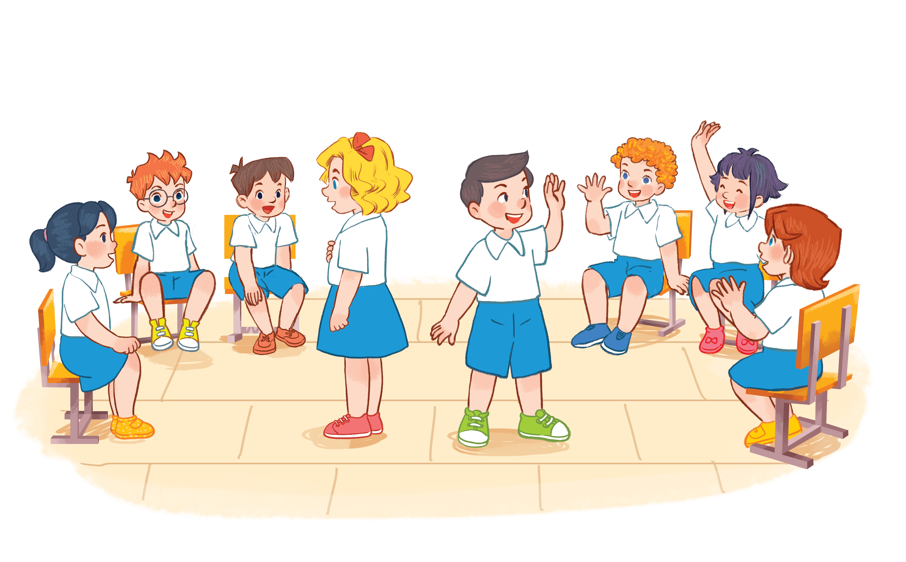
Notes:
- Ask 6 pupils to wear an animal hat in front of the class (they don’t know what the animal is).
- Then pupils takes turns asking their friends: What can you see?
- The whole class can use gestures or act out (without saying a word) for him/her to guess the name of the animal: It’s a....
- Next, they can ask: What is the ...doing?.
- The whole class will do an action (climb tree/ dance/ swing/ count): The ... is ...-ing.

Slide 20
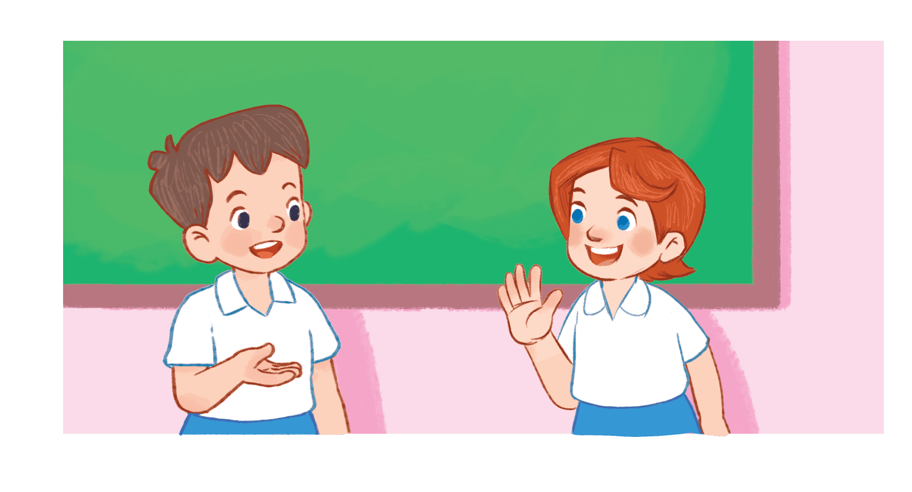

What can you see?
What’s the elephant doing?
It’s …
an elephant

Slide 21

a monkey
What’s the monkey doing?
What can you see?

Slide 22


What can you see?
What’s the tiger doing?
a tiger

Slide 23
a peacock
What’s the peacock doing?
What can you see?

Slide 24


What can you see?
What’s the parrot doing?
a parrot

Slide 25
a horse
What’s the horse doing?
What can you see?

Slide 26
04
Let’s sing.

Slide 27
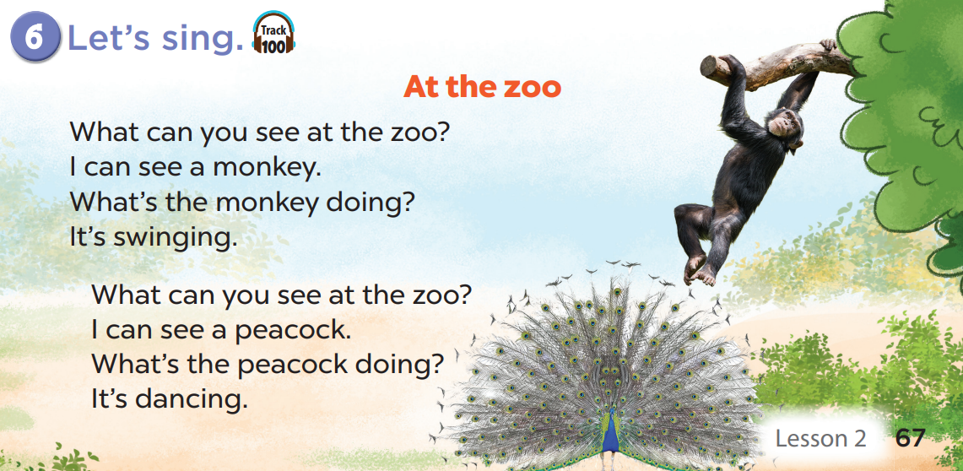

Slide 28
Notes:
Whole class will sing the answer.

Slide 29
05
Fun corner and wrap-up

Slide 30
Find the differences
Notes:
- Ask pupils to work in groups of 4-6.
- Ask them to look at the pictures, talk to their classmates and find the differences between 2 pictures. Set the time to work (2-3 minutes).
- Ask some pairs to share their answers with the whole-class.

Slide 31

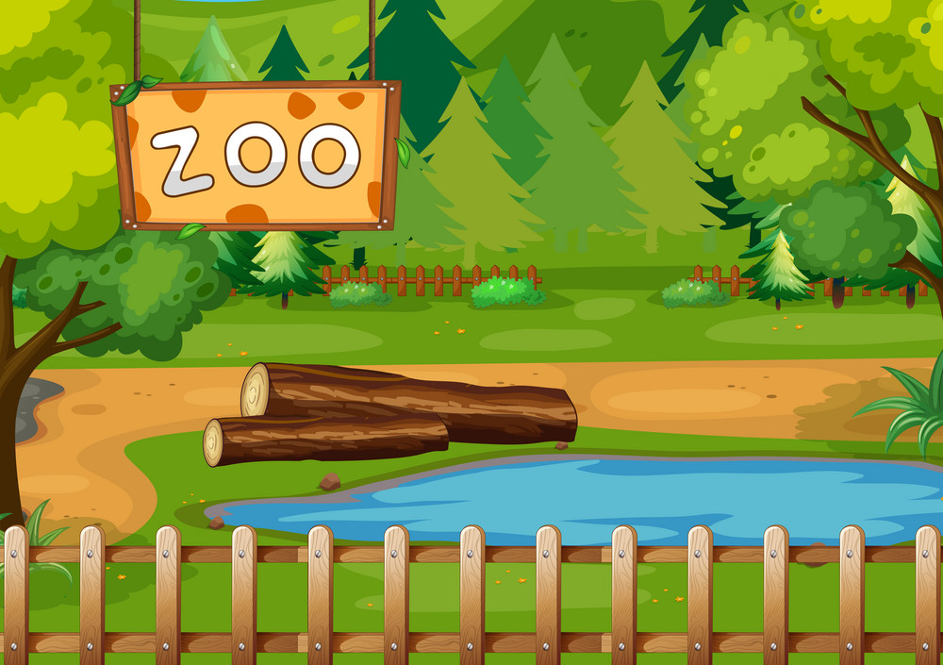
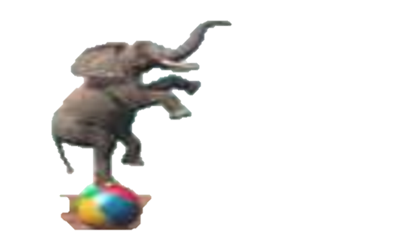
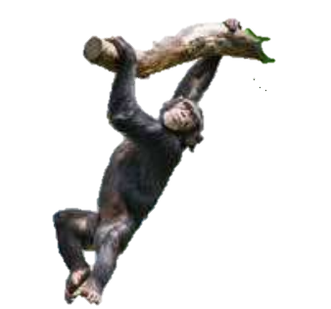
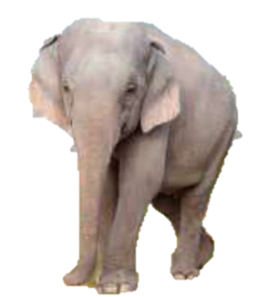

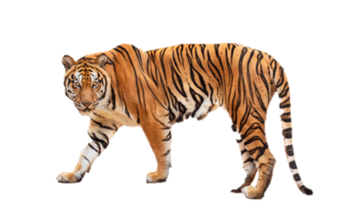
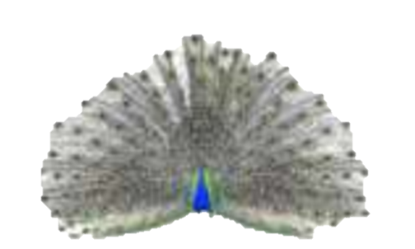
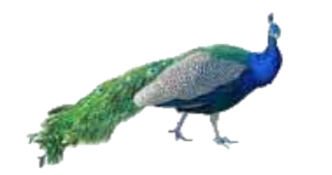

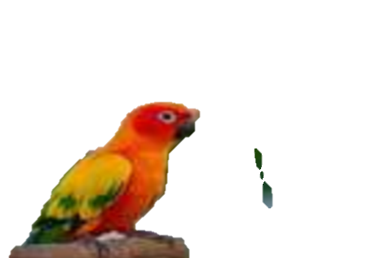

Find the differences
one, two,...
one, two,...

Slide 32
Find the differences
one, two,...
one, two,...

Slide 33
Find the differences
one, two,...
one, two,...

Slide 34
Find the differences
one, two,...
one, two,...

Slide 35
Find the differences
one, two,...
one, two,...

Slide 36

Website: hoclieu.vn
Fanpage: https://www.facebook.com/tienganhglobalsuccess.vn/

