Slide 1




Slide 2







9
Colours
LESSON 3
Period 6

Slide 3
01
Warm-up and review

Slide 4










Look and say the colours.
The fastest gets 2 points.
yellow
black
pink
brown
blue
green
white
orange

Slide 5




= 1 point
= - 2 points
= 5 points

Slide 6










TEAM 1
TEAM 2
TEAM 3
Notes:
Divide the class into three teams.
Each team takes turn choosing a number. Then answers the questions.
Calculate the points by the number of flowers on each questions.

Slide 7

What colour are they?
They’re red.
Notes:
- Click the house to go back.

Slide 8

What colour is it?
It’s yellow.
Notes:
- Click the house to go back.

Slide 9

What colour are they?
They’re blue.
Notes:
- Click the house to go back.

Slide 10

What colour is it?
It’s green.
Notes:
- Click the house to go back.

Slide 11

What colour are they?
They’re purple.
Notes:
- Click the house to go back.

Slide 12

What colour are they?
They’re pink.
Notes:
- Click the house to go back.

Slide 13

What colour is it?
It’s brown.
Notes:
- Click the house to go back.

Slide 14
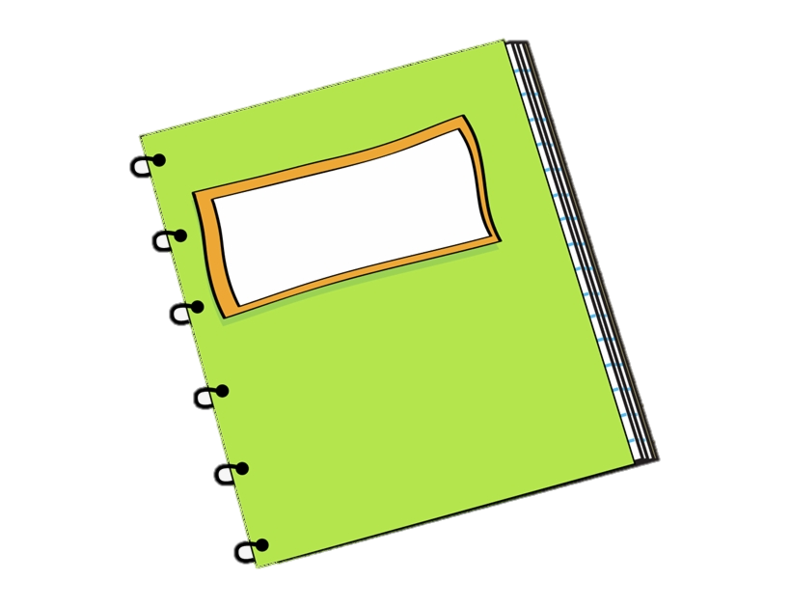
What colour are they?
They’re green.
Notes:
- Click the house to go back.

Slide 15
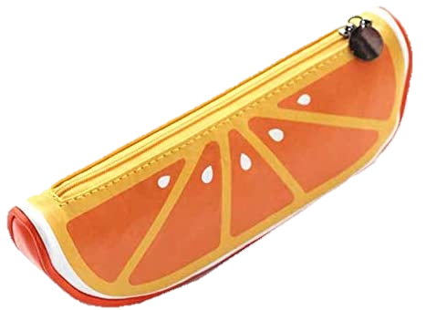
What colour is it?
It’s orange.
Notes:
- Click the house to go back.

Slide 16

Read and tick.

Slide 17
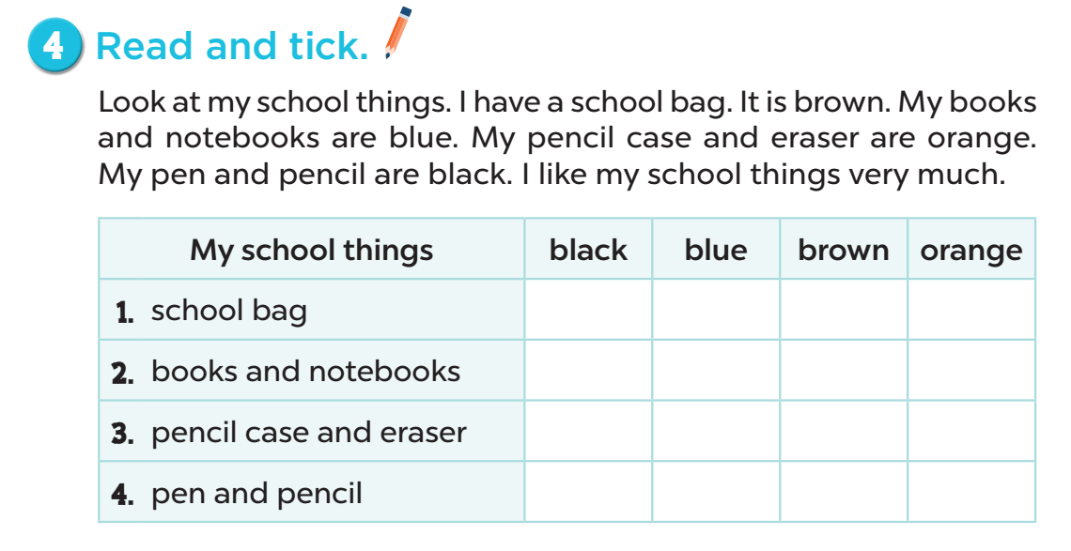
4
1
3
2

Slide 18


Slide 19

Let’s write.

Slide 20


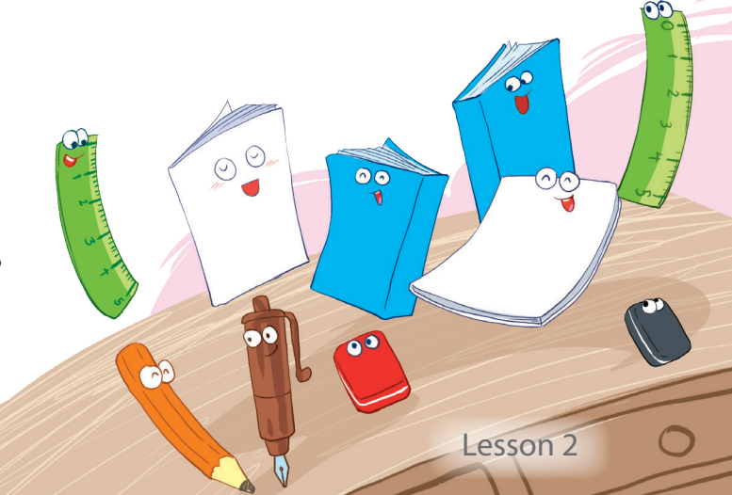

Work in pairs.
Look and make sentences.

Slide 21
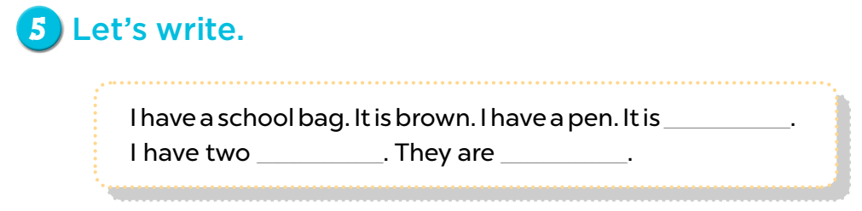

Slide 22

Project

Slide 23

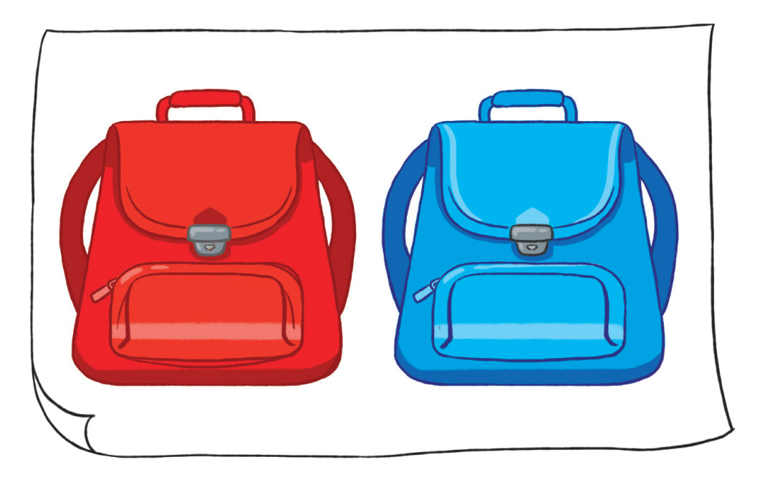

Slide 24

Fun corner and wrap-up

Slide 25
Ruler
Notebook
Pen
Eraser
Pencil
Notes:
Ask the pupils to make some labels/ word cards of the school things and put them on the real objects round the class. Invite a few pupils to read the sentences aloud and show their real objects to the class. Praise and encourage the pupils.

Slide 26

Website: sachmem.vn
Fanpage: www.facebook.com/sachmem.vn

