Slide 2
Review 4
LESSON 3
Period 3

Slide 3
Contents
1
Warm-up and review
2
Do the puzzle.
Quiz time
3
Look and match. Then talk.
4
5
Fun corner and wrap-up

Slide 4
1
Warm-up and review
Game: The magic apple

Slide 5
Start
The magic apple
Notes:
- Divide the class into 4 teams.
- Invite 1 pupil from each team to come to the front to choose the correct answer. If the answer is correct, one point for that team.
- Encourage pupils to join in the game.
- Give points to the pupils.

Slide 6
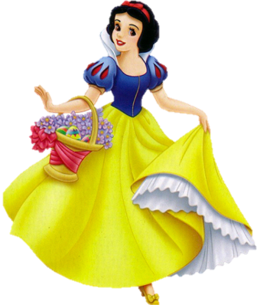
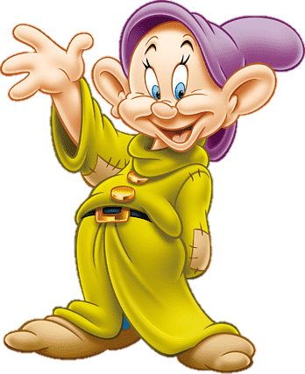
A. kite
B. car
C. bus
D. train

Slide 7
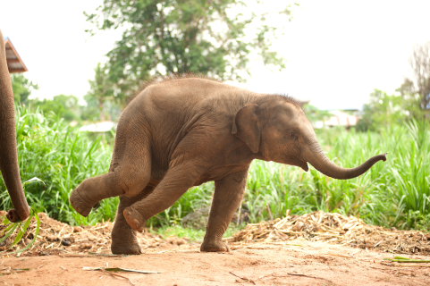
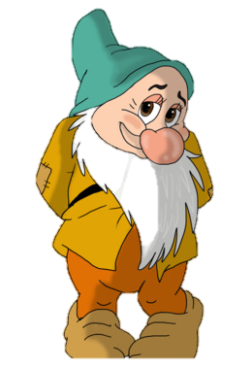
A. parrot
B. dolphin
C. elephant
D. lion

Slide 8
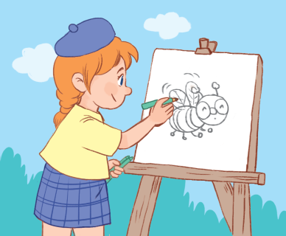
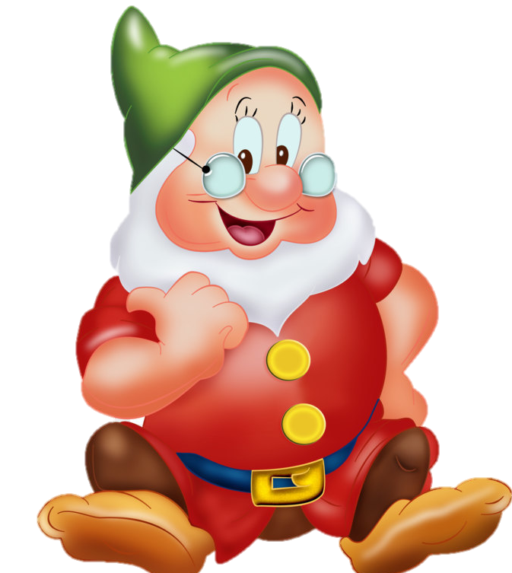
She’s ___.
A. drawing
B. cycling
C. singing
D. dancing

Slide 9
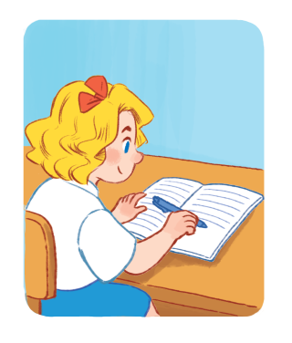
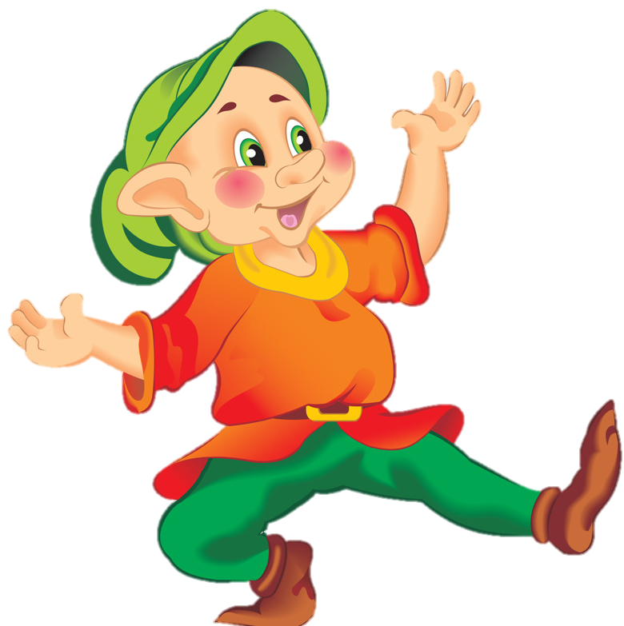
She’s ___.
A. sleeping
B. reading
C. listening
D. writing

Slide 10
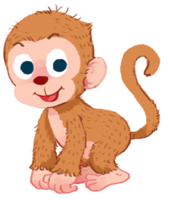
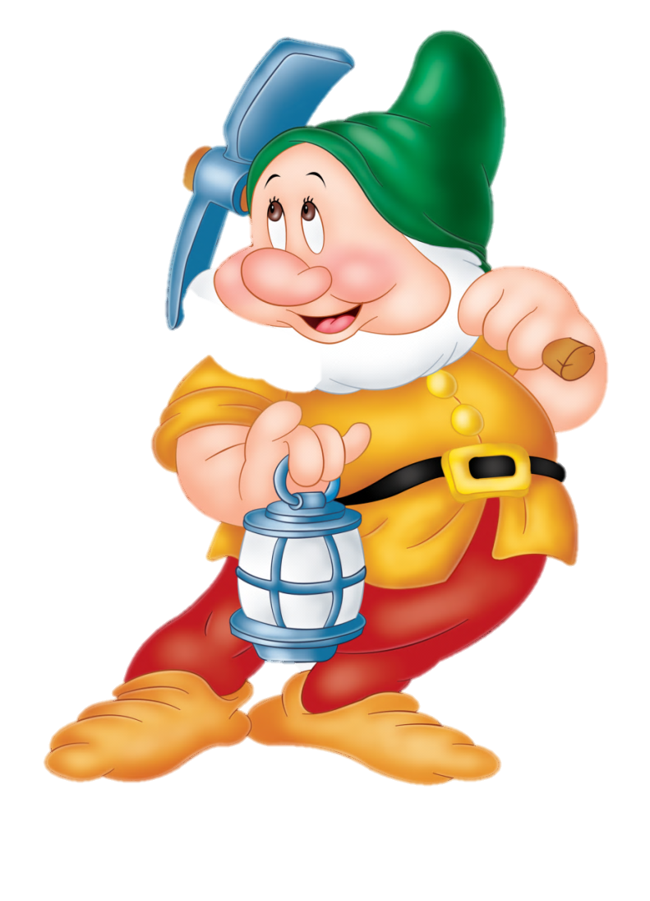
I can see a ___.
A. dog
B. elephant
C. monkey
D. rabbit

Slide 11
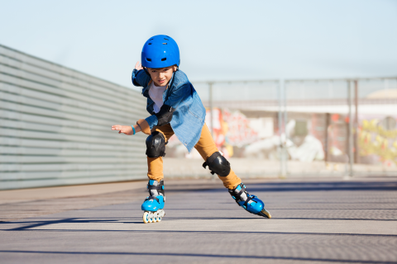
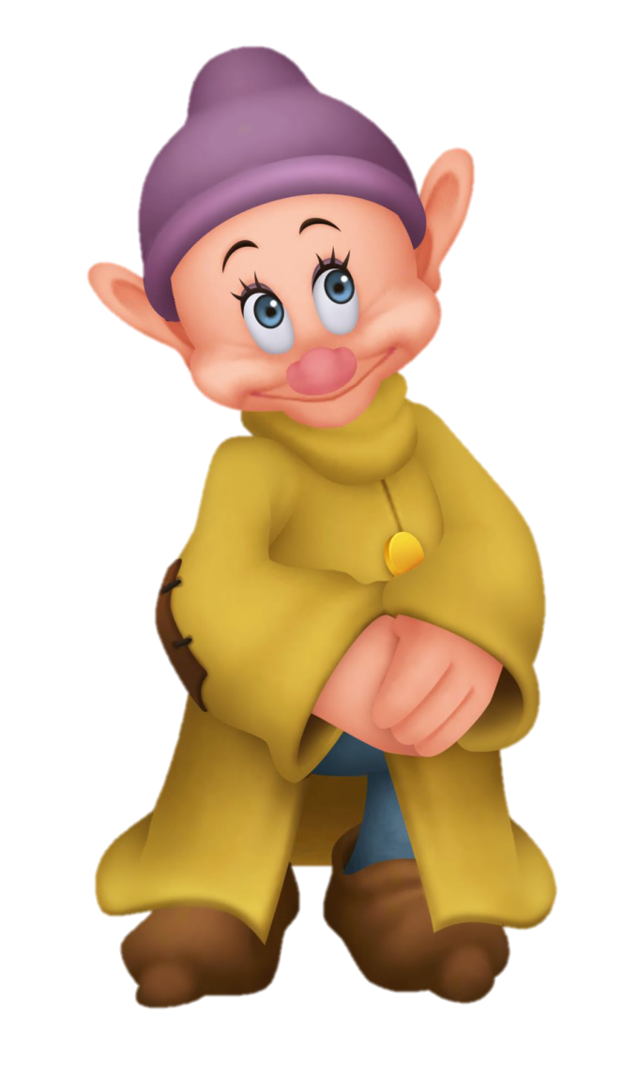
He’s ___.
A. painting
B. skating
C. skipping
D. jumping

Slide 12
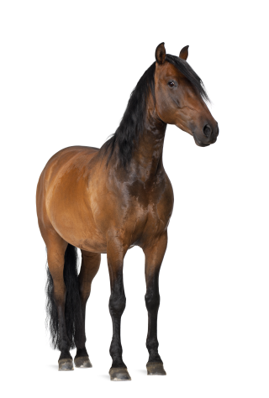
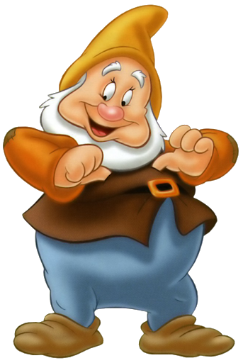
I can see a ___.
A. horse
B. monkey
C. tiger
D. cat

Slide 13
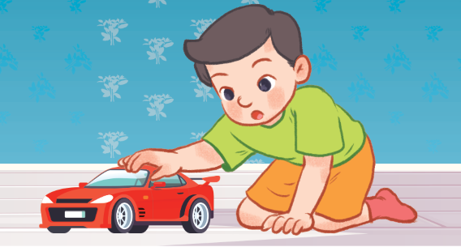
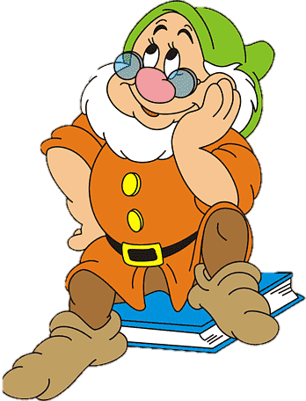
He has a ___.
A. car
B. truck
C. plane
D. train

Slide 14
2
Do the puzzle.

Slide 15
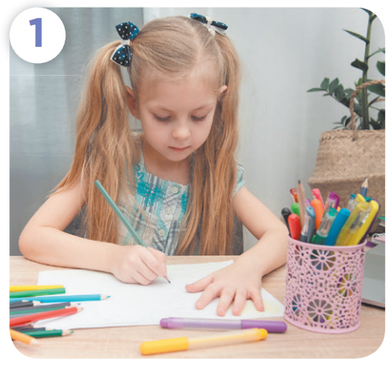
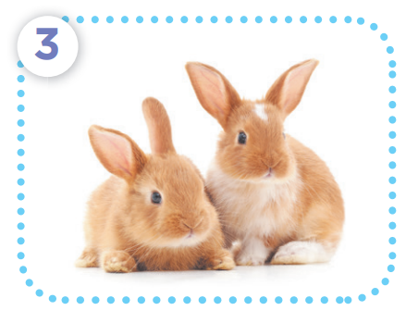
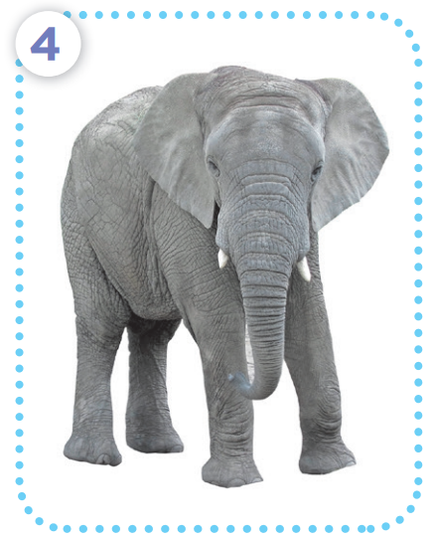
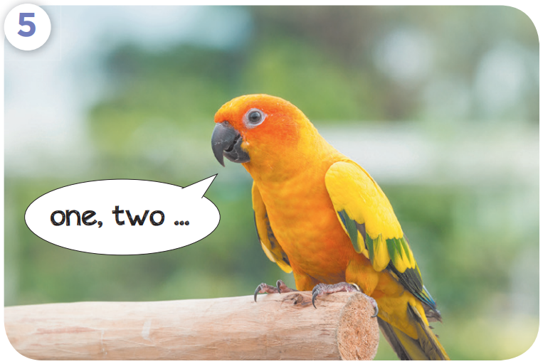

Slide 16
t r a i n
d r a w i n g
r b b t s
e l e ph a t
a r r o t

Slide 17
Welcome to the
_____________
Notes:
Step 1: Divide the class into 4 teams.
Step 2: Invite 1 pupil from each team to go to the front, read and choose the correct answer. The fastest pupil with the correct answer will have 1 point for the team.
Step 3: Encourage pupils to join in the game to practice speaking English.
Step 4: Give points for teams.

Slide 18
Super job!
PEACOCK
PIG
_____________

Slide 19
Excellent!
DUCK
PEACOCK
_____________

Slide 20
Well done!
HORSE
HARE
_____________

Slide 21
Good job!
ELEPHANT
PUPPY
_____________

Slide 22
Excellent!
PARROTS
RABBITS
_____________

Slide 23
Very good!
MONKEY
DONKEY
_____________

Slide 24
3
Quiz time

Slide 26
Survey

Slide 27
4
Look and match. Then talk.

Slide 29
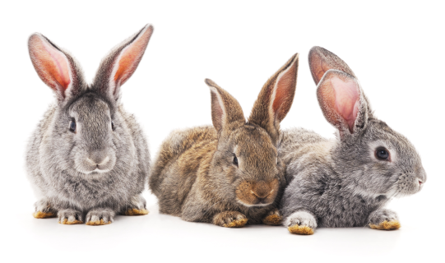
Listen and choose.

Slide 30
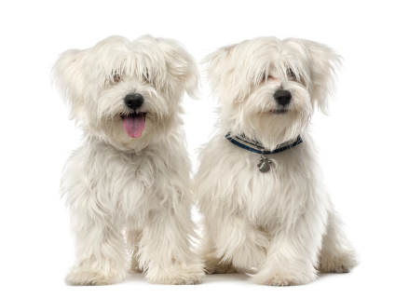
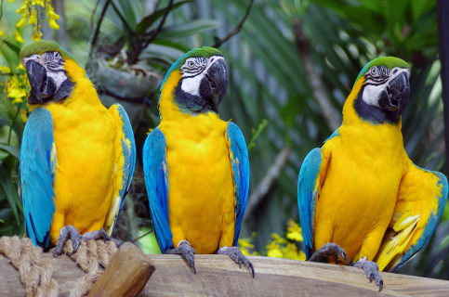
Listen and choose.

Slide 31
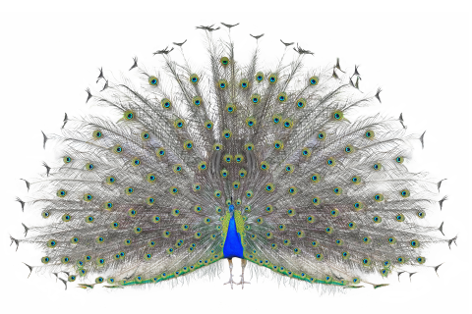
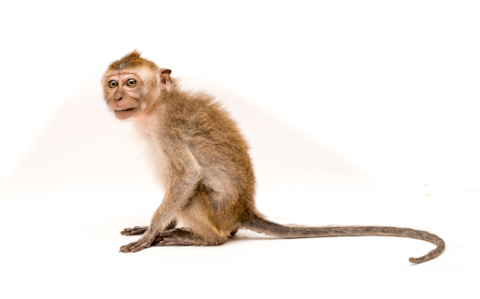
Listen and choose.

Slide 32
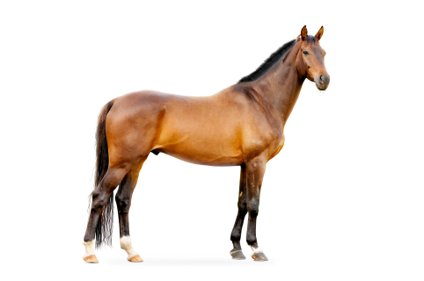
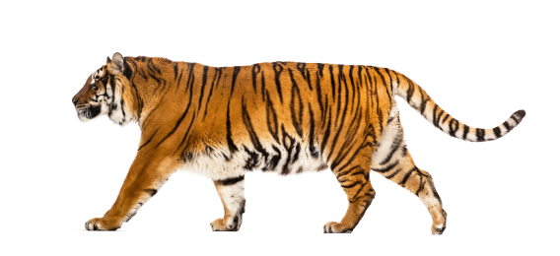
Listen and choose.

Slide 33
Listen and choose.

Slide 34
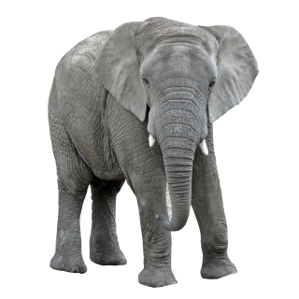
Listen and choose.

Slide 35
5
Fun corner and wrap-up

Slide 36
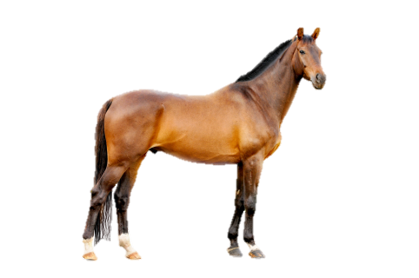
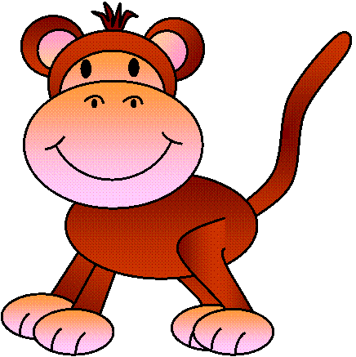
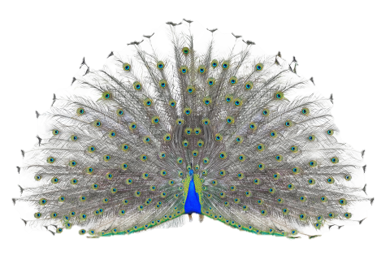
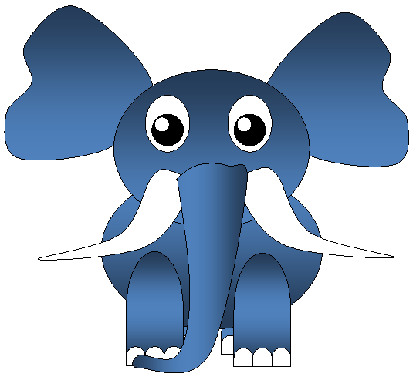
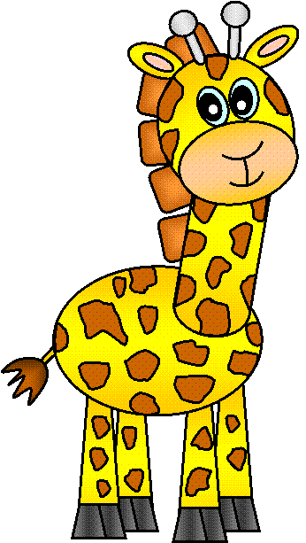
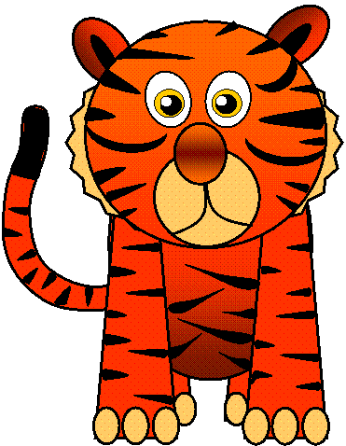
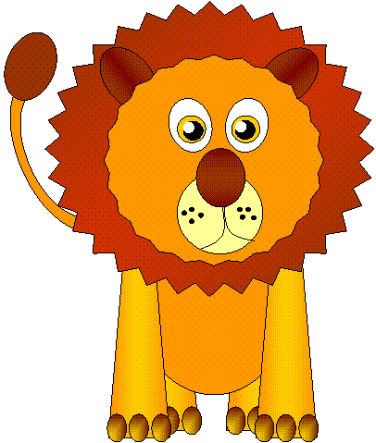
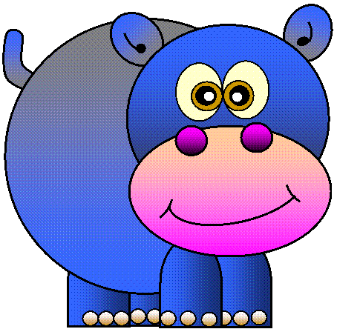
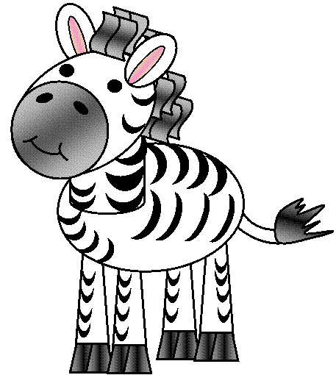
There are lots of animals in the magic forest.
Can you name them?
GO
Notes:
Step 1: Divide the class into 4 teams.
Step 2: Invite 1 pupil from each team to come to the front, read and choose a correct answer, then say aloud the word. If correct, one point for the team.
Step 3: Encourage pupils to practice speaking English.
Step 4: Give points for pupils.

Slide 37
OK
tiger
elephant
hippo
giraffe
lion
NEXT

Slide 38
OK
tiger
elephant
hippo
giraffe
zebra
NEXT

Slide 39
OK
tiger
elephant
hippo
giraffe
lion
NEXT

Slide 40
OK
tiger
elephant
hippo
giraffe
lion
NEXT

Slide 41
OK
zebra
elephant
hippo
rhino
bear
NEXT

Slide 42
OK
panda
rabbit
rhino
monkey
squirrel
NEXT

Slide 43
OK
tiger
zebra
lion
panda
monkey
NEXT

Slide 44
OK
zebra
bear
squirrel
rhino
panda
NEXT

Slide 45
OK
hippo
squirrel
rhino
bear
horse
NEXT

Slide 46
OK
rhino
bear
tiger
peacock
monkey

Slide 47
Website: hoclieu.vn
Fanpage: facebook.com/www.tienganhglobalsuccess.vn

