Slide 1
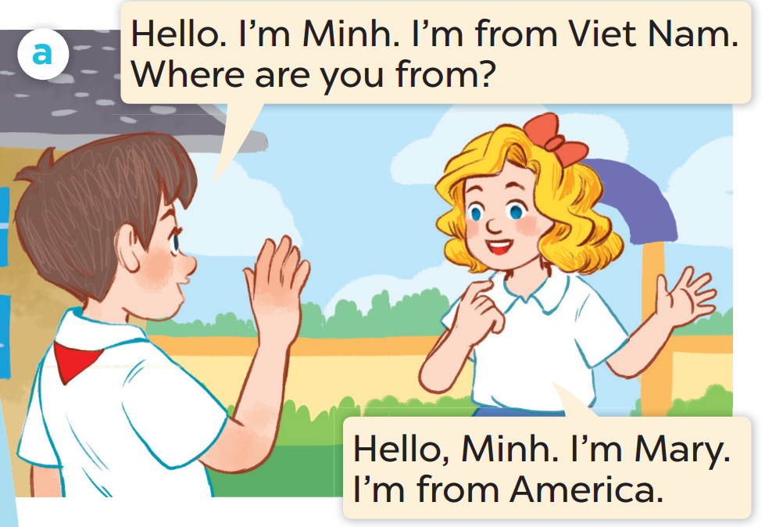
Who is the boy?
Who is the girl?

Slide 2
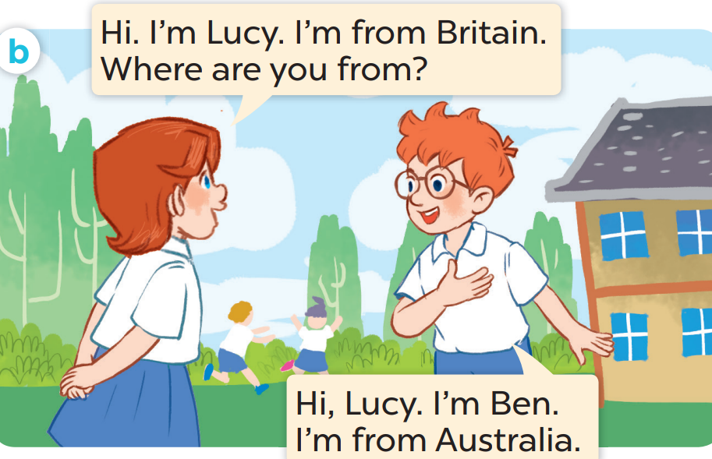
Who is the girl?
Who is the boy?

Slide 3
Listen and repeat.
Notes:
Click on the Speaker Icon to play the audio.

Slide 4
Listen and repeat.
Notes:
Click on the Speaker Icon to play the audio.

Slide 5
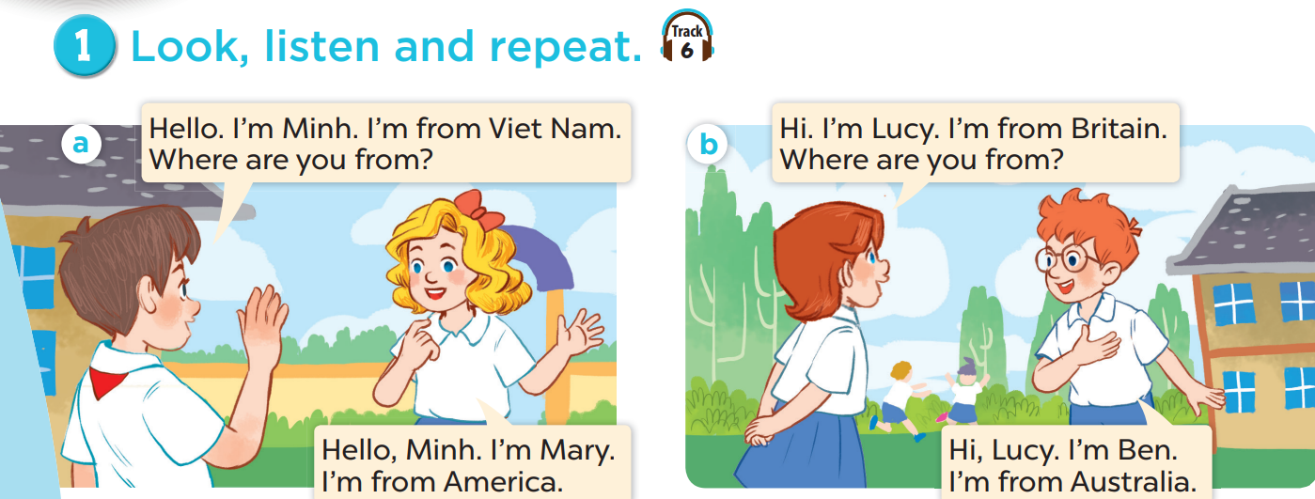
Work in pairs, practise.
Act it out.

Slide 6
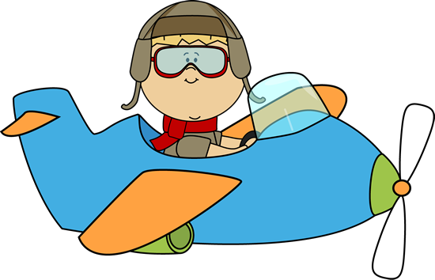
Look, guess, then learn.
Let's visit some countries with me.
Hello. I'm Ben.

Slide 8
Viet Nam

Slide 10
Britain

Slide 12
America

Slide 13
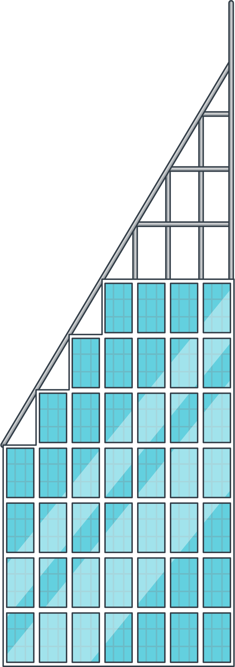

Slide 14
Australia

Slide 15
Review
Viet Nam
America
Britain
Australia

Slide 16
Viet Nam

Slide 17
America

Slide 18
Australia

Slide 19
Britain

Slide 20
Notes:
Click on the Speaker Icon to play the audio.

Slide 21
Where are you from?
I'm from America.

Slide 22
Where are you from?
I'm from Australia.

Slide 23
Where are you from?
I'm from Viet Nam.

Slide 24
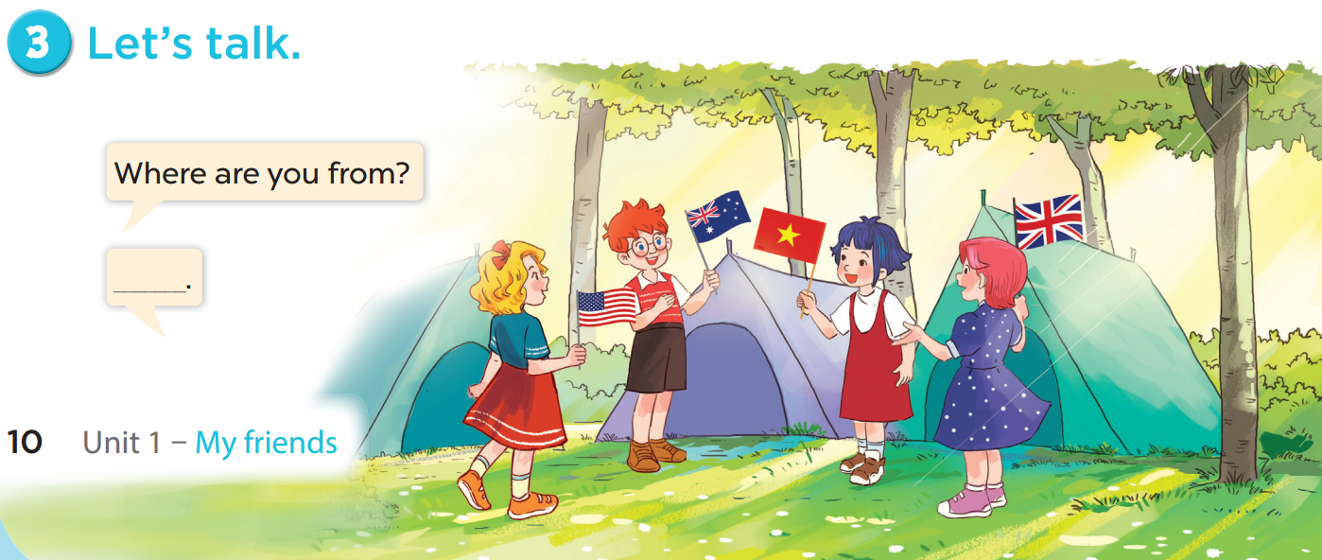

Slide 25
06
Fun time
Choose a number.
Ask, answer and have fun.

Slide 26
1
2
3
= +1 point
4
5
6
= lose 2 points
= rock, paper, scissors
(winner takes 2)
7
8
9

