Slide 1
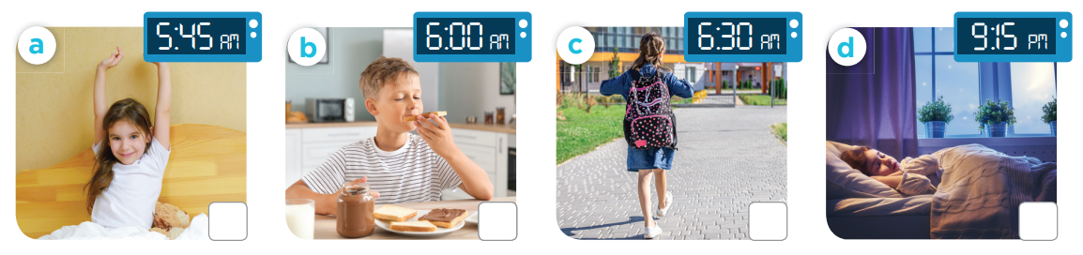
Slap the board!
Notes:
Teacher can read the action or time

Slide 2
02
Listen and number.

Slide 3
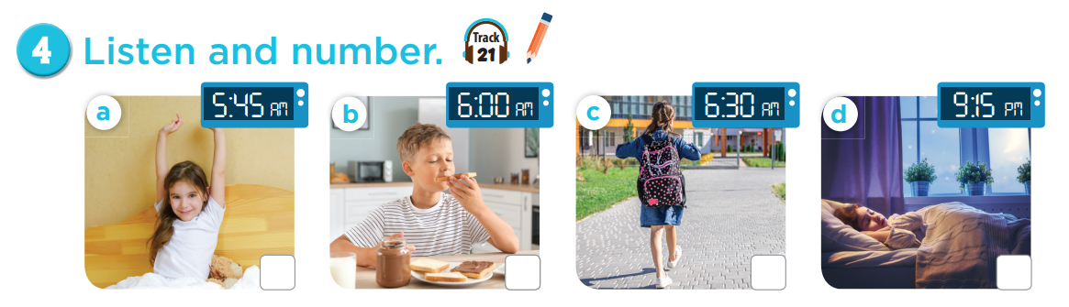

3
4
2
1

Slide 4
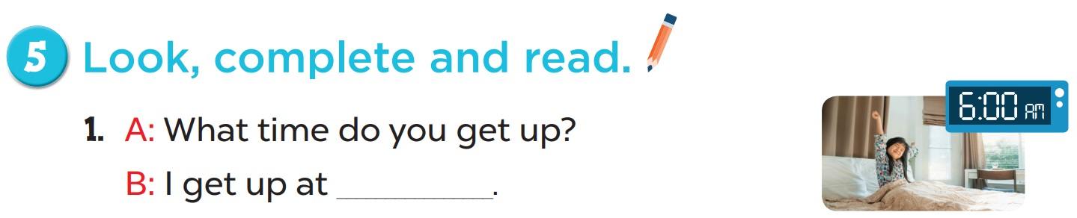
6 o’clock

Slide 5
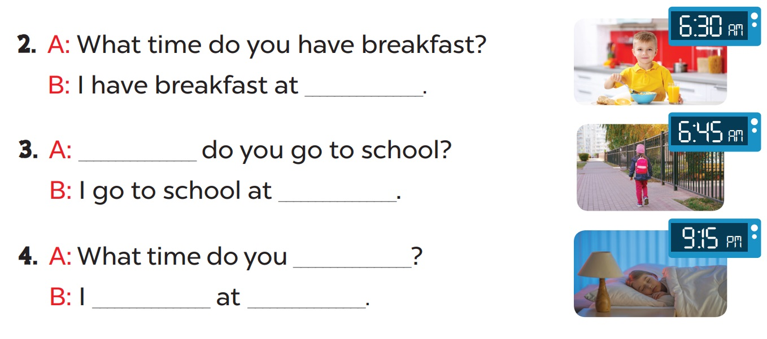
six thirty
What time
six forty-five
go to bed
go to bed
nine fifteen

Slide 6
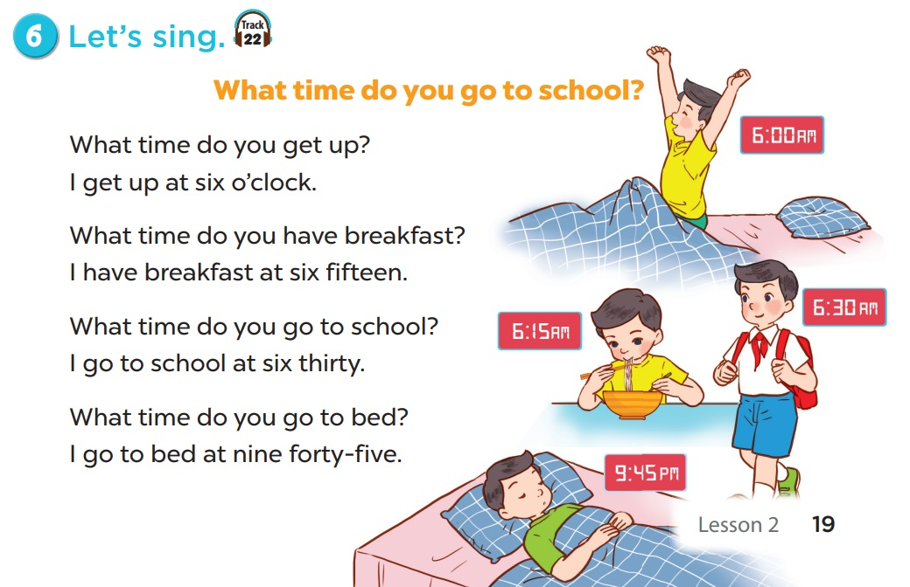

Slide 7
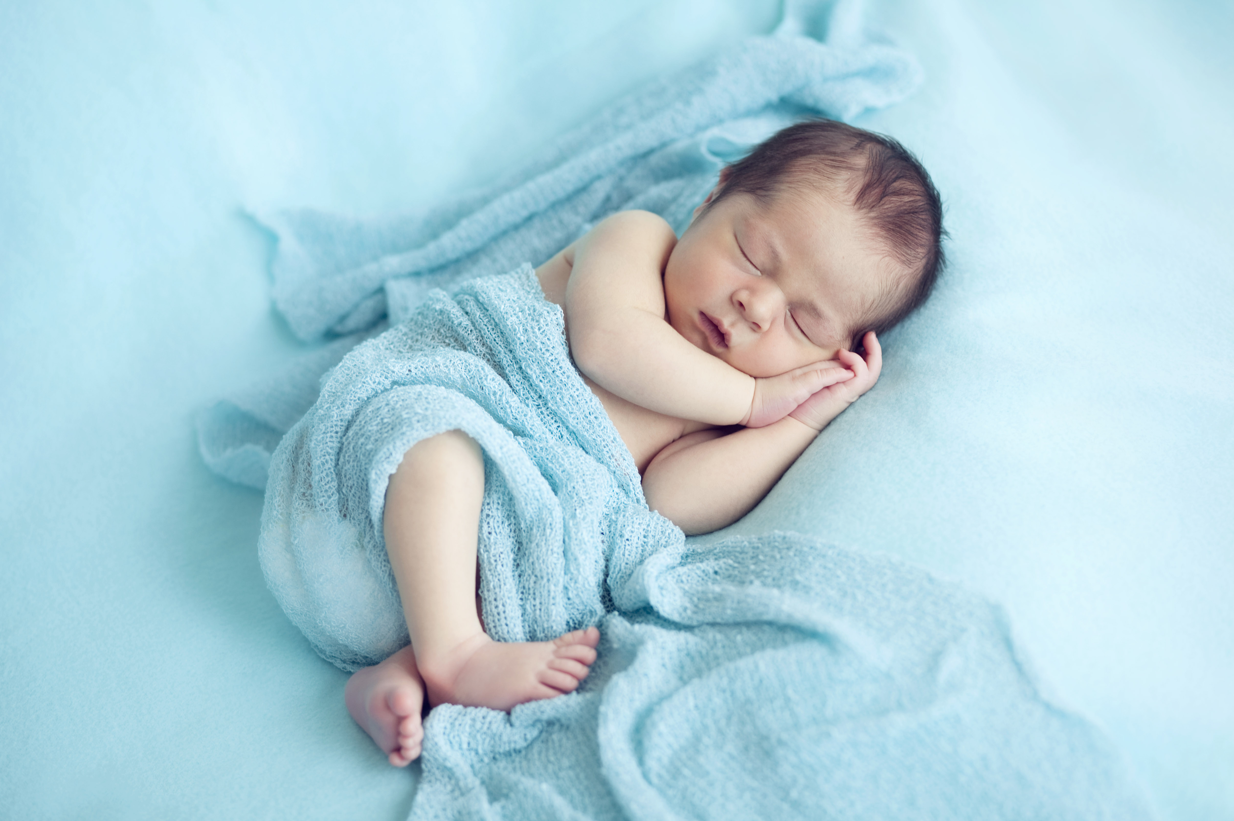

What/ bed/ go/
time/ you/ do/ to/ ?
Check
What time do you go to bed?

Slide 8
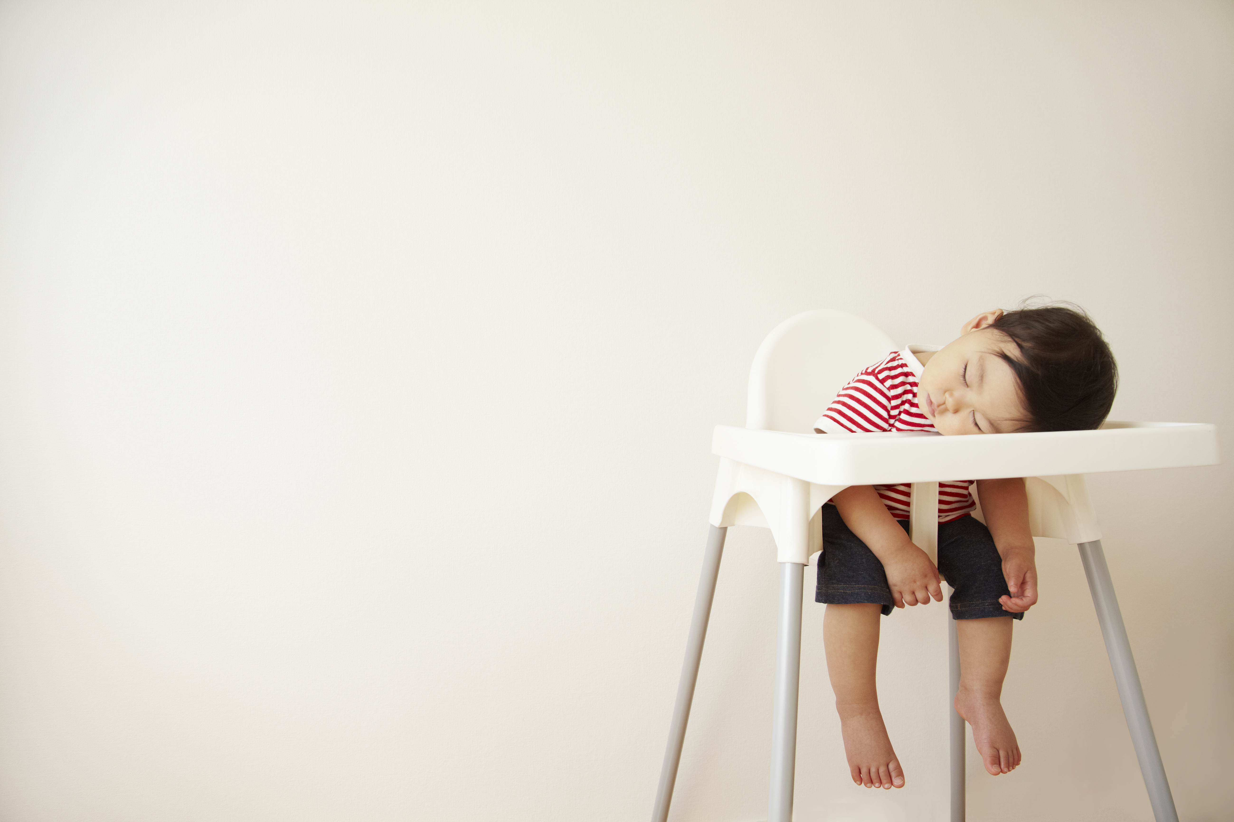
nine/ fifteen/ I/
go/ to/ at/ bed/ .
Check
I go to bed at nine fifteen.

Slide 9
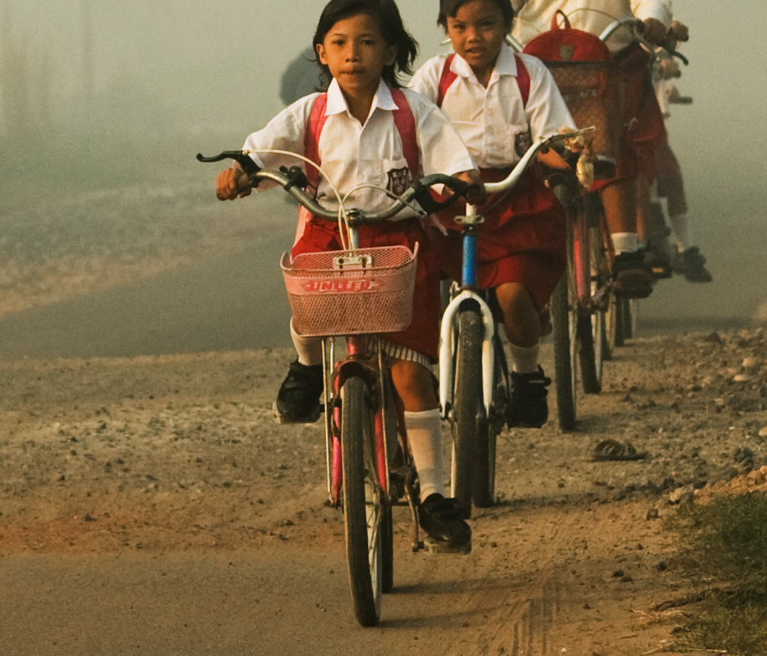
I/ six/ forty-five./
school/ to/ go/ at
Check
I go to school at six forty-five.

Slide 10
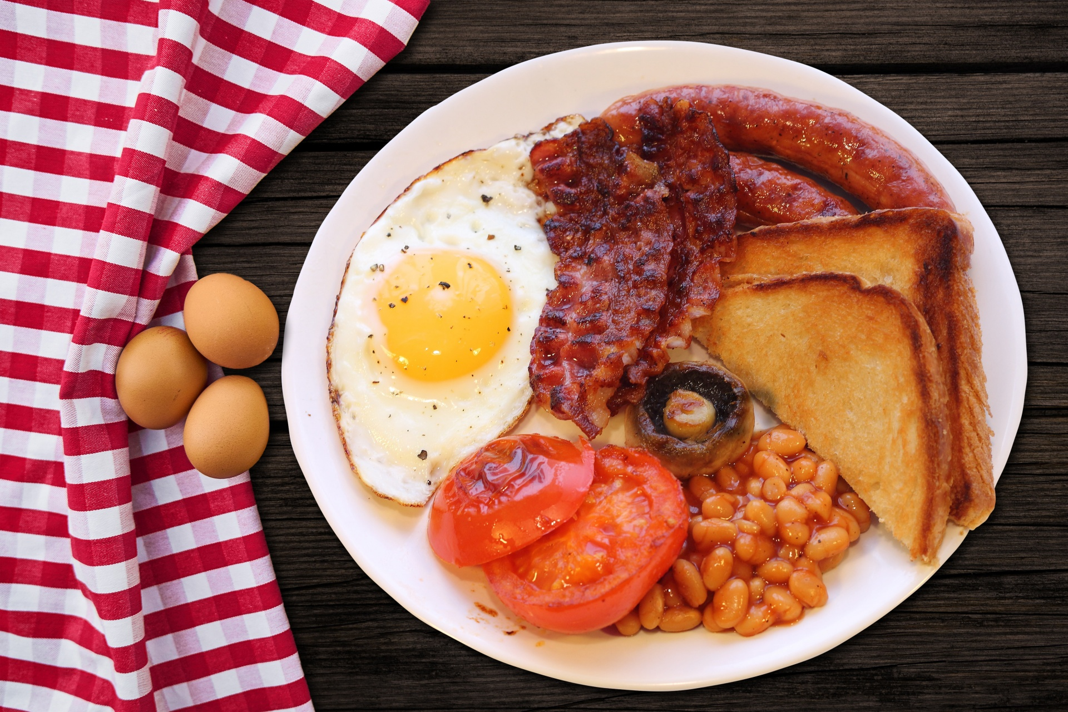
I/ breakfast/ at/
have/ six/ thirty/.
Check
I have breakfast at six thirty.

Slide 11

End

