Slide 1
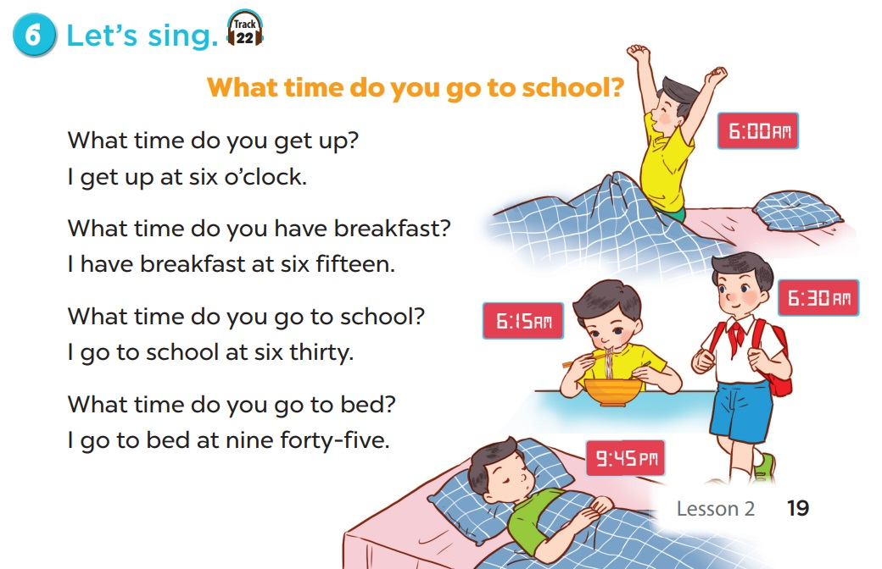

Slide 3
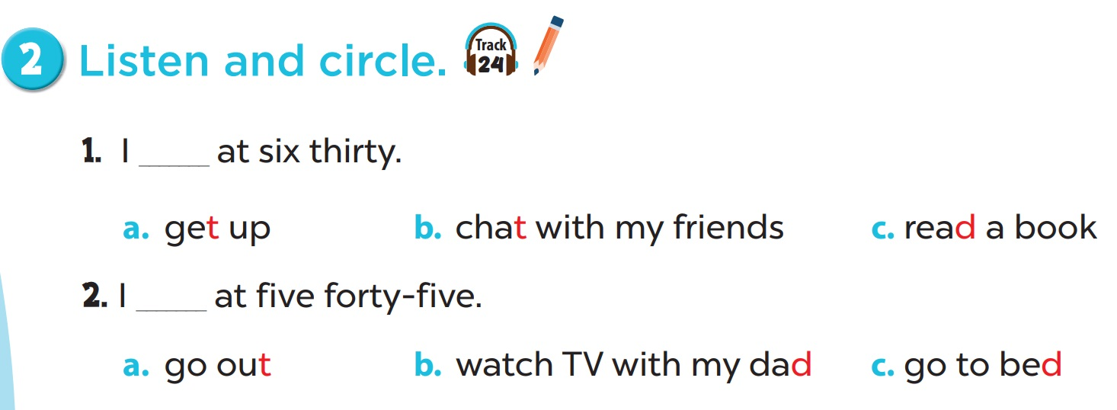

Slide 4
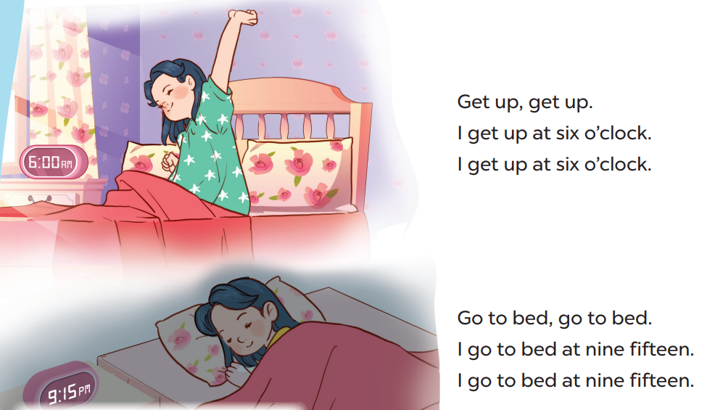

Slide 5
SPIN AND SAY
TIGER
DONKEY
TEACHER
DUCK
TUB
T
DUCK
D
DOG
GET
BED
TIGER
Click the needle to start and then again to stop the wheel. Then READ ALOUD.

