Slide 3
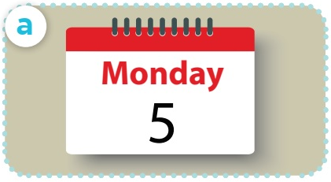
What day is it today?
It’s Monday.

Slide 4
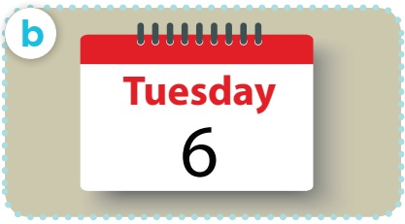
What day is it today?
It’s Tuesday.

Slide 5
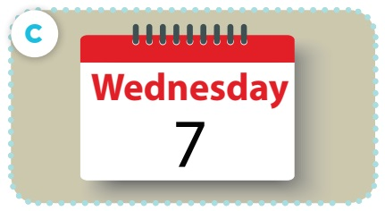
What day is it today?
It’s Wednesday.

Slide 6
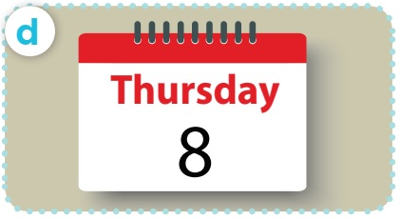
What day is it today?
It’s Thursday.

Slide 7
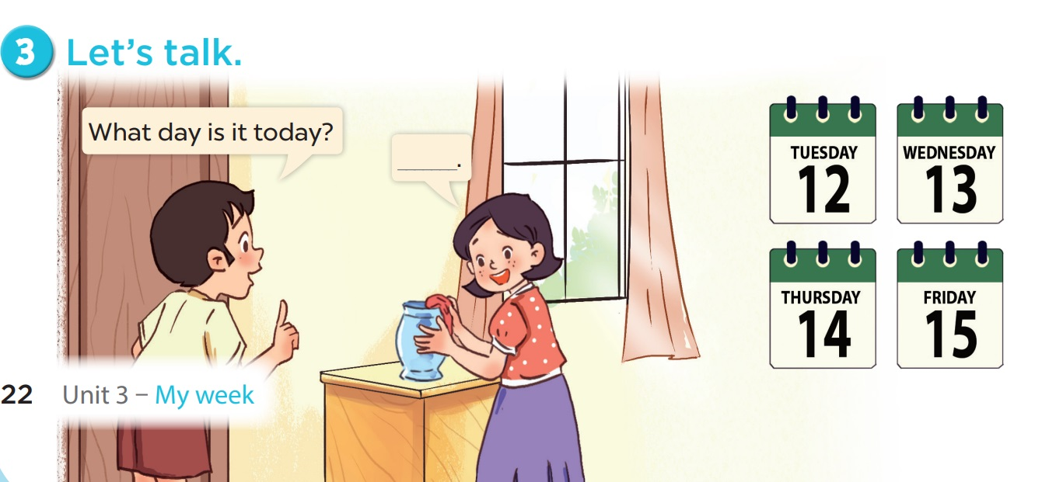

Slide 8
QUESTION 1:
FIND THE THE MISSING LETTER.
TU_SDAY
E
Notes:
Repeat the question when the letter blinks
Key: TUESDAY

Slide 9
QUESTION 2:
The 3 letters stand next to each other in all days of the week.
DAY
Notes:
DAY

Slide 10
QUESTION 3:
How many days are there except the weekend?
5
Notes:
5

Slide 11
QUESTION 4:
The day you have English lessons
Notes:
Pupils’ answer

Slide 12
QUESTION 5:
The day you can get up late
Notes:
Pupils answer.
It can be anyday when you don’t go to school/ don’t have to get up early.

Slide 13
QUESTION 6:
The days have the letter ‘s’
5 days
What are they?
Tuesday, Wednesday, Thursday, Saturday, Sunday

Slide 14
QUESTION 7:
The day with more letters than any days in a week
Wednesday
Notes:
WEDNESDAY

