Slide 1
What day is it today?
It’s Monday.

Slide 2
What day is it today?
Tuesday
Wednesday
Monday
Friday
Thursday
Saturday
Sunday
Notes:
quick Q-A

Slide 3
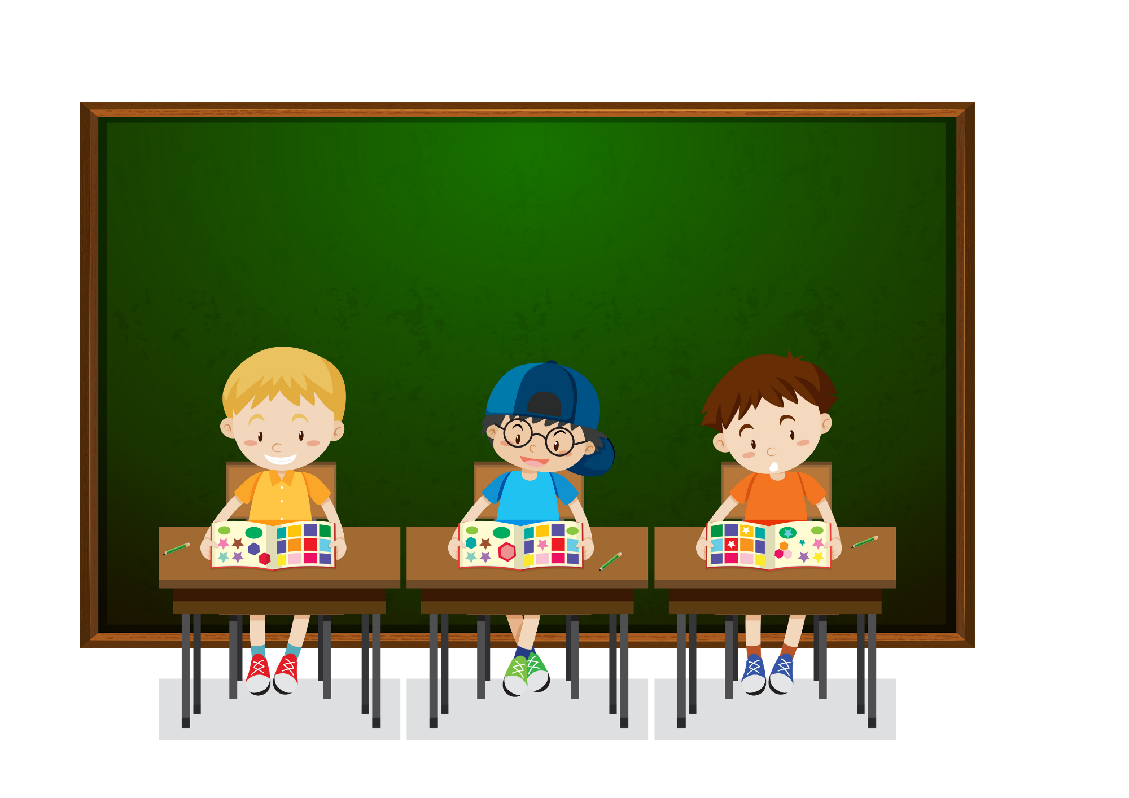
WHAT DO YOU DO ON MONDAYS?
I STUDY AT SCHOOL.

Slide 4
Let’s sing together!

Slide 6
03
Activity 2 Listen and circle.

Slide 7
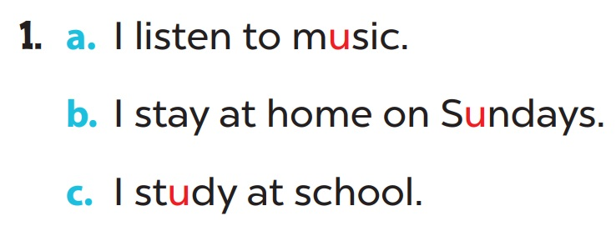

Slide 8
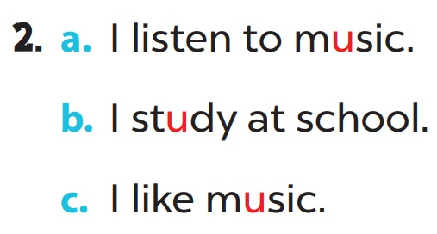

Slide 9
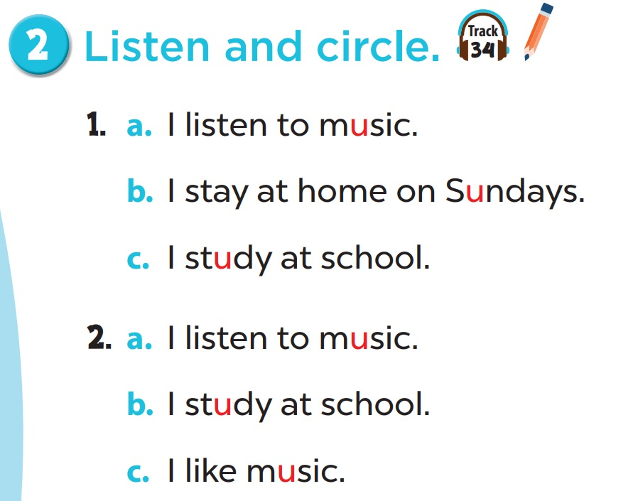

Slide 10
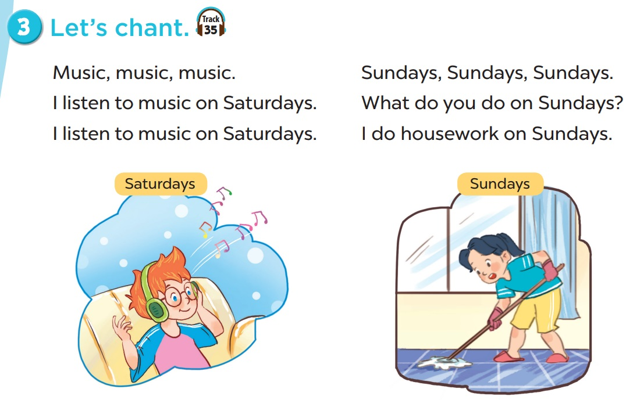

Slide 11
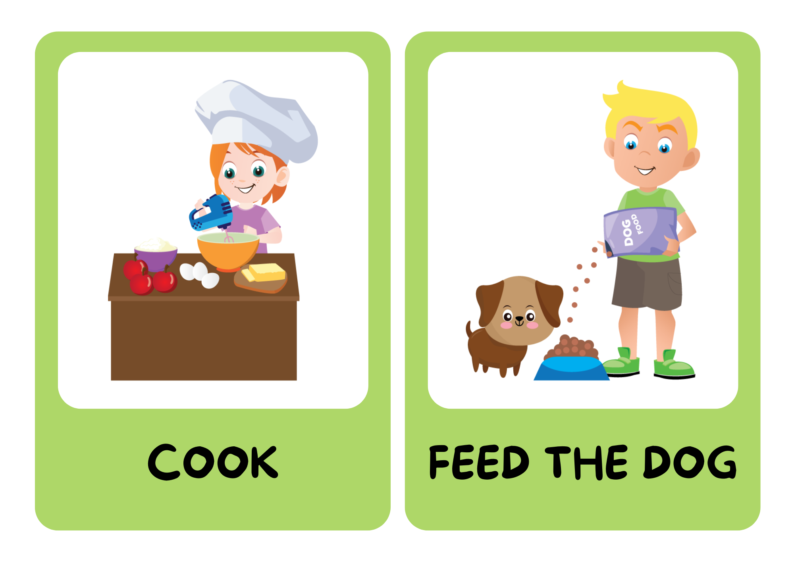
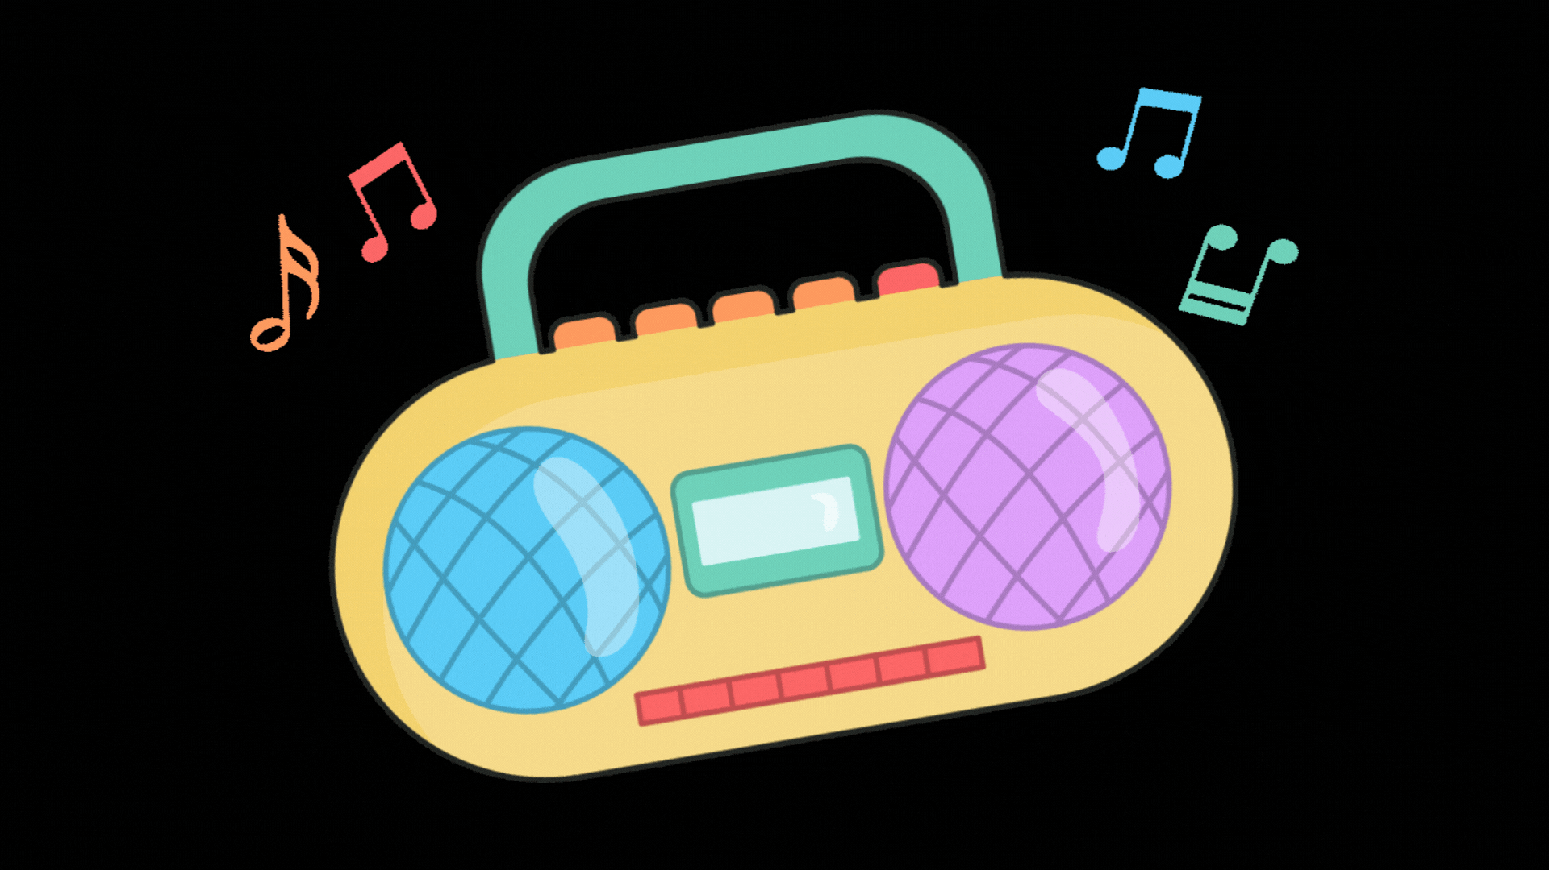
Be a chant composer!

Slide 12
BE A CHANT COMPOSER!
Music, music, music. I listen to music on Thursdays.
Notes:
look at the pictures
say out loud
combine pictures to make a new chant

Slide 13
Fridays, Fridays, Fridays. What do you do on Fridays? I do housework on Fridays.

Slide 14
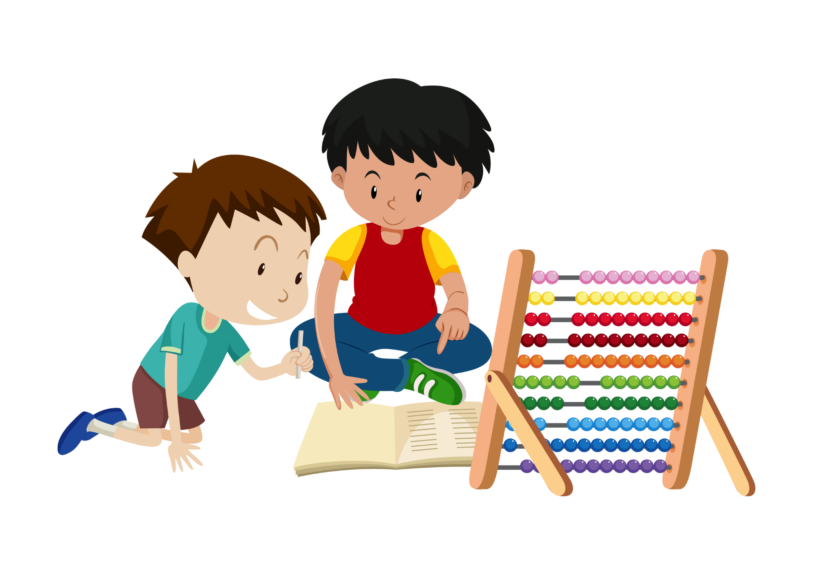
Mondays, Mondays, Mondays. What do you do on Mondays? I do homework on Mondays.

