Slide 2
03
Activity 2
Listen and circle.

Slide 5
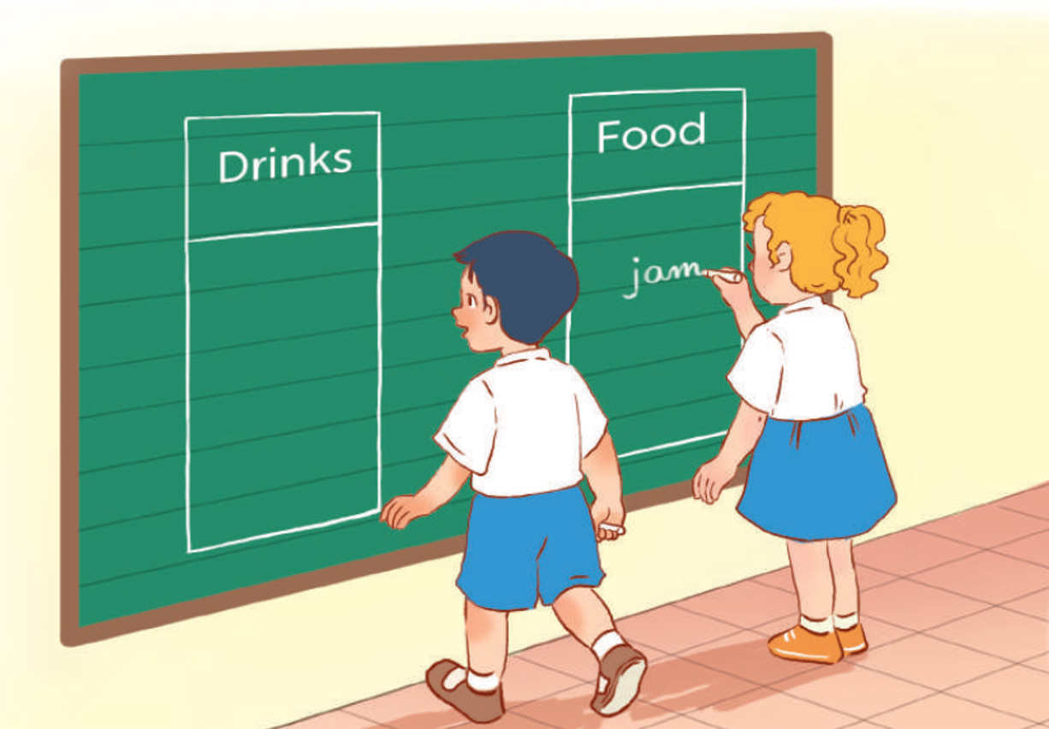
Board Race
w
j

Slide 6
04
Activity 3
Let’s chant.

Slide 7
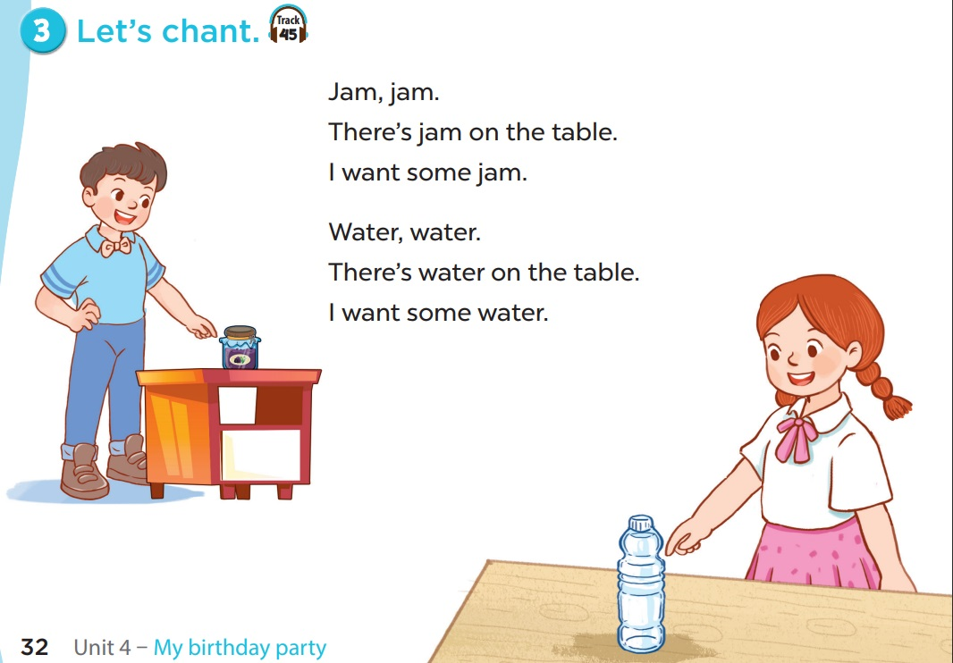

Slide 8
Minions Game

Slide 10
= points
Mystery Power up
Minions english game

Slide 11
What do you want to eat?
I want some jam.

Slide 13
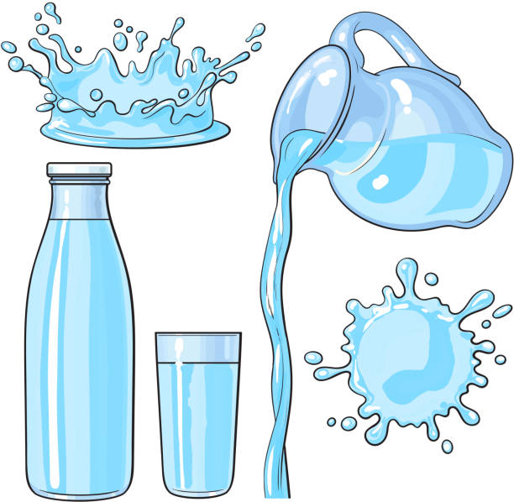
What do you want to drink?
I want some water.

Slide 15
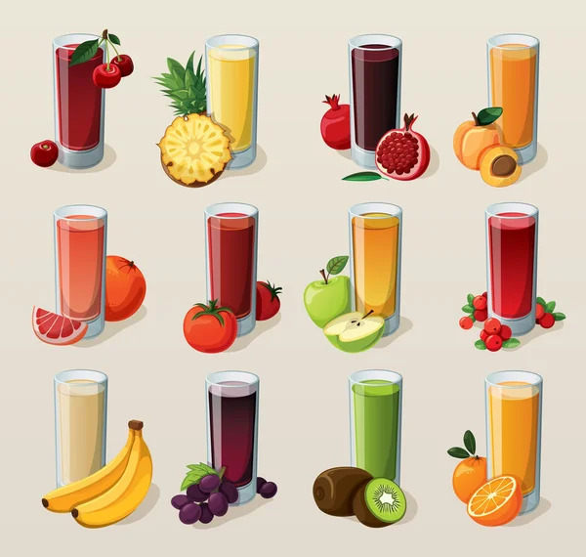
What do you want to drink?
I want some juice.

Slide 17
Listen and repeat.
I want some water.

Slide 19
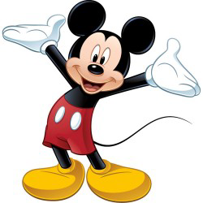
_ater
w

Slide 21
Special slide 1
Gain bananas

