Slide 2
Notes:
Step 1: Draw pupils’ attention to the letter y, the word yes and the sentence Can you draw? – Yes, I can.
Play the recording and encourage pupils to point to the letter / word / sentence while listening.
Step 2: Play the recording again for pupils to listen and repeat. Do this several times until
pupils feel confident. Correct their pronunciation where necessary and praise them if their
pronunciation is good.
Step 3: Repeat Steps 1 and 2 for the letter n.

Slide 3
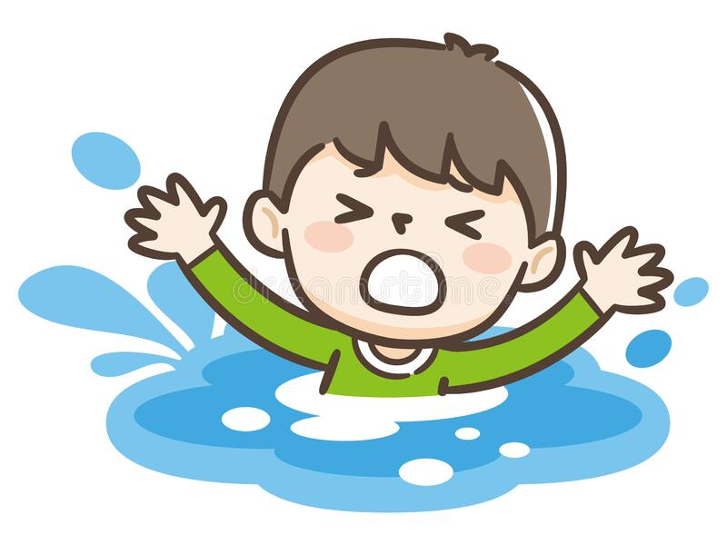
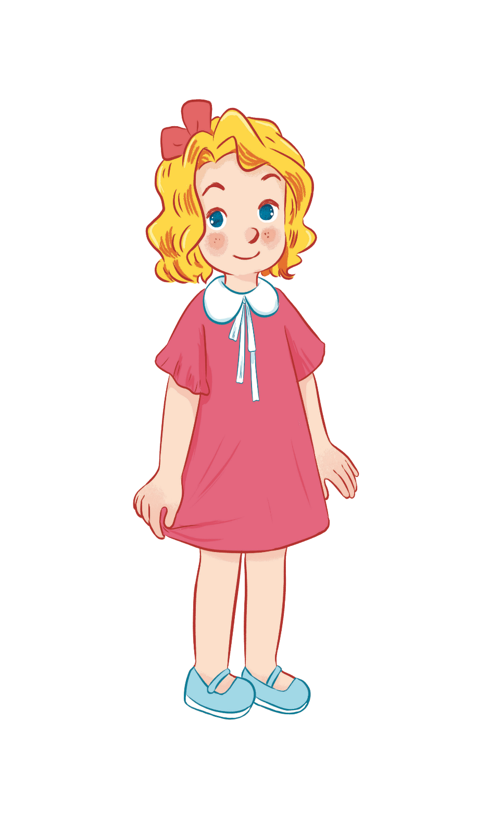
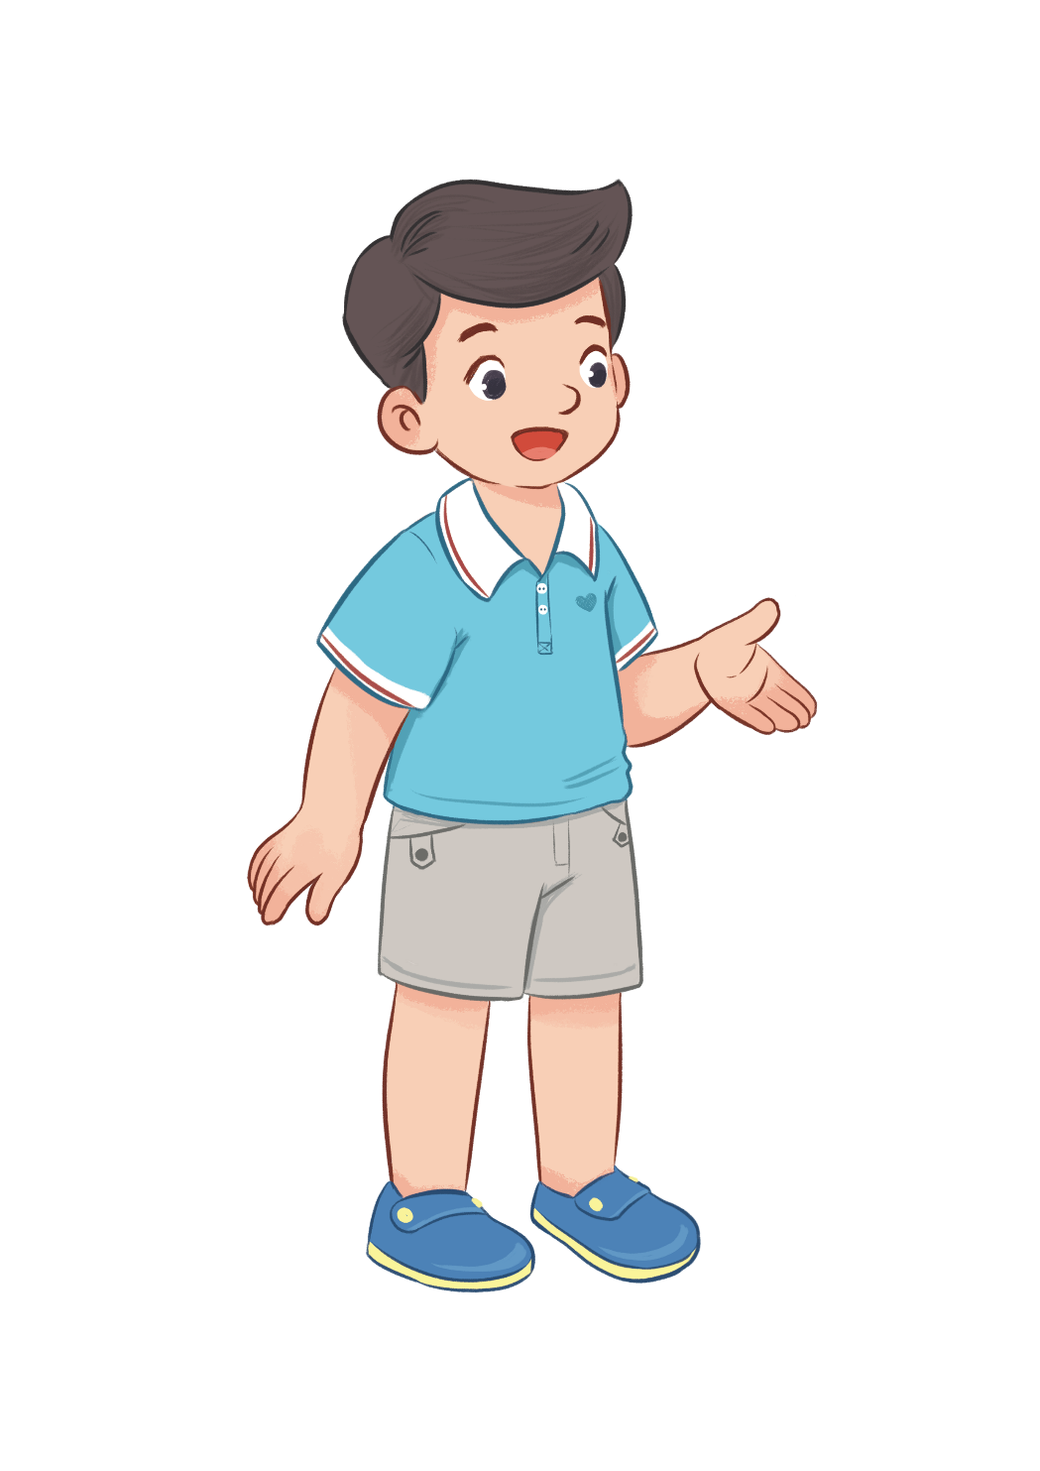
Can he swim?
No, he can’t.
Yes, he can.

Slide 4
Can they draw?
Yes, they can.
No, they can’t.

Slide 6
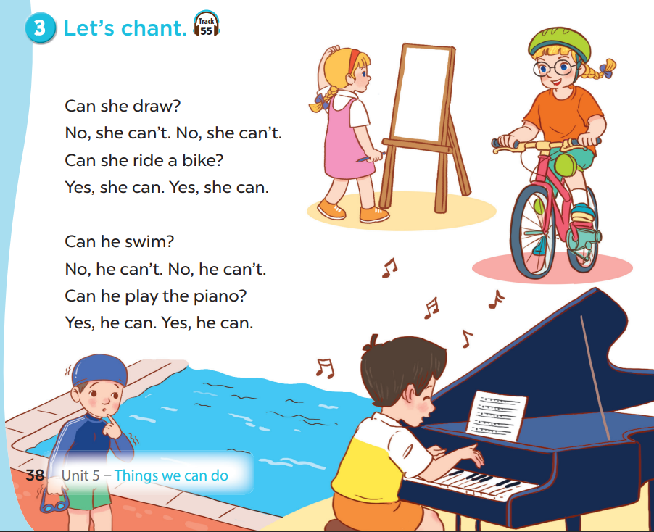

Slide 7
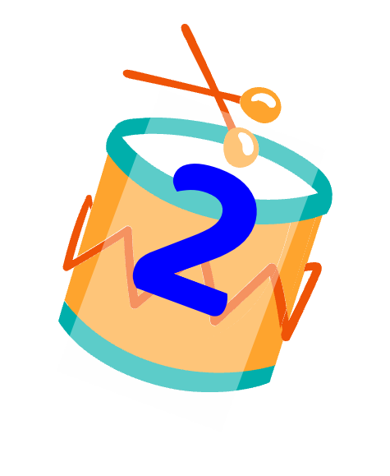
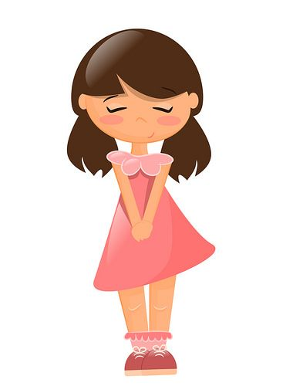
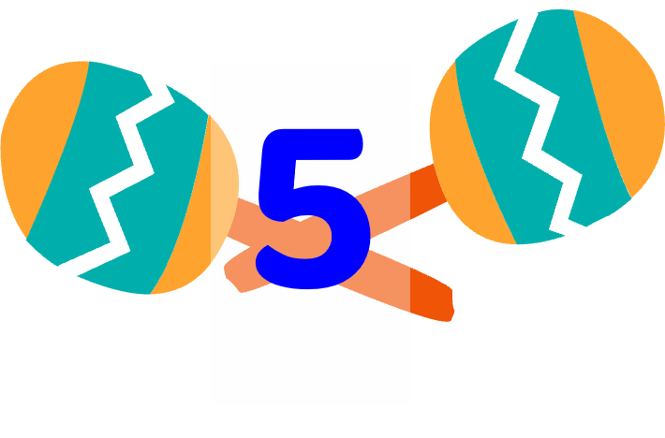
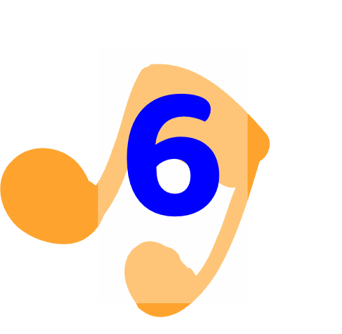
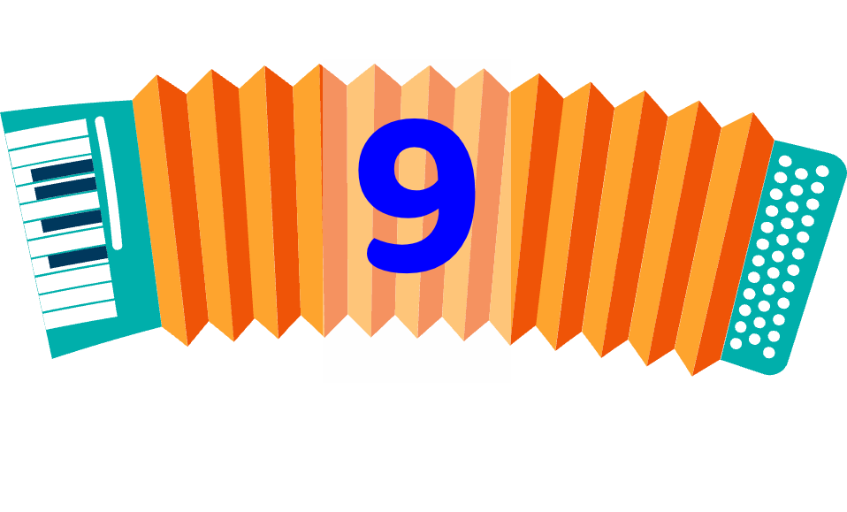
Notes:
Choose a number.
Read the quiz and say the answer.
Get points when balloon flies away.

Slide 8
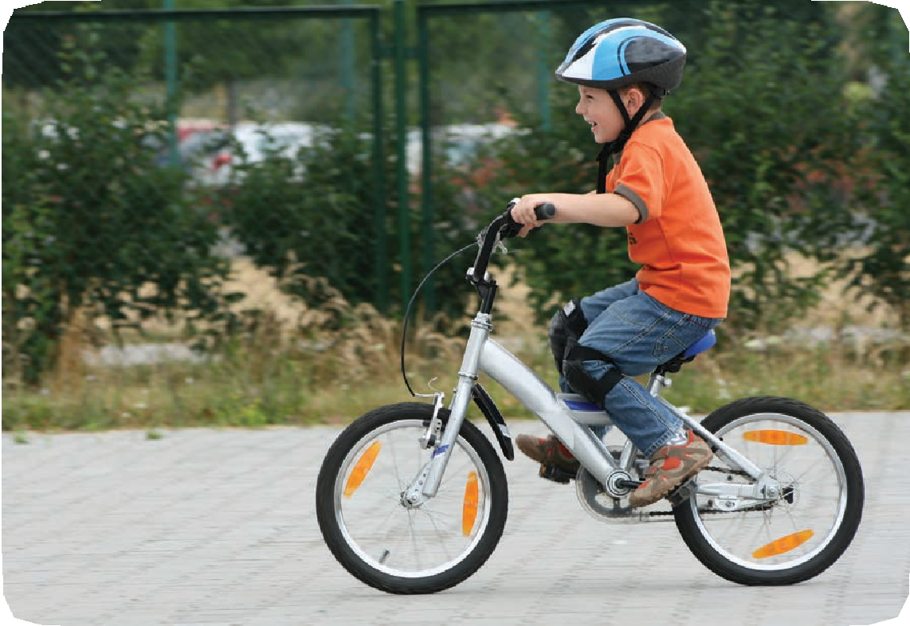
Can he ride a bike?
Yes, he can.

Slide 9
+ 5 POINTS

Slide 10
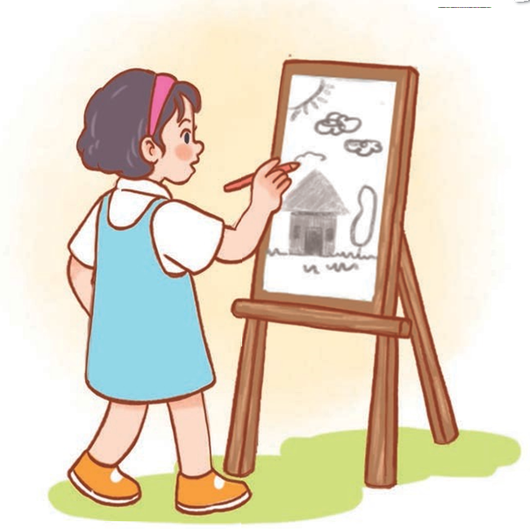
Can she draw?
Yes, she can.

Slide 11
- 2 POINTS

Slide 12
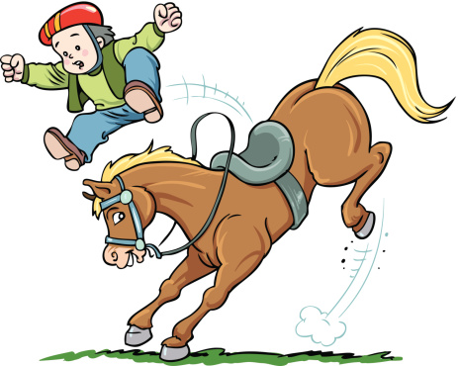
Can he ride a horse?
No, he can’t.

Slide 13
+ 3 POINTS

Slide 14
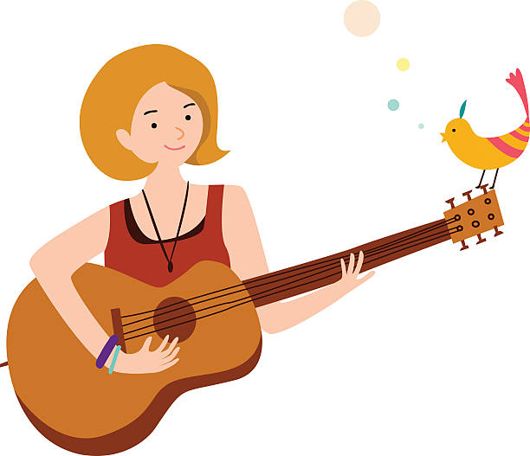
Can she play the guitar?
Yes, she can.

Slide 15
GIVE 3 POINTS

Slide 16
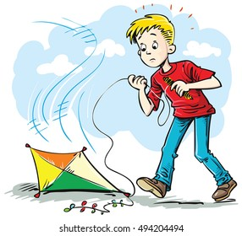
Can he fly a kite?
A. Yes, he can.
B. No, he can.
C. No, he can’t.

Slide 17
- 5 POINTS

Slide 18
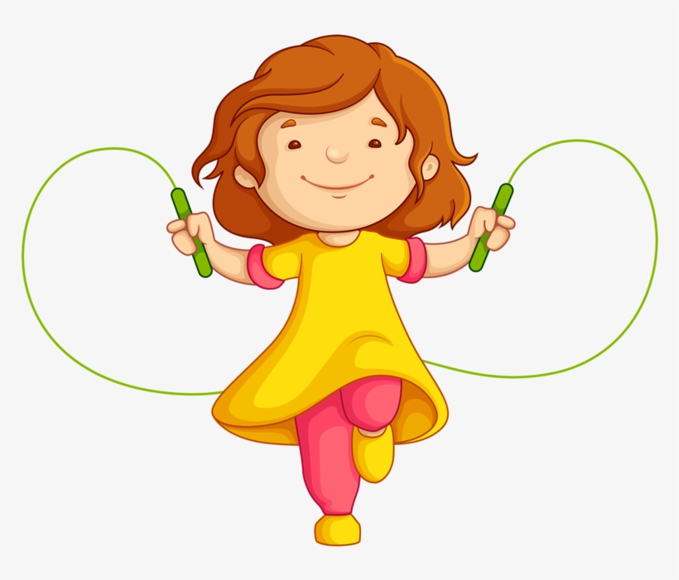
Can she skip?
A. Yes, she can’t.
B. Yes, she can.
C. No, she can’t.

Slide 19
+ 10 POINTS

Slide 20
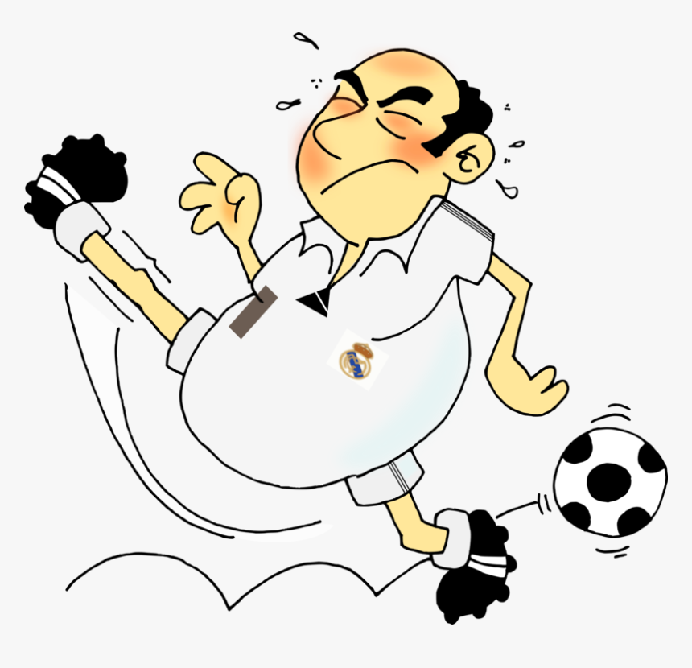
Can your father
play football?
A. No, he can’t.
B. No, he can.
C. Yes, he can.

Slide 21
STEAL 5 POINTS

Slide 22
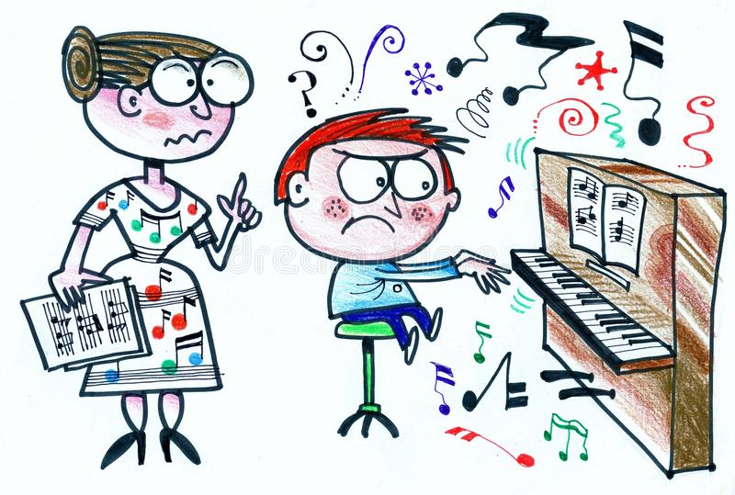
Can he play the piano?
No
…………, he can’t.

Slide 23
DOUBLE POINTS

Slide 24
Can your mother cook?
Yes
…………, she can.

Slide 25
+ 1 POINTS

Slide 26
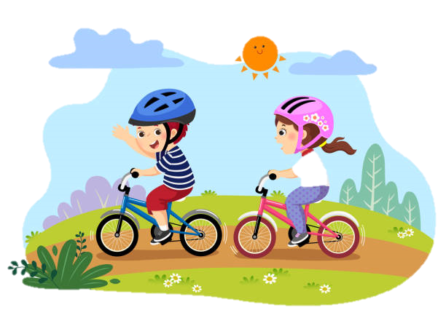
Can they ride a bike?
Yes
…………, they can.

Slide 27
- 5 POINTS

