Slide 2
Let’s read.

Slide 3
village
three
garden
playground

Slide 5
big/ small
My school is ___.
in the city/ village/ town/ mountains

Slide 6
There are (1) ___ (2) ____.
1. two/ three/ four
2. buildings/ computer rooms

Slide 7
There is (1)___ (2) ____.
1. a big/ small
2. garden

Slide 8
We can play _____ there.
football
badminton
volleyball
basketball

Slide 9
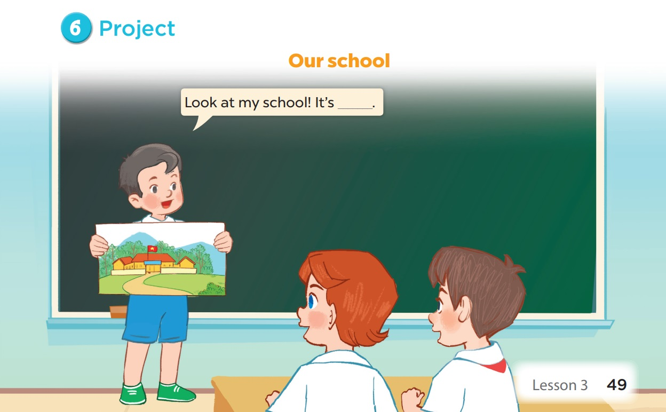

Slide 10
05
Game

Slide 11
LUCKY CHICKEN
Next Activity

Slide 12
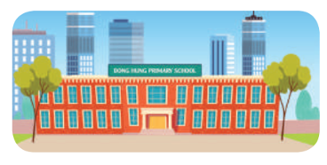
Where’s your school?
It’s in the city.

Slide 13
There are two ____ at my school.
A. building B. buildings
B. buildings

Slide 14
_____ one garden at my school.
A. There is B. There are
A. There is

Slide 15
We can play sports in the ___.
A. garden B. playground
B. playground

Slide 16
How many computer rooms _____?
A. are there B. there are
A. are there

Slide 17
Where’s your school?
It’s in the ___.

Slide 18
Lucky chicken

Slide 19
Lucky chicken

Slide 20
Lucky chicken

Slide 21
THANK YOU
Website: hoclieu.vn
Fanpage: facebook.com/www.tienganhglobalsucces.vn
Website: sachmem.vn; hoclieu.vn
Fanpage: www.facebook.com/sachmem.vn

