Slide 1
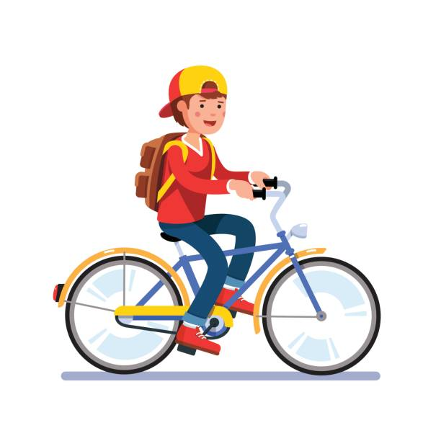
ride a bike

Slide 2
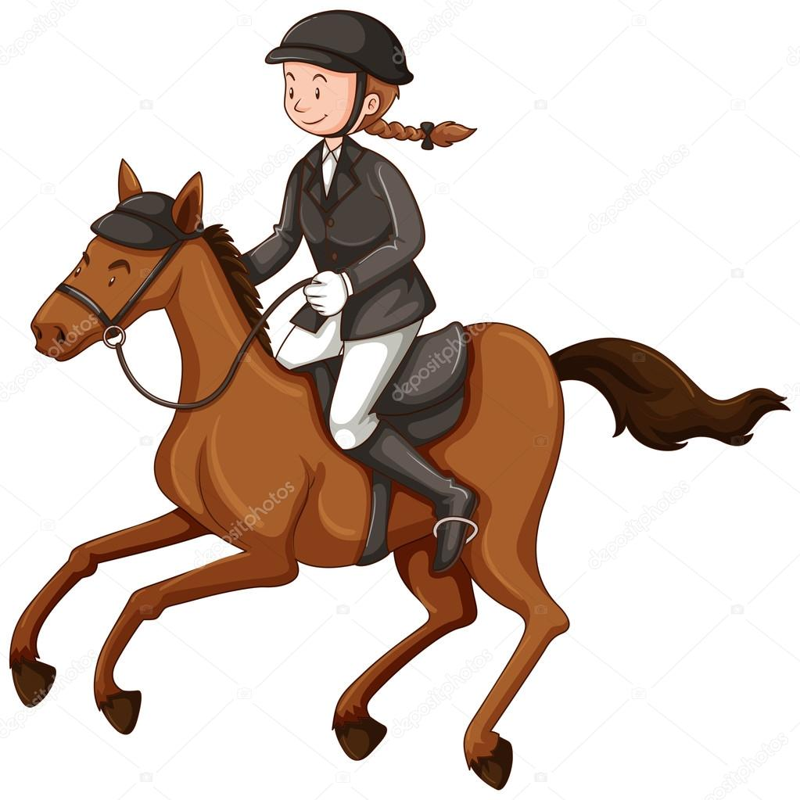
ride a horse

Slide 3
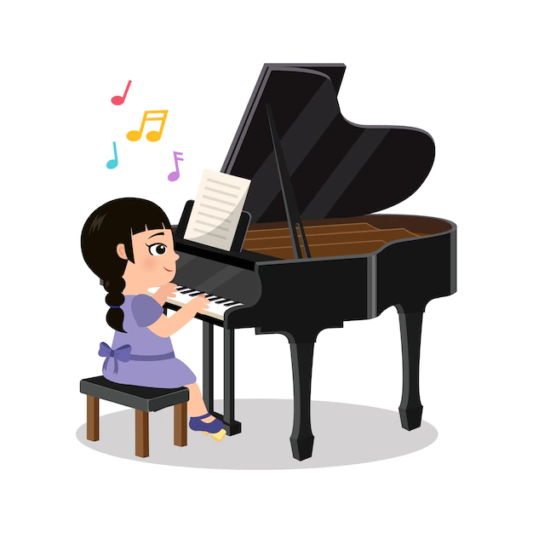
play the piano

Slide 4
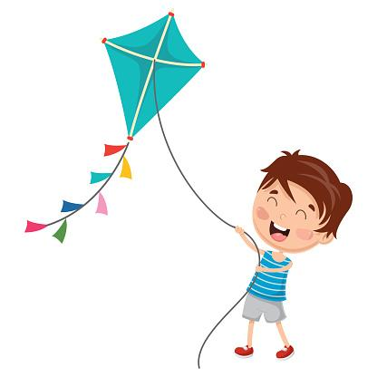
fly a kite

Slide 5
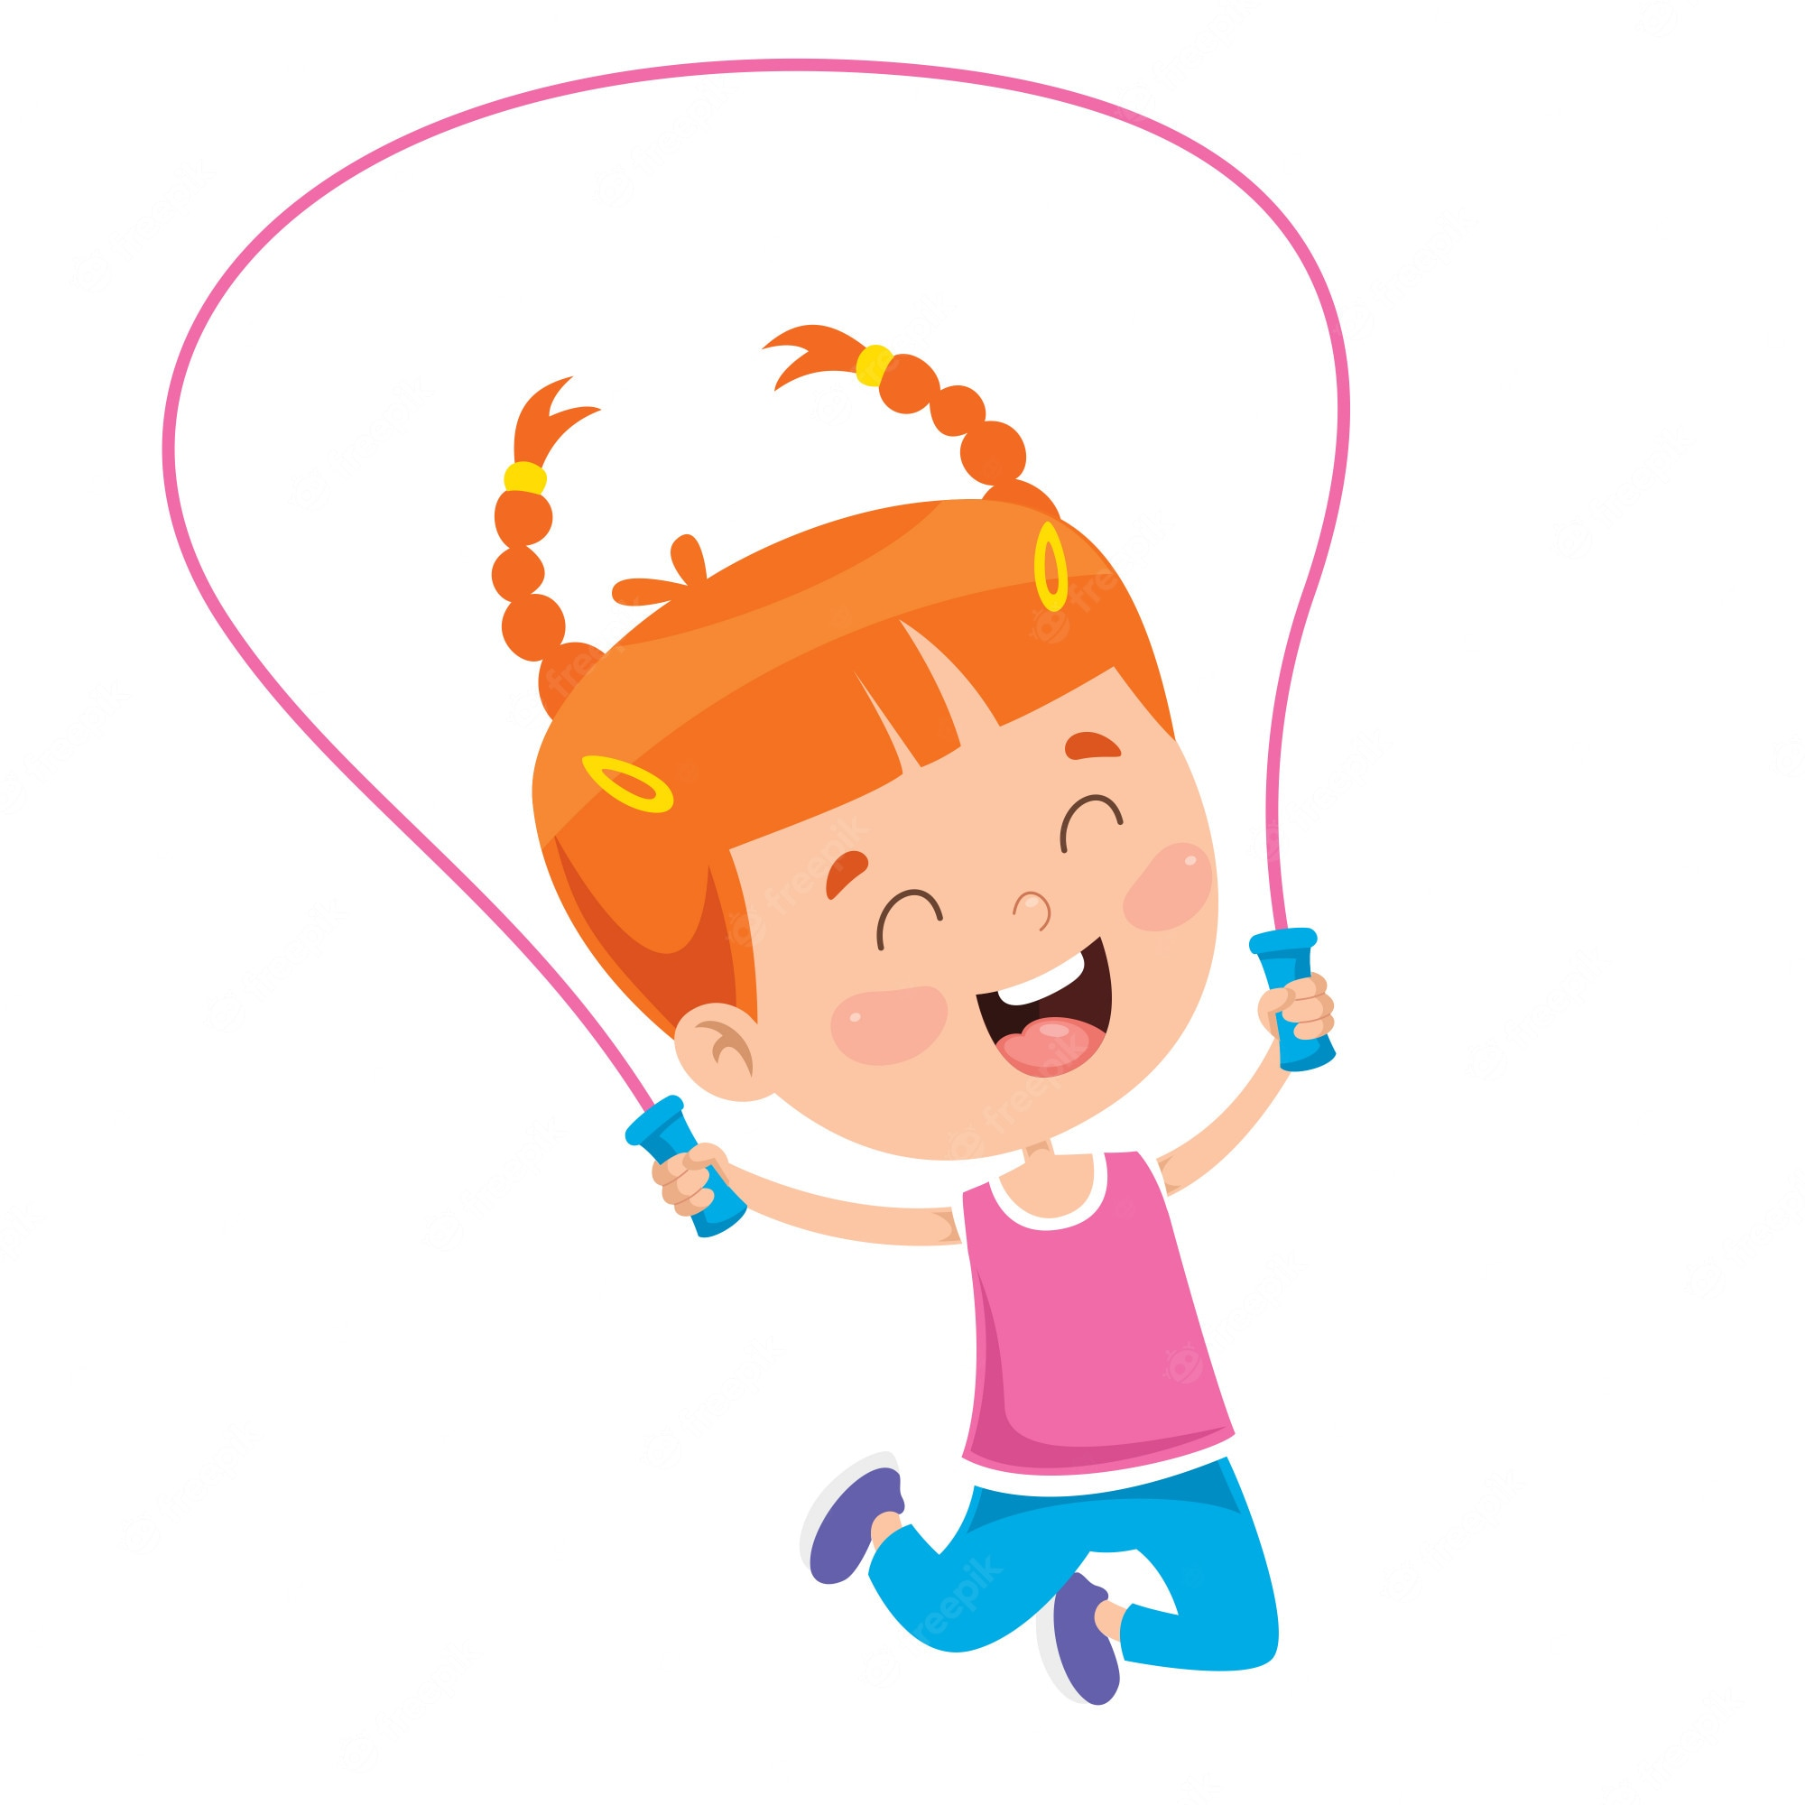
skip

Slide 6
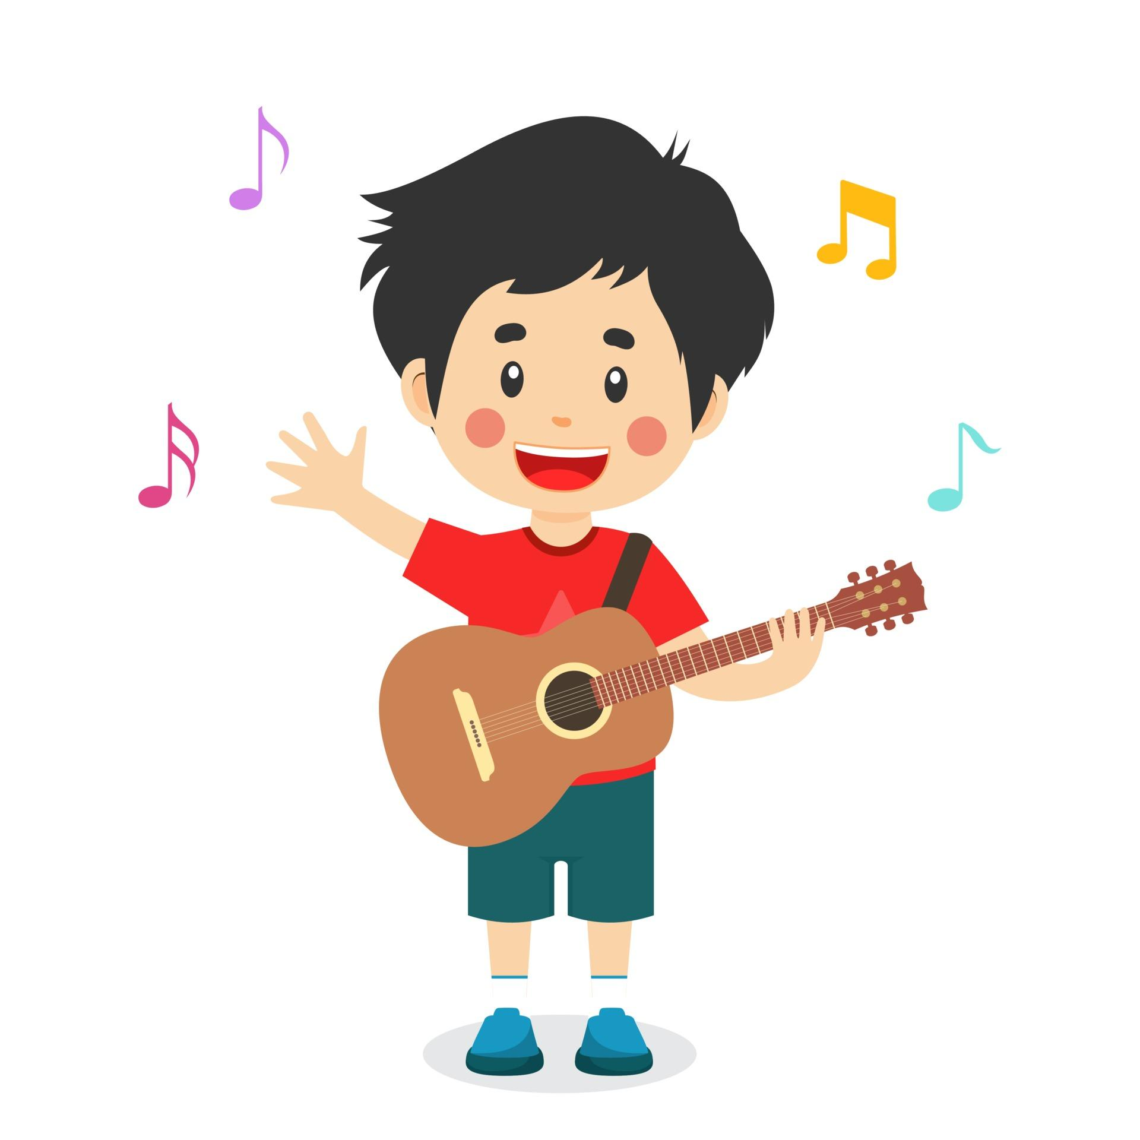
play the guitar

Slide 7
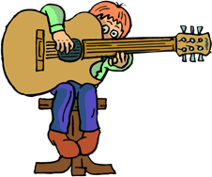
Can you play the guitar?
No, I can’t.

Slide 8
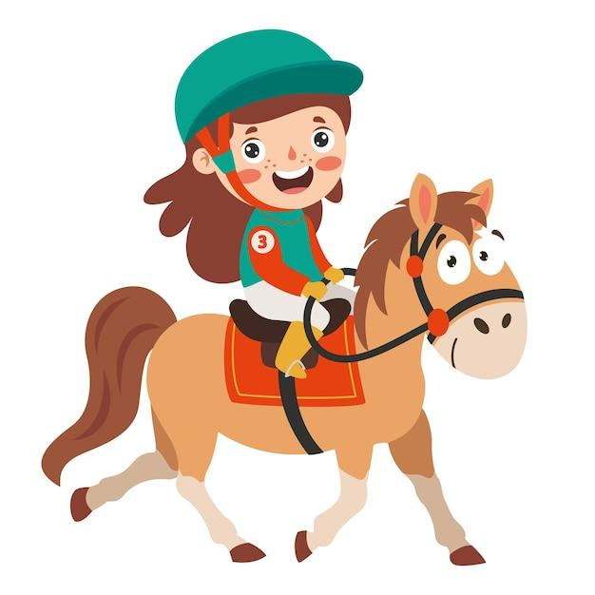
Can you ride a horse?
Yes, I can.

Slide 9
02
Activity 4 Listen and tick.

Slide 10
Listen and tick.

Slide 11
Work in pairs. Practise.
Yes, I can.
No, I can’t
play the guitar
ride a horse
Yes
No

Slide 13
06
Games

Slide 14
Lucky number!

Slide 15
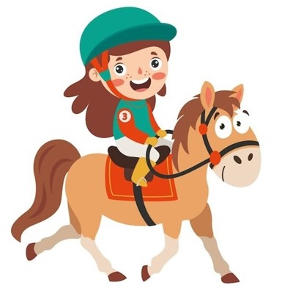
Can you ….………………….?
ride a horse
….., I can’t.
Back
No
Notes:
DICE ROLL GAME

Slide 16
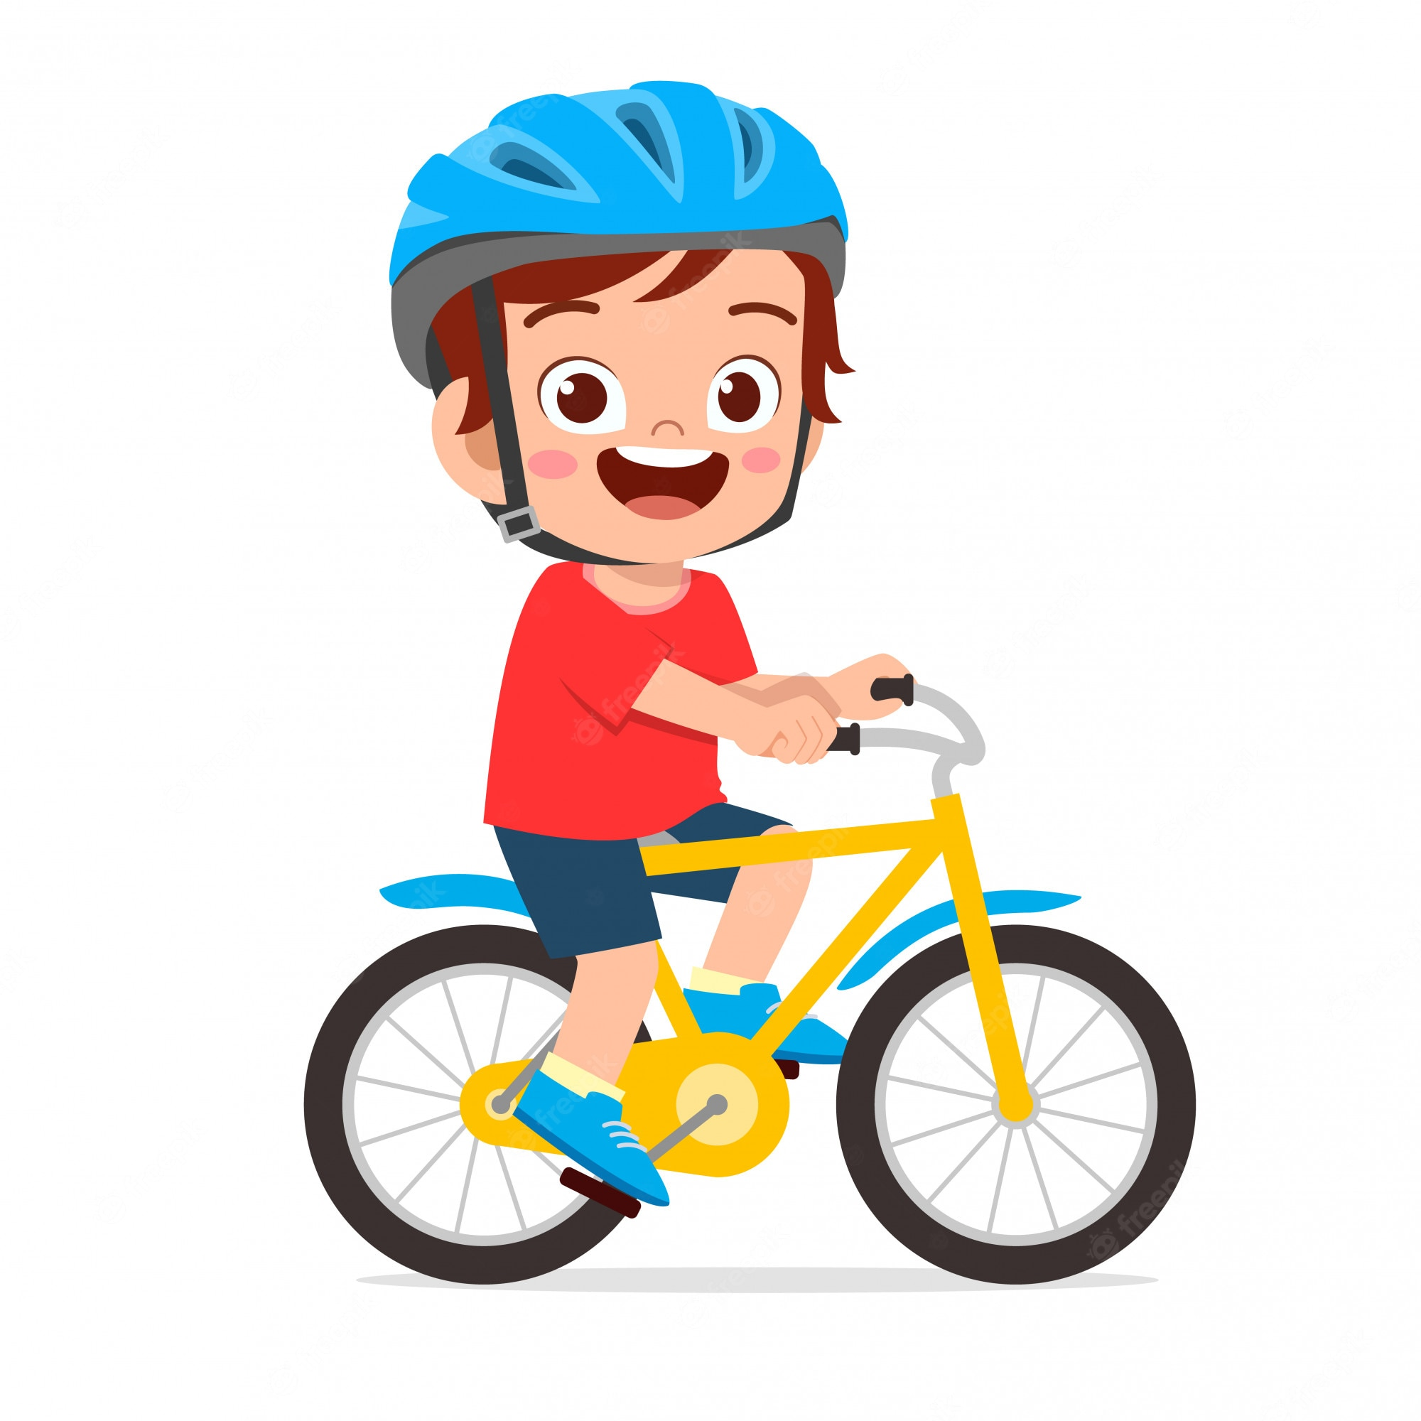
Can you ………………….?
ride a bike
….., I can’t.
Back
No

Slide 17
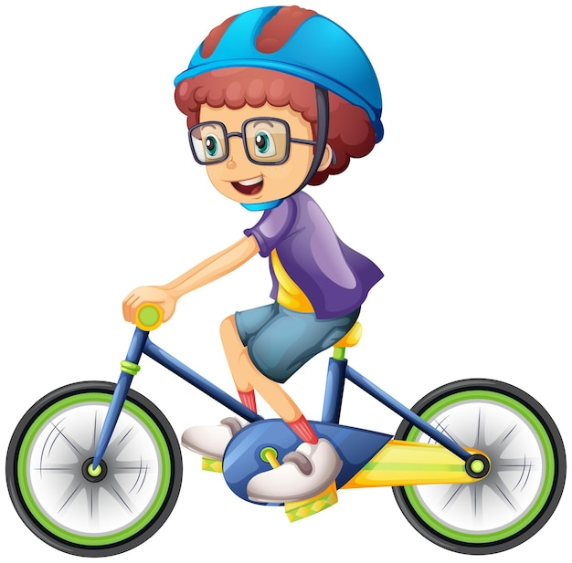
Can you ………………….?
ride a bike
Yes, …………..
I can
Back

Slide 18
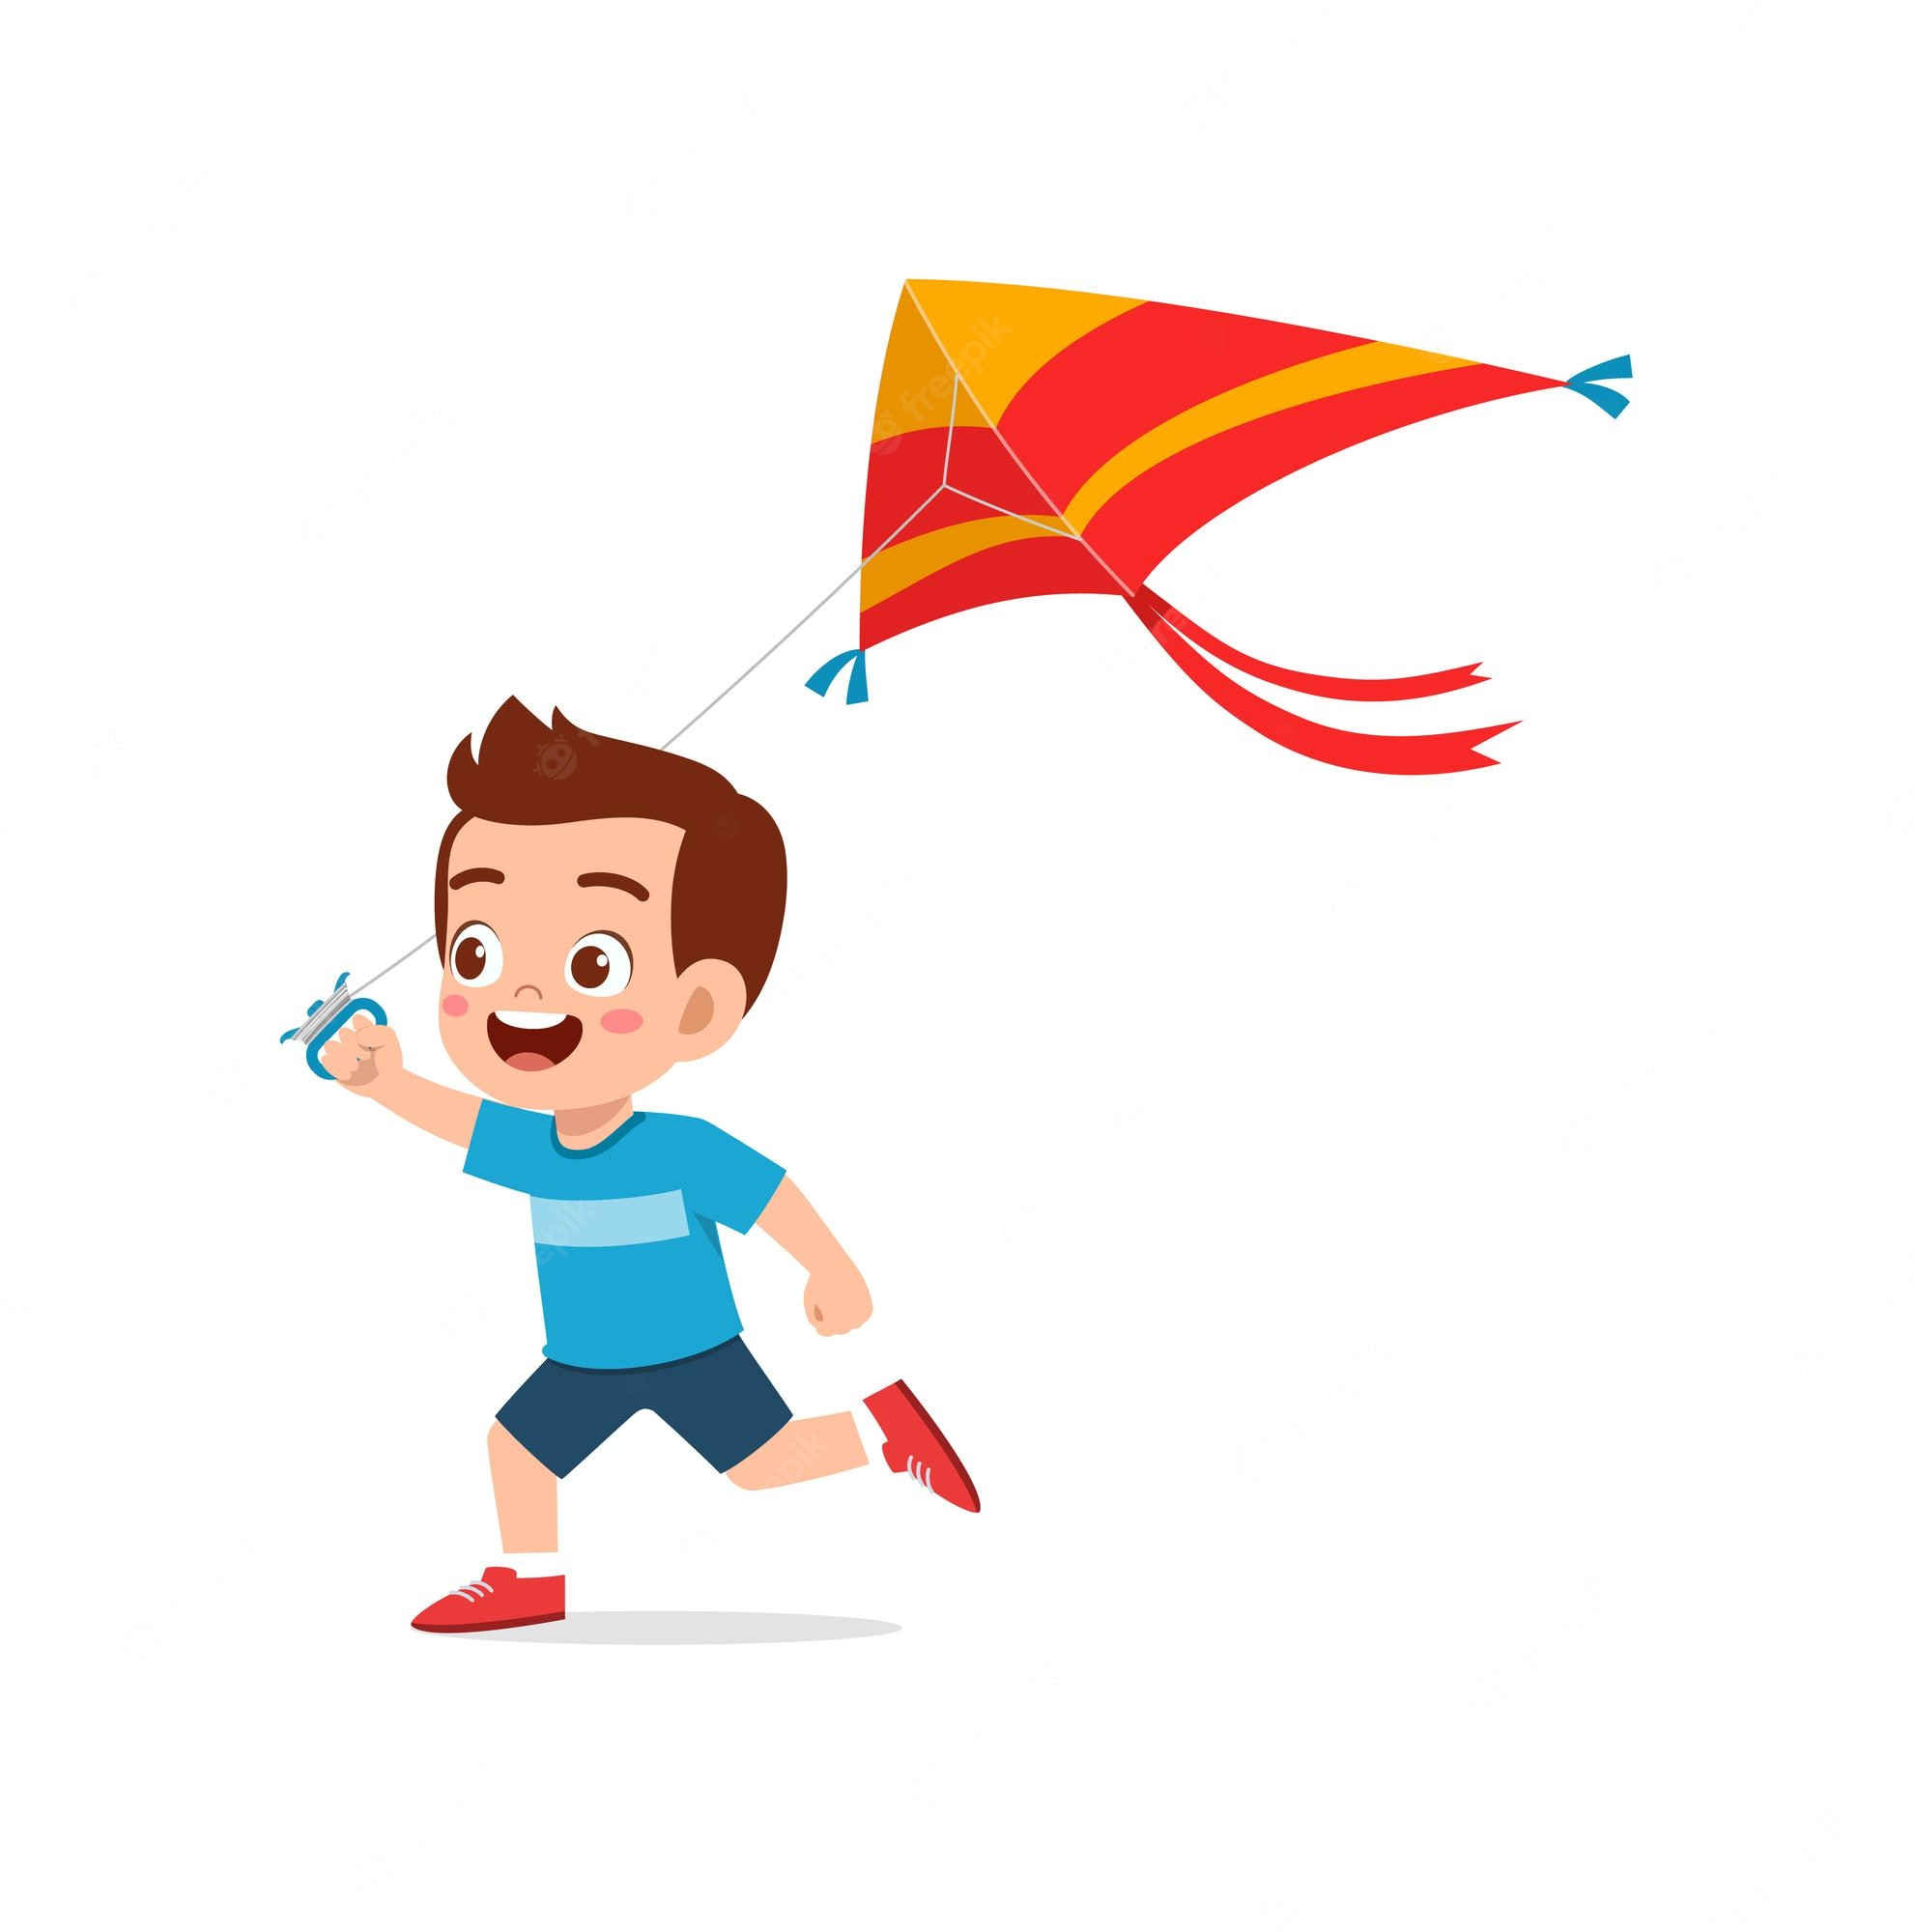
Can you ………………….?
fly a kite
….., I can.
Back
Yes

Slide 19
Can you ………………..………….?
play the piano
No, ……………….
I can’t
Back

Slide 20
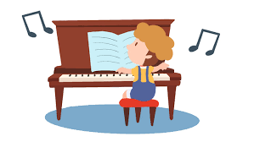
Can you ………….…………….?
play the piano
….., I can.
Back
Yes

Slide 21
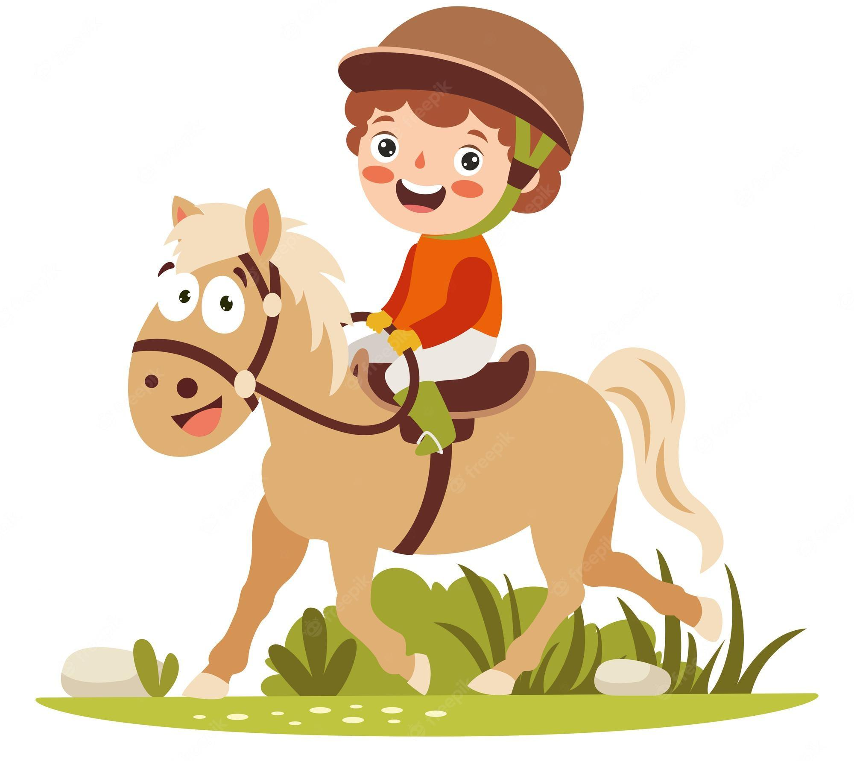
Can you ……………………….?
ride a horse
Yes, …………..
I can
Back

Slide 22
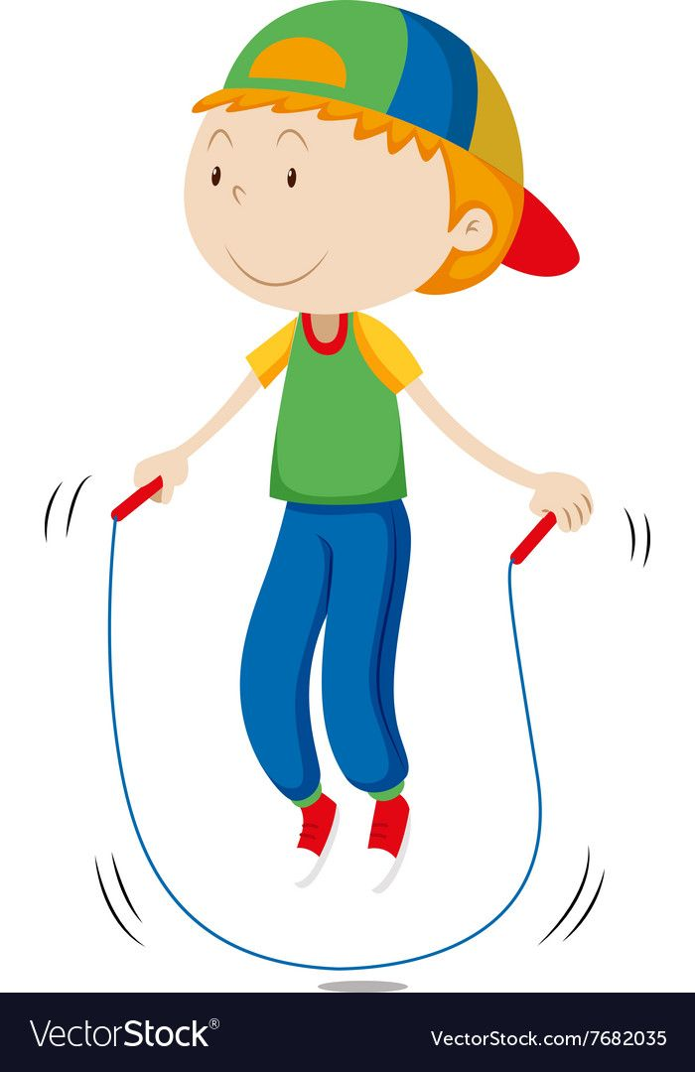
Can you ………………….?
skip
No, ………………..
I can’t
Back

Slide 23
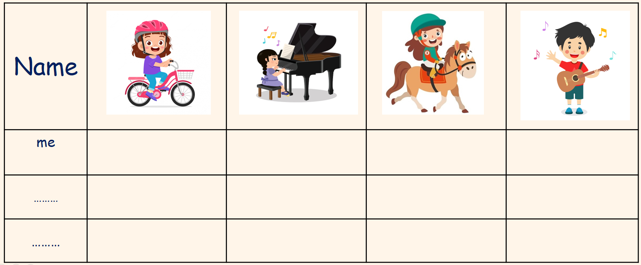
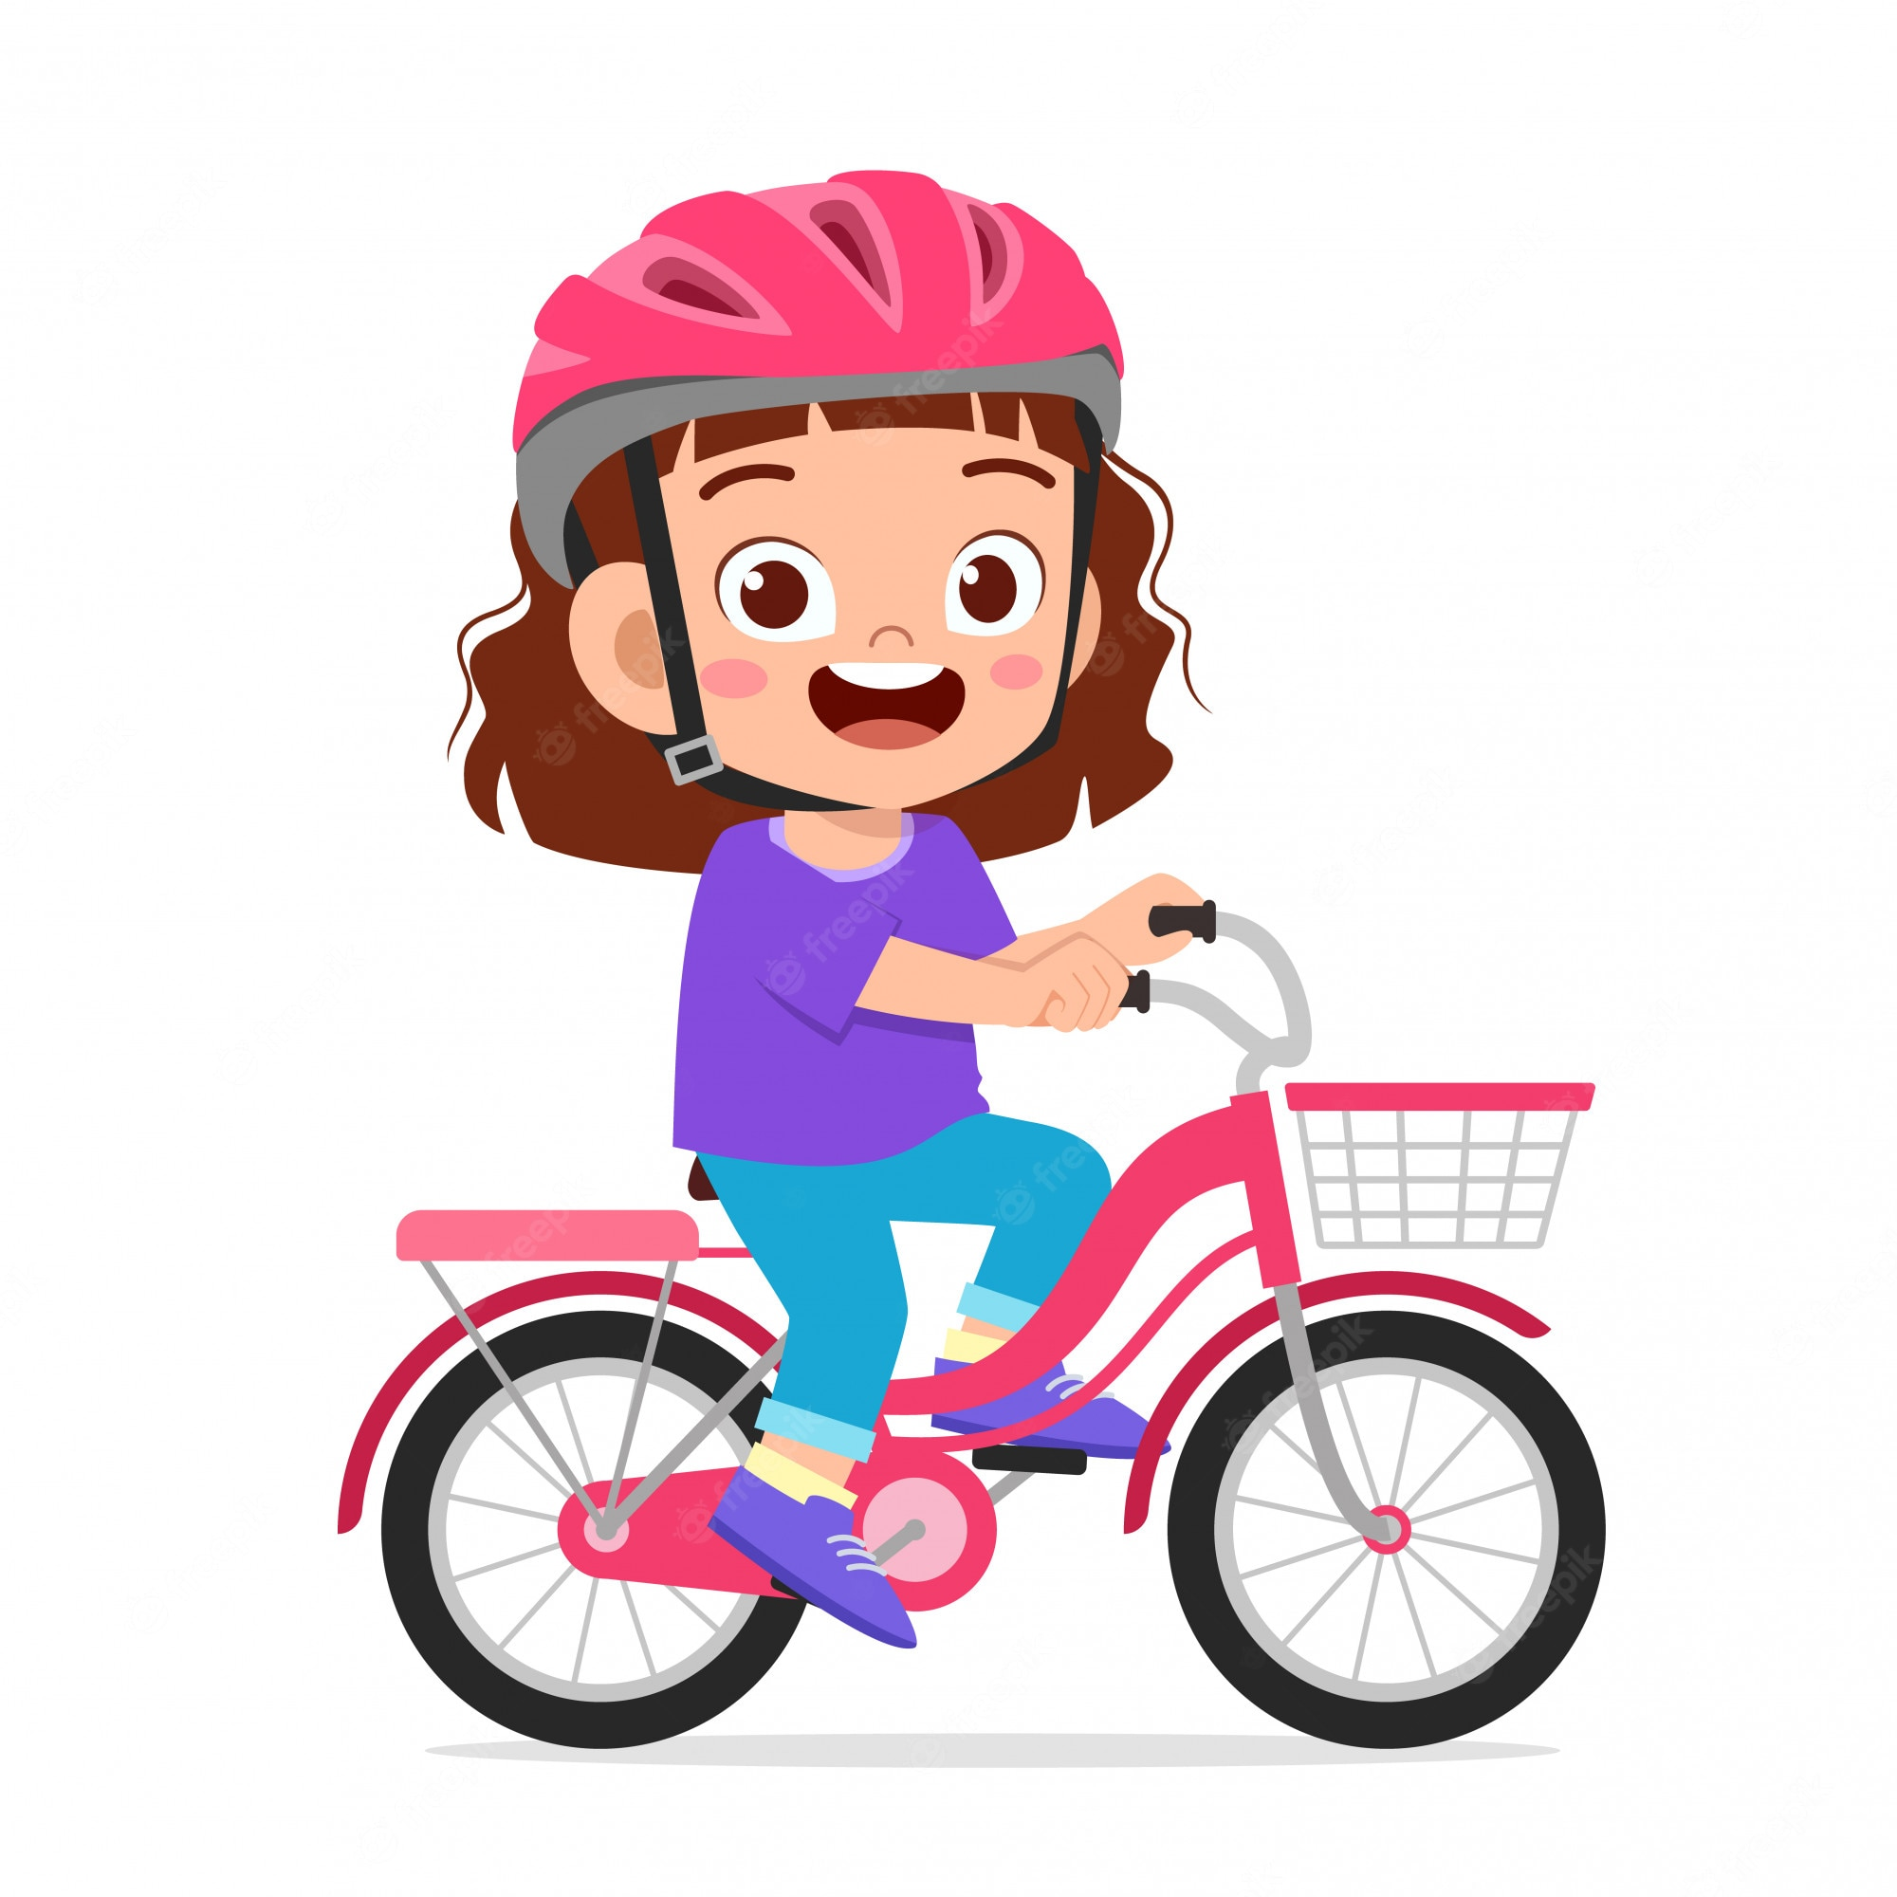
Put a tick (✓) and a cross (x) for you. Then ask your friends and put a tick or a cross.
Can you …………………?
Name
me
………
………

