Slide 1
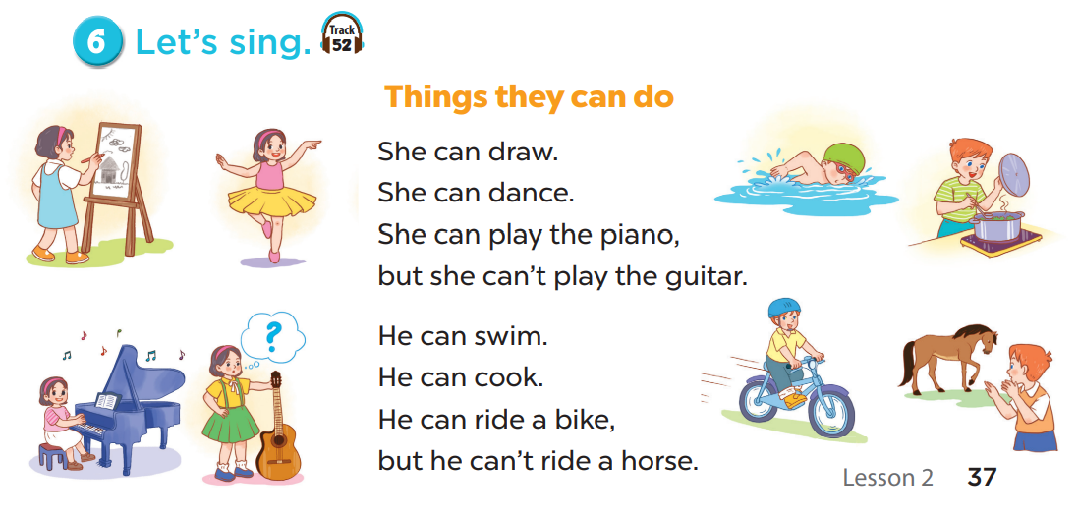


Slide 2
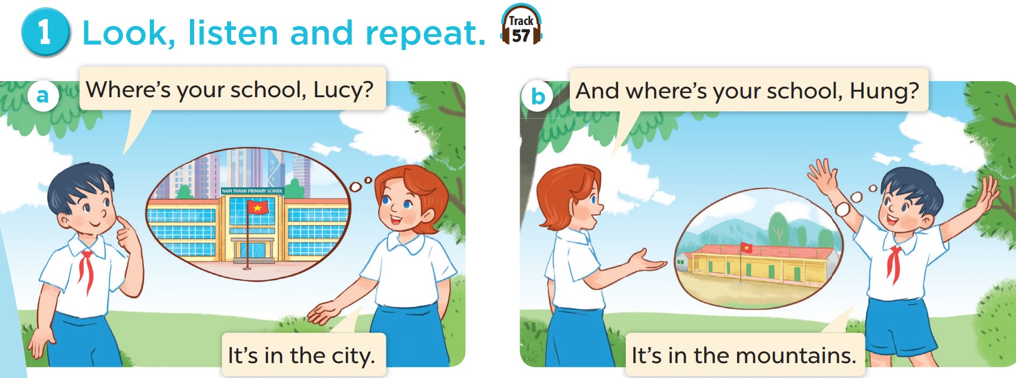
Hung and Lucy are talking about their schools.
Listen.

Slide 3
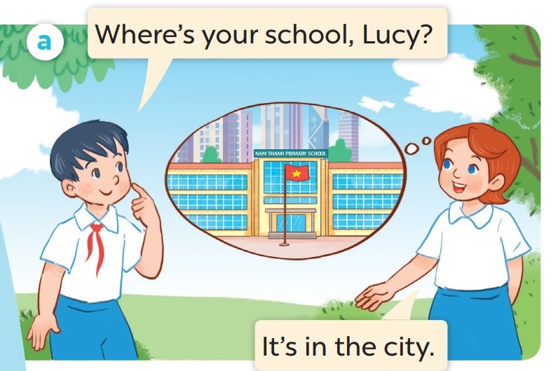
Listen and repeat.

Slide 4

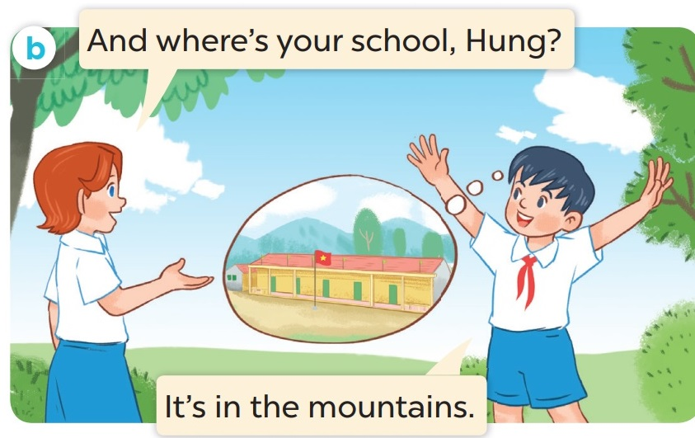
Listen and repeat.

Slide 5
Where is Lucy’s school?
It’s in the city.

Slide 6
03
Activity 2
Listen, point and say.

Slide 7
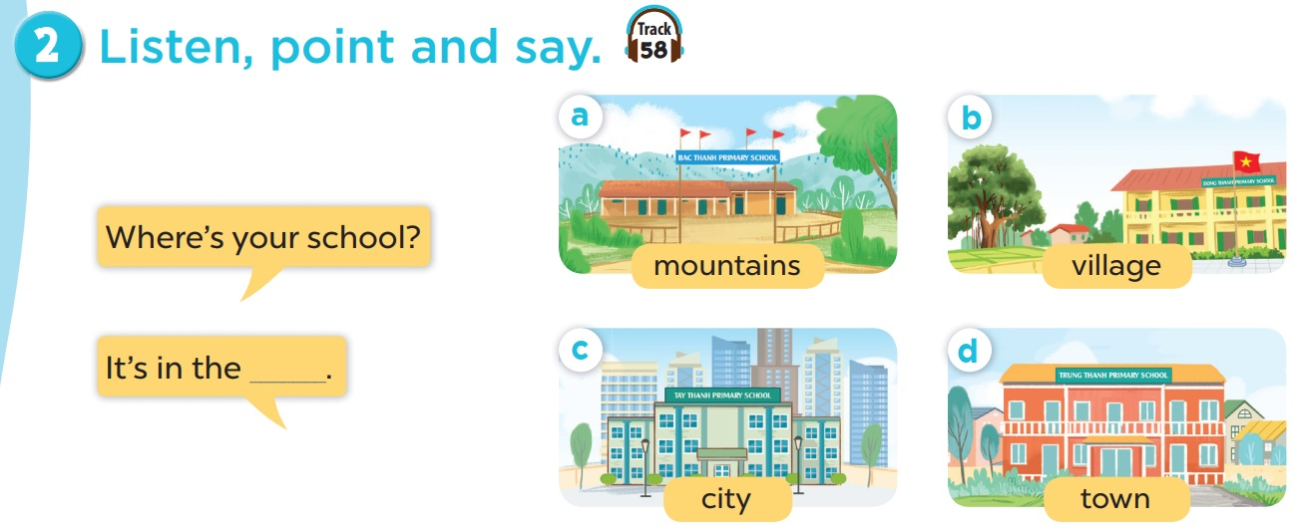

Slide 8
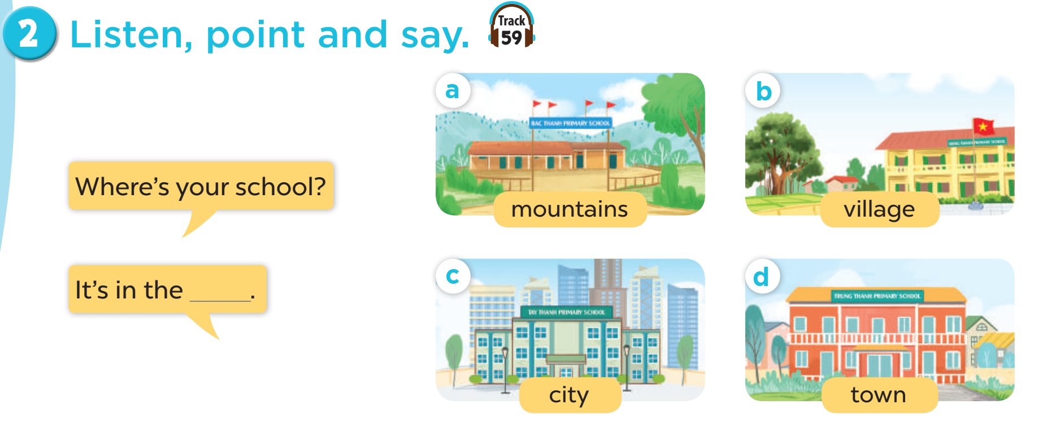
Listen and repeat.
Work in pairs. Play roles.

Slide 9
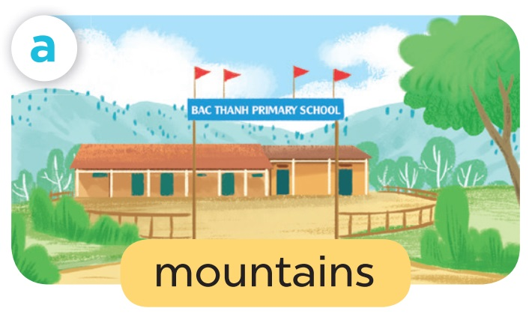
Where’s your school?
It’s in the mountains.

Slide 10
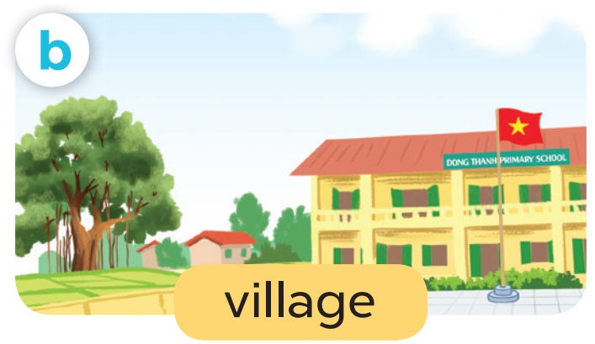
Where’s your school?
It’s in the village.

Slide 11
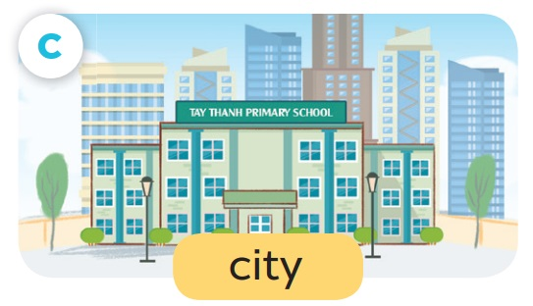
Where’s your school?
It’s in the city.

Slide 12
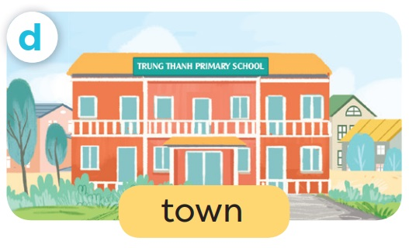
Where’s your school?
It’s in the town.

Slide 13
04
Activity 3
Let’s talk.

Slide 14
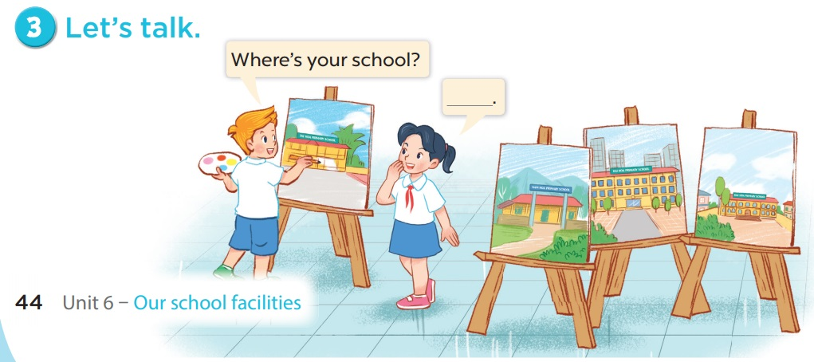

Slide 16

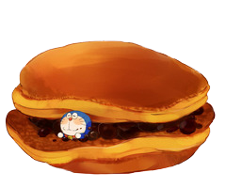
= Mystery
power-up
= points

Slide 17
O
P
Q
R
S
T
U
V
W
X
Y
Z
End game

Slide 18



    - _____ is your school?
    - It’s in the city.
Where

Slide 20
- Where is your school?
- It’s in the ____.
city

Slide 22
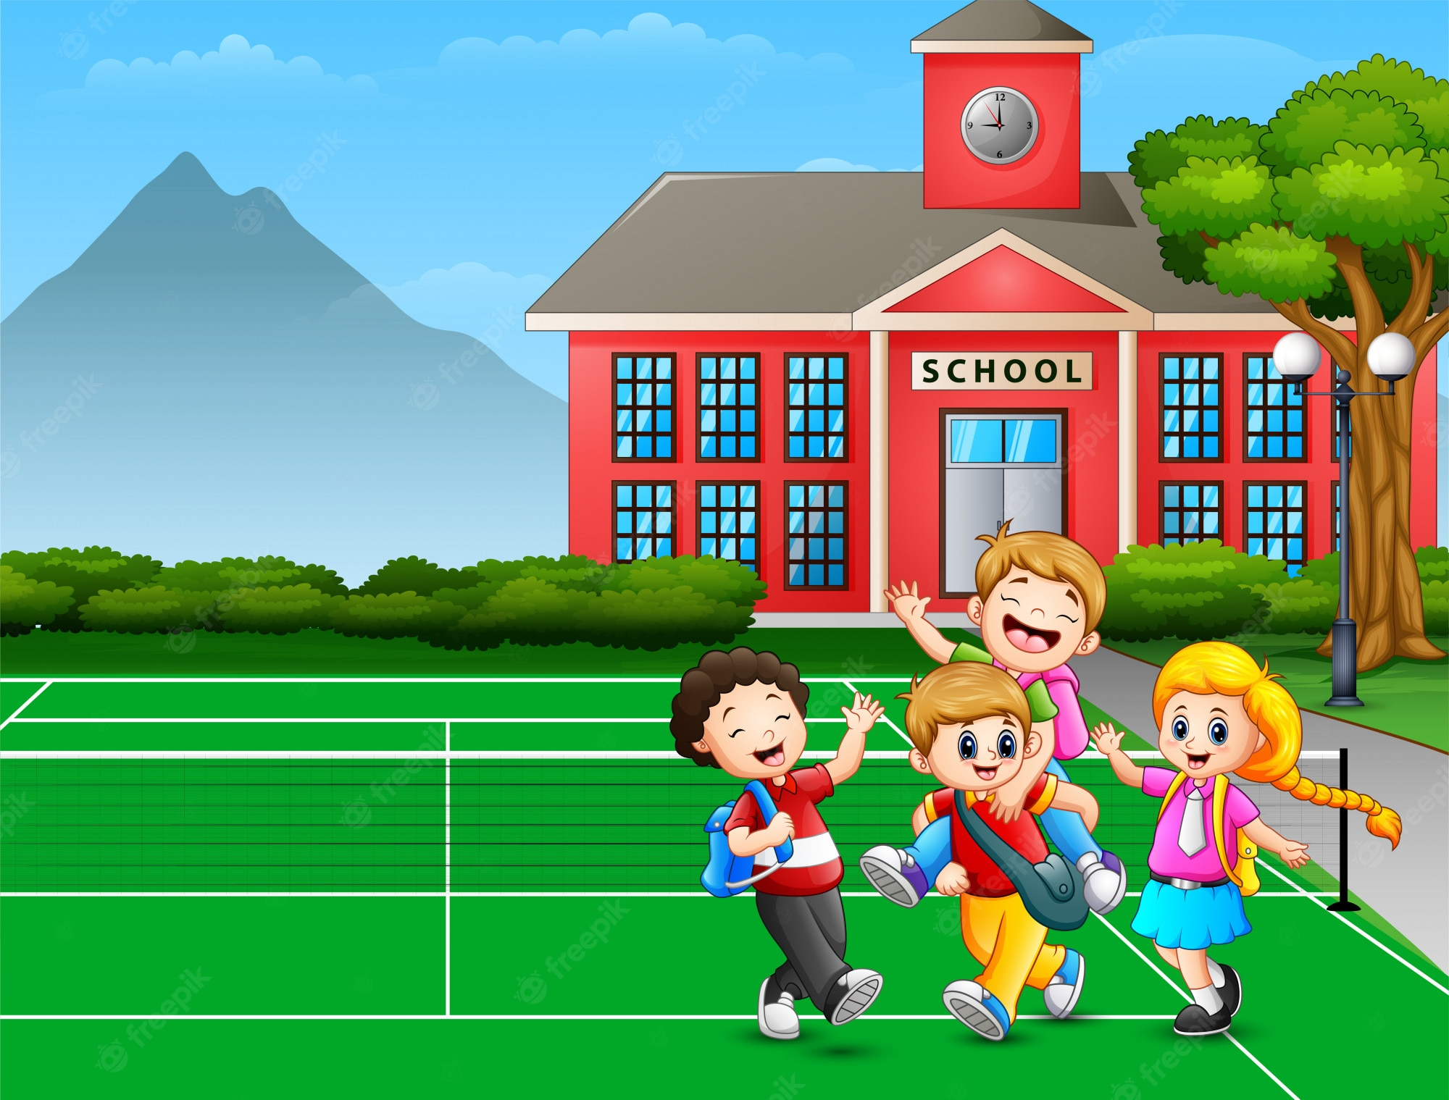
- Where’s your school?
- ______________.
It’s in the mountains.

Slide 24
Where are the children?
A. At home. B. At school.
B. At school.

Slide 26
How many children are there
at the playground?
There are four.

Slide 28

- Is it a village?
- _________.
Yes, it is.

Slide 30

- Where is the Minion?
- _____________.
It’s in the village.

Slide 32

It’s a village.
A
B
A

Slide 34
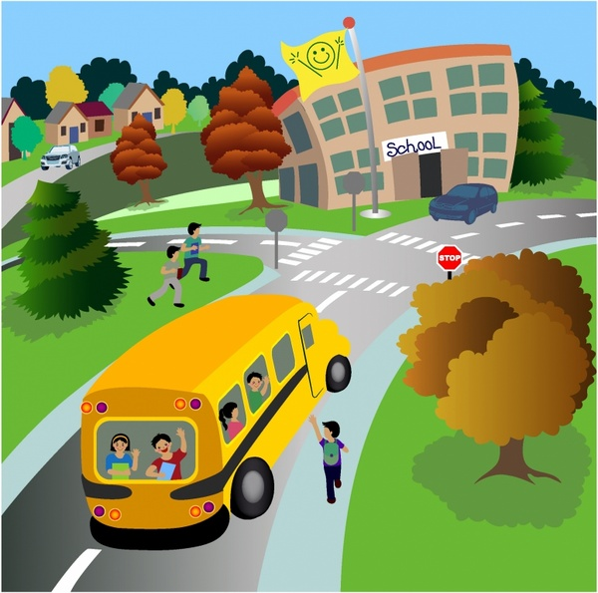
- Is it a city?
- ______.
No, it isn’t. It’s a town.

Slide 36
My school is in the mountains.
A
B
B

Slide 37
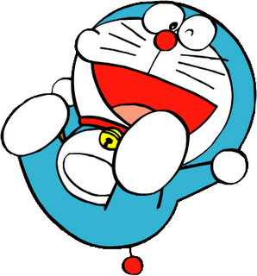




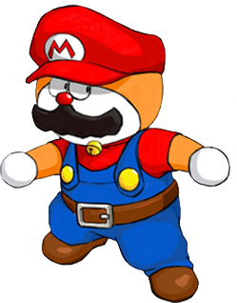

Slide 38
Change points!

Slide 39
Steal 3 points!

Slide 40
7 points!

Slide 41
Where is the school?
It’s in the town.

Slide 42
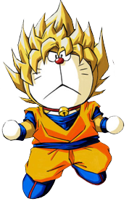
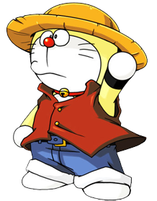


Slide 43
Steal 3 points!

Slide 44
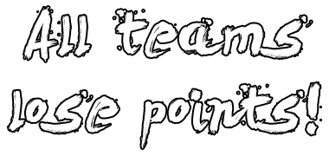



Slide 45
9 points!

Slide 46
town / the / in / school / is / My /.
My school is in the town.

Slide 47


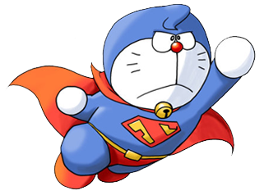

Slide 48
10 points!

Slide 49
Change points!

