Slide 1
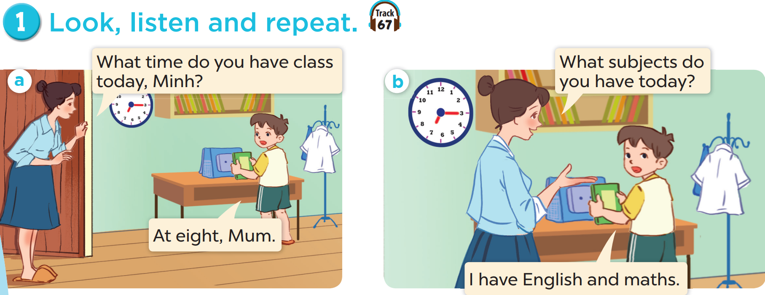

Slide 2
vocabulary

Slide 8
What subjects do you have today?
I have Vietnamese.

Slide 10
Answer the questions.
Play
MsPham-0936082789

Slide 11
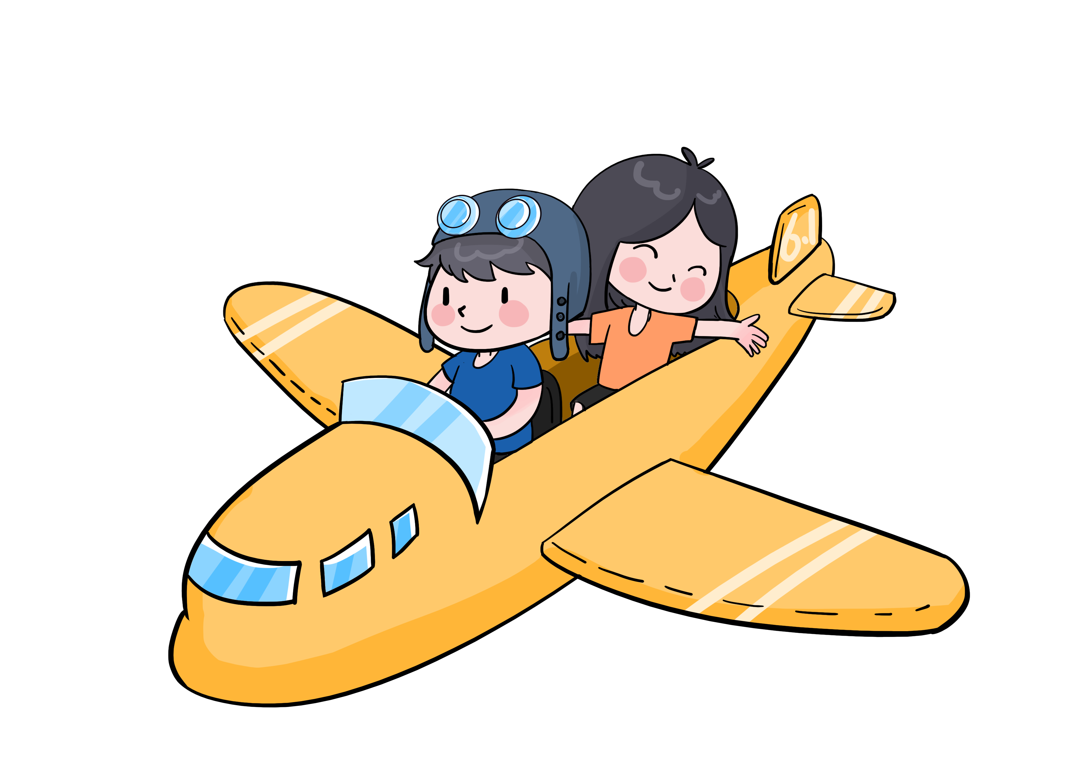
What subjects do you have today?
English (+5)
Check
Next

Slide 12
What subjects do you have today?
Science (+10)
Check
Next

Slide 13
What subjects do you have today?
Vietnamese (+6)
Check
Next

Slide 14
What subjects do you have today?
Maths (+7)
Check
Next

Slide 15
THANK YOU
Website: hoclieu.vn
Fanpage: facebook.com/www.tienganhglobalsuccess.vn
Website: sachmem.vn; hoclieu.vn
Fanpage: www.facebook.com/sachmem.vn

