Slide 2
Unit 11: My home
Lesson 1 - period 1

Slide 3
Table of Contents
01
02
03
04
Look, listen and repeat.
Warm-up
Listen, point and say.
Let’s talk.
05
fun corner & Wrap-up

Slide 4
01
Warm-up

Slide 5
Notes:
https://www.youtube.com/watch?v=3EDzQeh7mWE

Slide 6
02
Look, listen and repeat.

Slide 7
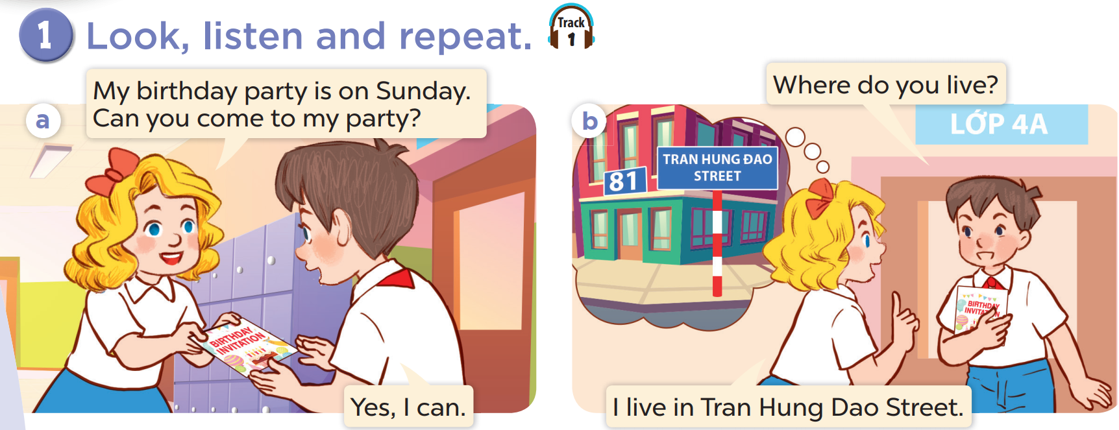

Slide 8
03
Listen, point and say.

Slide 9
vocabulary

Slide 10
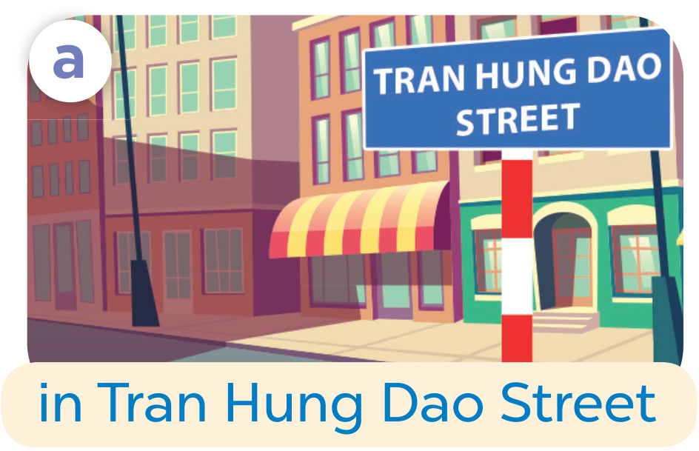

Slide 12
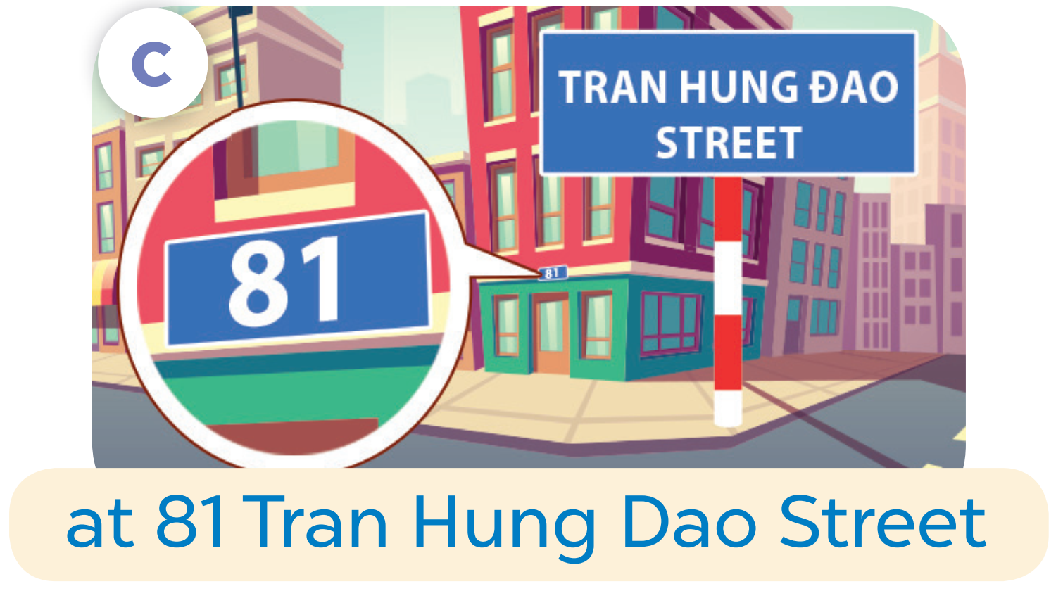

Slide 13
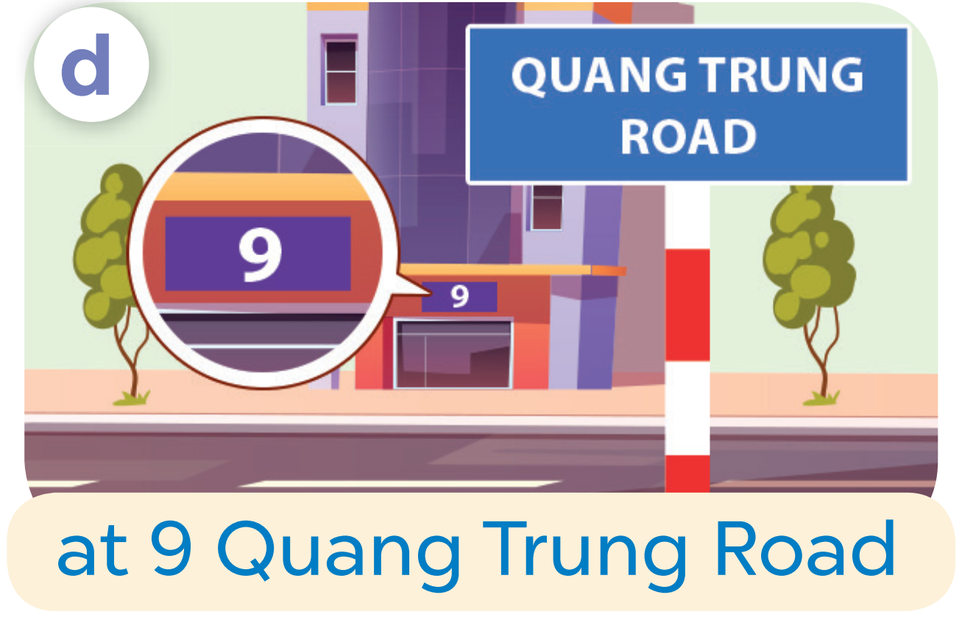

Slide 15
Where do you live?
I live in Tran Hung Dao Street.

Slide 16
04
Let’s talk.

Slide 17
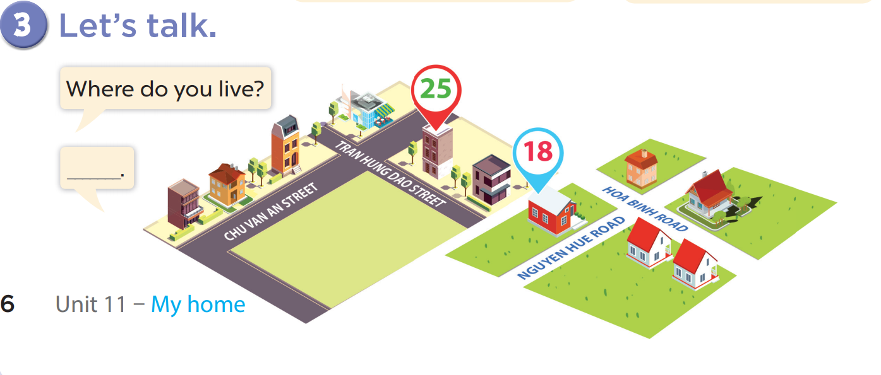

Slide 18
05
fun corner & Wrap-up

Slide 19
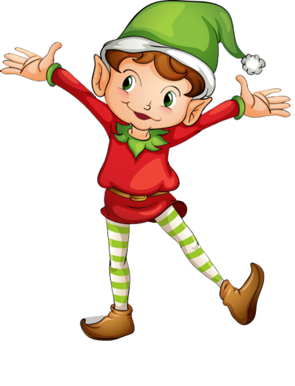
1
point
5
points
Lucky wheel!
Question
Question
Question
Question
Question
Question
SPIN
Question
3
points
2
points
10
points
End
Notes:
Click on “spin” button to spin the wheel, click again to stop

Slide 20
Ask and answer!
Where do you live?
I live in Tran Hung Dao Street.
Check
Back

Slide 21
Ask and answer!
Where do you live?
I live in Quang Trung Road.
Back
Check

Slide 22
Ask and answer!
Where do you live?
I live at 81 Tran Hung Dao Street.
Back
Check

Slide 23
Ask and answer!
Where do you live?
I live at 9 Quang Trung Road.
Back
Check

Slide 24
Ask and answer!
Where do you live?
I live in/at…….
Back
Check

Slide 25
Ask and answer
Where do you live?
I live in/at…….
Back
Check

Slide 26
Ask and answer!
Where do you live?
I live in/at…….
Back
Check

Slide 27
What have you learnt today?

Slide 28
THANK YOU
Website: hoclieu.vn
Fanpage: facebook.com/www.tienganhglobalsuccess.vn
Website: sachmem.vn; hoclieu.vn
Fanpage: www.facebook.com/sachmem.vn

