Slide 1





Slide 2
Unit 11: My home
Lesson 2 - period 4

Slide 3
Table of Contents
01
02
03
04
  Listen and tick.
Warm-up
Look, complete and read.
Let’s sing.
05
Fun corner & Wrap-up

Slide 4
01
Warm-up

Slide 5
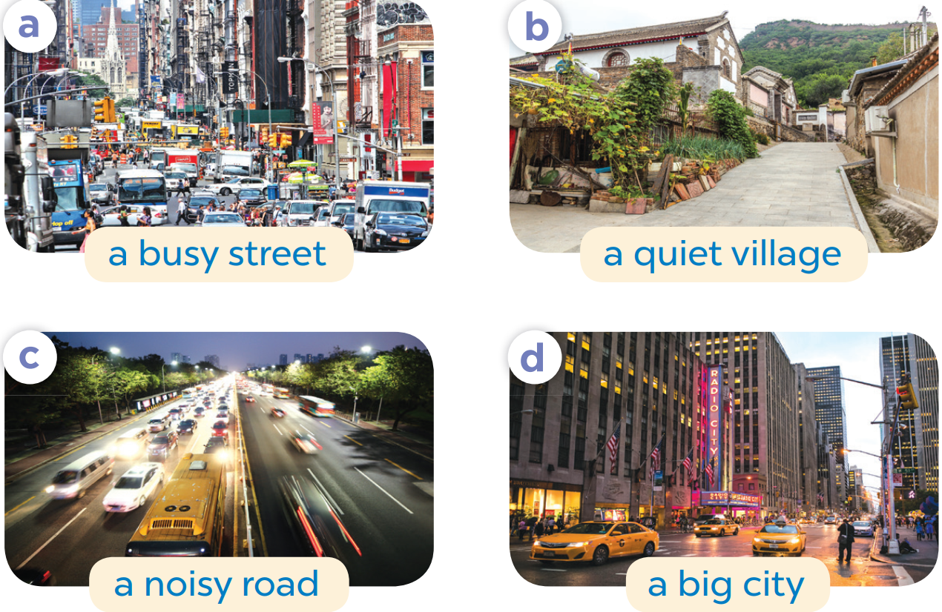
Slap the board

Slide 6
02
Listen and tick.

Slide 7

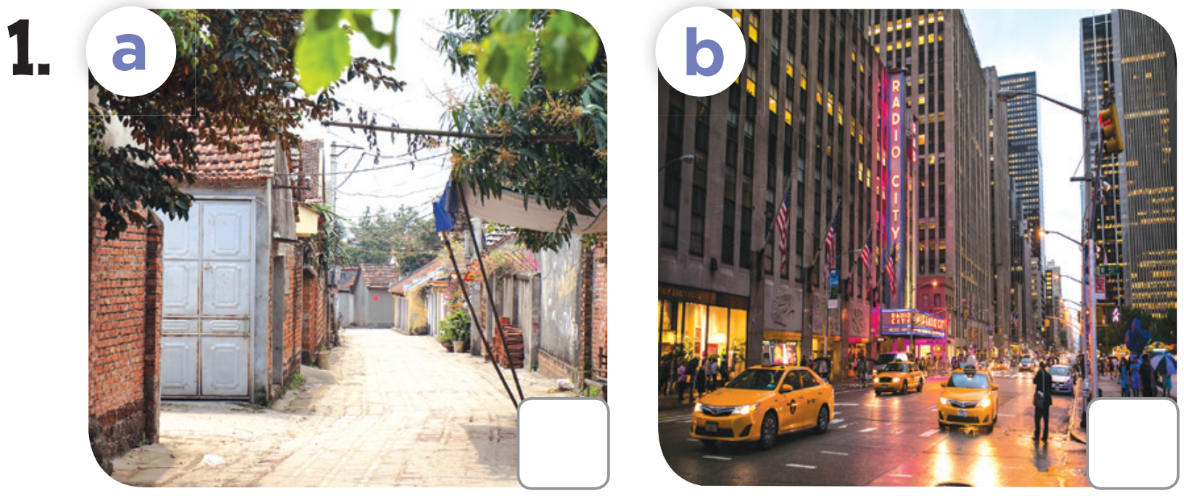
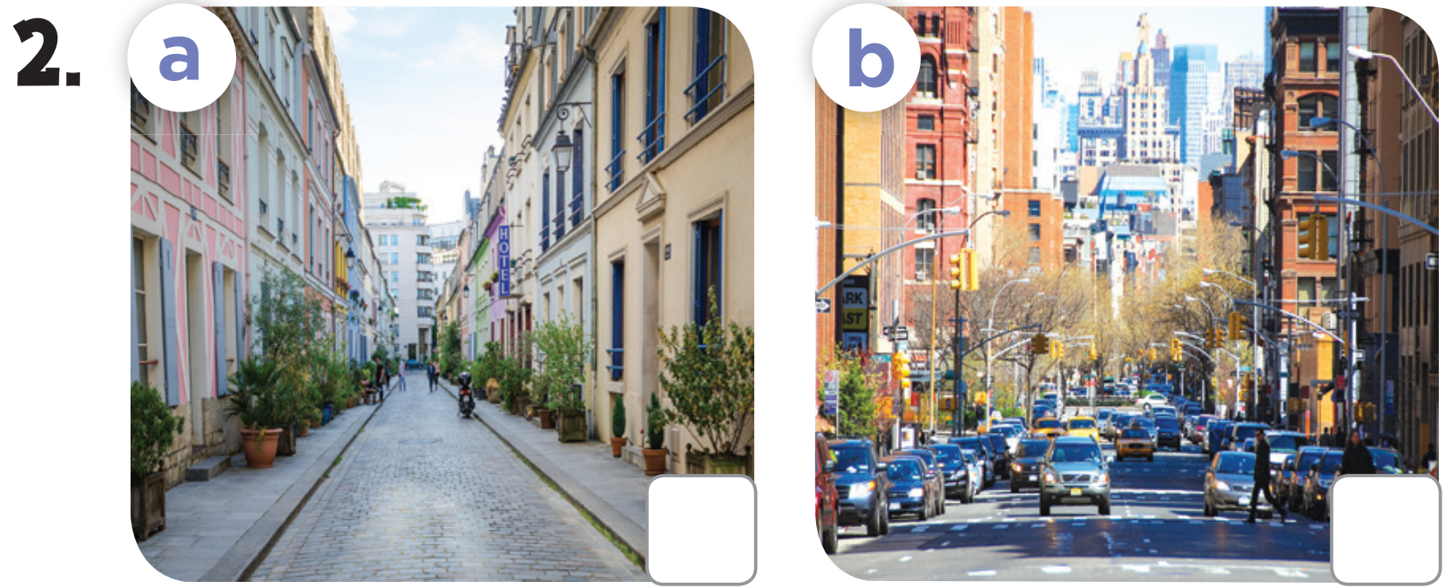

Slide 8


Slide 9
03
Look, complete and read.

Slide 10
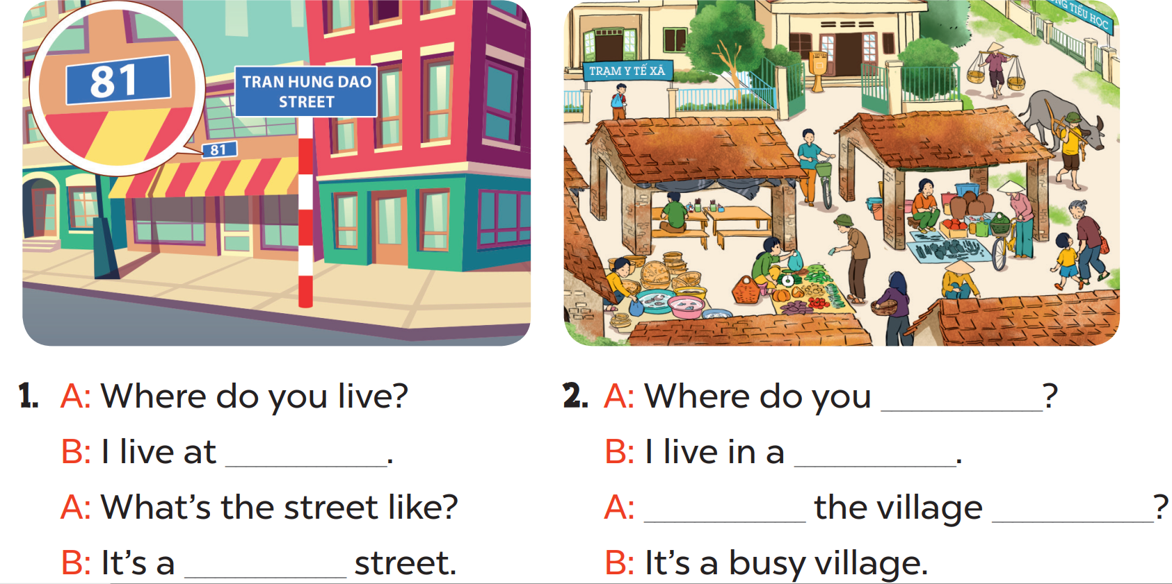

Slide 11
live
81 Tran Hung
Dao Street
village
What’s
like
quiet

Slide 12
04
Let’s sing.

Slide 13
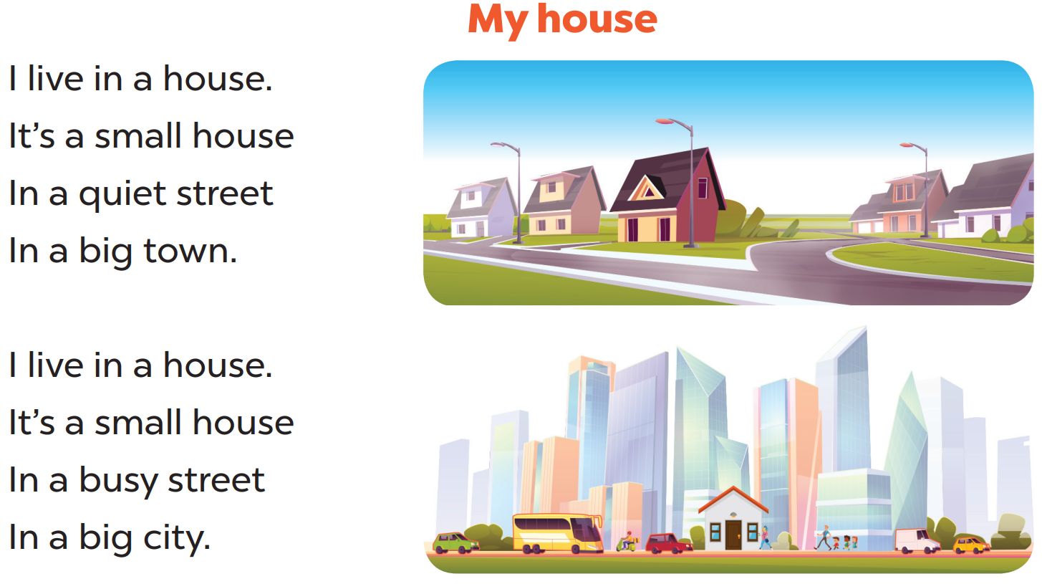

Slide 14
05
Fun corner & Wrap-up

Slide 15


Quiz
START

Slide 16



Where_____you live?
do
Does
do
Is doing
Are doing

Slide 17
I live ____ a city.
in
in
under
at
on

Slide 18
____ the city like?
What’s
What
How
What’s
Why’s

Slide 19
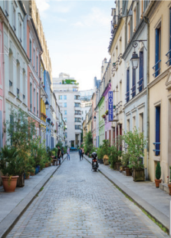
It’s a______street.
quiet
busy
high
quiet
big

Slide 20
_____ do you live?
Where
When
Where’s
When’s
Where

Slide 21
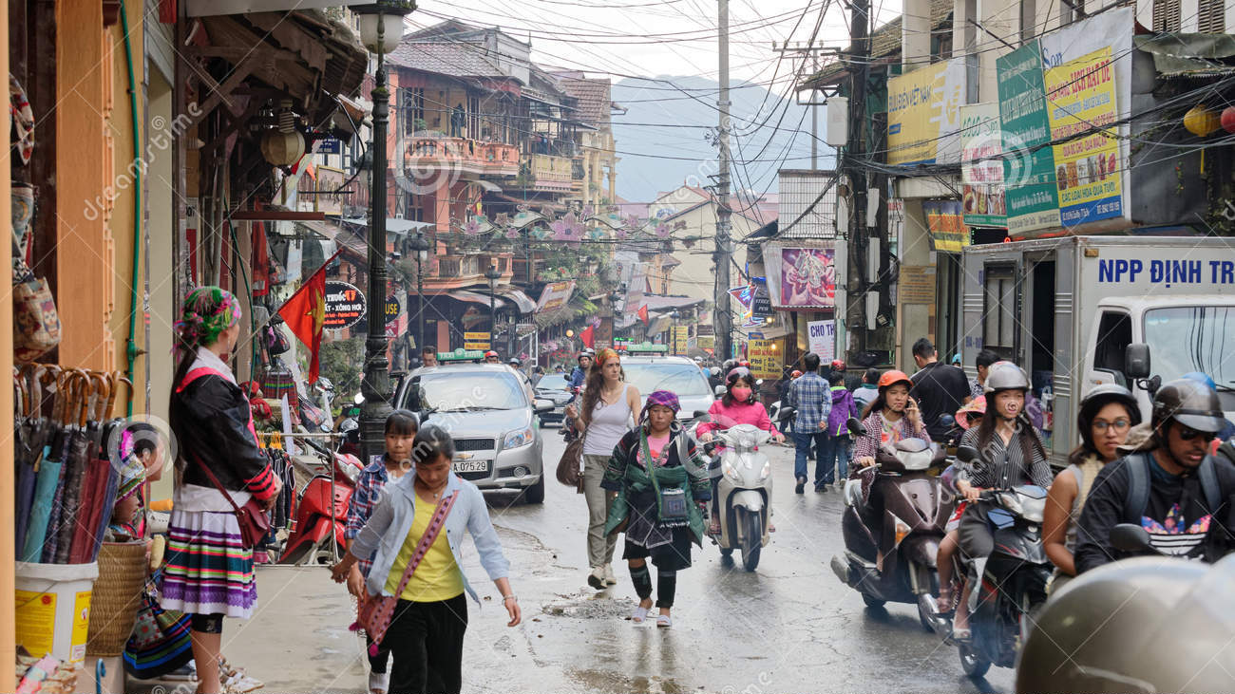
What’s the village like?
It’s______ village.
a busy
a quiet
quiet
busy
a busy

Slide 22
What have you learnt today?

Slide 23








THANK YOU
Website: hoclieu.vn
Fanpage: facebook.com/www.tienganhglobalsuccess.vn
Website: sachmem.vn; hoclieu.vn
Fanpage: www.facebook.com/sachmem.vn

