Slide 2
Unit 11: My home
Lesson 3 - period 6

Slide 3
Table of Contents
01
02
03
04
Read and circle.
Warm-up
Let’s write.
Project
fun corner & Wrap-up
05

Slide 4
01
Warm-up

Slide 5
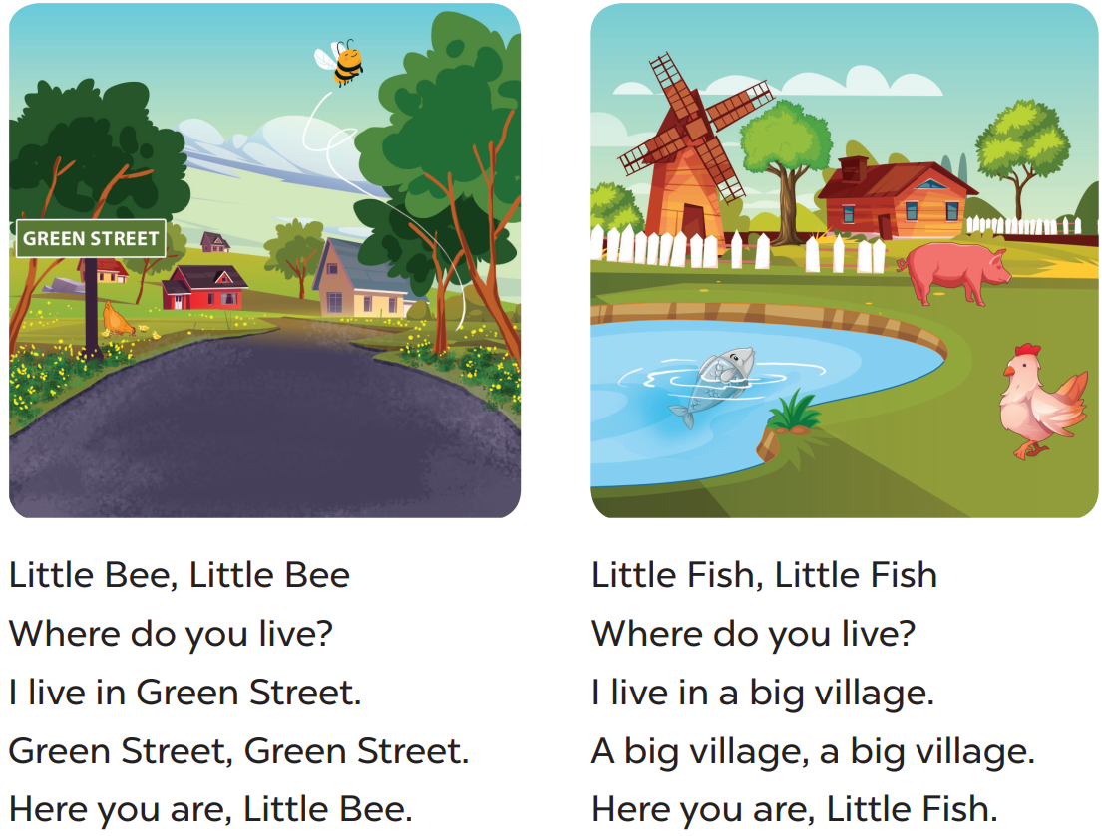

Slide 6
02
Read and circle.

Slide 10
03
Let’s write.

Slide 12
04
Project

Slide 13
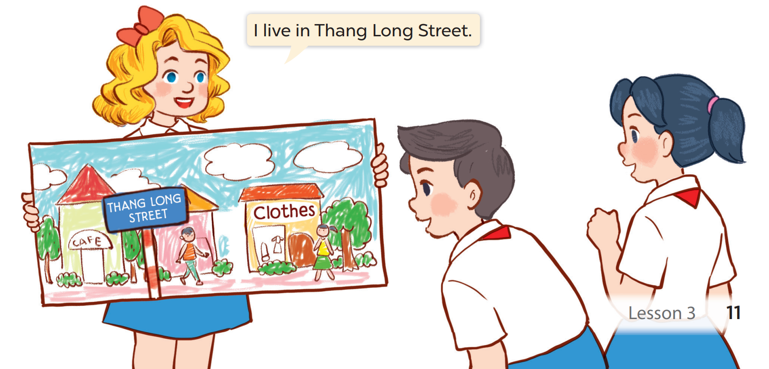

Slide 14
05
fun corner & Wrap-up

Slide 15
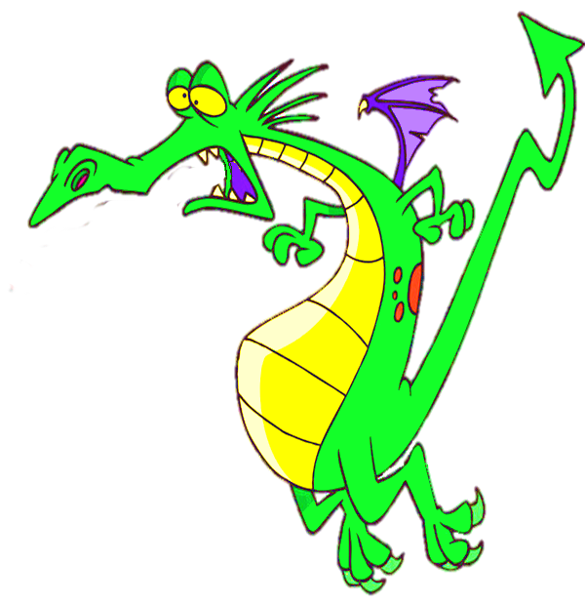
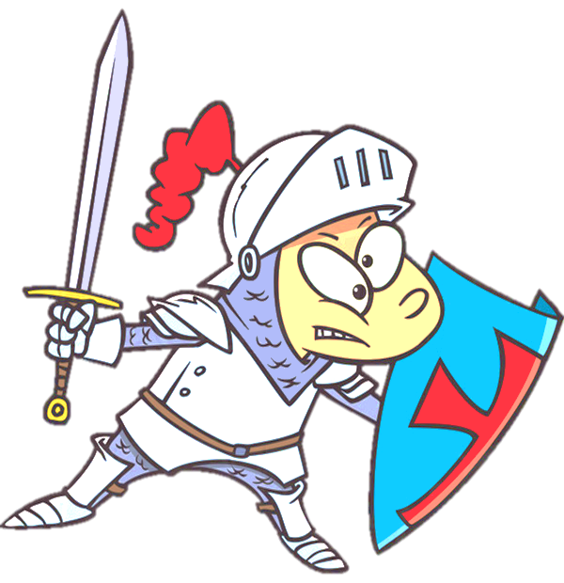
George beats the dragon.

Slide 16
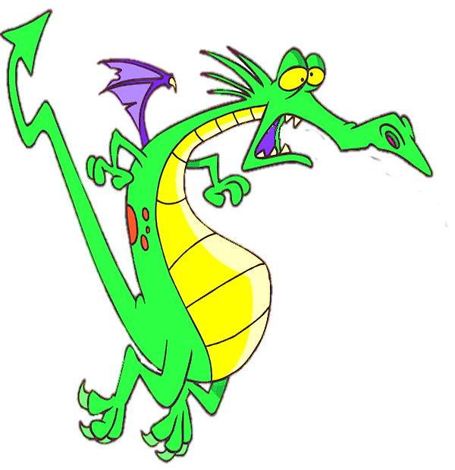
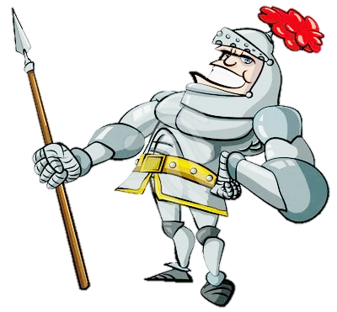
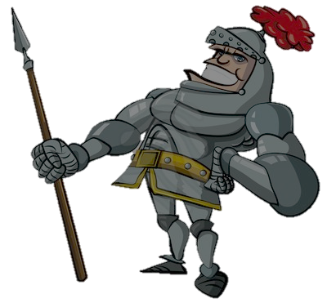
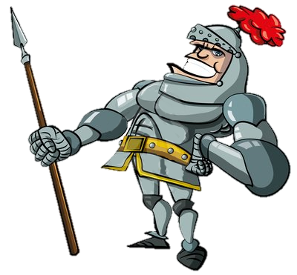
live
I ____ in a small house with my family.
is living
lives
live

Slide 17
He _____in a big city.
lives
lives
live
is living

Slide 18
It __ in Hai Ba Trung Street.
is
is
am
was

Slide 19
quiet
The street is very _____.
queti
qiute
quiet

Slide 20
The city ______ and crowded.
is busy
busy
is busy
are busy

Slide 21
are beautiful
The villages______________and quite.
are
beautiful
beautiful
is beautiful

Slide 22
What have you learnt today?

Slide 23
THANK YOU
Website: hoclieu.vn
Fanpage: facebook.com/www.tienganhglobalsuccess.vn
Website: sachmem.vn; hoclieu.vn
Fanpage: www.facebook.com/sachmem.vn

