Slide 1
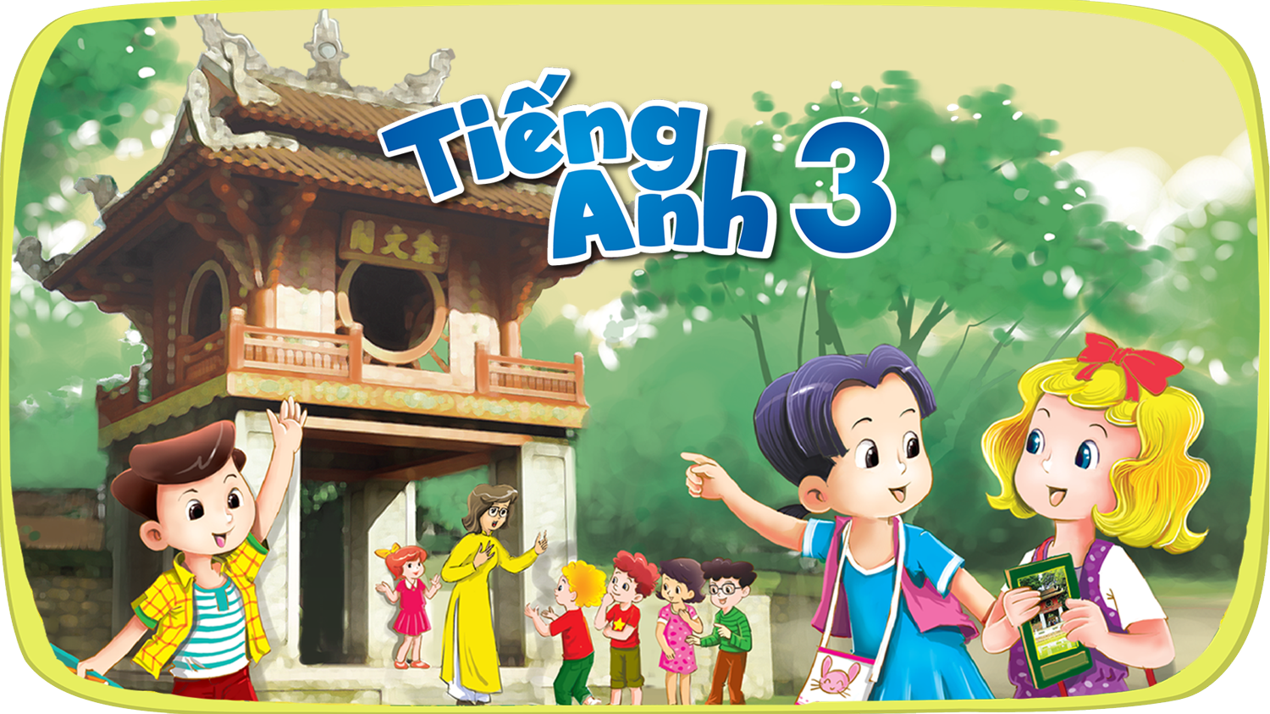




Slide 2
Unit 13
Appearance
Lesson 2 - Period 3

Slide 3
Table of contents
01
Warm-up and review
04
02
03
Let's talk.
Look, listen and repeat.
05
Fun corner and wrap-up
Listen, point and say.

Slide 4
Warm-up
01
Game: "Teacher says…"
Notes:
- Teacher quickly review body parts, focus on Face features.
- Teacher plays "Teacher says": Touch your ears/nose/face/eyes/hair .... to review face features.

Slide 5
02
Look, listen and repeat.

Slide 6
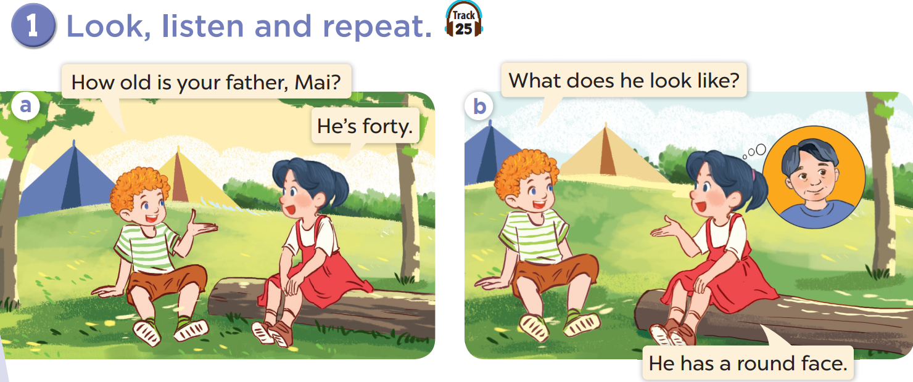
Who is he? Who is she?
Look at Mai's father. Is his face round?

Slide 7

Look, listen and repeat.

Slide 8
03
Listen, point and say.

Slide 9
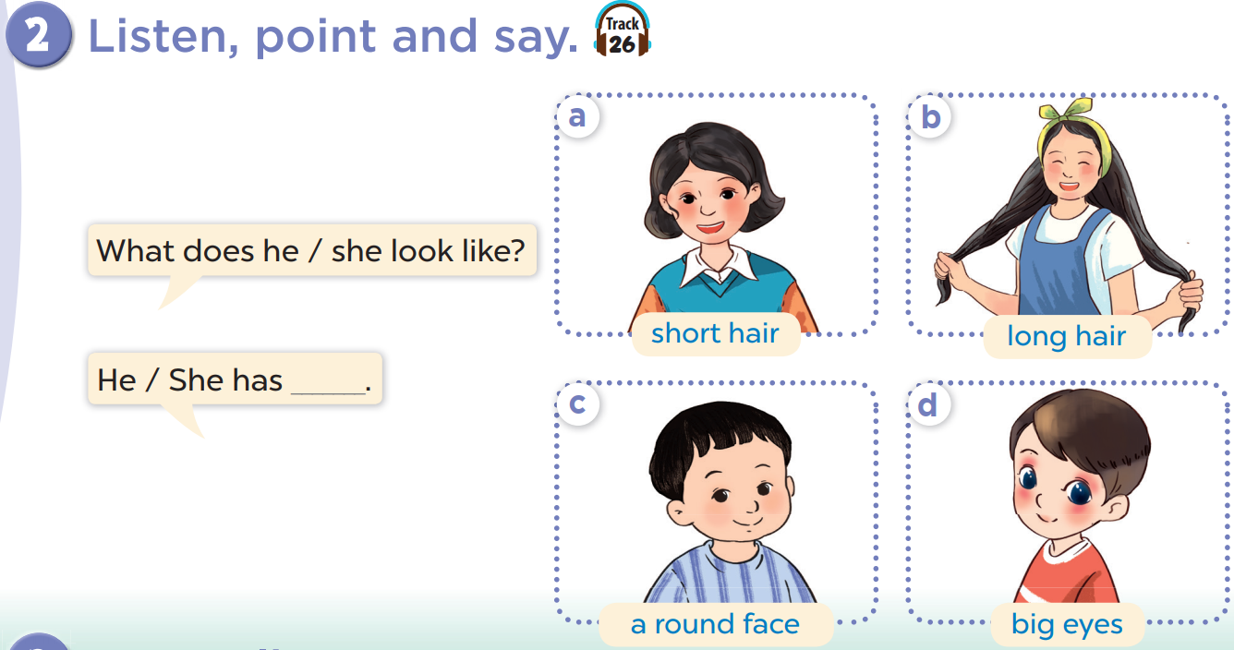
Listen, point and say.
Work in pairs. Practise.
Notes:
Click on the Speaker Icon to play the audio.

Slide 10
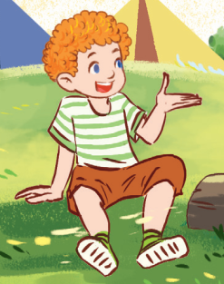
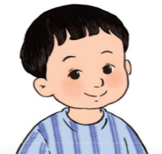
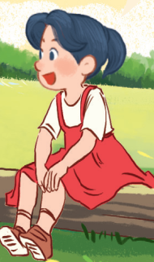
What does he look like?
He has a round face.

Slide 11

What does she look like?
She has big eyes.

Slide 12
What does he/she look like?
He/She has _____.

Slide 13
04
Let's talk.

Slide 14
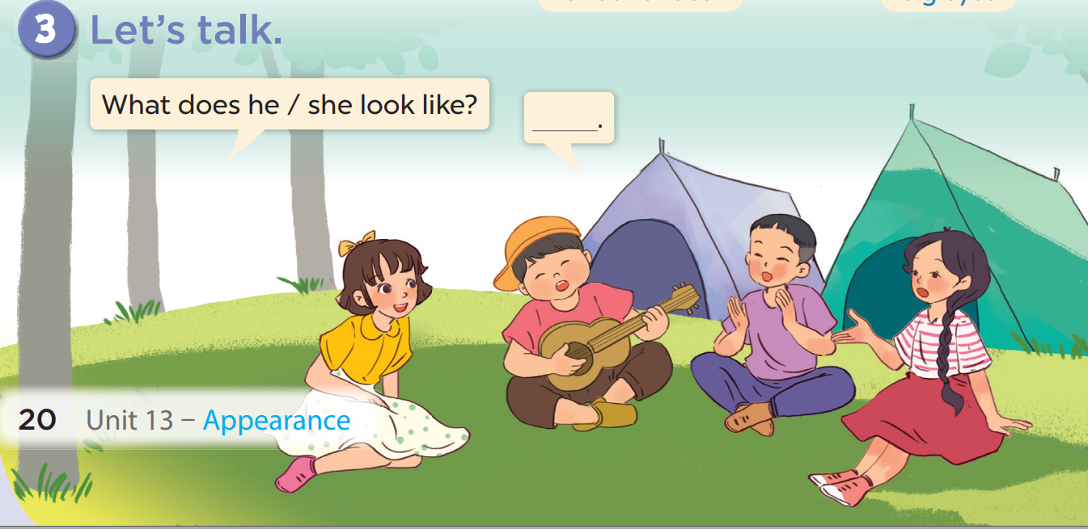

Slide 15
Fun corner and wrap-up
05

Slide 16
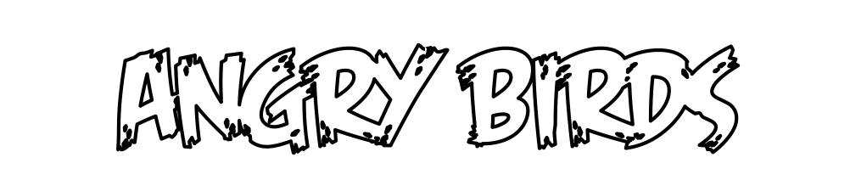
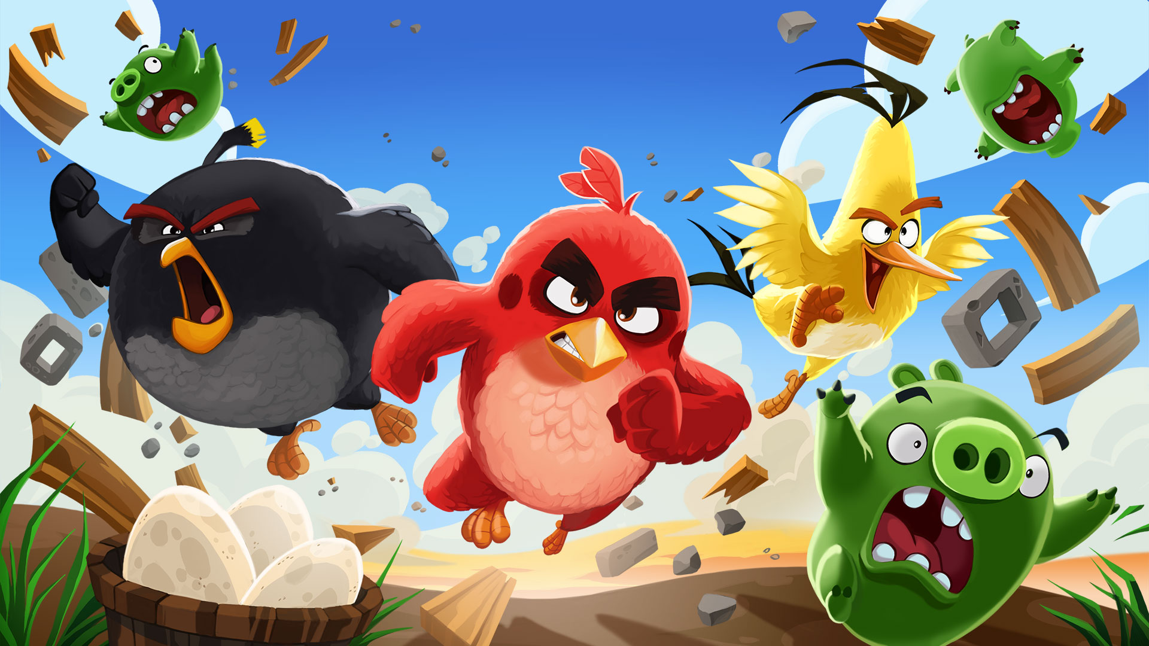

Slide 17

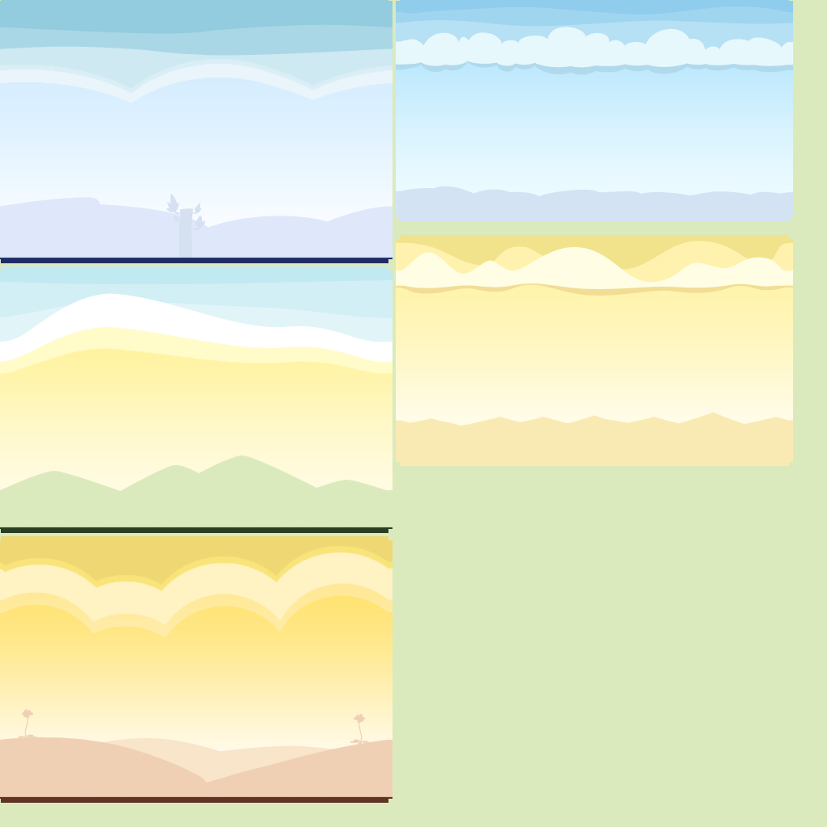


















1
2
3
4
5
6
7
8
1
2
3
4
5
6
7
8
1 point
3 points
Take 5 points
2 points
4 points
Notes:
Click to numbers at the top to answer the questions
Click to numbers in the bricks to review points
17

Slide 18

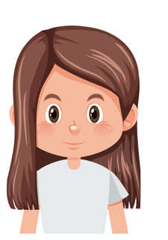
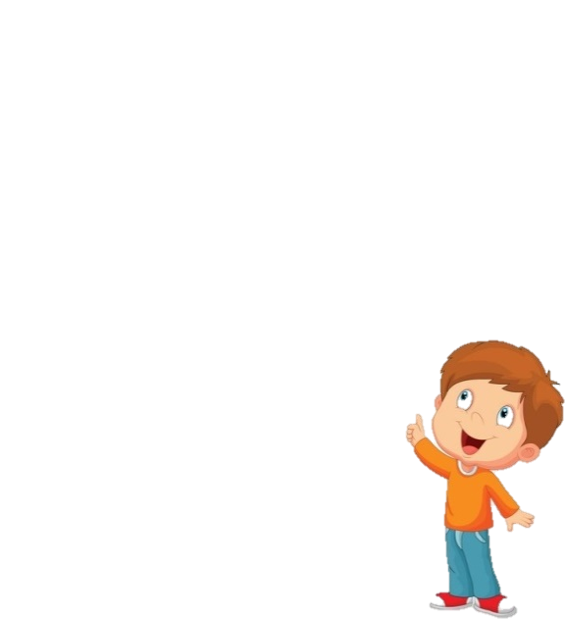
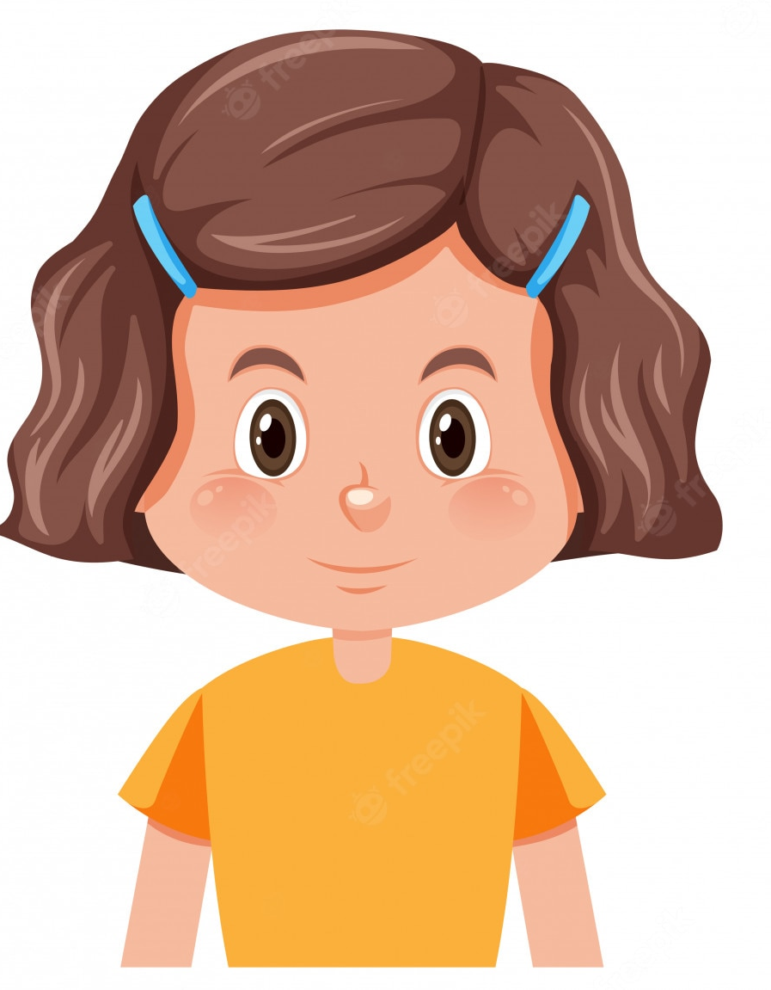
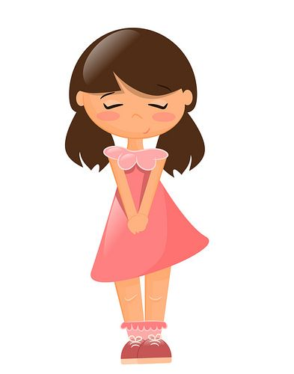
What does Mai look like?
Mai
Hoa
She has short hair.
Notes:
Other answers can be accepted if correct.
Click the red angry bird to come back

Slide 19
What does Hoa look like?
Mai
Hoa
She has long hair.
Notes:
Other answers can be accepted if correct.
Click the red angry bird to come back

Slide 20
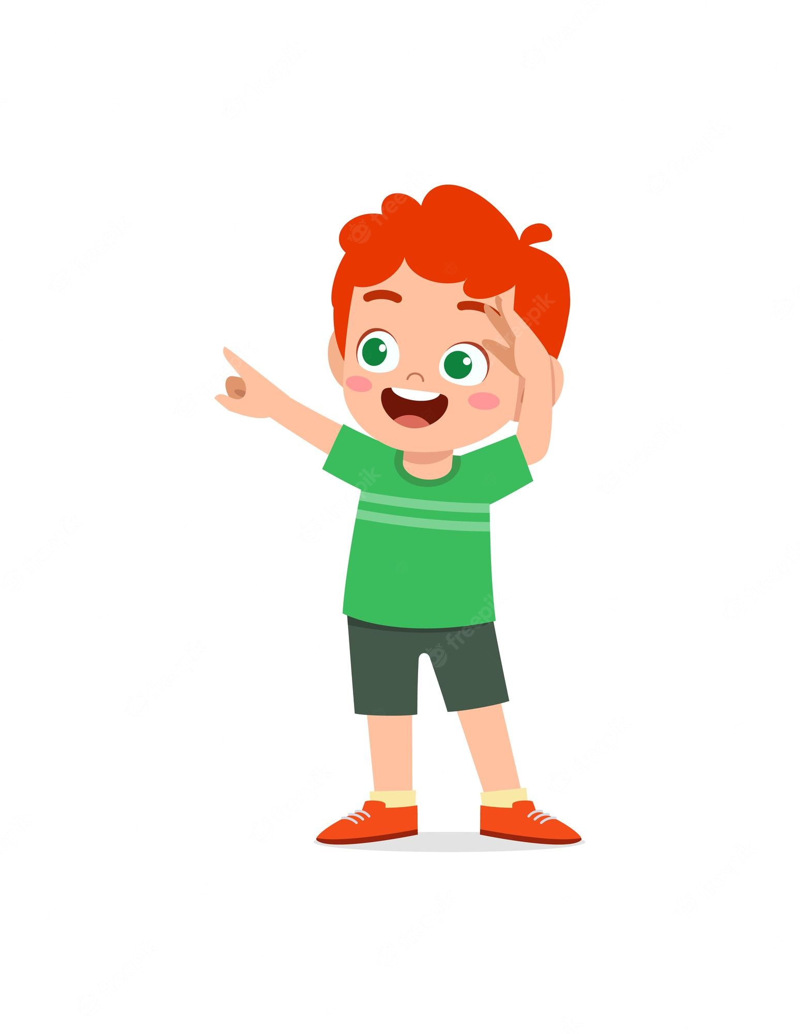
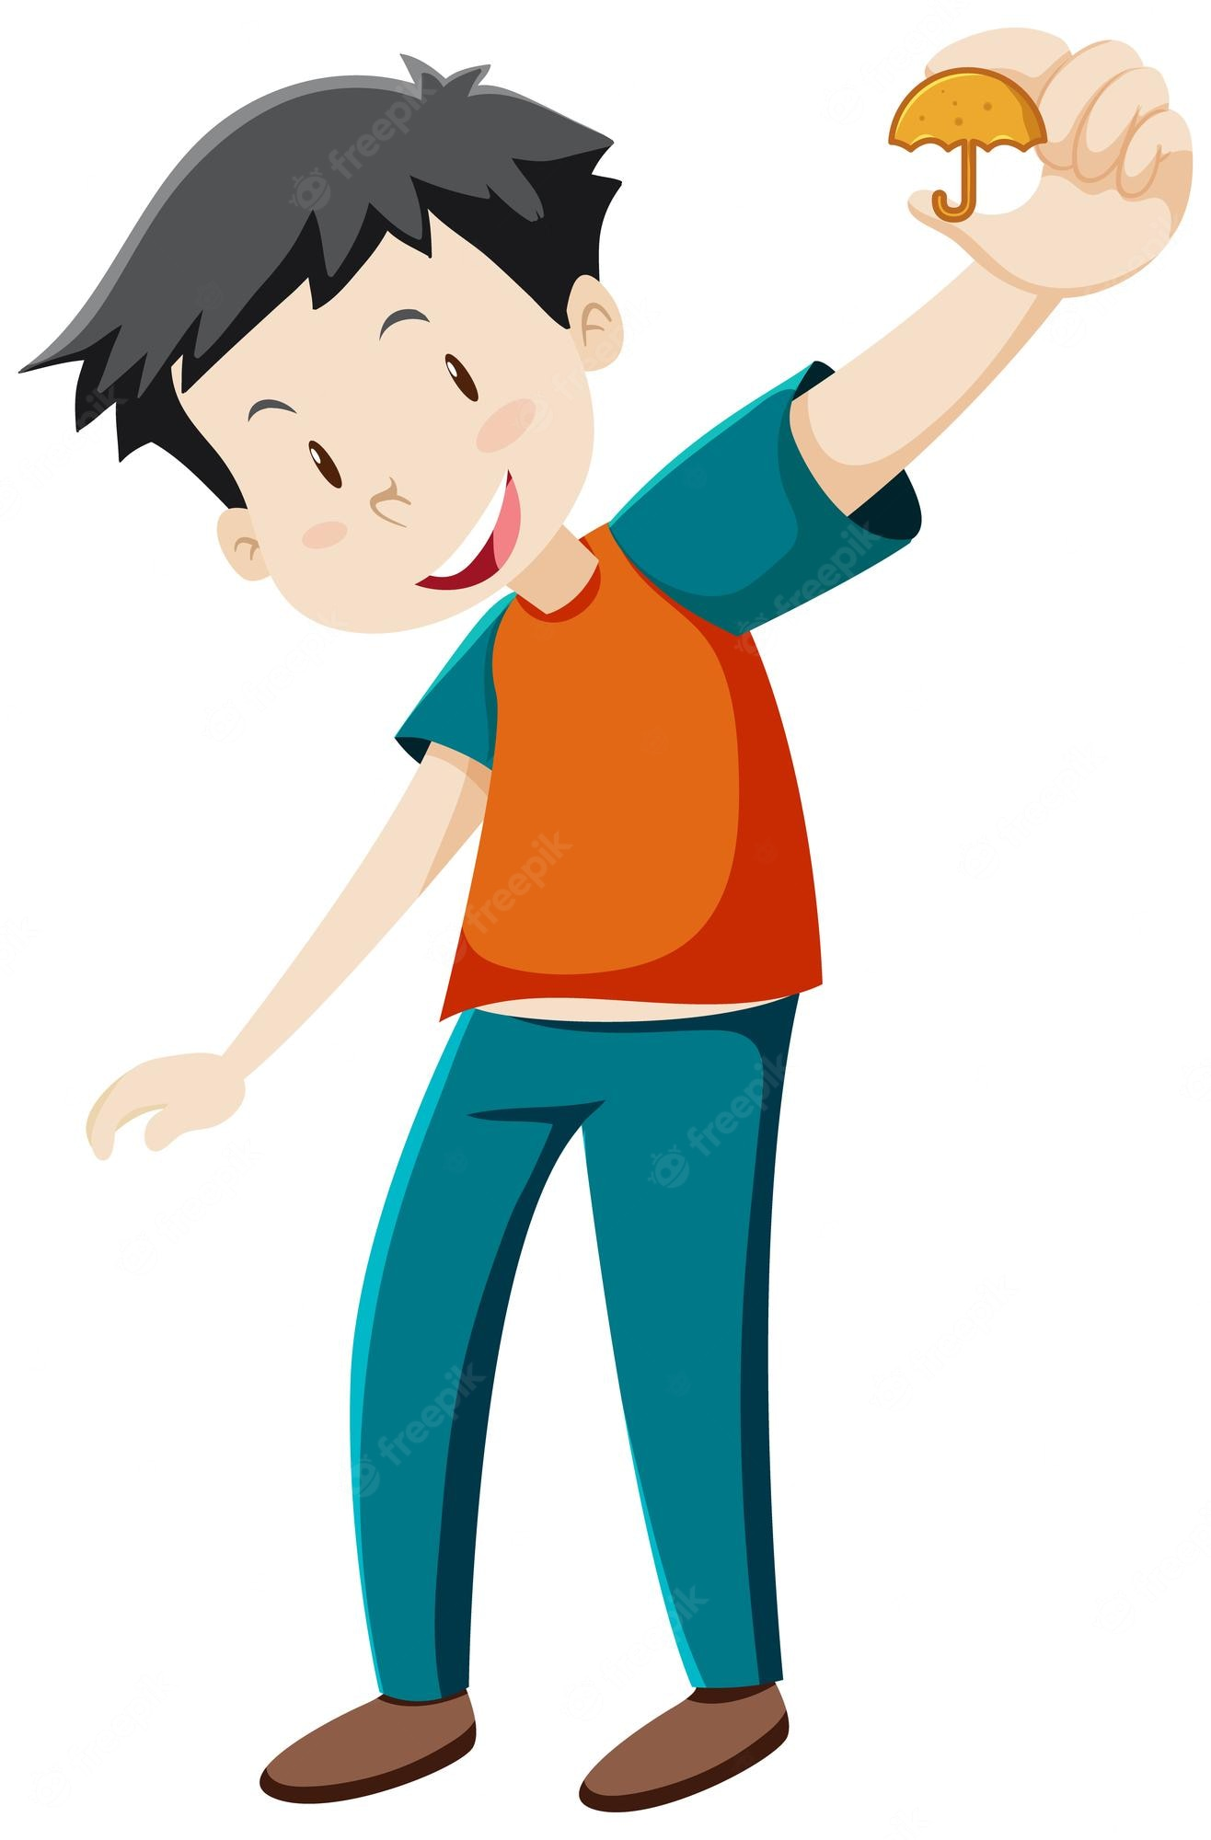
What does Ben look like?
Minh
Ben
He has big eyes.
Notes:
Other answers can be accepted if correct.
Click the red angry bird to come back

Slide 21
...........................?
What does he look like
He is slim. He has a round face.
Notes:
Other answers can be accepted if correct.
Click the red angry bird to come back

Slide 22
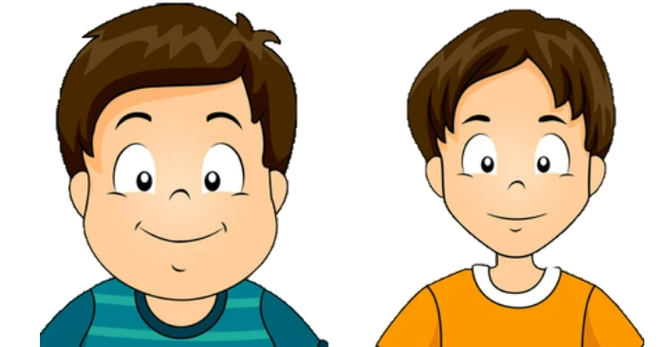
What does Peter look like?
Peter
Nam
He has a round face.
Notes:
Other answers can be accepted if correct.
Click the red angry bird to come back

Slide 23
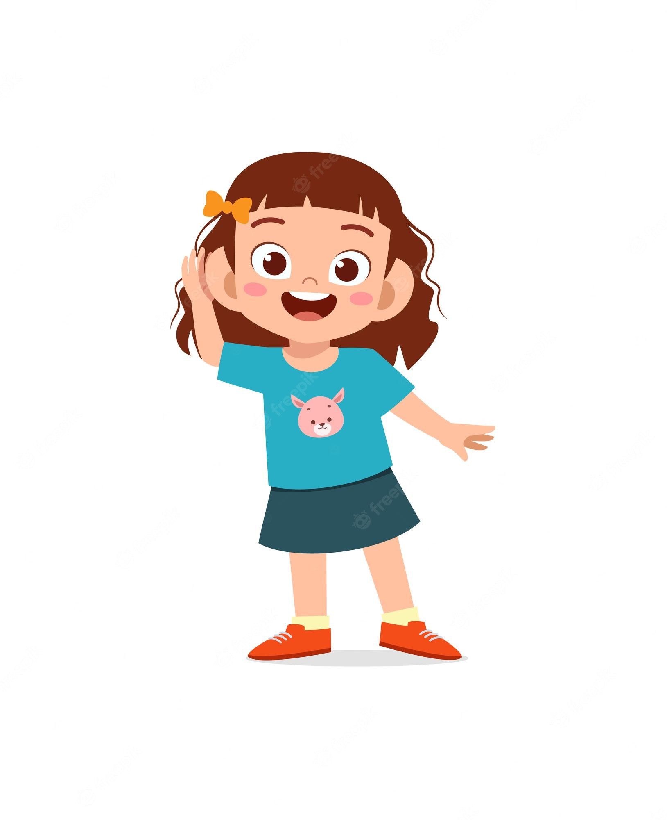
What does she look like
.........................?
She has big eyes.
Notes:
Click the red angry bird to come back

Slide 24
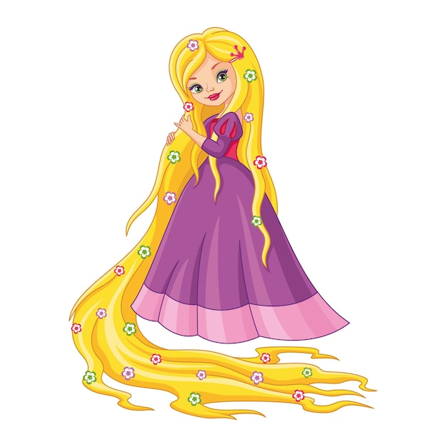
What does she look like?
She has long hair.
Notes:
Click the red angry bird to come back

Slide 25
What does Minh look like?
Minh
Ben
He has small eyes.
Notes:
Explain that student chooses to describe their mother or father.
Click the red angry bird to come back

Slide 26



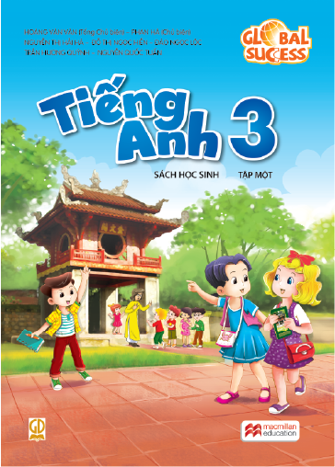




THANK YOU
Website: hoclieu.vn
Fanpage: facebook.com/www.tienganhglobalsuccess.vn

