Slide 1





Slide 2
Unit 13
Appearance
Lesson 2 - Period 4

Slide 3
Table of contents
01
Warm-up and review
04
02
03
Let's play.
Listen and number.
05
Fun corner and wrap-up
Look, read and complete.

Slide 4
Warm-up
01

Slide 5

Find the odd one out.
long hair
tall
short
A
B
C

Slide 6
Find the odd one out.
slim
big
handsome
A
B
C

Slide 7
Find the odd one out.
big eyes
tall
a round face
A
B
C

Slide 8
Find the odd one out.
big eyes
slim
big
A
B
C

Slide 9
Find the odd one out.
has
she
is
A
B
C

Slide 10
Find the odd one out.
mother
round
sister
A
B
C

Slide 11
02
Listen and number.

Slide 12

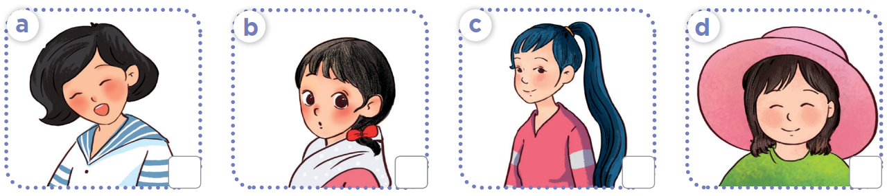
In pairs, look, ask and answer.
What does she look like?
START TIMER
2 : 00
1 : 59
1 : 58
1 : 57
1 : 56
1 : 55
1 : 54
1 : 53
1 : 52
1 : 51
1 : 50
1 : 49
1 : 48
1 : 47
1 : 46
1 : 45
1 : 44
1 : 43
1 : 42
1 : 41
1 : 40
1 : 39
1 : 38
1 : 37
1 : 36
1 : 35
1 : 34
1 : 33
1 : 32
1 : 31
1 : 30
1 : 29
1 : 28
1 : 27
1 : 26
1 : 25
1 : 24
1 : 23
1 : 22
1 : 21
1 : 20
1 : 19
1 : 18
1 : 17
1 : 16
1 : 15
1 : 14
1 : 13
1 : 12
1 : 11
1 : 10
1 : 09
1 : 08
1 : 07
1 : 06
1 : 05
1 : 04
1 : 03
1 : 02
1 : 01
1 : 00
0 : 59
0 : 58
0 : 57
0 : 56
0 : 55
0 : 54
0 : 53
0 : 52
0 : 51
0 : 50
0 : 49
0 : 48
0 : 47
0 : 46
0 : 45
0 : 44
0 : 43
0 : 42
0 : 41
0 : 40
0 : 39
0 : 38
0 : 37
0 : 36
0 : 35
0 : 34
0 : 43
0 : 32
0 : 31
0 : 30
0 : 29
0 : 28
0 : 27
0 : 26
0 : 25
0 : 24
0 : 23
0 : 22
0 : 21
0 : 20
0 : 19
0 : 18
0 : 17
0 : 16
0 : 15
0 : 14
0 : 13
0 : 12
0 : 11
0 : 10
0 : 09
0 : 08
0 : 07
0 : 06
0 : 05
0 : 04
0 : 03
0 : 02
0 : 01
0 : 00
TIME’S UP!
She has ____.
Notes:
After pair works, teacher calls out some pairs to check with class.

Slide 13

Listen and number.
2
4
3
1
Notes:
Click on the audio icon to play again (if needed)

Slide 14
03
Look, complete and read.

Slide 15
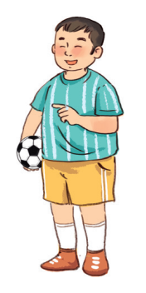
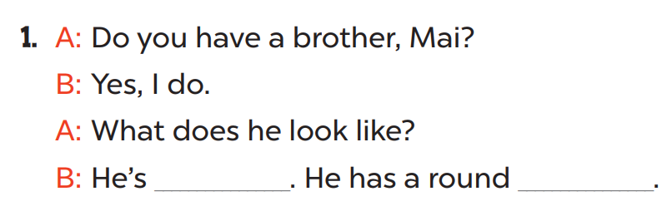
Look at the picture.
Is the boy slim or big?
Is his face round or slim?
What are the missing words?
big
face

Slide 16
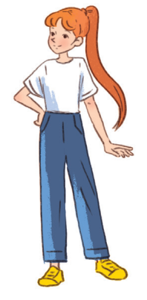
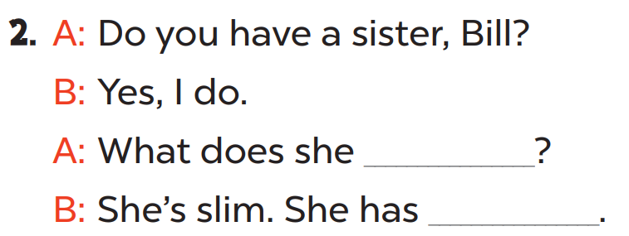
Look at the picture.
Is the girl slim or big?
Is her hair long or short?
What are the missing words?
look like
long hair

Slide 17
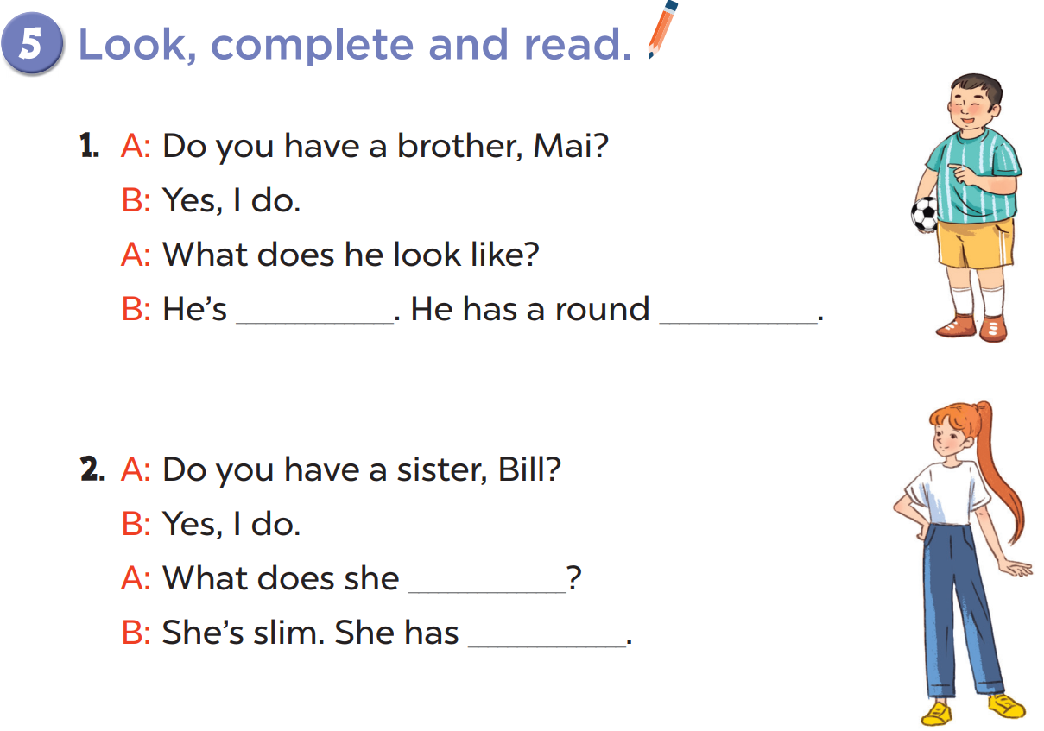
Practise in pairs.
big
face
Act it out!
look like
long hair

Slide 18
04
Let's play.

Slide 19
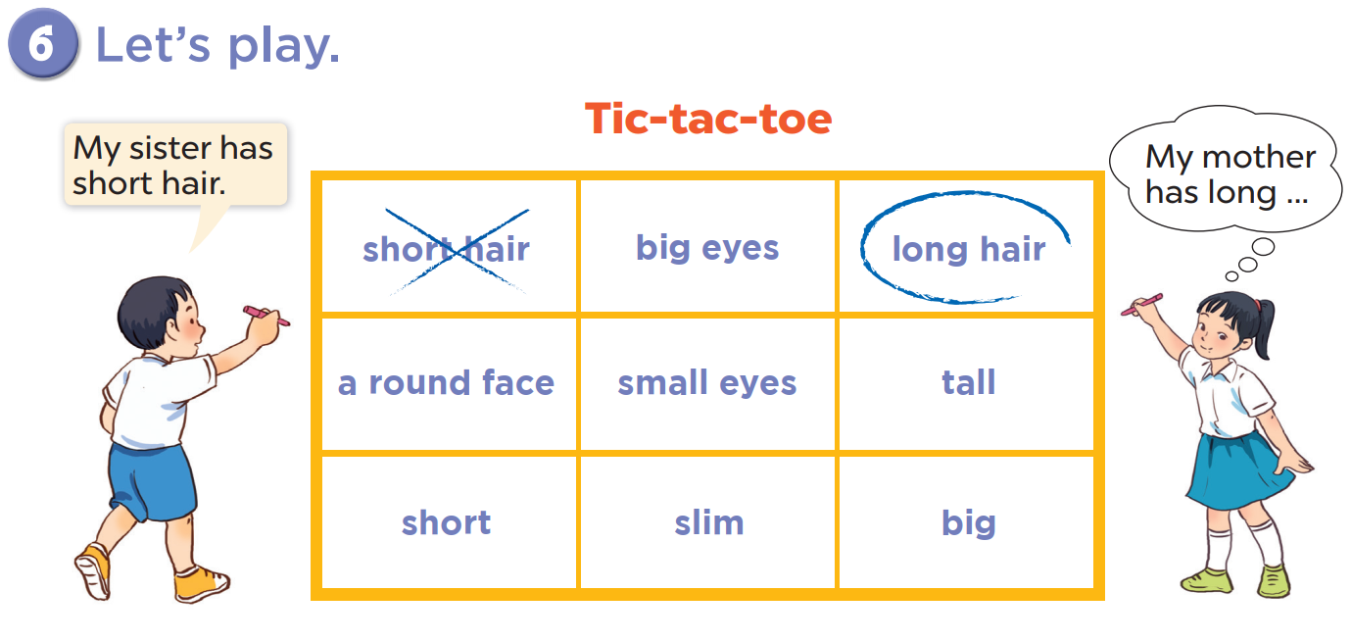

Slide 20
05
Fun corner and wrap-up
Doraemon Game

Slide 21

1
2
3
4
5
6
7
8
9
Notes:
Click on Doraemon to go to the question.

Slide 22
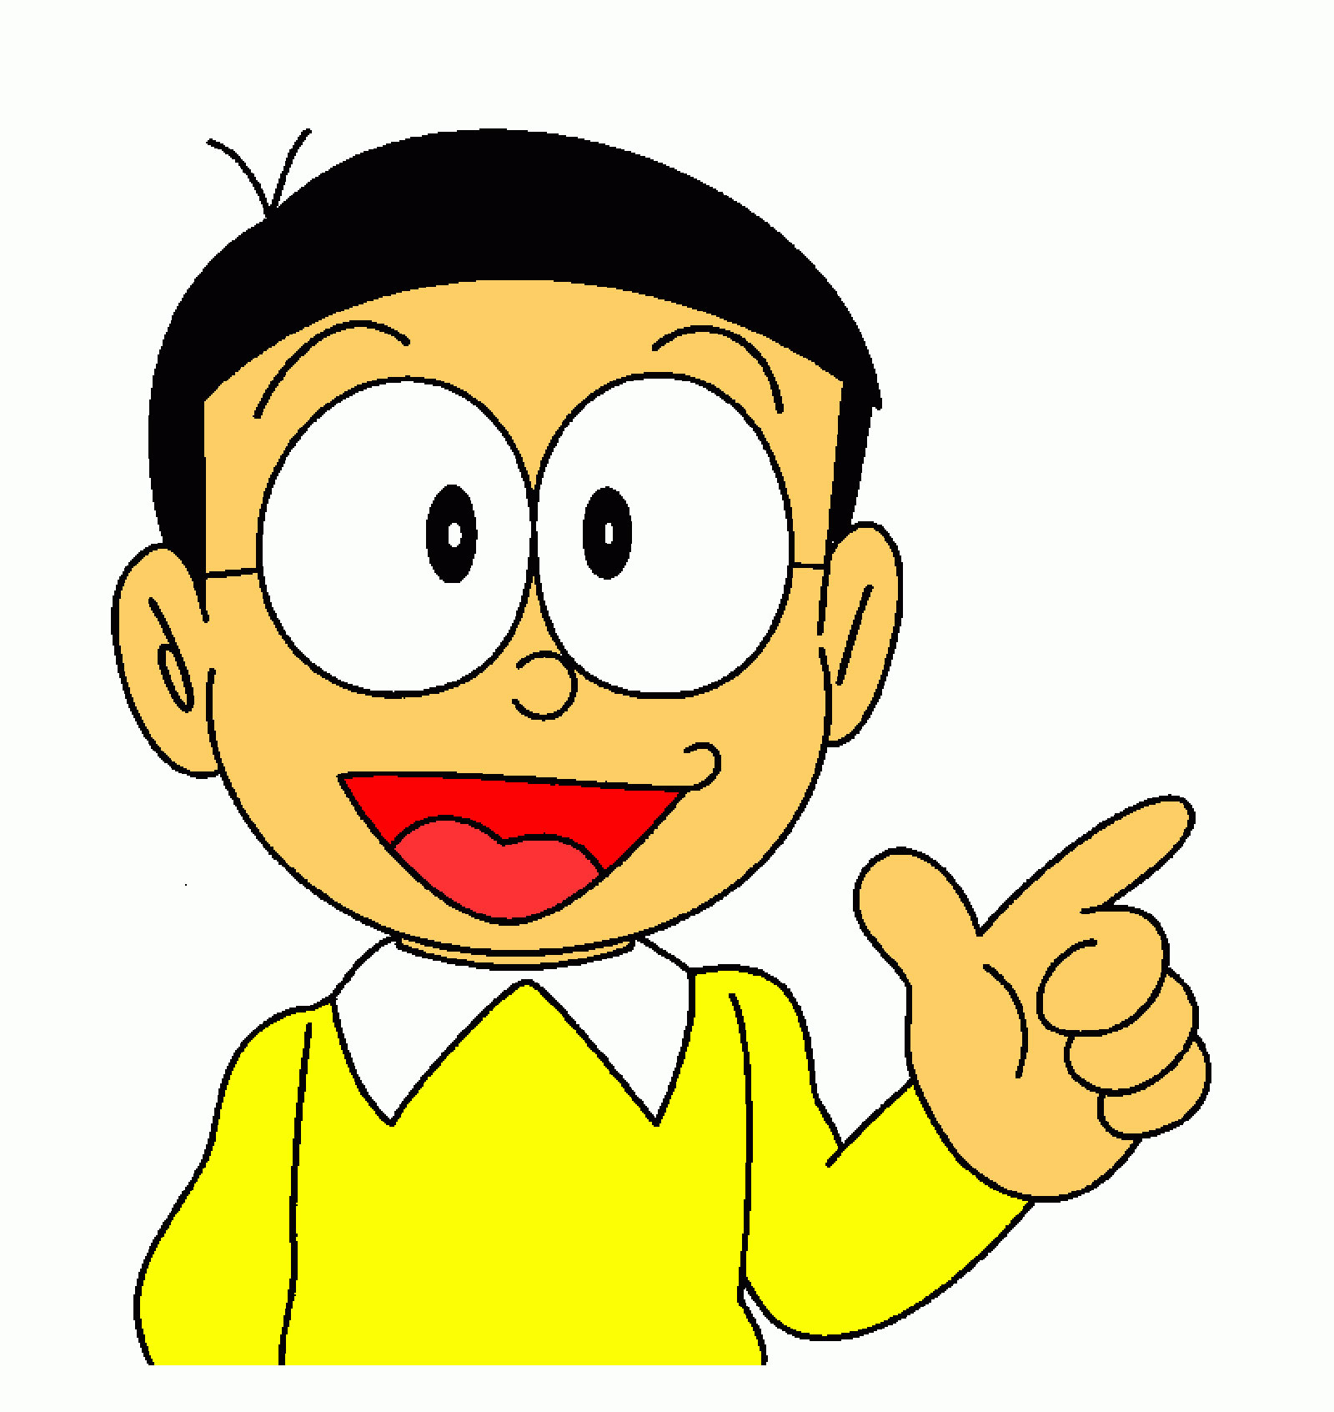
Nobita ___ big eyes.
A. is
B. has
C. look
Notes:
Go to next slide for the scores.

Slide 23
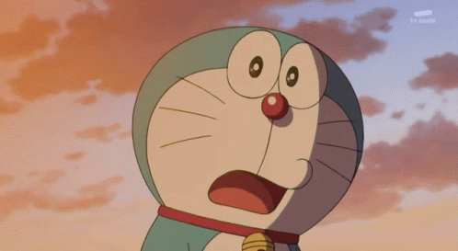
Wow!
+ 4 dorayaki
Notes:
Click on the Return button to questions slide.

Slide 24
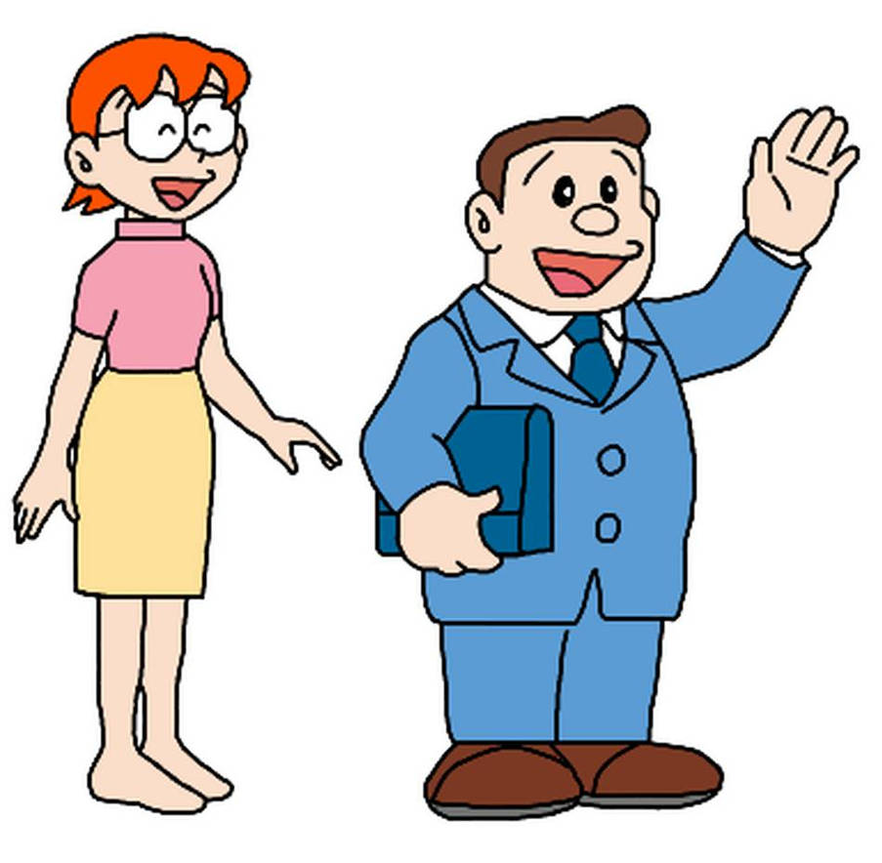
Nobita's mother _____.
A. is slim
B. has slim
C. is short
Notes:
Go to next slide for the scores.

Slide 25
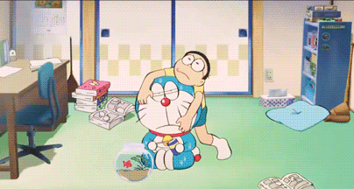
-2 dorayaki
It's a bad day!
Notes:
Click on the Return button to questions slide.

Slide 26
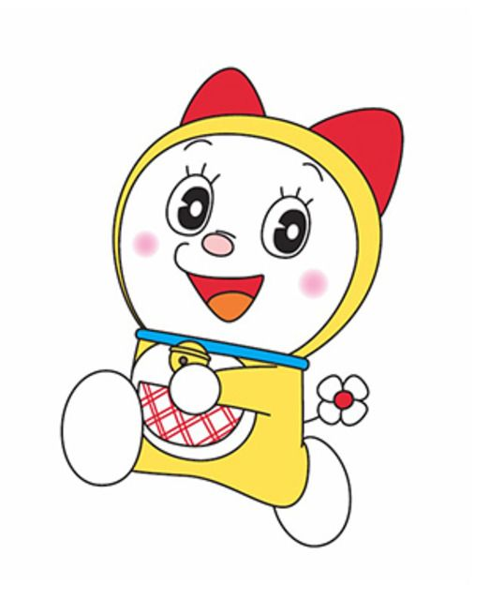
Dorami ______ .
A. is tall
B. has short
C. is short
Notes:
Go to next slide for the scores.

Slide 27
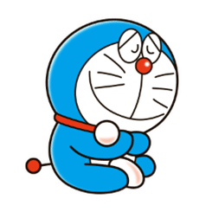

+2 dorayaki
Doraemon is happy today!
Notes:
Click on the Return button to questions slide.

Slide 28
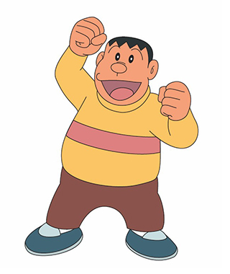
Jaian ________ .
A. has tall
B. is big
C. look short
Notes:
Go to next slide for the scores.

Slide 29
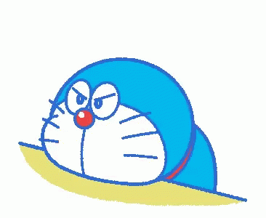
0 dorayaki
Not feeling lucky
Notes:
Click on the Return button to questions slide.

Slide 30
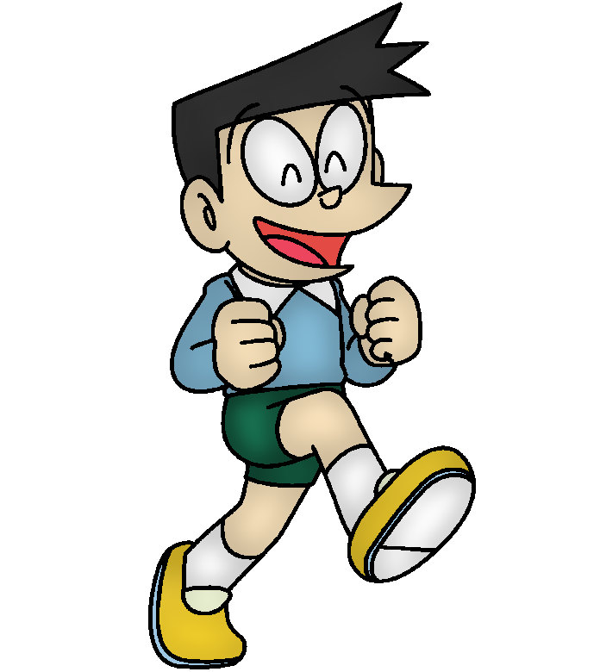
Suneo _______ .
A. has short hair
B. is short hair
C. has short
Notes:
Go to next slide for the scores.

Slide 31
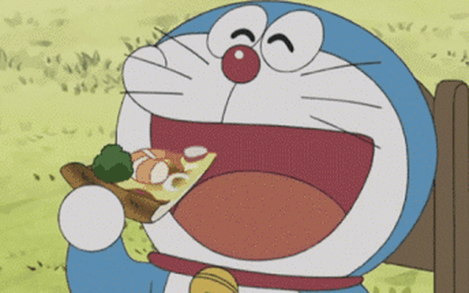
+3 dorayaki
Doraemon is in a good mood!
Notes:
Click on the Return button to questions slide.

Slide 32
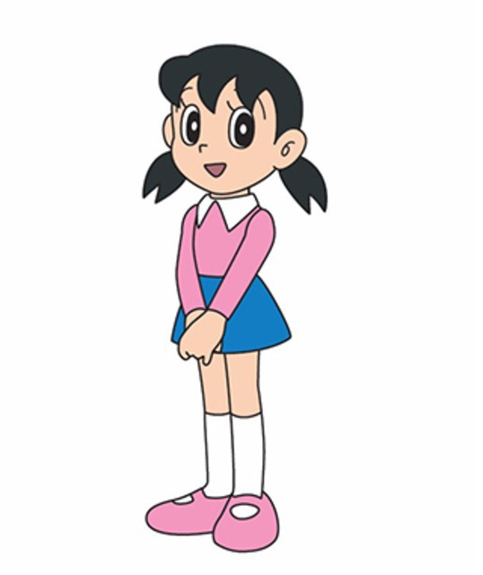
Shizuka ___ long ___.
A. has - eyes
B. is - hair
C. has - hair
Notes:
Go to next slide for the scores.

Slide 33
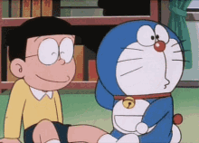
+2 dorayaki
Such a funny story!
Notes:
Click on the Return button to questions slide.

Slide 34
Nobita's father ___ big and short.
A. look
B. has
C. is
Notes:
Go to next slide for the scores.

Slide 35
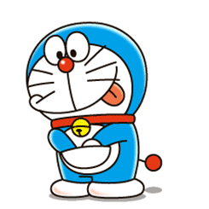
+3 dorayaki
Doraemon has a gift for you
Notes:
Click on the Return button to questions slide.

Slide 36
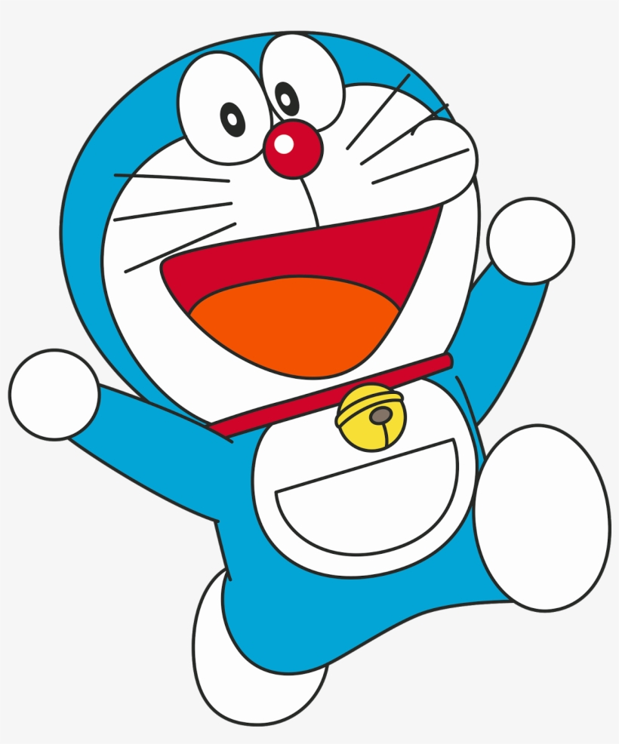
Doraemon __ a round __.
A. is - face
B. has - hair
C. has - face
Notes:
Go to next slide for the scores.

Slide 37
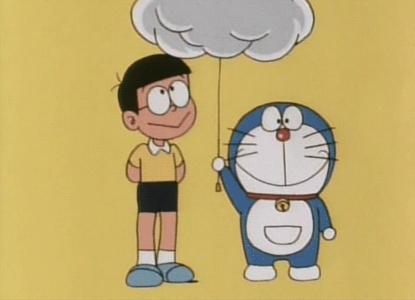
-1 dorayaki
It's rainy. They get wet.
Notes:
Click on the Return button to questions slide.

Slide 38
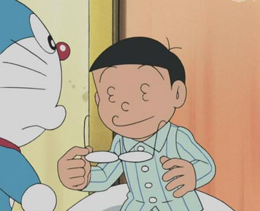
Nobita has _____.
A. round face
B. small eyes
C. big eyes
Notes:
Go to next slide for the scores.

Slide 39
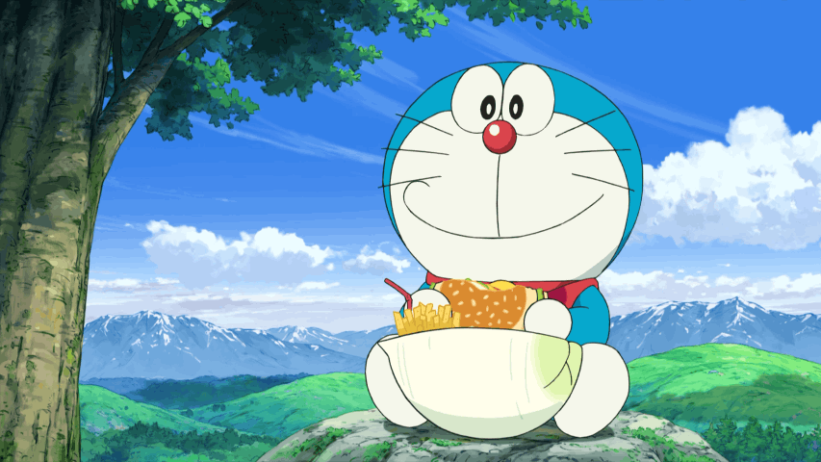
+4 dorayaki
Yummy!
Notes:
Click on the Return button to questions slide.

Slide 40








THANK YOU
Website: hoclieu.vn
Fanpage: facebook.com/www.tienganhglobalsuccess.vn

