Slide 2
Unit 13 Appearance
Lesson3 - Period 6

Slide 3
Table of contents
01
Warm-up and review
04
02
03
Project
Read and complete.
Let’s write.

Slide 4
Warm-up
01

Slide 5
Sorting
He/She is ... | He/She has ...
a round face
beautiful
long legs
slim
a big nose
tall
small eyes
big

Slide 6
Number Race
1
2
1
2
3
4
3
4
Notes:
- Teacher devides class into teams.
- Teacher gives each pupil in one team a number so that each team has equal numbers.
- Teacher shows the questions, allow time for pupils to think. Then T calls out a number, pupils with that number from each team stands up and shouts out the answers. T praise and give points for the teams.

Slide 7
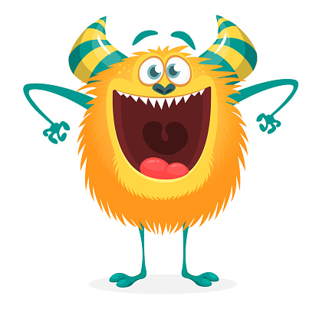
The monster _____ a big mouth.
has

Slide 8
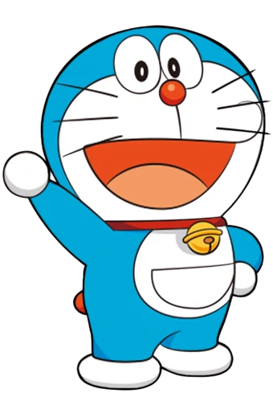
Doraemon ____ short.
is

Slide 9
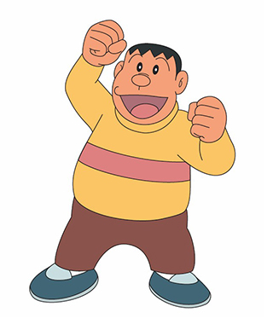
Jaian _____ big.
is

Slide 10
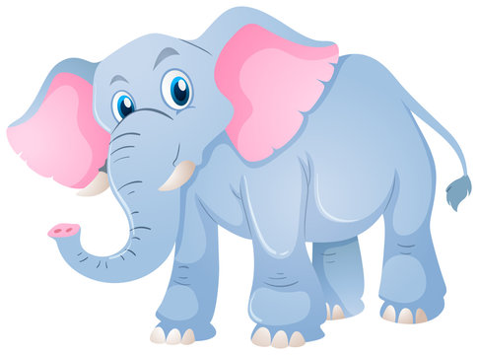
The elephant _____ big ears.
has

Slide 11
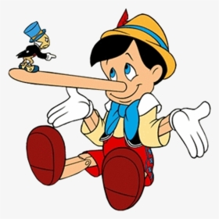
Pinocchio _____ a long nose.
has

Slide 12
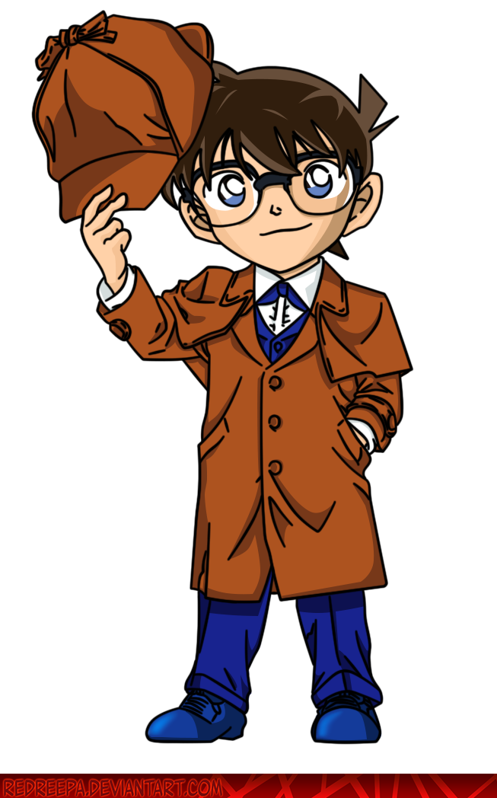
Conan _____ short hair.
has

Slide 13
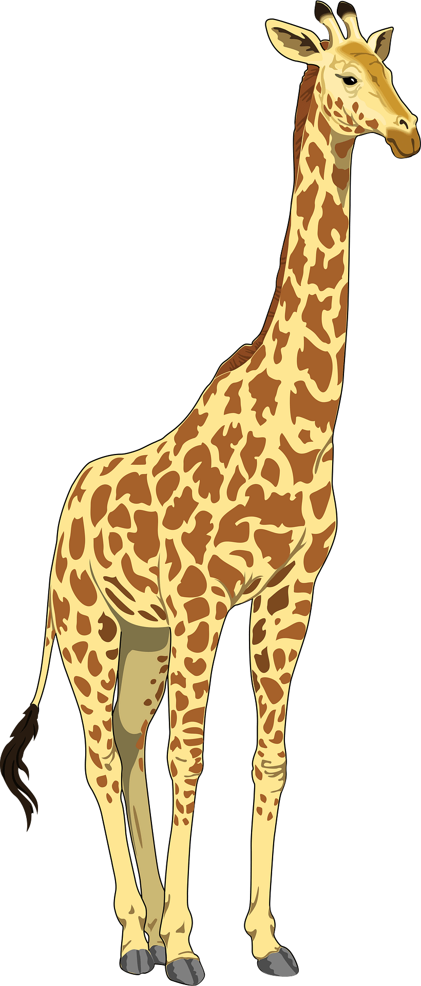
The giraffe _____ tall.
is

Slide 14
02
Read and complete

Slide 15
big
very tall
long hair
a round face and big eyes

Slide 16
03
Let's write.

Slide 17
There are __ people in my family.
My father is ____. He has _____.
My mother is ____. She has ____.
My_______________________.
I love my family!
Notes:
Teacher adds a picture and details about T's family

Slide 18
Your turn!

Slide 19
04
Project

Slide 21
THANK YOU
Website: hoclieu.vn
Fanpage: facebook.com/www.tienganhglobalsuccess.vn

