Slide 1





Slide 2


Daily activities
14
Lesson 2 – Period 4

Slide 3
Contents
01
Warm-up
04
02
05
Game
03
Let’s play.
Listen and number.
Look, complete
and read.

Slide 4
01
Warm-up

Slide 5
Listen and draw.

Slide 6
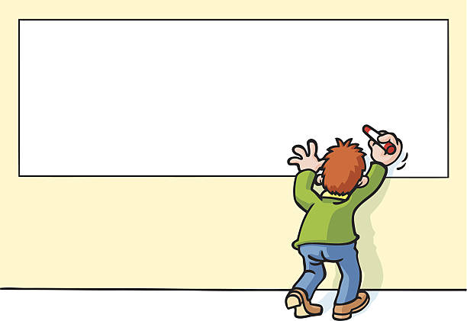



Slide 7
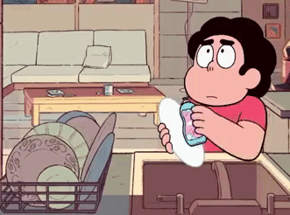

Slide 8


Slide 9
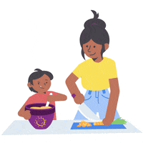

Slide 10
02
Listen and number.

Slide 11
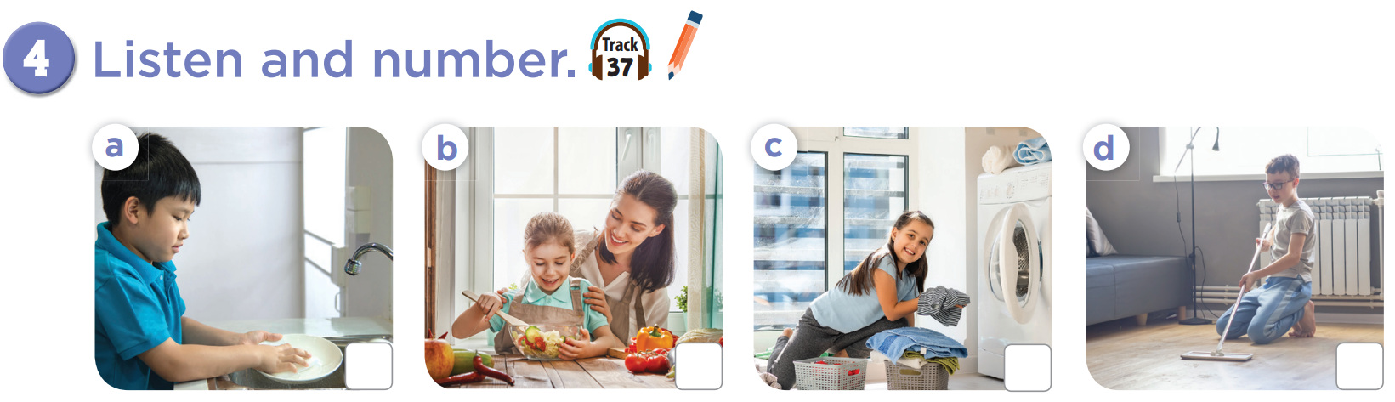

2
4
1
3

Slide 12
03
Look, complete and read.

Slide 13
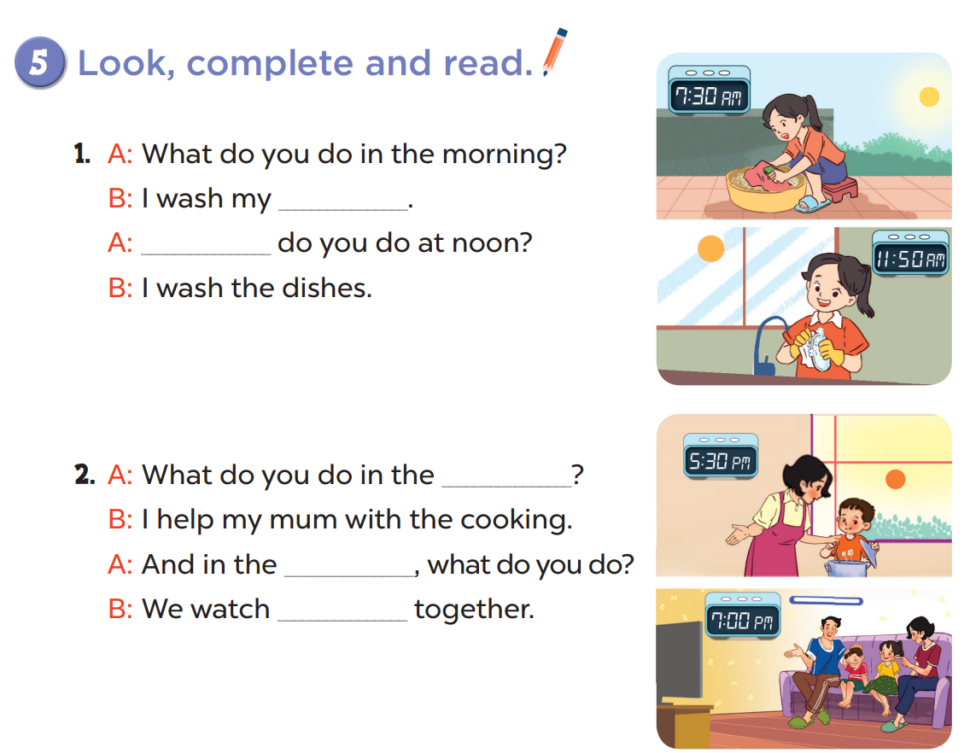

Slide 14
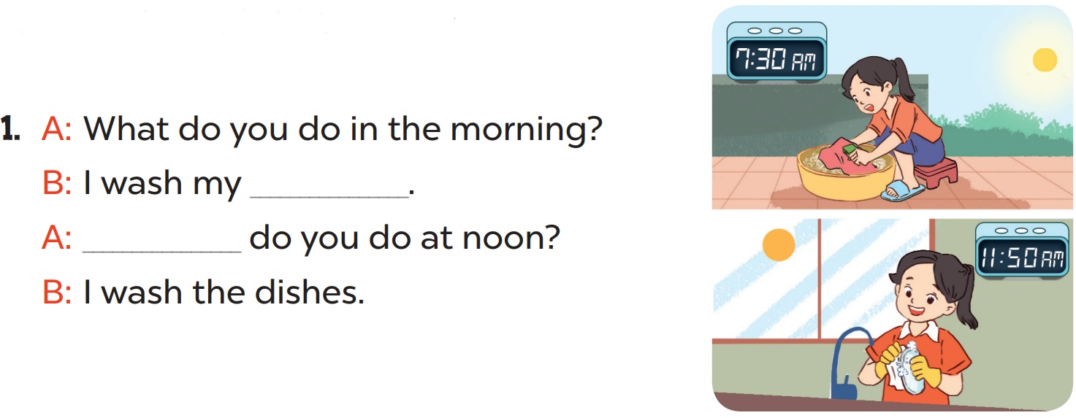
clothes
What

Slide 15
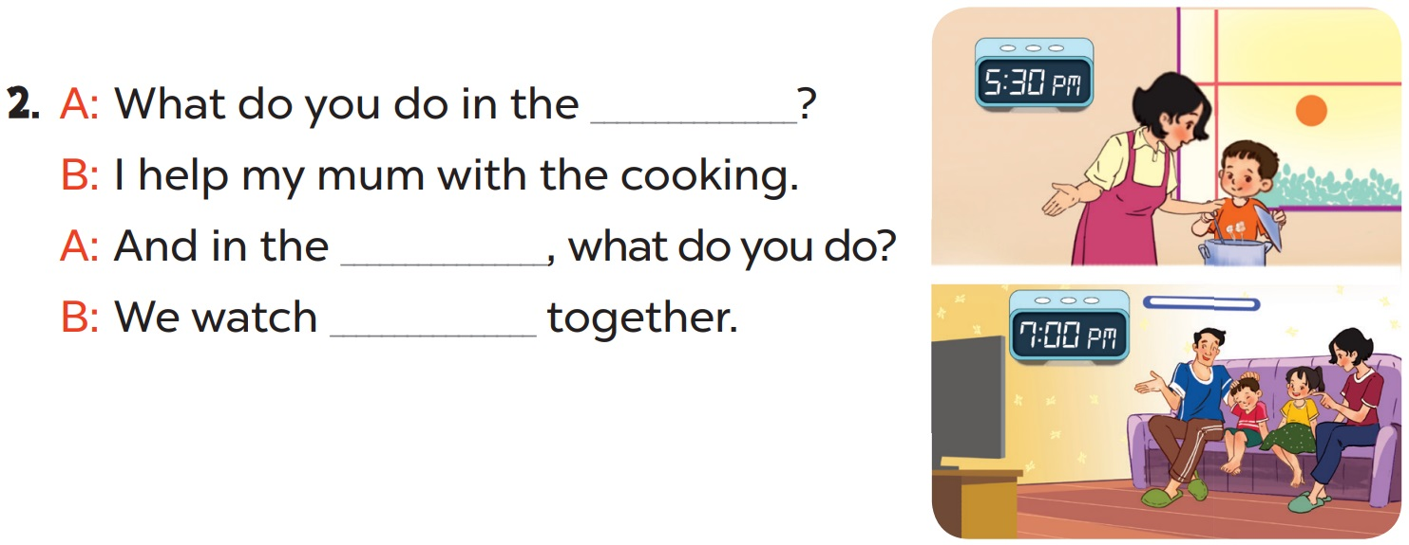
afternoon
evening
TV

Slide 16
04
Let’s play.

Slide 17
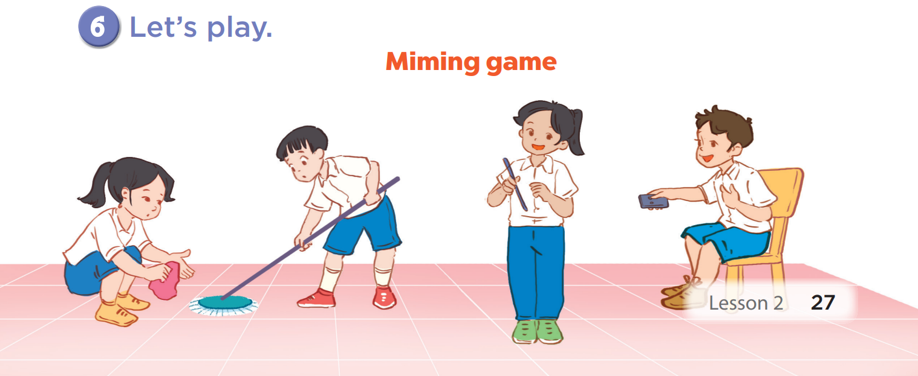

Slide 18
05
Game

Slide 19







Notes:
© Copyright Showeet.com

Slide 20
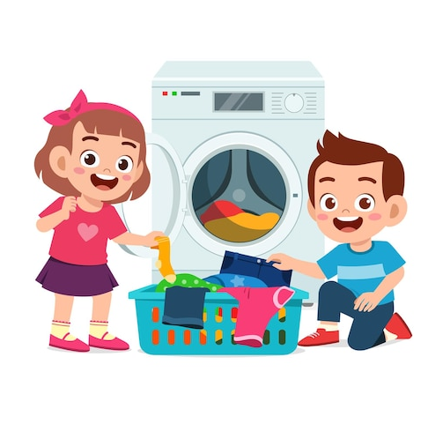

I wash the ____ at noon.
A. clothes
B. dishes
Notes:
© Copyright Showeet.com

Slide 21
A:____ do you read books?
B: I read in the afternoon.
A. What
B. When
Notes:
© Copyright Showeet.com

Slide 22

I ____ the dishes in the evening.
A. watch
B. wash
Notes:
© Copyright Showeet.com

Slide 23
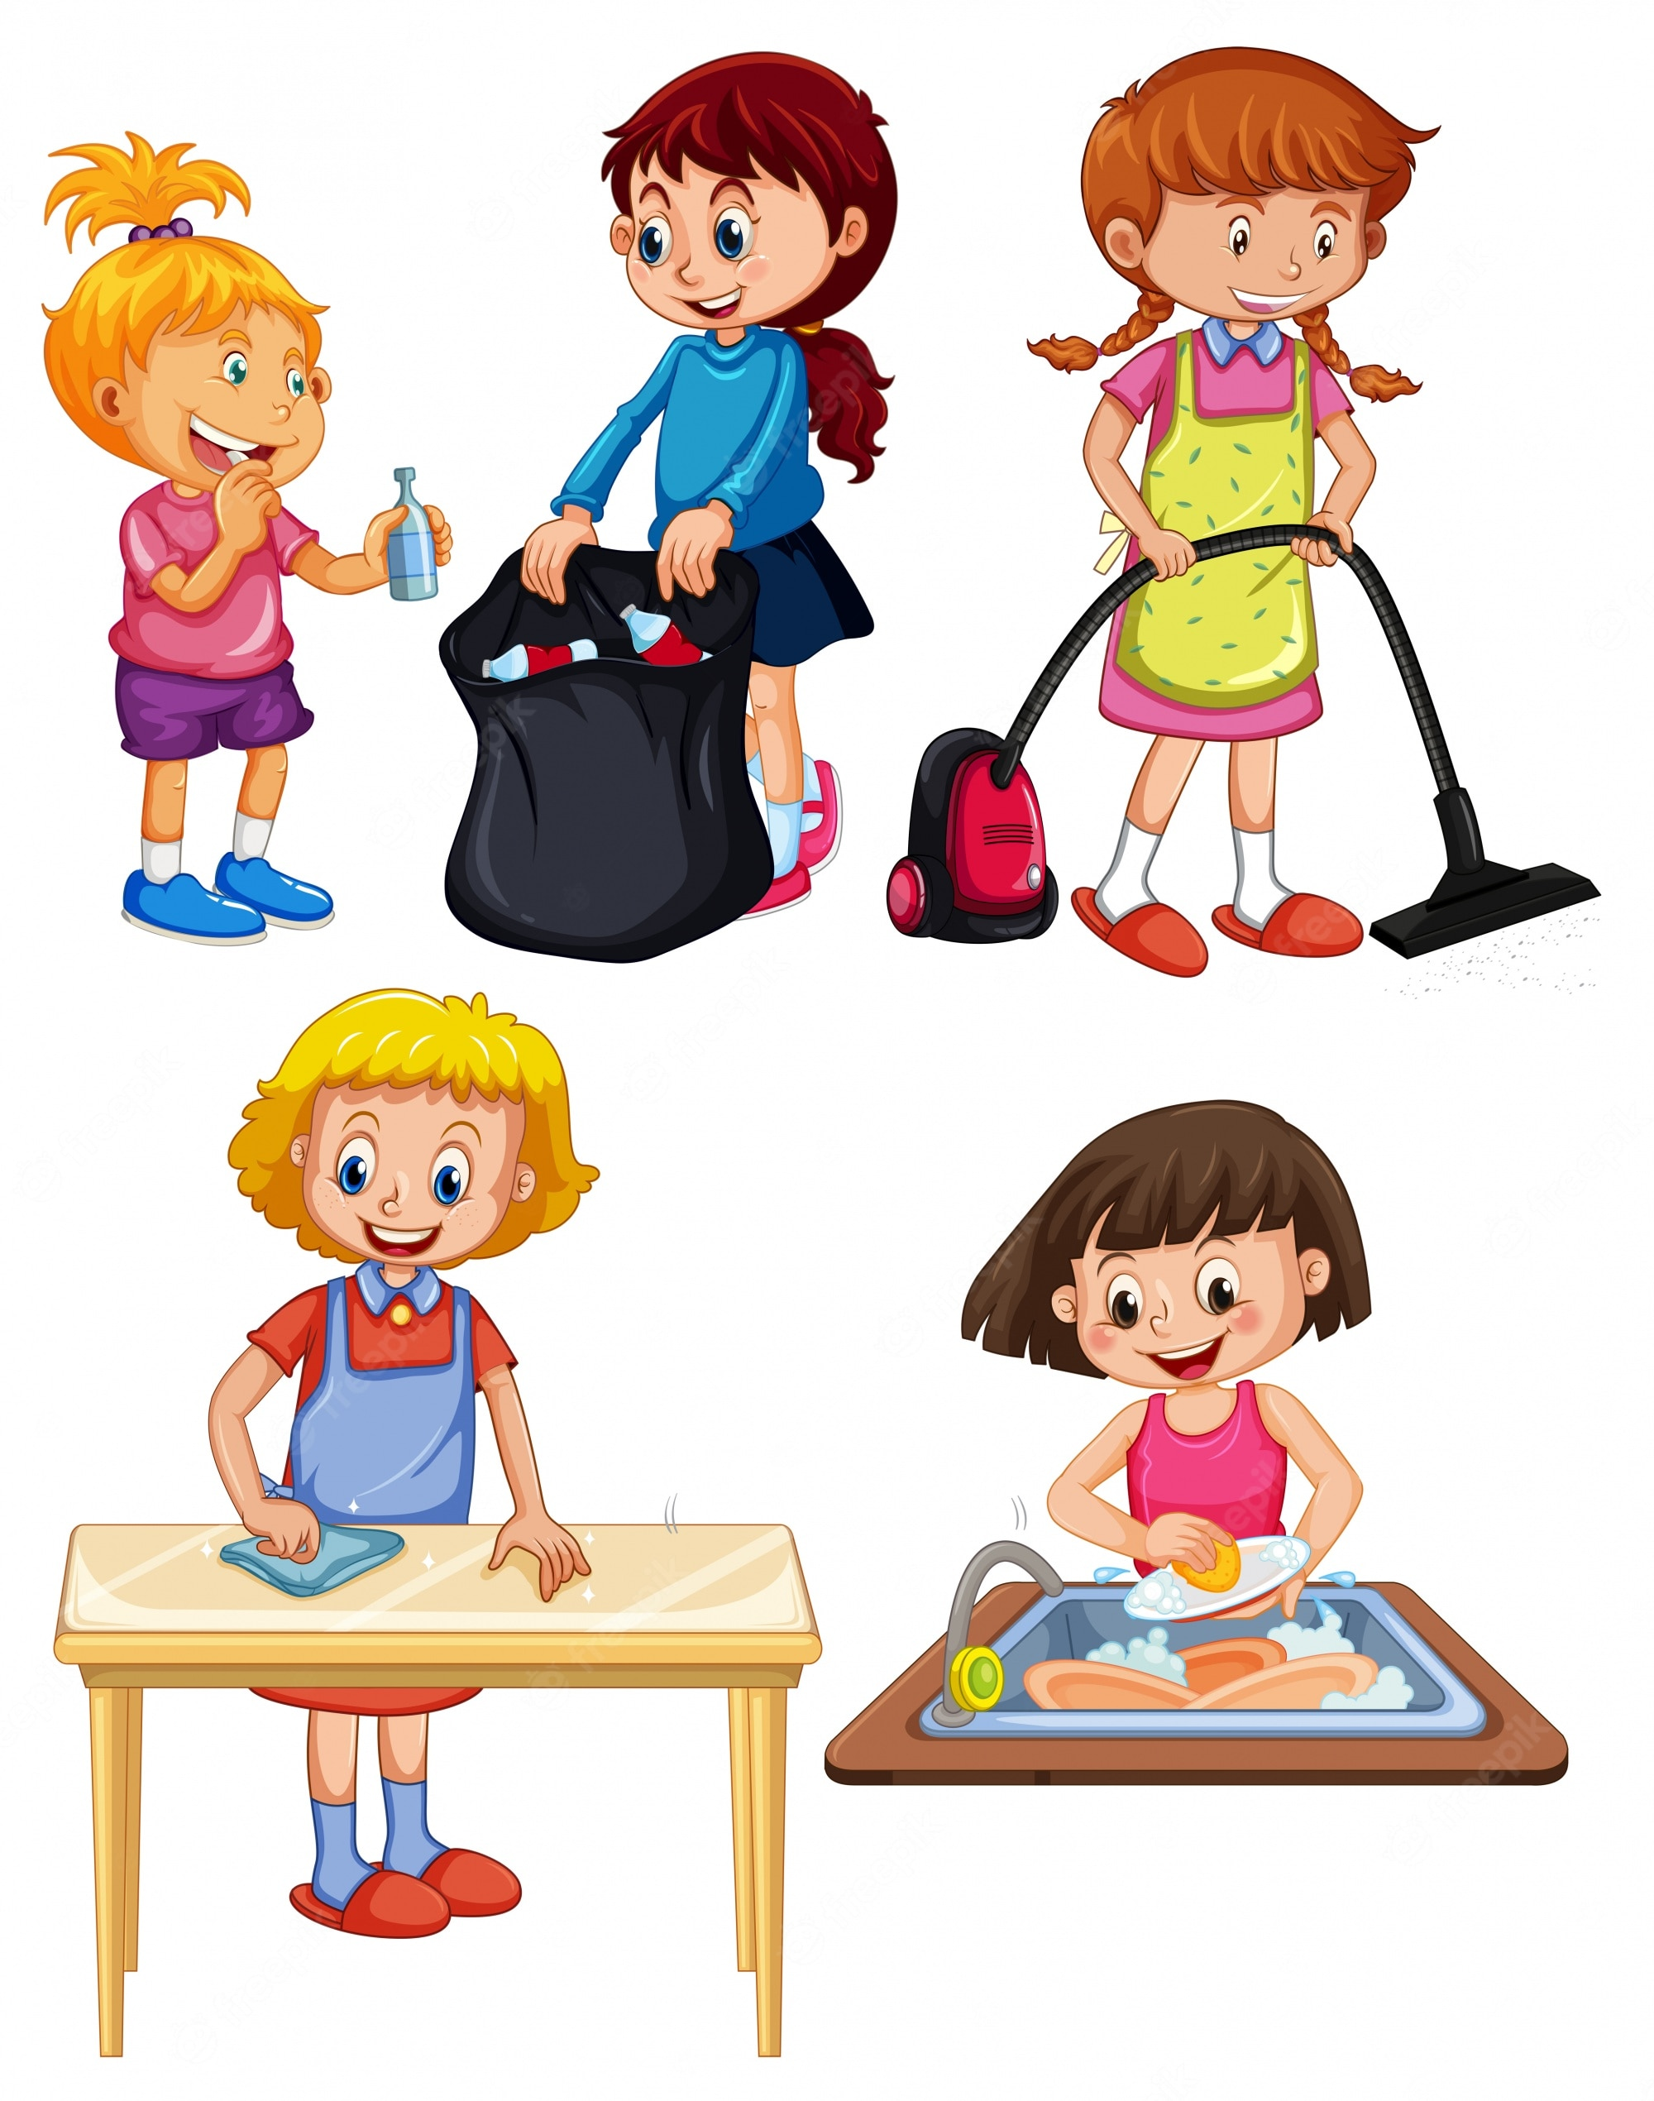

I do the ______ in the morning.
A. homework
B. housework
Notes:
© Copyright Showeet.com

Slide 24

A: When do you play tennis?
B: _____________________.
A. Football
B. At noon
Notes:
© Copyright Showeet.com

Slide 25

A: When do you read books?
B: _____________________.
A. The piano
B. In the morning
Notes:
© Copyright Showeet.com

Slide 26



Slide 28


Slide 30


Change stars with another team.

Slide 31
Change stars with another team.

Slide 32








THANK YOU
Website: hoclieu.vn
Fanpage: facebook.com/www.tienganhglobalsuccess.vn
Website: sachmem.vn; hoclieu.vn
Fanpage: www.facebook.com/sachmem.vn

