Slide 1





Slide 2


Daily activities
14
Lesson 3 – Period 6

Slide 3
Contents
01
Warm-up
04
02
05
Game
03
Project
Read and match.
Let’s write.

Slide 4
01
Warm-up

Slide 5
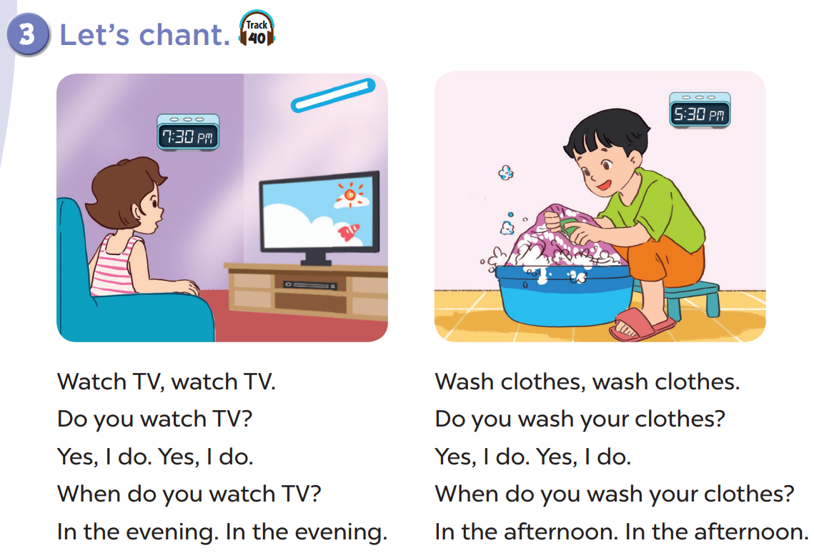


Slide 6
02
Read and match.

Slide 7
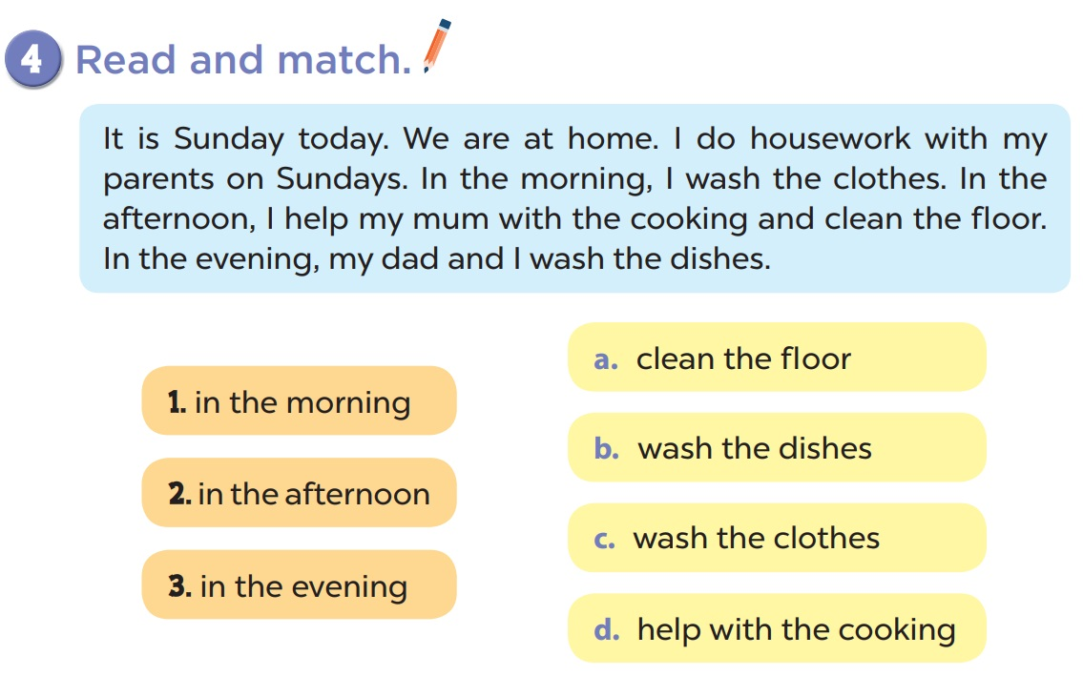

Slide 8
03
Let’s write.

Slide 9
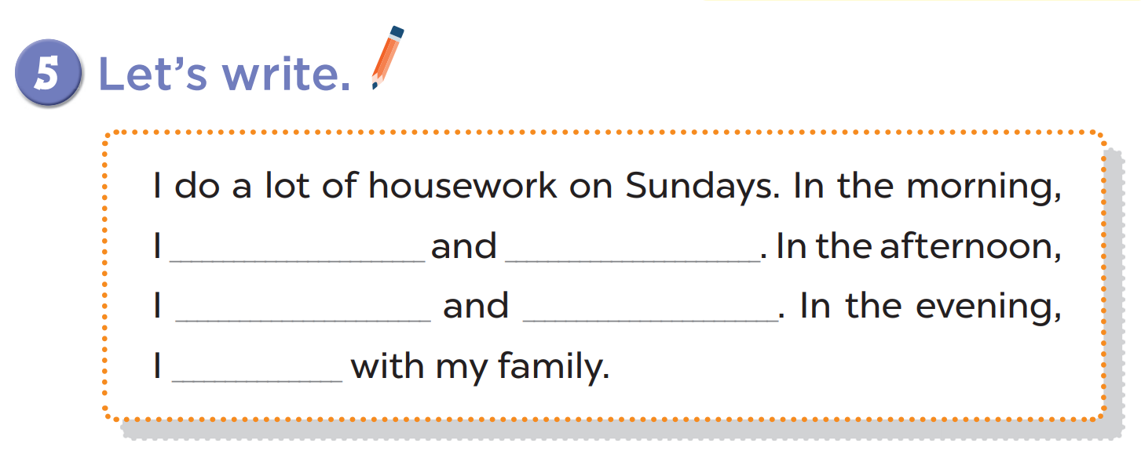

Slide 10
04
Project

Slide 11
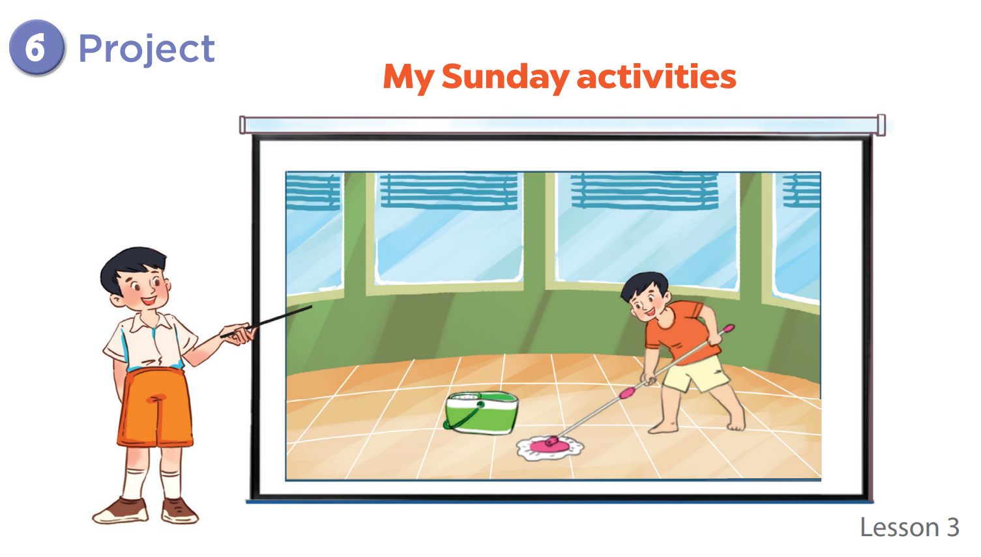

Slide 12
05
Game

Slide 13

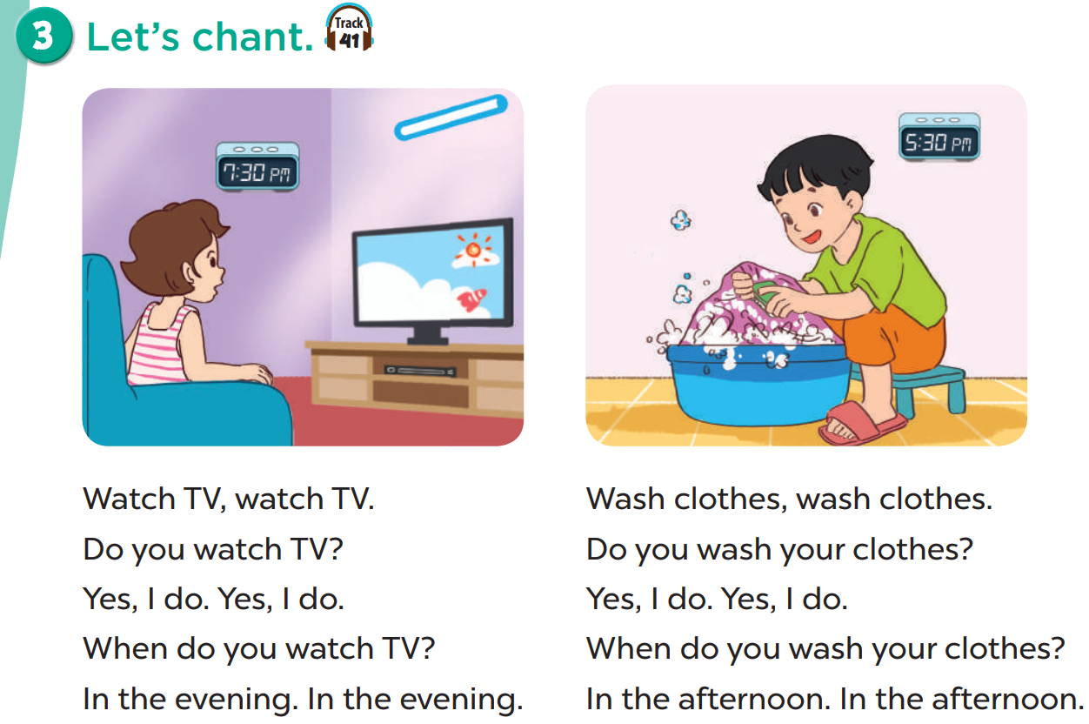


What do you do in the evening?
I watch TV.

Slide 14




Slide 15
When do you wash the clothes?
In the afternoon.

Slide 17
A: What ___ you do at noon?
B: I take a nap.
do

Slide 19
A: What ___ your mother
do in the evening?
B: She cleans the floor.
does

Slide 21
My father ____ my mum with the cooking in the evening.
helps

Slide 23
I listen to ____ in the morning.
music

Slide 25
I ____ books in the evening.
read

Slide 27
A: _____ do you wash the dishes?
B: In the afternoon.
When

Slide 29
A: ____ do you do in the evening?
B: I read books.
What

Slide 31
What do you do in the afternoon?

Slide 33
What do you do in the evening?

Slide 35








THANK YOU
Website: hoclieu.vn
Fanpage: facebook.com/www.tienganhglobalsucces.vn
Website: sachmem.vn; hoclieu.vn
Fanpage: www.facebook.com/sachmem.vn

