Slide 1





Slide 3
1
2
3
Warm-up and review
4
5
Fun corner and wrap-up
Look, listen and repeat.
Listen, point and say.
Let’s talk.

Slide 4

Travelling with Doraemon

Slide 5
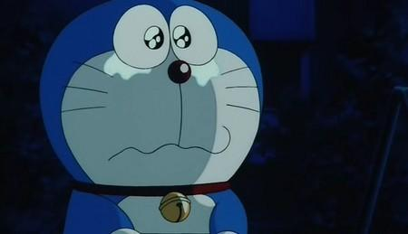

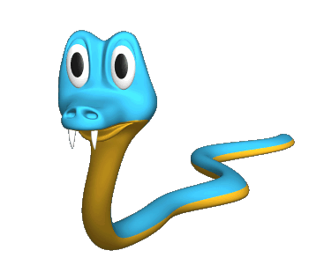
Pick the correct question.
A. What is the weather like yesterday?
B. What was the weather like yesterday?
A
B

Slide 6
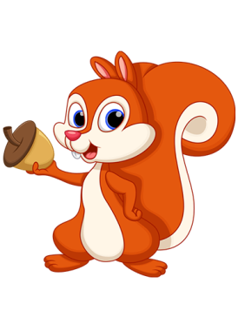
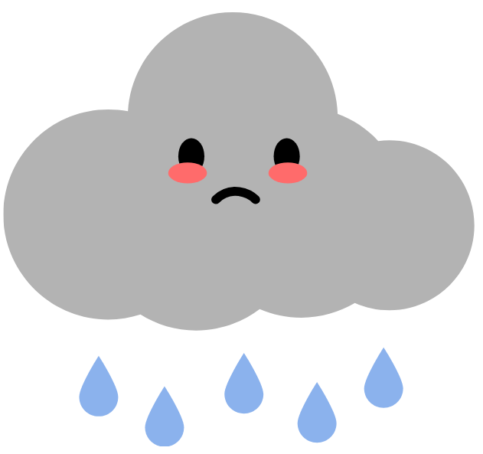

What was the weather like yesterday?
A. It was rainy.
B. It was sunny.
A
B

Slide 7
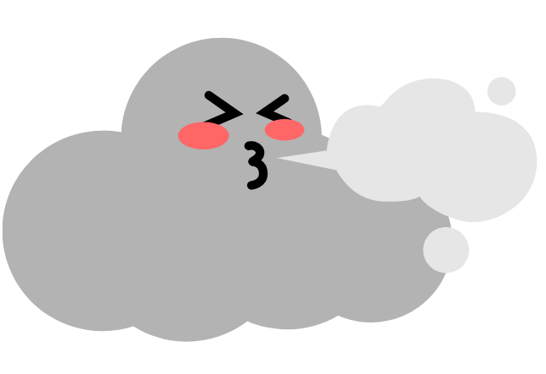
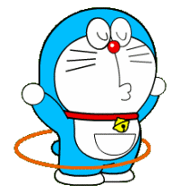
What was the weather like yesterday?
A. It was windy.
B. It was cloudy.
A
B

Slide 8
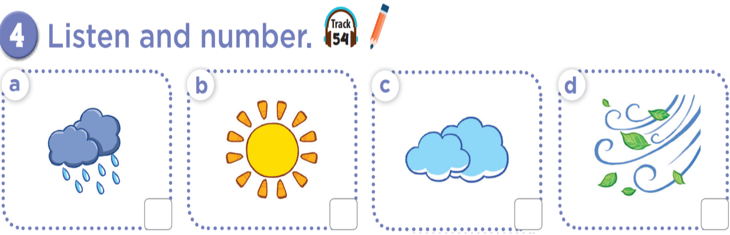


Slide 9
2
4
3
1

Slide 10
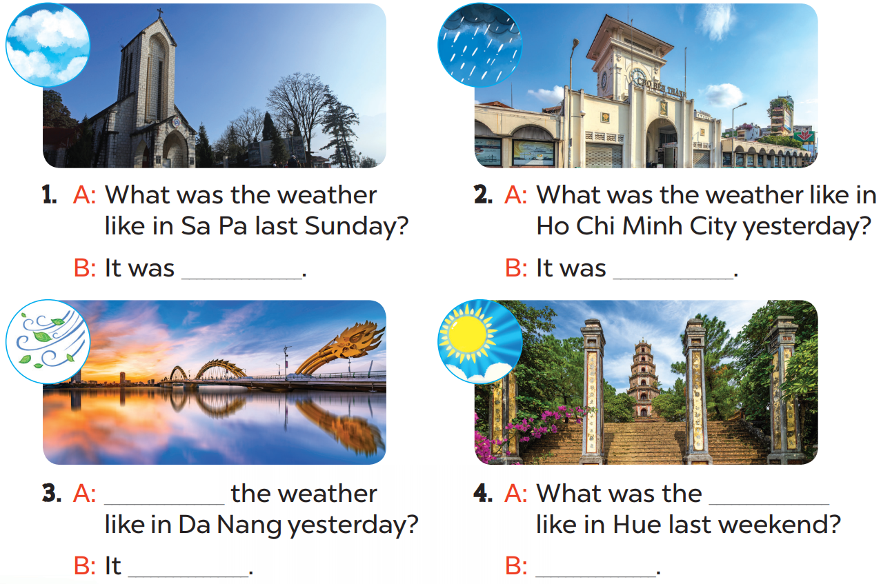

Slide 11
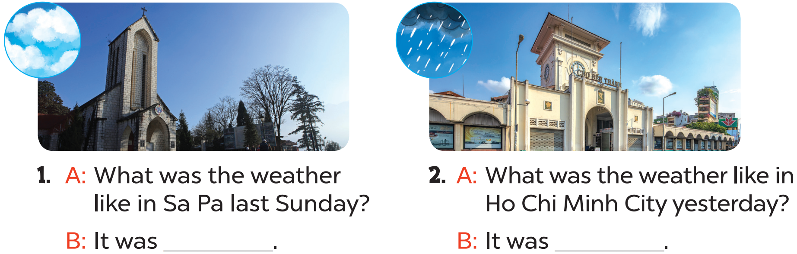
cloudy
rainy

Slide 12
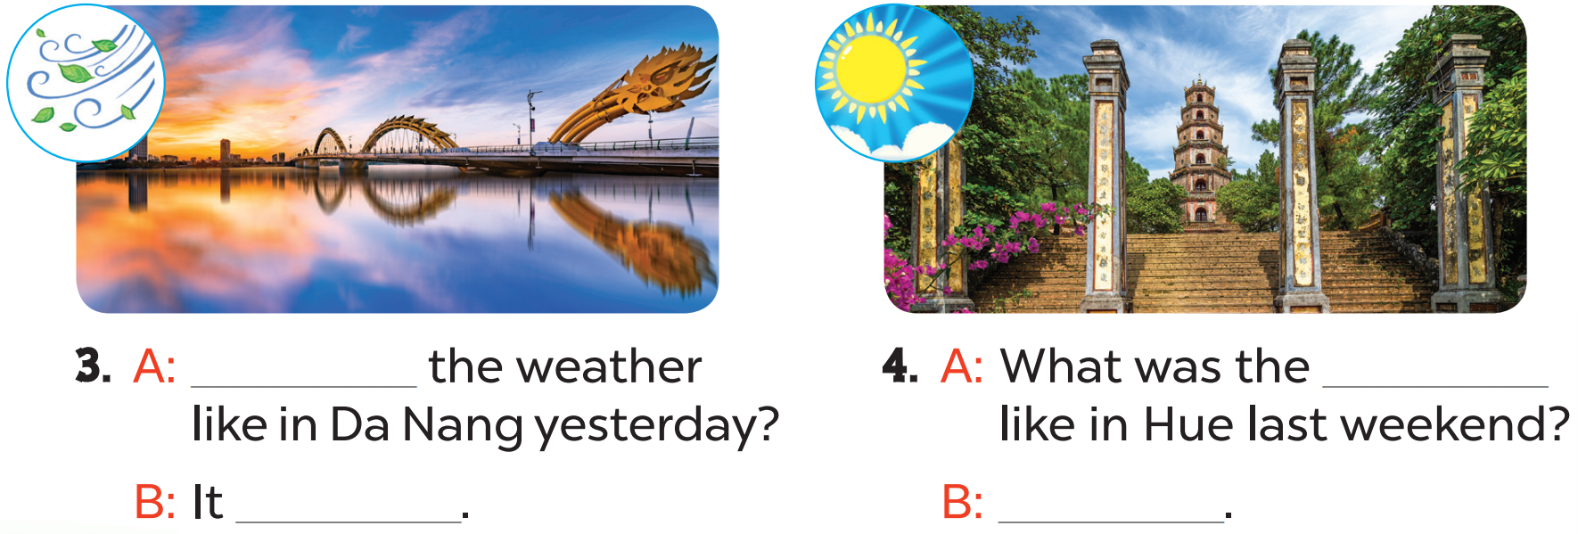
What was
weather
windy
It was sunny

Slide 13
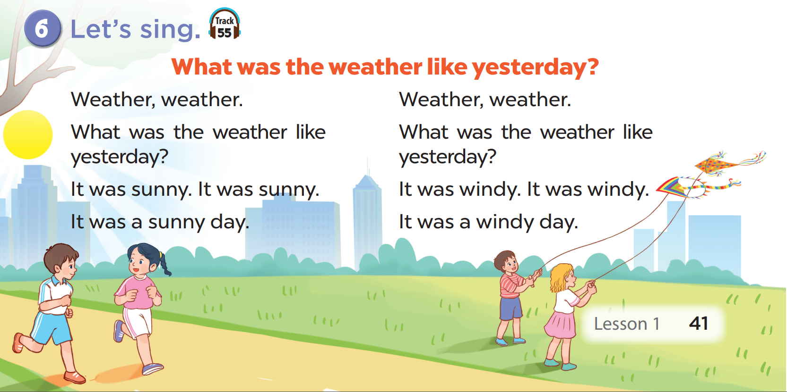

Slide 14
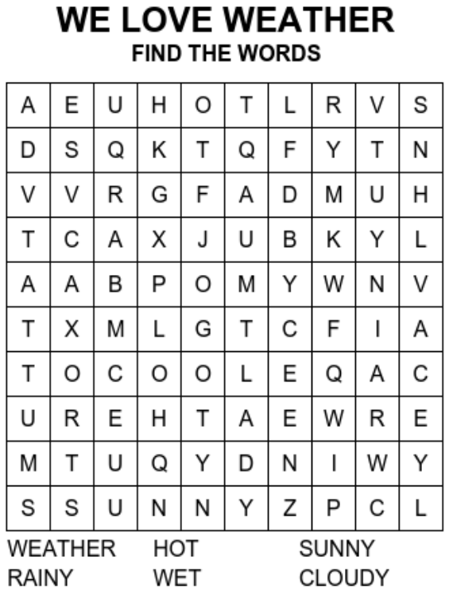
PLAY OFFLINE VERSION!

Slide 15

Website: hoclieu.vn
Fanpage: facebook.com/www.tienganhglobalsuccess.vn

