Slide 1





Slide 2


My family’s weekend
15
Lesson 2 – Period 3

Slide 3
Table of contents
01
02
03
04
05
Warm-up
Look, listen
and repeat.
Listen, point and say.
Let’s talk.
Game

Slide 4
01
Warm-up

Slide 5
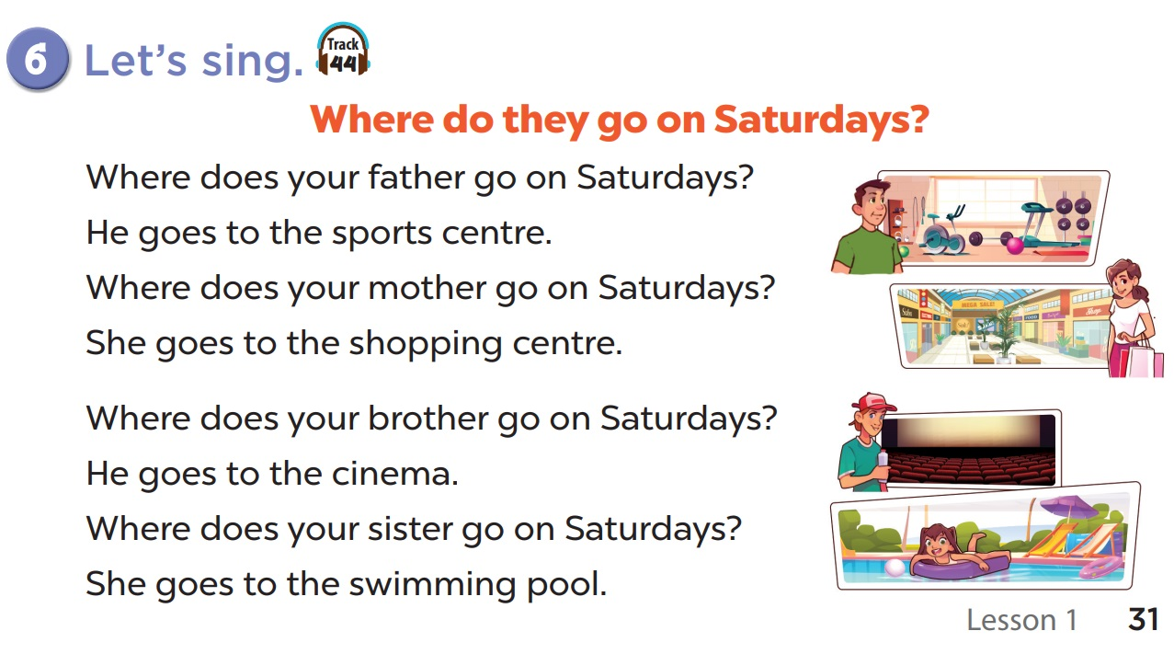


Slide 6
Look, listen and repeat.
02

Slide 7
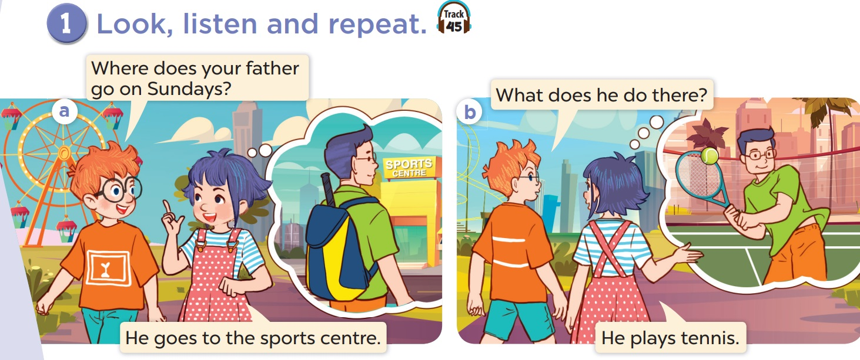

Slide 8
03
Listen, point
and say.

Slide 9
Vocabulary

Slide 10
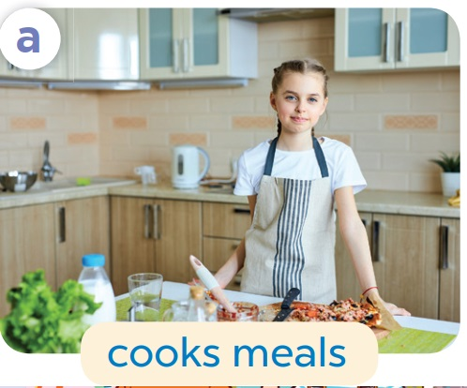

Slide 11
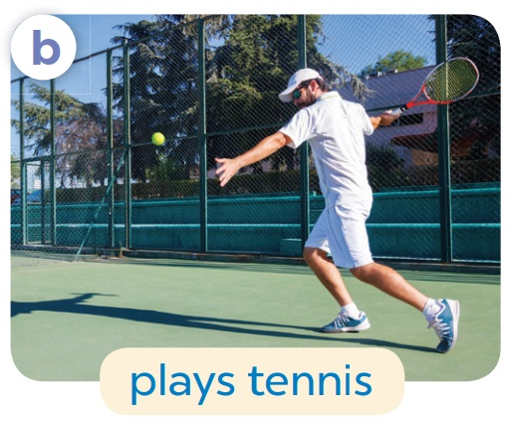

Slide 12


Slide 13
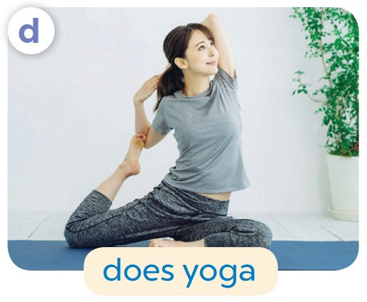

Slide 14
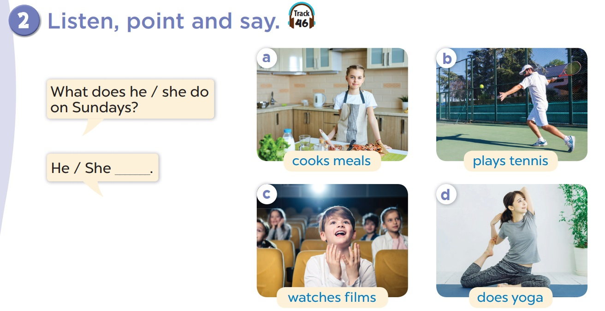

Slide 15
What does she do on Sundays?
She cooks meals.

Slide 16
What does he do on Sundays?
He plays tennis.

Slide 17
What does he do on Sundays?
He watches films.

Slide 18
What does she do on Sundays?
She does yoga.

Slide 19
REMEMBER!
I | She / He
cook meals
play tennis
watch films
do yoga
cooks meals
plays tennis
watches films
does yoga

Slide 20
04
Let’s talk.

Slide 21
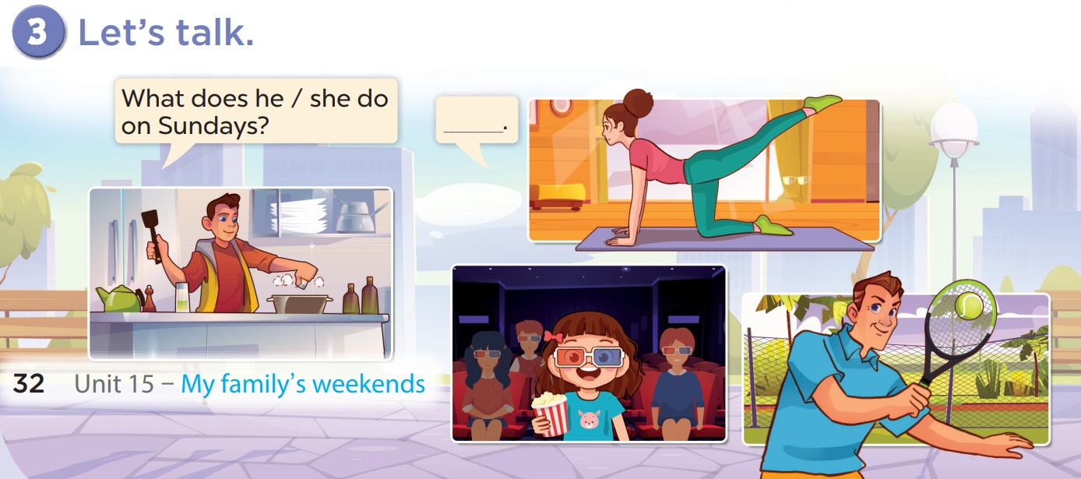

Slide 22
05
Game

Slide 23




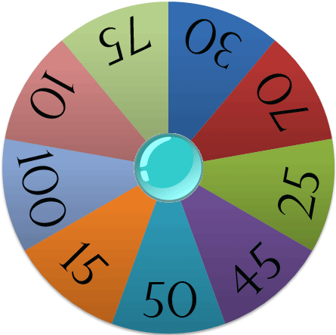


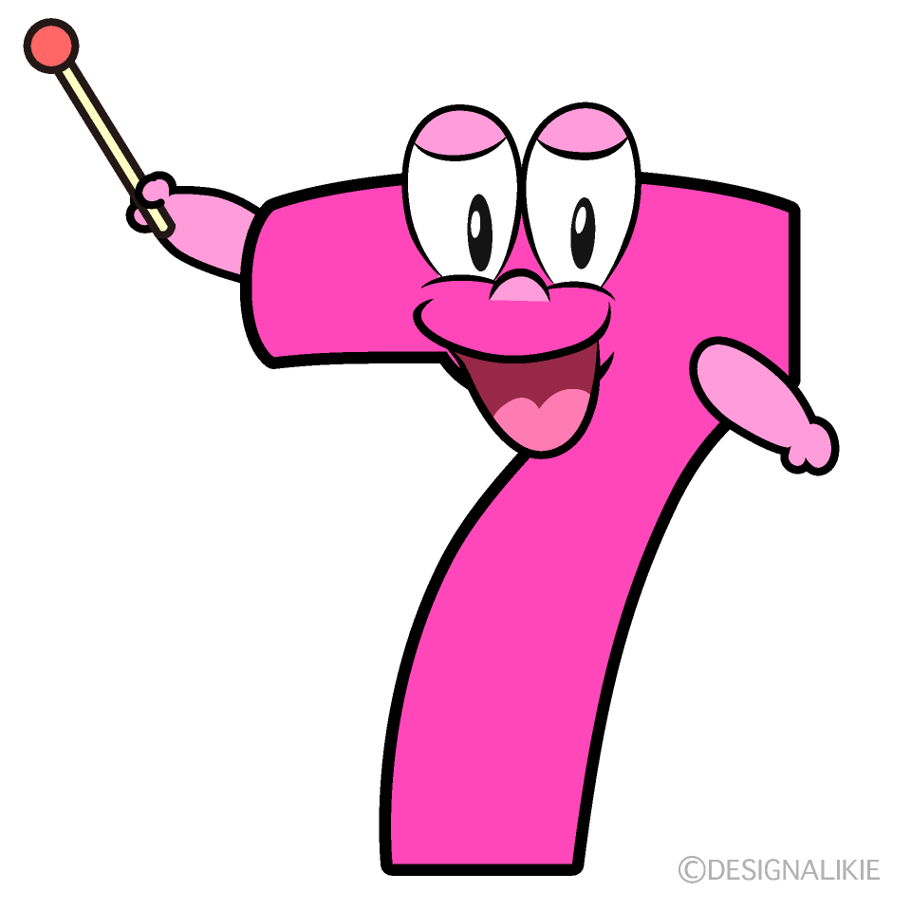

Spin the wheel
Girls
Boys
Points

Slide 24

She ……………….. meals on Sundays.
cooks
plays
cook

Slide 25
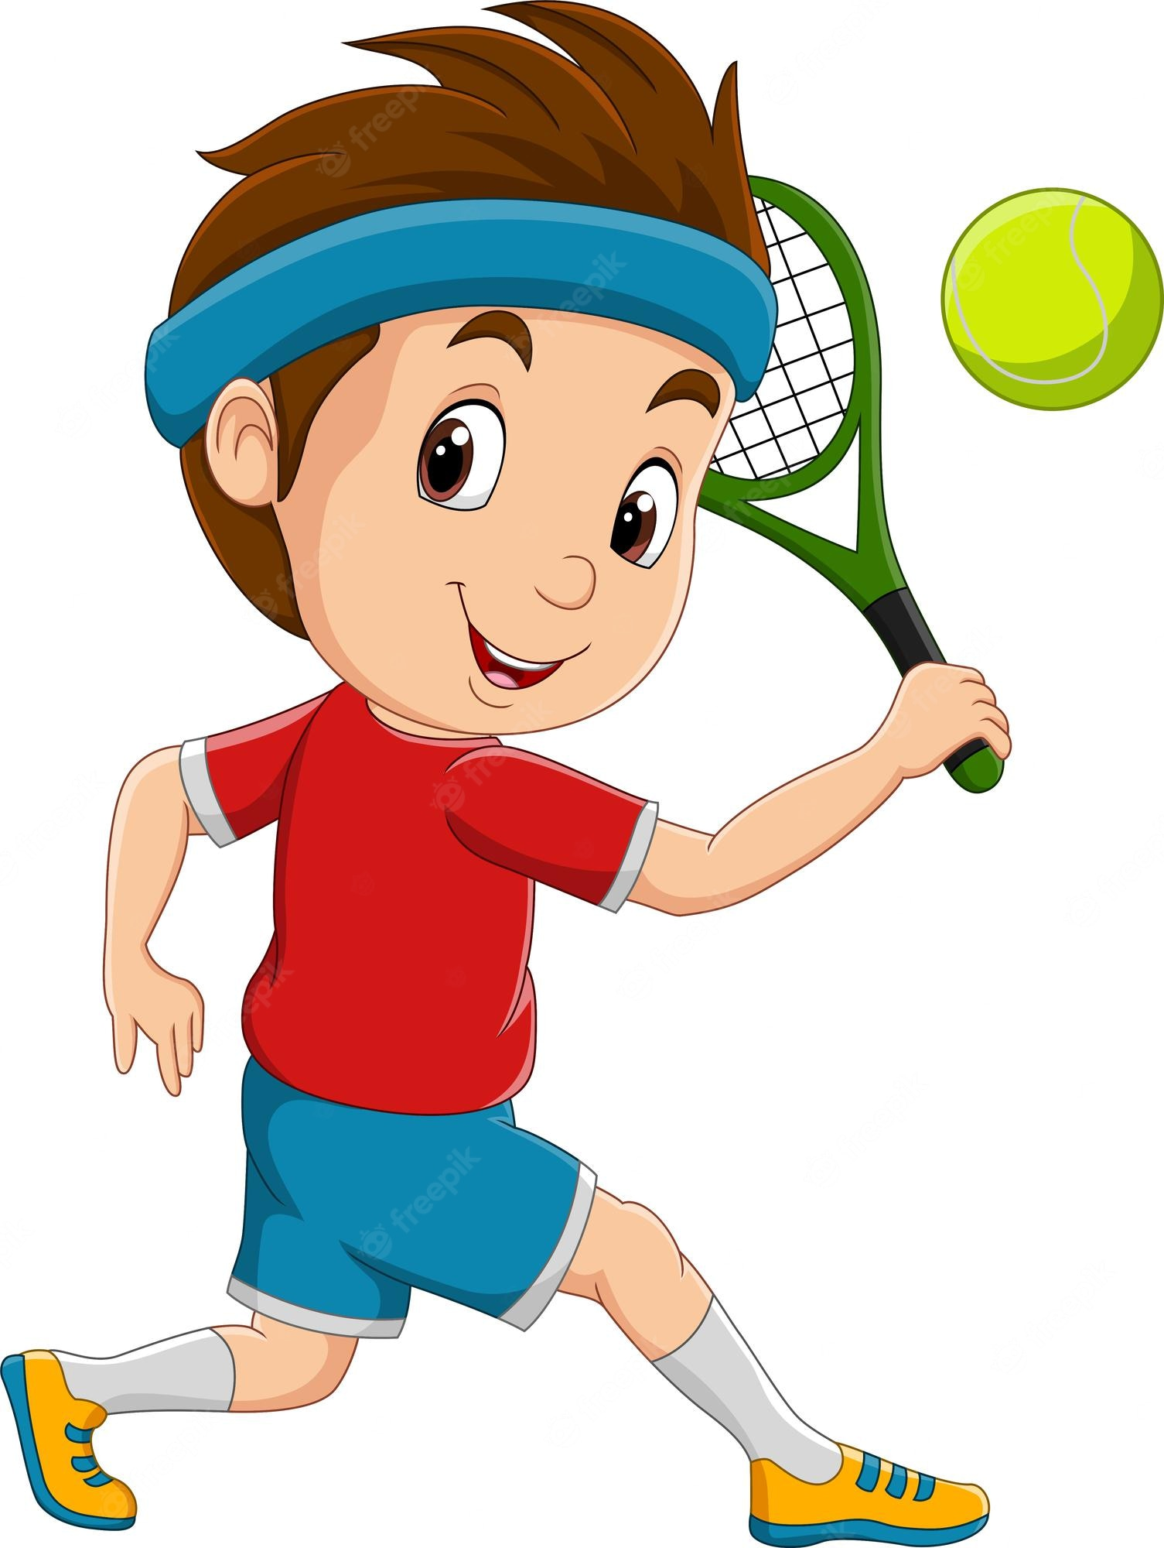
He ……………….. on Sundays.
plays tennis
watches films
cooks meals

Slide 26

I ………….. films on Sundays.
watches
makes
watch

Slide 27
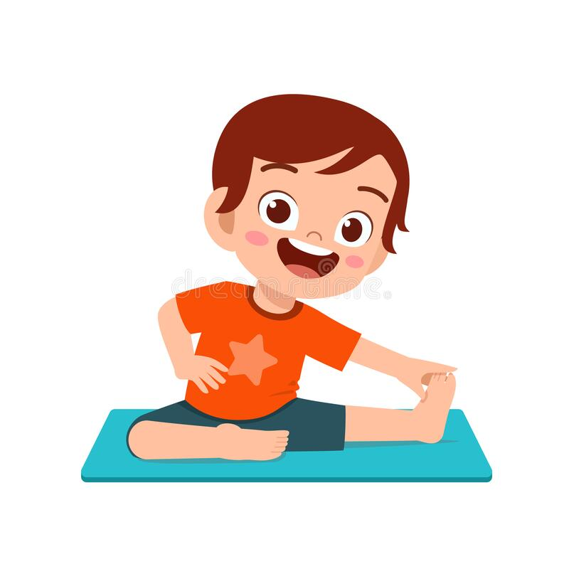
He …………… on Sundays.
cooks meals
does yoga
plays tennis

Slide 28
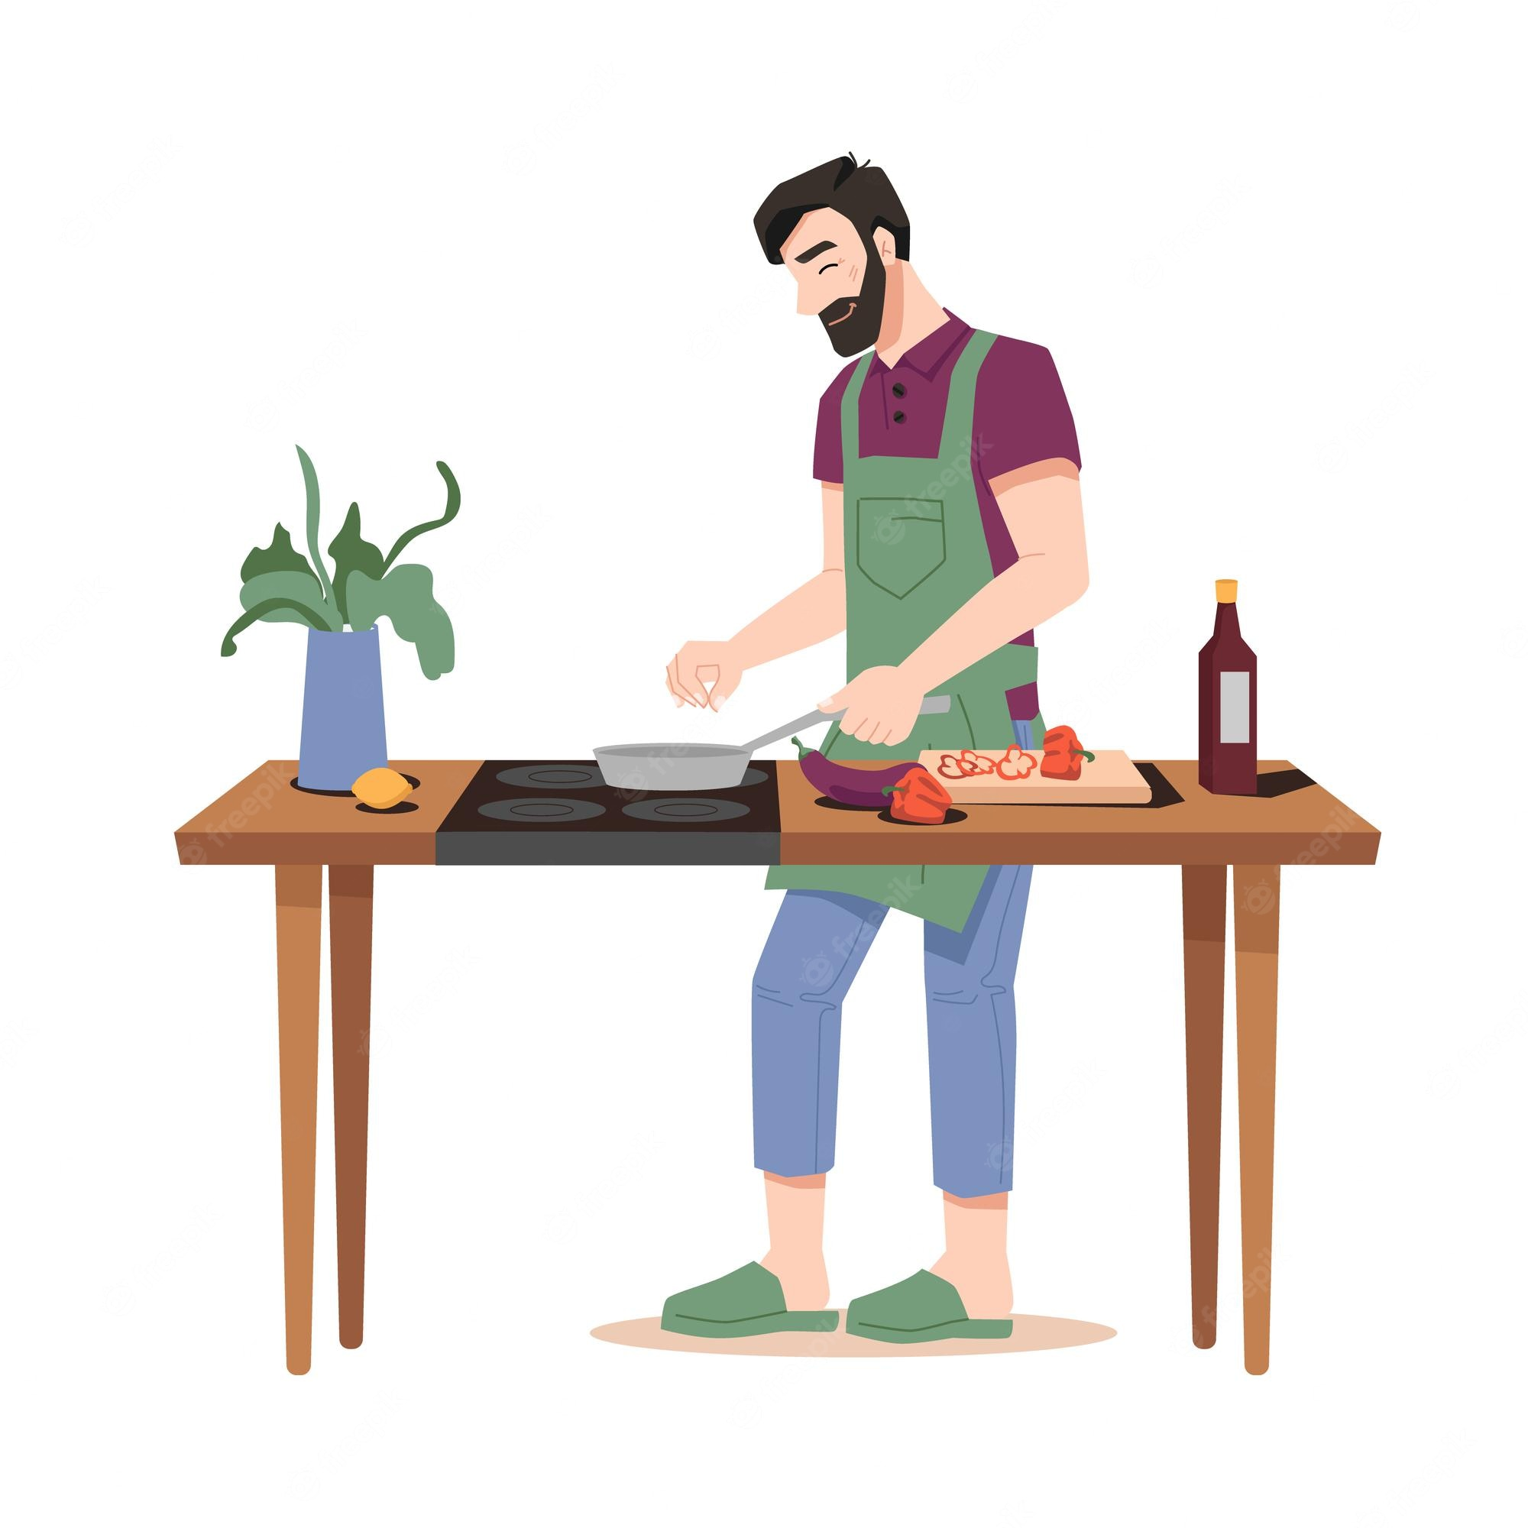
My dad ………..…. on Sundays.
cooks meals
plays tennis
does yoga

Slide 29
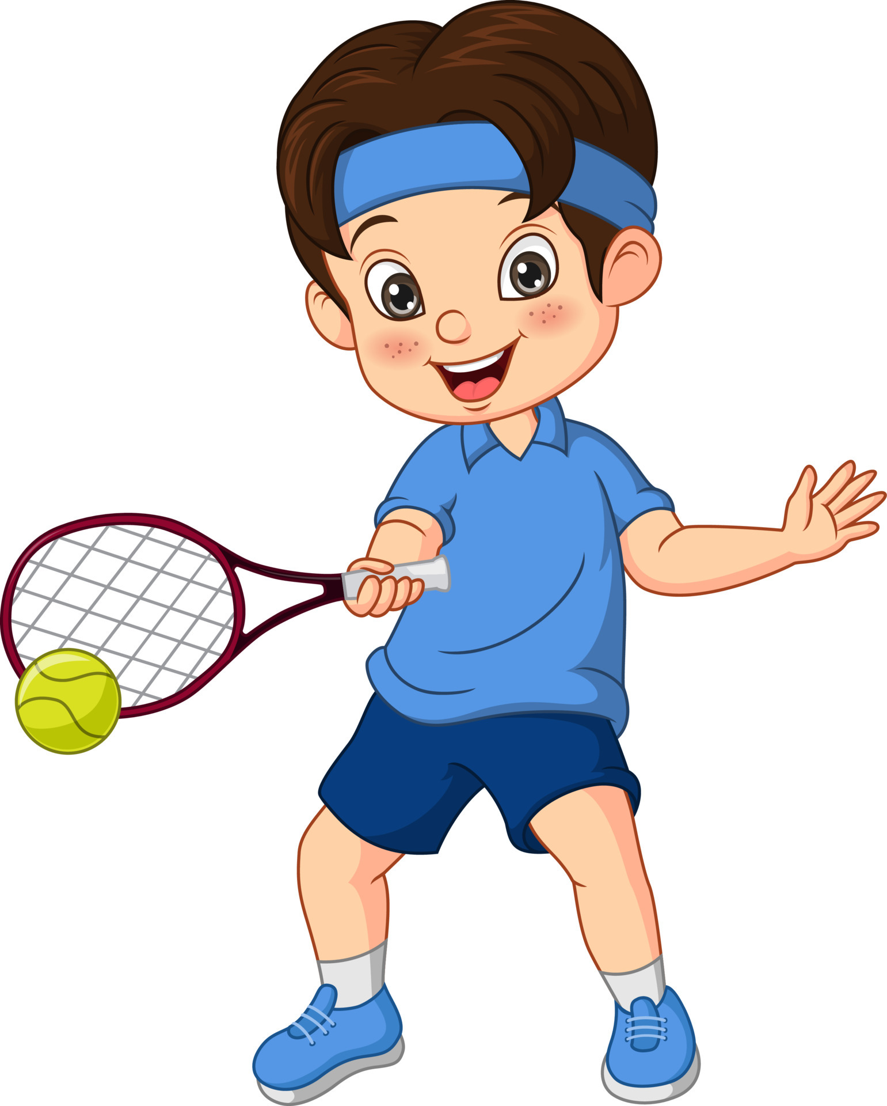
I …………….. on Sundays.
play tennis
plays tennis
play football

Slide 30
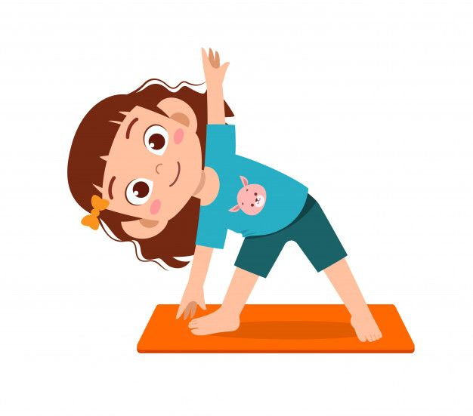
She …………. yoga on Sundays.
do
does
play

Slide 31

He ………………. on Tuesday.
does yoga
plays tennis
watches films

Slide 32








THANK YOU
Website: hoclieu.vn
Fanpage: facebook.com/www.tienganhglobalsuccess.vn
Website: sachmem.vn; hoclieu.vn
Fanpage: www.facebook.com/sachmem.vn

