Slide 1





Slide 3
1
2
3
Warm-up and review
4
5
Fun corner and wrap-up
Look, listen and repeat.
Listen, point and say.
Let’s talk.

Slide 4
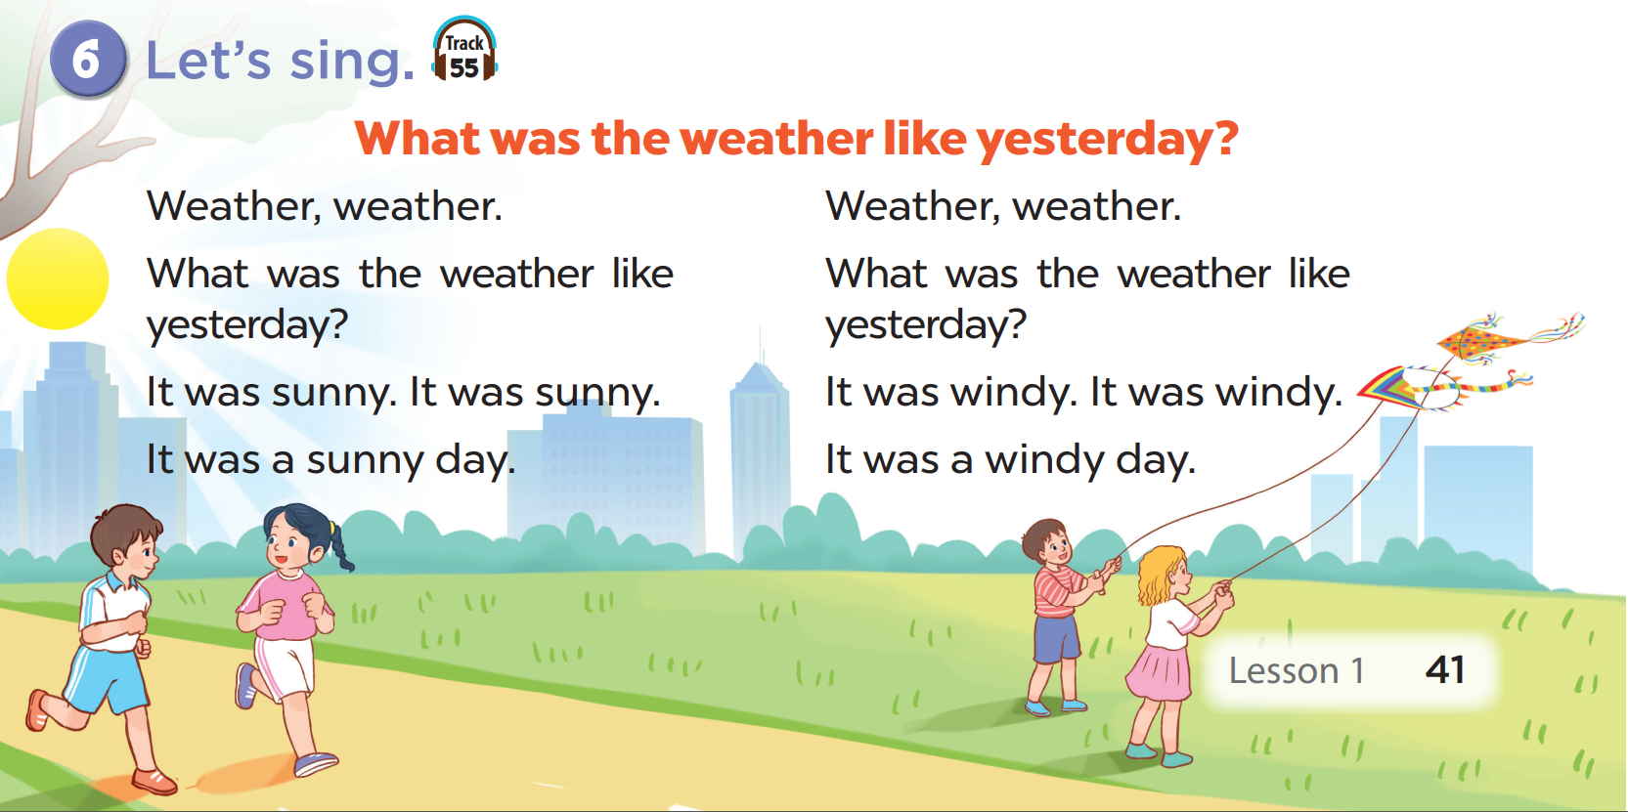

LET’S SING TOGETHER.

Slide 5
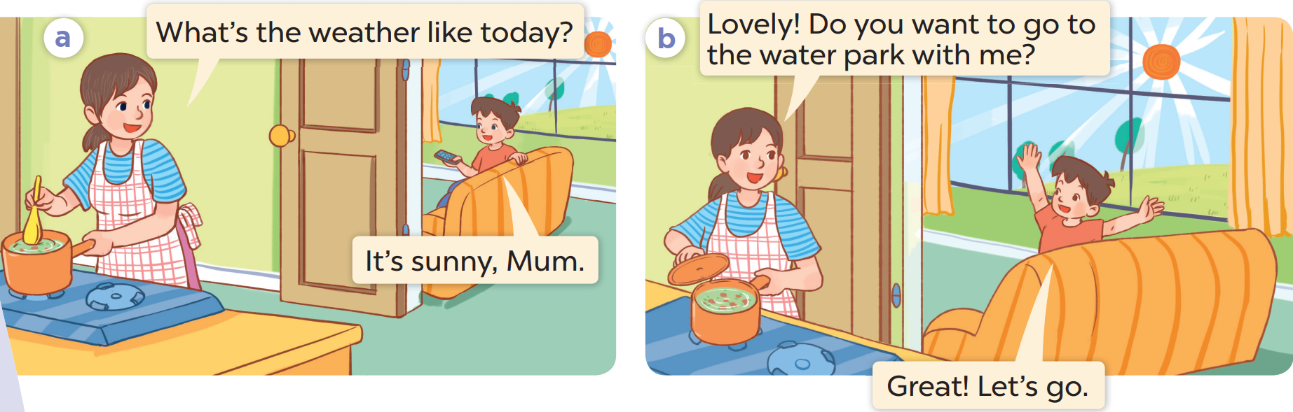

Slide 6
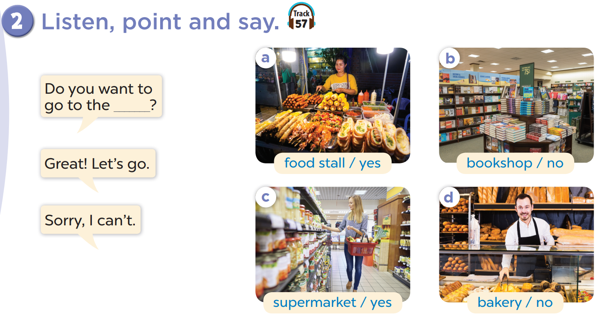

Slide 7
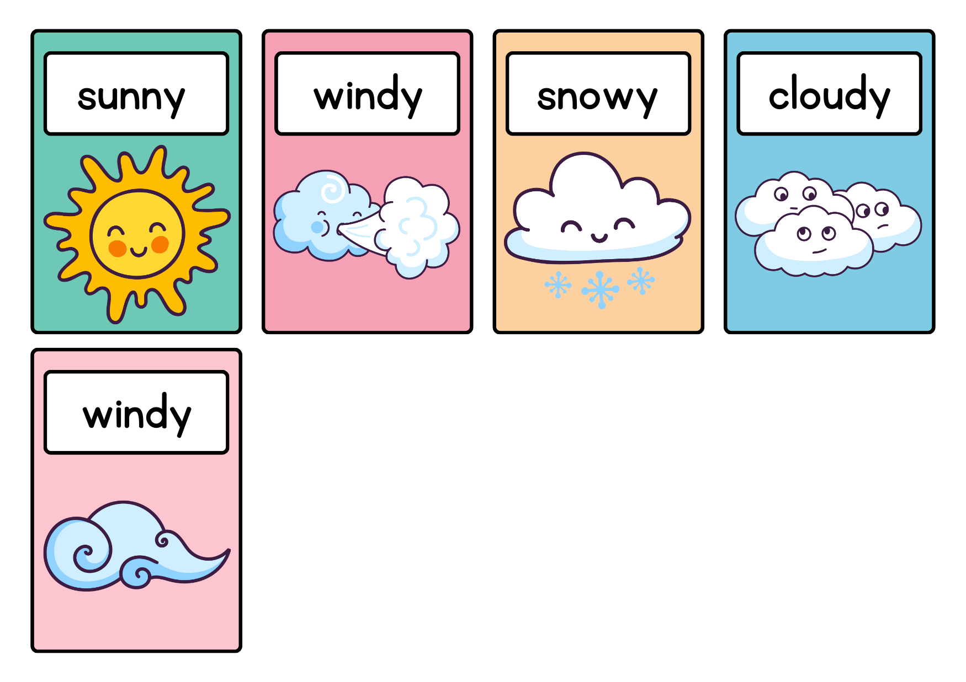
WHAT’S THE WEATHER LIKE TODAY?

Slide 8
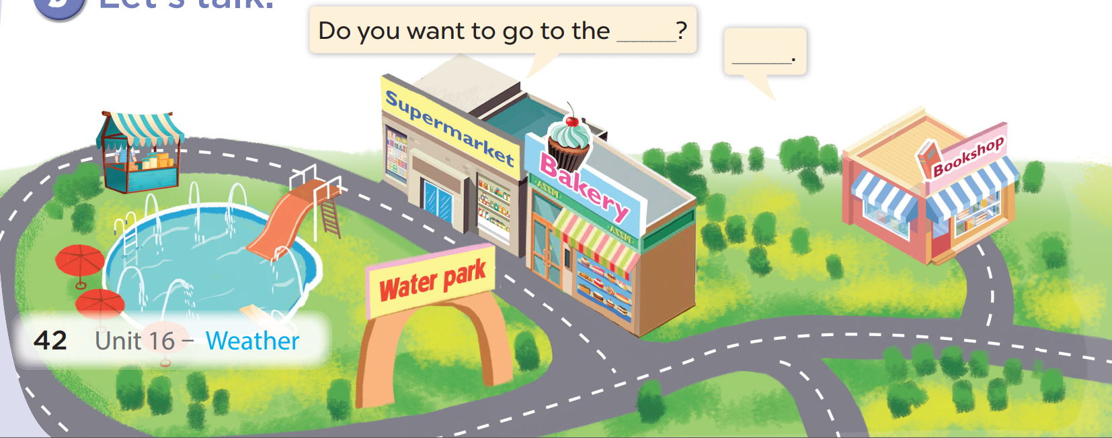

LET’S TALK.

Slide 9
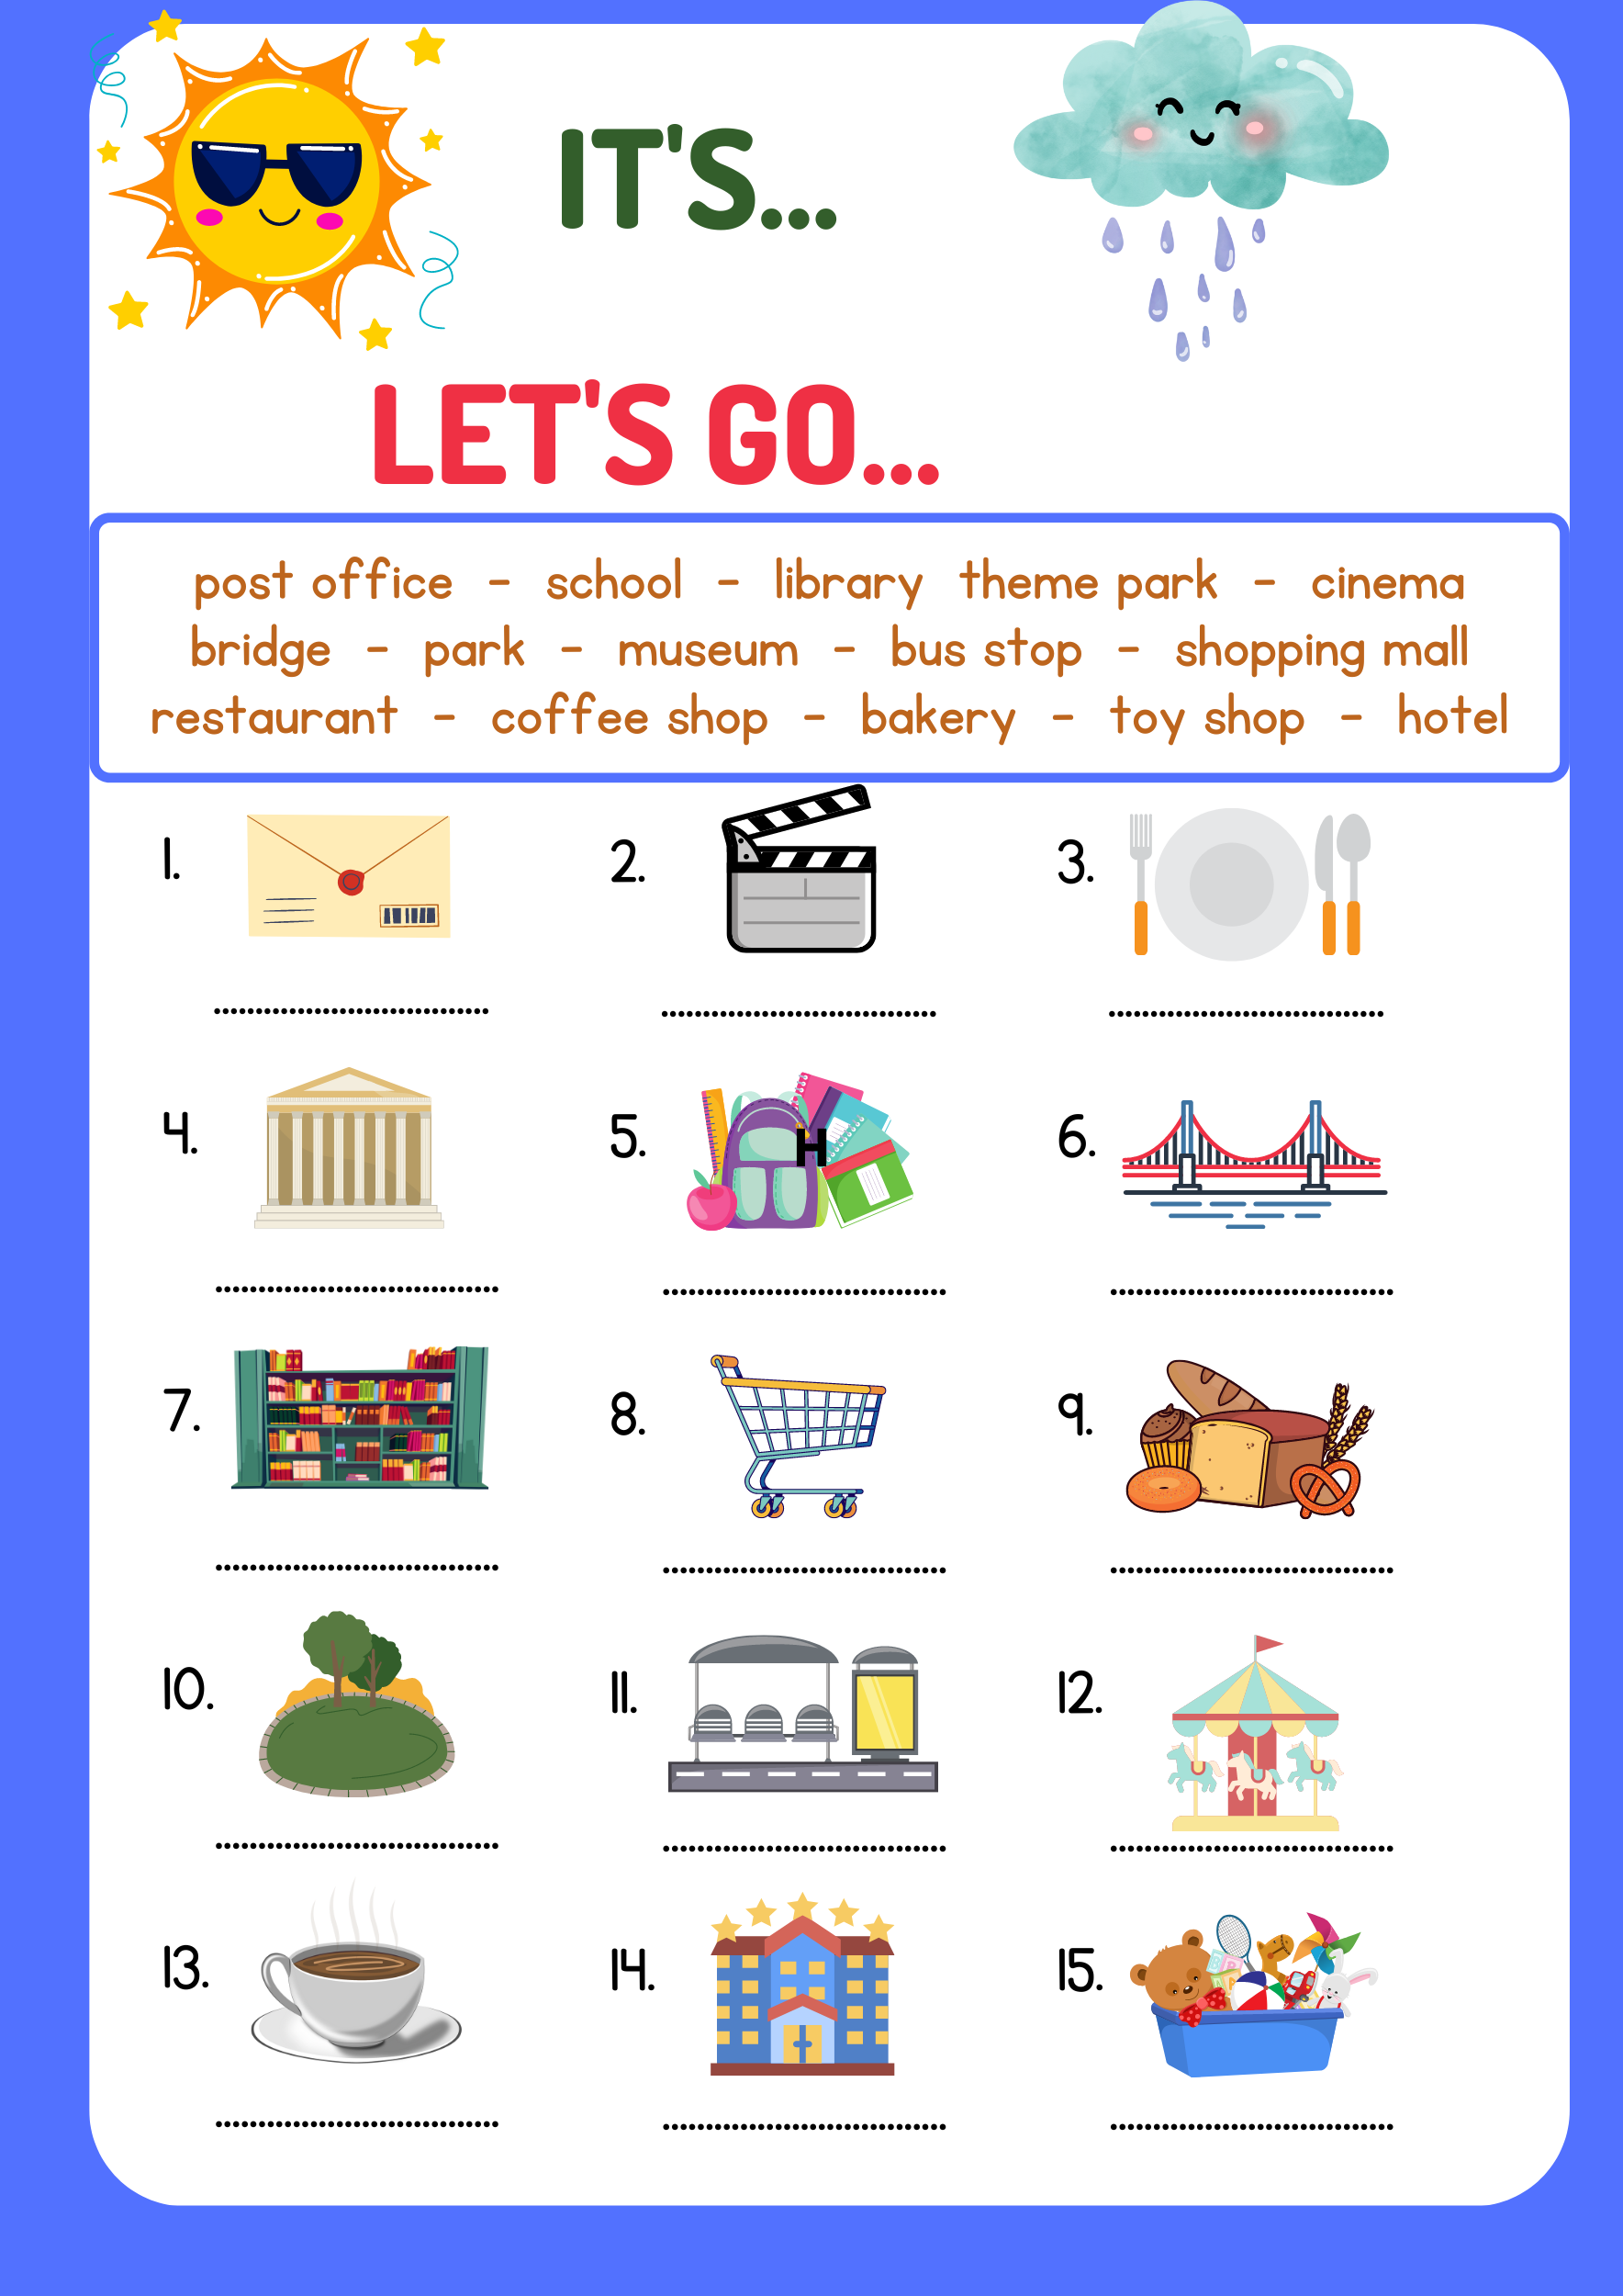
DO YOU WANT TO GO TO THE...?
post office
cinema
restaurant
GREAT! LET’S GO
museum
school
bridge
library
shopping mall
bakery
SORRY, I CAN’T
park
bus stop
theme park
coffee shop
hotel
toy shop
Notes:
let pupils speak in pairs or groups freely about the weather and the places they want to go. If the level of the class is lower, skip some pictures.

Slide 10
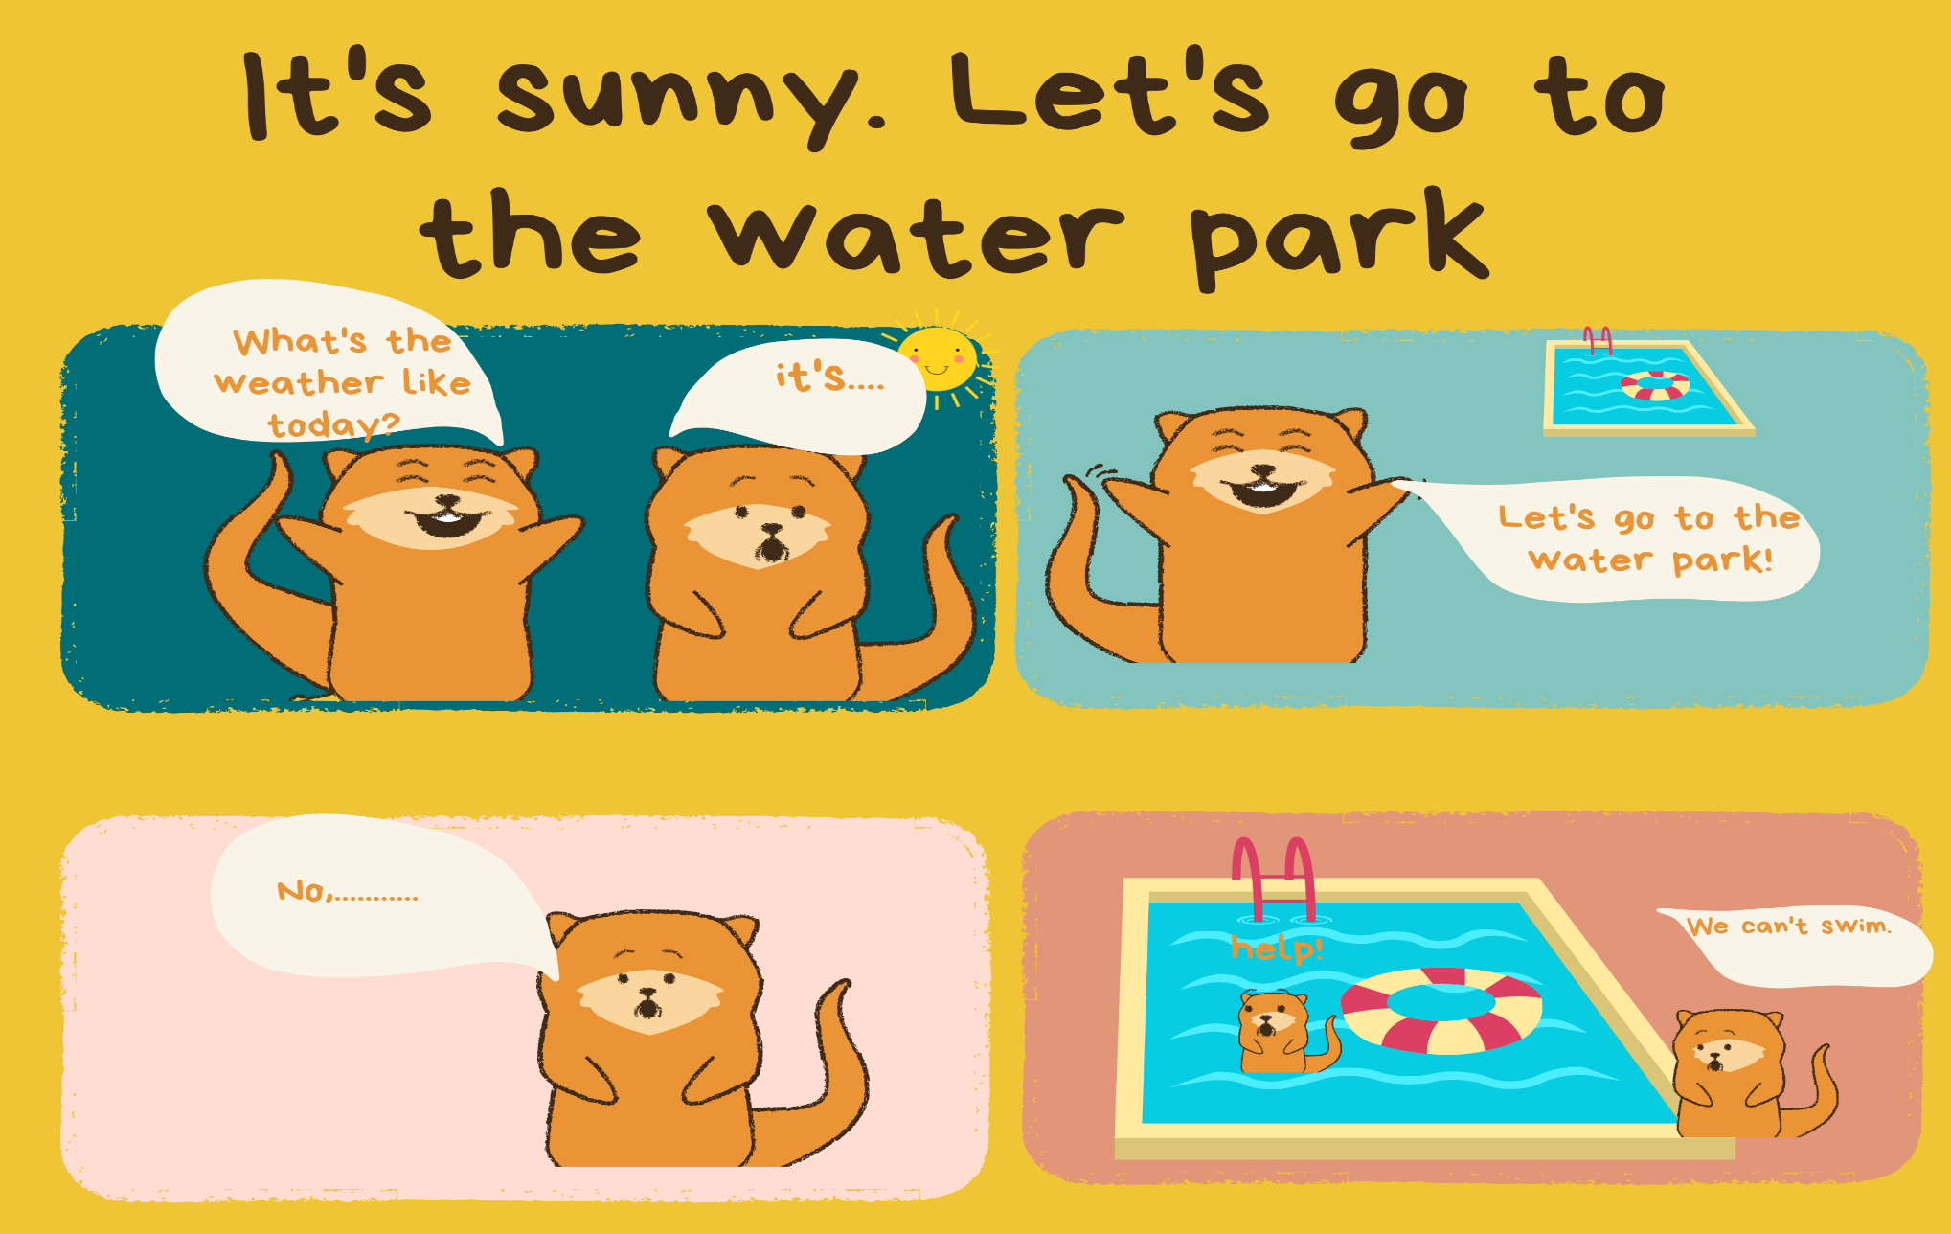
Read and complete the story.

Slide 11

Website: hoclieu.vn
Fanpage: facebook.com/www.tienganhglobalsuccess.vn

