Slide 3
1
2
3
Warm-up and review
4
5
Fun corner and wrap-up
Listen and number.
Look, complete and read.
Let’s play.

Slide 4
Open the door, ask and suggest a place to go.
Notes:
Suggested answer: What’s the weather like? - It’s stormy. - Let’s stay at home! - Great!

Slide 5
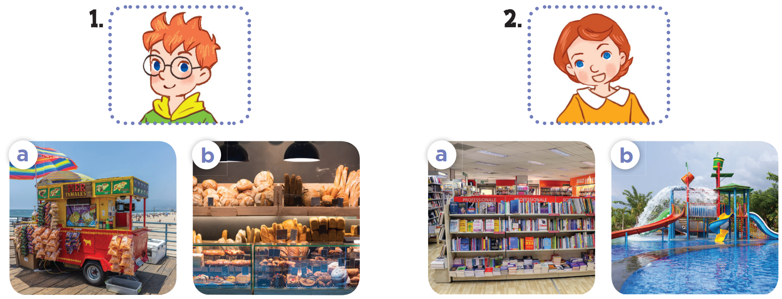

Slide 7
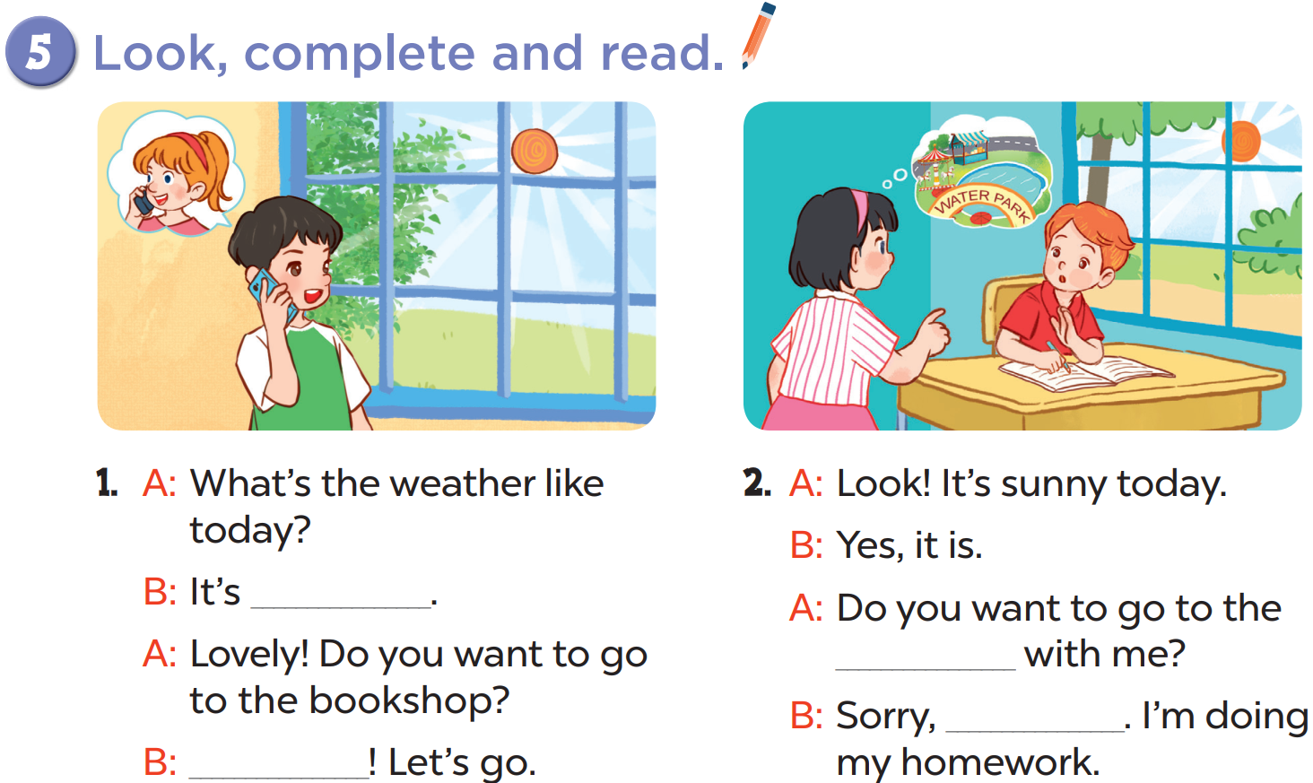
sunny
water park
I can’t
Great

Slide 9
MAKE A DIALOGUE WITH THE PICTURES.

Slide 10
MAKE A DIALOGUE WITH THE PICTURES.
Notes:
Suggested answer:
What’s the weather like? - It’s cloudy.
Do you want to go to the park. – Great! Let’s go.

Slide 14
Website: hoclieu.vn
Fanpage: facebook.com/www.tienganhglobalsuccess.vn

