Slide 1





Slide 3
1
2
3
Warm-up and review
4
5
Fun corner and wrap-up
Look, listen and repeat.
Listen, point and say.
Let’s talk.

Slide 4

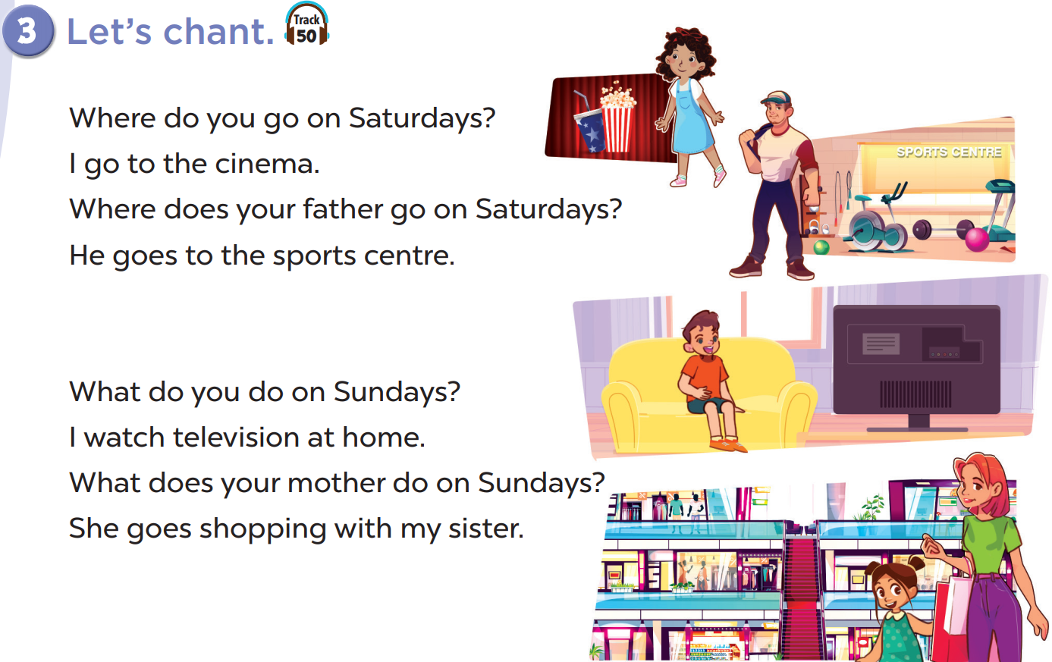

Slide 5
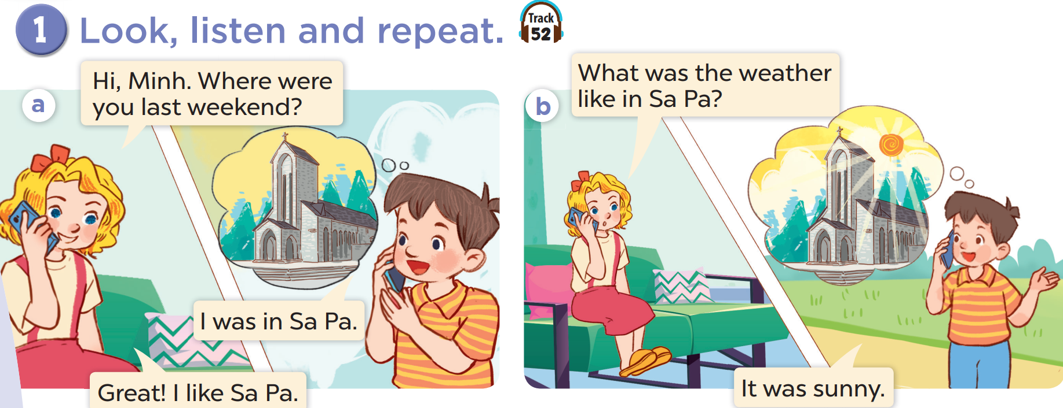

Slide 6
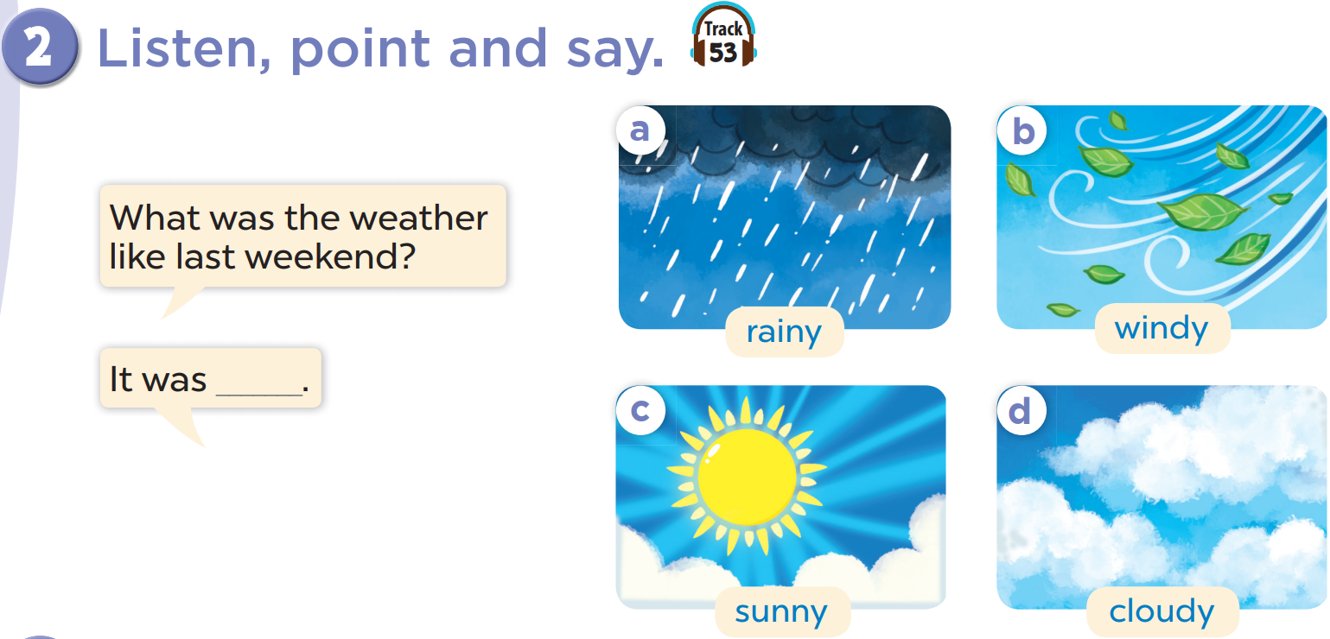

Slide 7
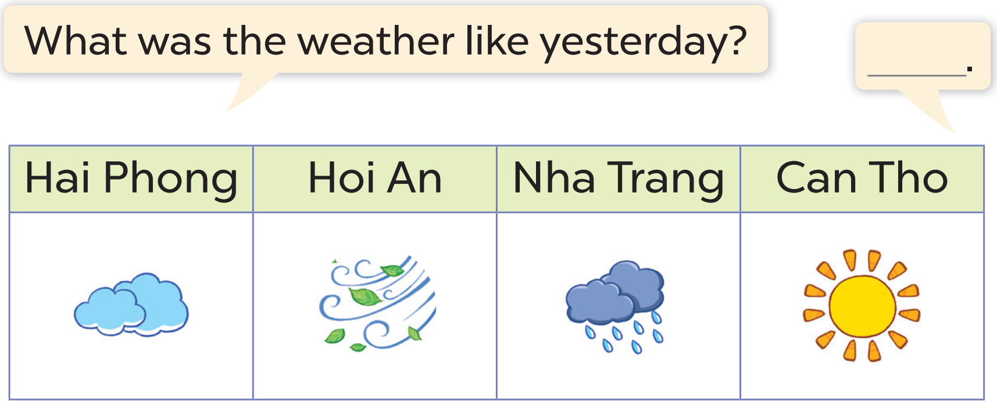

Slide 8
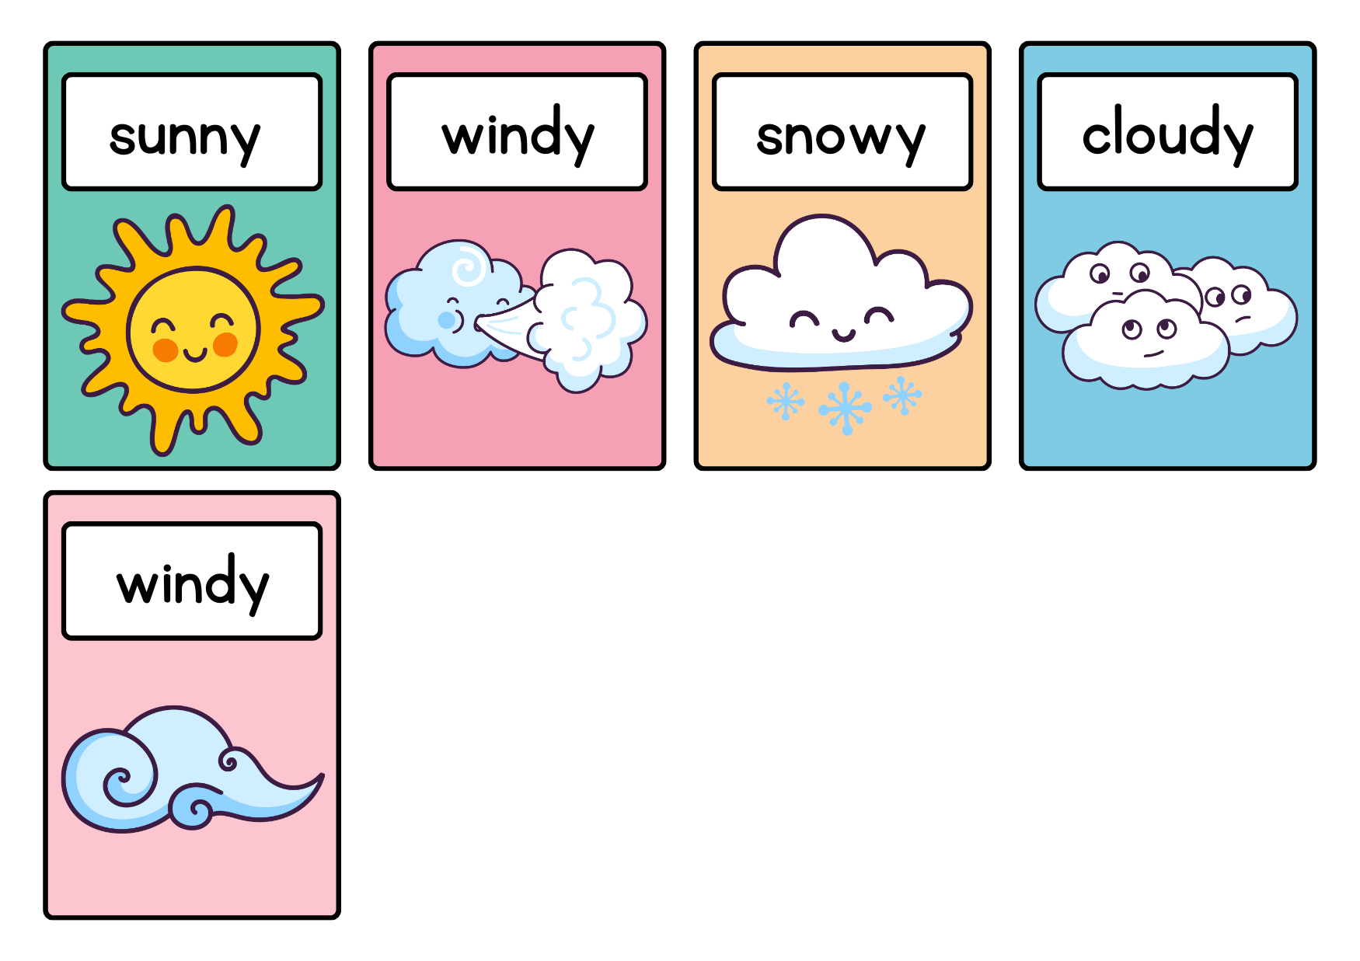
HANOI

Slide 9
WHAT’S THE MISSING LETTER?

Slide 10


S
U
?
N
N
Y

Slide 11


W
I
D
?
N
Y

Slide 12

C
L
O
U
D
?
Y

Slide 13

Website: hoclieu.vn
Fanpage: facebook.com/www.tienganhglobalsuccess.vn

