Slide 2
In the city
Lesson 1 - Period 1

Slide 3
01
Warm-up
03
02
Table of contents
Listen, point and say.
Look, listen and repeat.
05
04
Fun corner and wrap-up
Let’s talk.

Slide 4
Warm-up
01
Let’s chant!

Slide 5
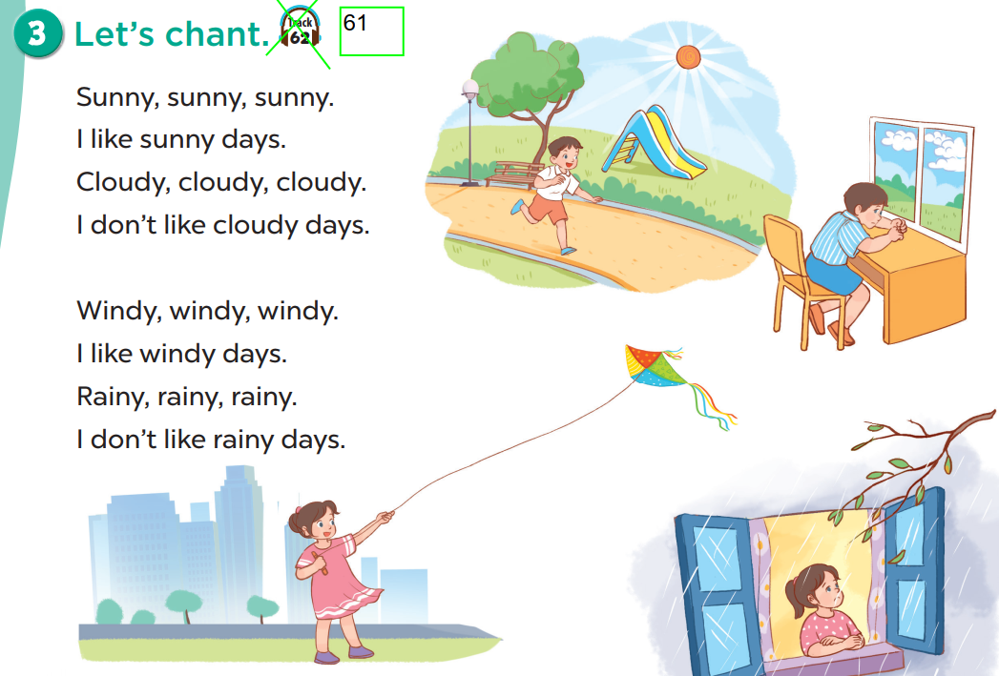
Let’s chant!

Slide 6
Look, listen and repeat.
02
Activity 1

Slide 7
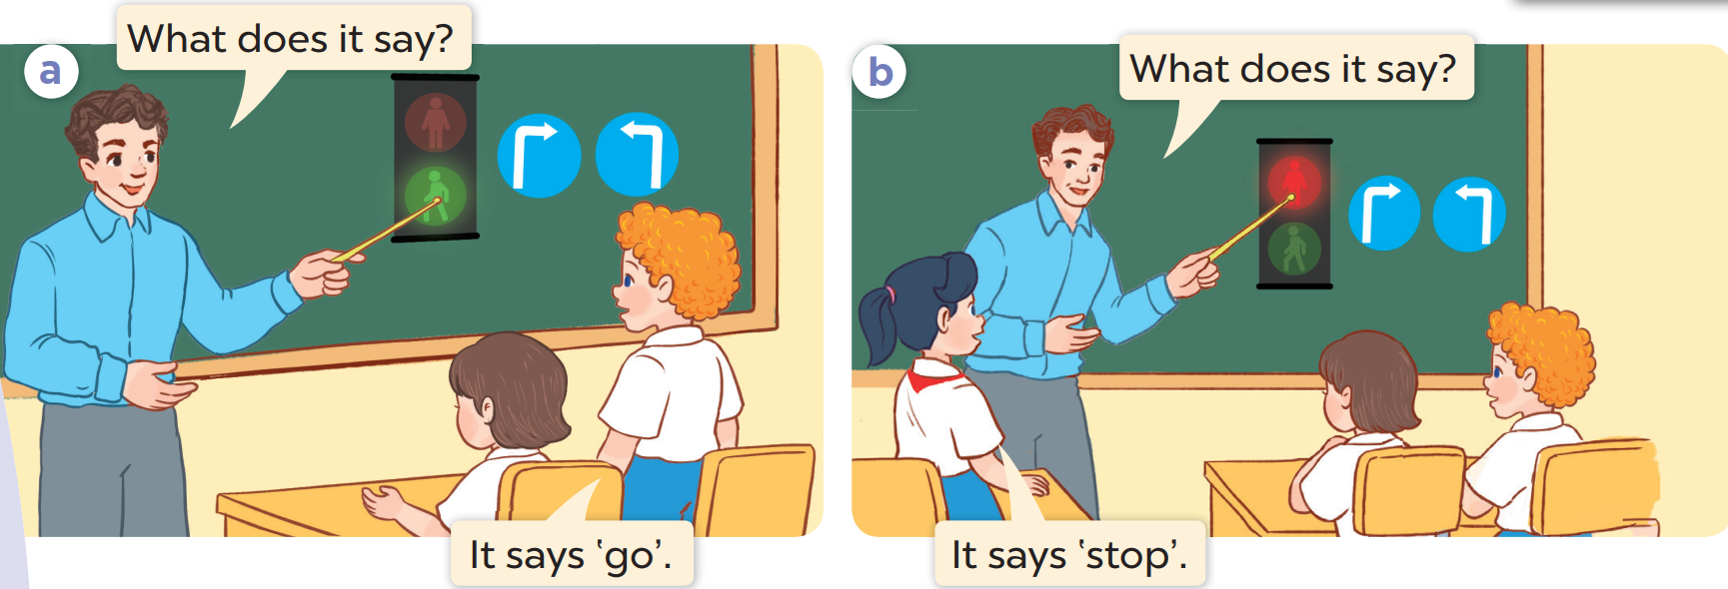
What is this?
Who are they?

Slide 8
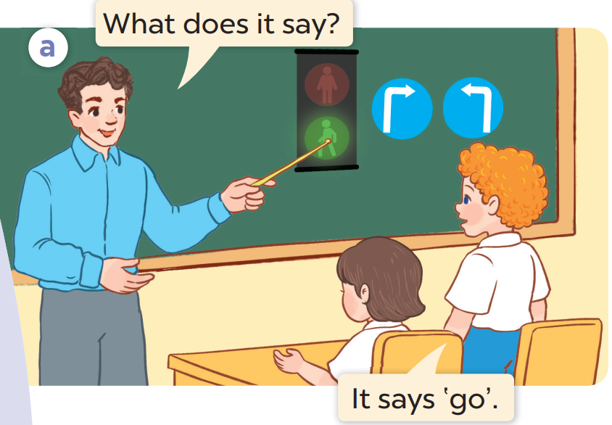
Listen and repeat.

Slide 9
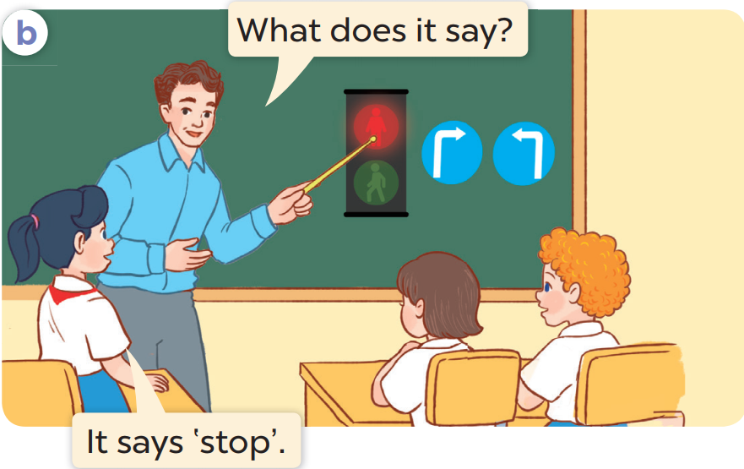
Listen and repeat.

Slide 10
Listen, point and say.
03
Activity 2

Slide 11
Work in pairs. Practise.
Listen, point and say.

Slide 12
go

Slide 13
stop

Slide 14
go straight

Slide 15
turn left

Slide 16
turn right

Slide 17
Look and guess!

Slide 18
go straight

Slide 19
stop

Slide 20
turn right

Slide 21
go

Slide 22
turn left

Slide 23
What does it say?
stop
It says ‘____________’.

Slide 24
What does it say?
go straight
It says ‘____________’.

Slide 25
Let’s talk!
04
Activity 3

Slide 26
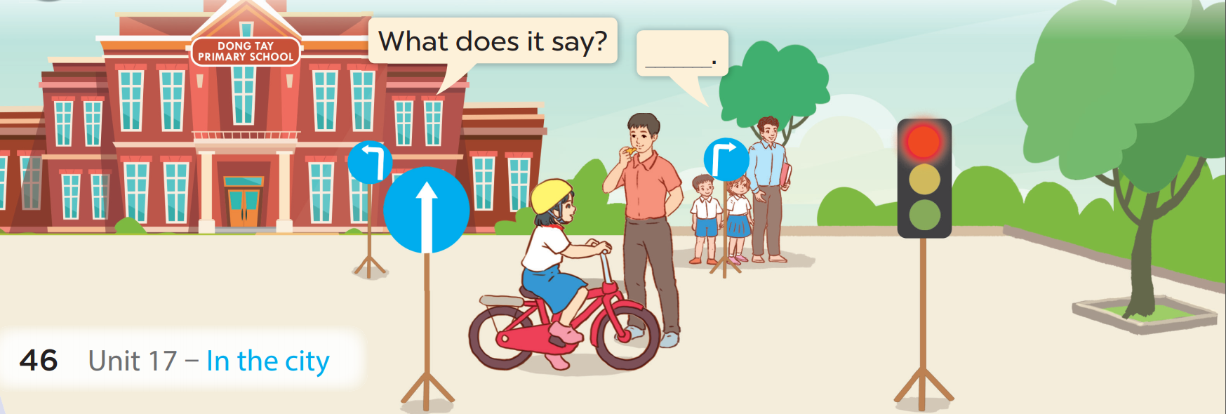

Slide 27
Fun corner
05
Lucky number

Slide 28
LUCKY NUMBER
1
2
3
4
5
6

Slide 29
What does it say?
Next
go
It says ‘____________’.

Slide 30
What does it say?
Next
turn left
It says ‘____________’.

Slide 31
What does it say?
Next
stop
It says ‘____________’.

Slide 32
Next
+ 5 points

Slide 33
What does it say?
Next
turn right
It says ‘____________’.

Slide 34
What does it say?
Next
go straight
It says ‘____________’.

Slide 35
THANK YOU
Website: hoclieu.vn
Fanpage: facebook.com/www.tienganhglobalsuccess.vn
Website: sachmem.vn; hoclieu.vn
Fanpage: www.facebook.com/sachmem.vn

