Slide 2
In the city
In the city
Lesson 1 - Period 2
Lesson 1 - Period 2

Slide 3
01
02
Warm-up and review
Listen and tick or cross.
Table of contents
03
04
Let’s sing!
Look, complete and read.
05
Fun corner and wrap-up

Slide 4
Warm-up
Race and slap the board.

Slide 5
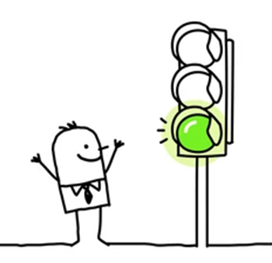
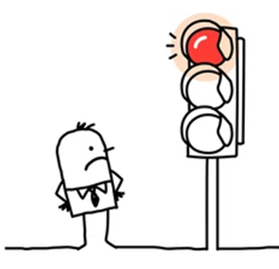
What does it say?

Slide 6
What does it say?

Slide 7
What does it say?

Slide 8
What does it say?

Slide 9
What does it say?

Slide 10
Listen and tick or cross.
02
Activity 4

Slide 11
What does the sign say?

Slide 12
Listen and tick or cross.

Slide 13
Look, complete and read.
03
Activity 5

Slide 14
Read. What's the missing word?
stop

Slide 15
stop
go straight
What
say
turn right
turn left

Slide 16
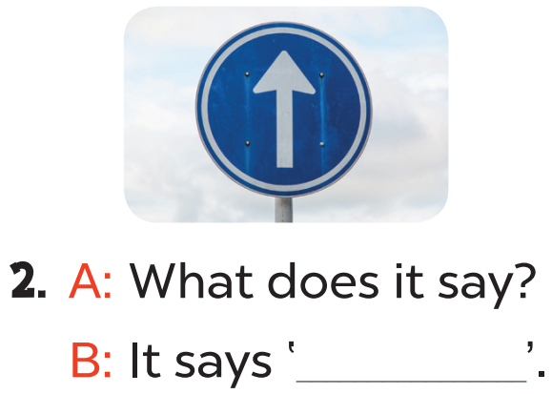
Read aloud.
stop
go straight

Slide 17
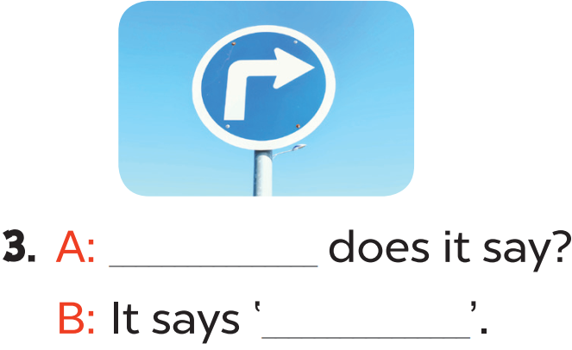
Act it out
What
turn right

Slide 18
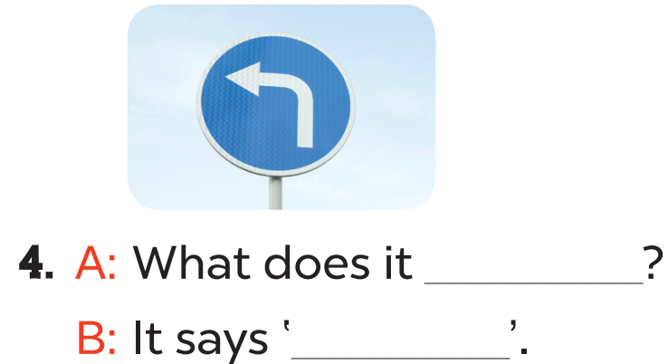
Act it out
say
turn left

Slide 19
Let’s sing.
04
Activity 6

Slide 20
What are they doing?
What colour is the traffic light?
What does it say?

Slide 21
Read the lyrics.

Slide 22
Listen
Practise line by line.
Sing the song.

Slide 24
1
2
3
4
5
6
7
8
1
2
3
4
5
6
7
8
1 point
3 points
Take 5 points
2 points
4 points
Notes:
Pick a number on the upper left corner to go to the question slide.
Click on the number on the right to get score.
24

Slide 25
Goodbye!

Slide 26
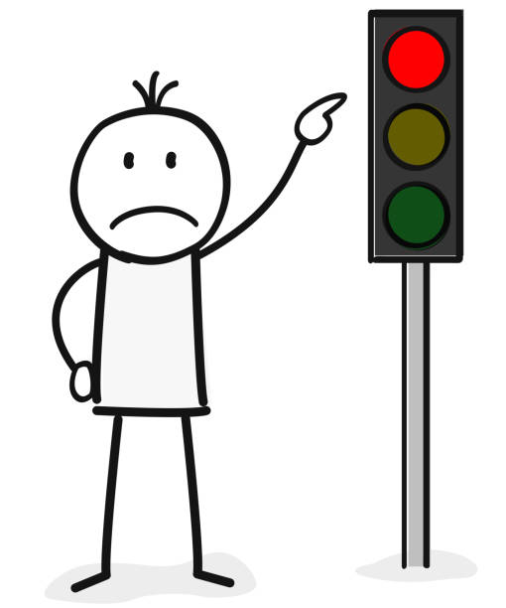
What does it say?
stop
It says ' .....................'
Notes:
Click on the arrow to go back.

Slide 27
What does it say?
turn right
It says ' .....................'
Notes:
Click on the arrow to go back.

Slide 28
................ does it say?
A. How
B. What
C. Where
Notes:
Click on the arrow to go back.

Slide 29
What does it ................. ?
A. says
B. say
Notes:
Click on the arrow to go back.

Slide 30
What does it say?
turn left
It says ' .....................'
Notes:
Click on the arrow to go back.

Slide 31
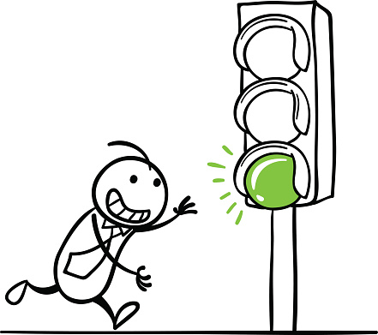
It .............. ' go'.
A. says
B. tells
Notes:
Click on the arrow to go back.

Slide 32
What does it say?
go straight
It says '........................ '
Notes:
Click on the arrow to go back.

Slide 33
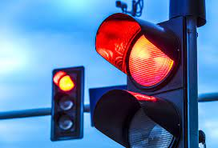
......................... it say?
A. How do
B. What do
C. What does
Notes:
Click on the arrow to go back.

Slide 34
THANK YOU
Website: hoclieu.vn
Fanpage: facebook.com/www.tienganhglobalsuccess.vn
Website: sachmem.vn; hoclieu.vn
Fanpage: www.facebook.com/sachmem.vn

