Slide 2
In the city
Lesson 2 - Period 3

Slide 3
01
02
Warm-up and review
Look, listen and repeat.
Table of contents
03
Listen, point and say.
04
Let’s talk.
05
Fun corner and wrap-up

Slide 4
Warm-up
01
Look and answer.

Slide 5
What does it say?
It says ‘stop’.

Slide 6
What does it say?
It says ‘turn left’.

Slide 7
What does it say?
It says ‘turn right’.

Slide 8
What does it say?
It says ‘go straight’.

Slide 9
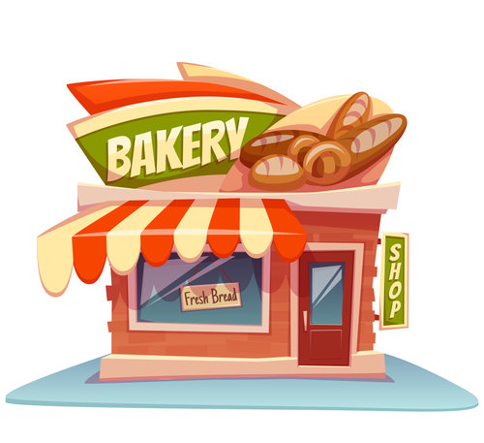
bakery

Slide 10
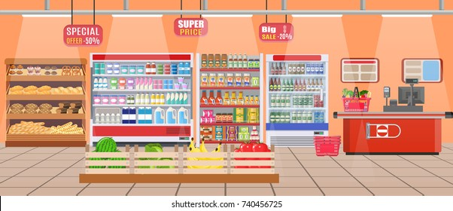
supermarket

Slide 11
cinema

Slide 12
bookshop

Slide 13
Look, listen and repeat.
02
Activity 1

Slide 14
What do they want to buy?
Look and guess.
Where can they buy it?

Slide 15
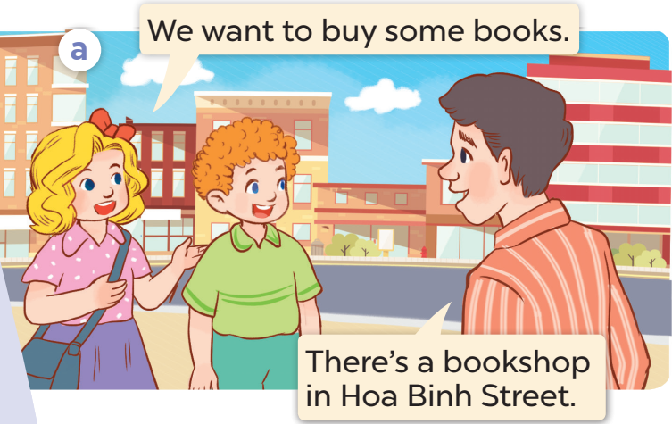
Listen and repeat

Slide 16
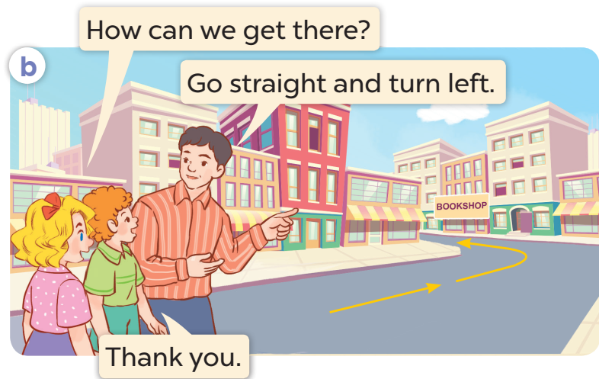
Listen and repeat

Slide 17
Listen, point and say.
03
Activity 2

Slide 18
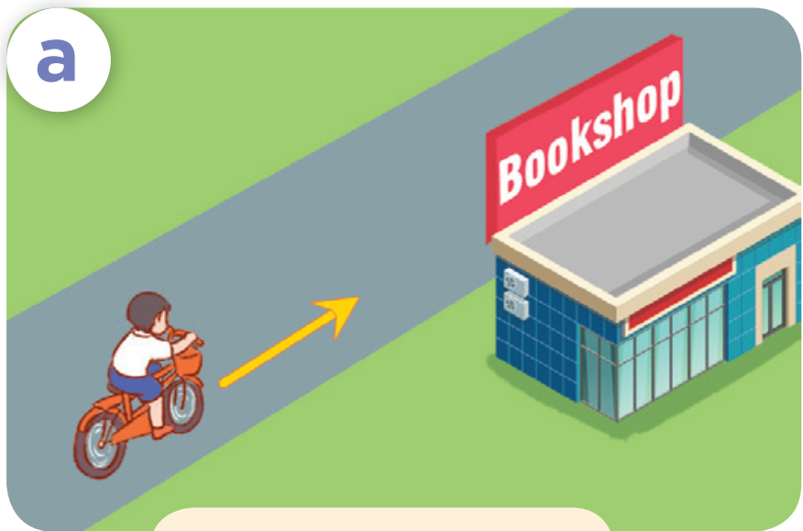
How can I get to the ………………?
bookshop
Go straight.

Slide 19
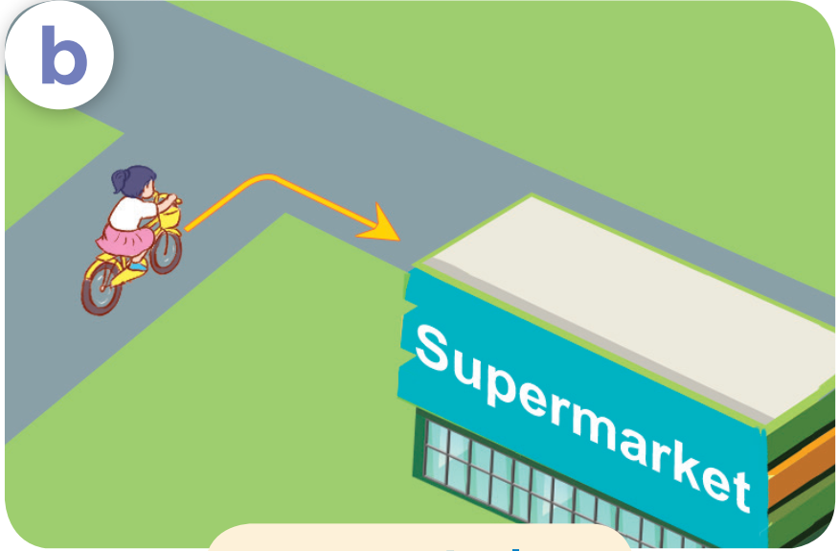
How can I get to the …………………………?
supermarket
Turn right.

Slide 20
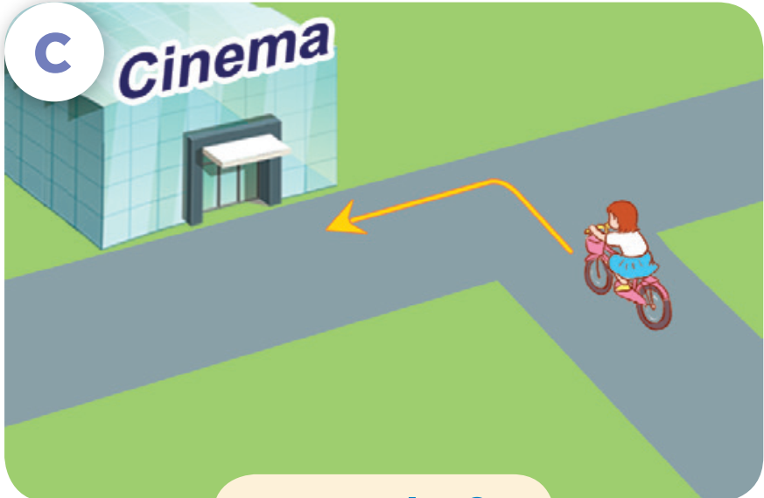
How can I get to the ………………?
cinema
Turn left.

Slide 21
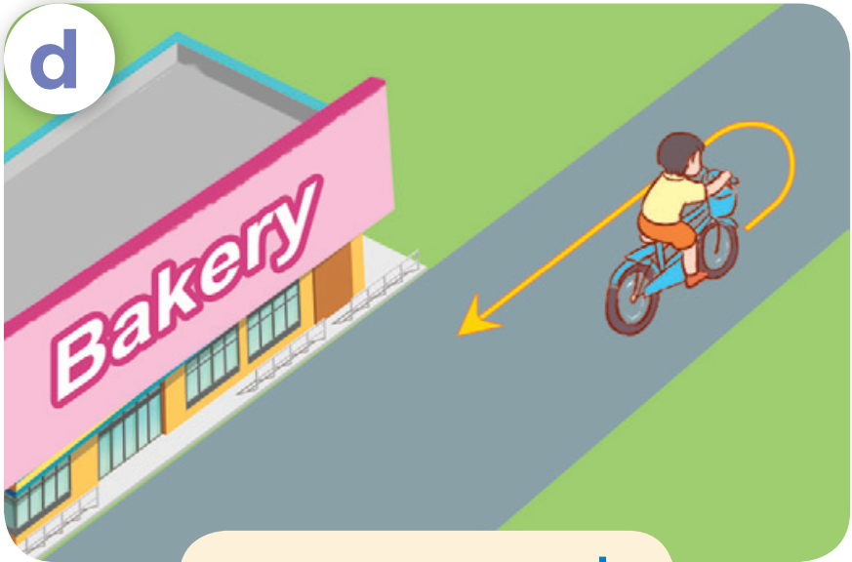
How can I get to the ………………?
bakery
Turn round.

Slide 22
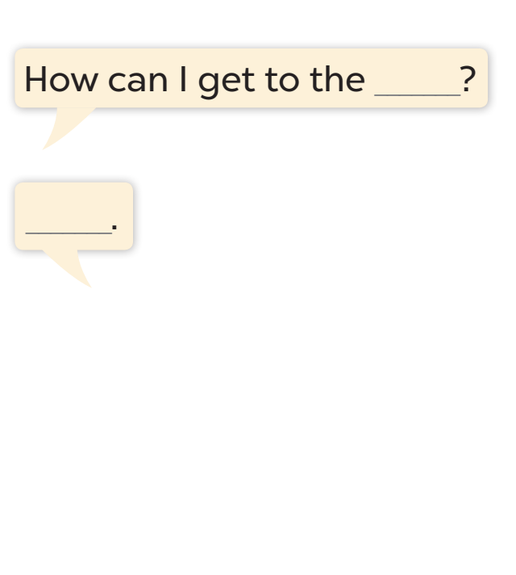
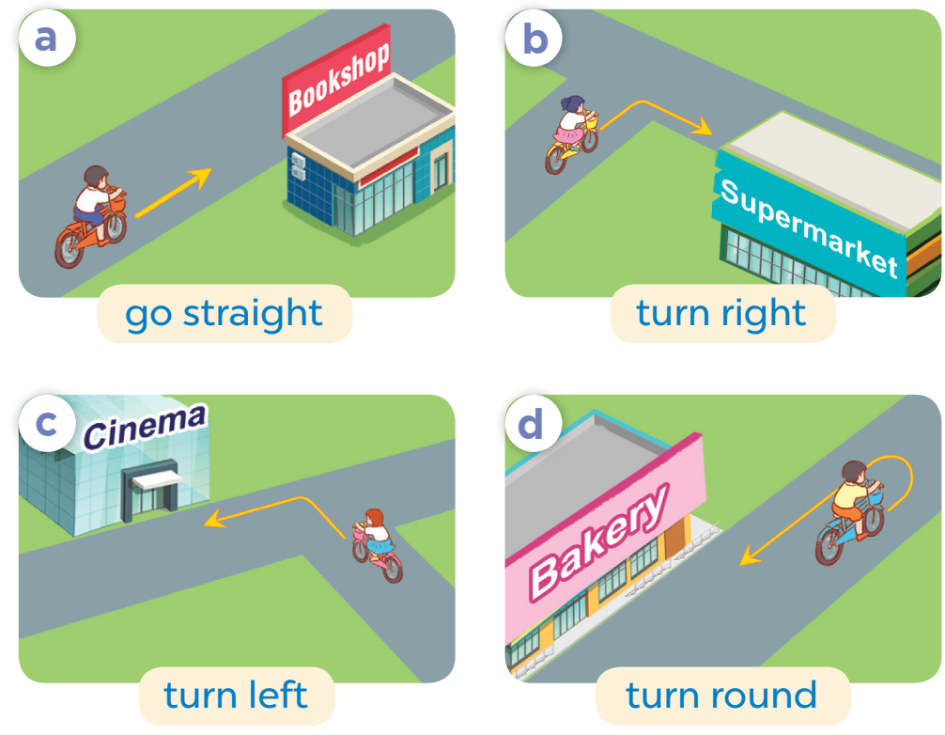
Listen, point and say.

Slide 23
Let’s talk.
04
Activity 3

Slide 24
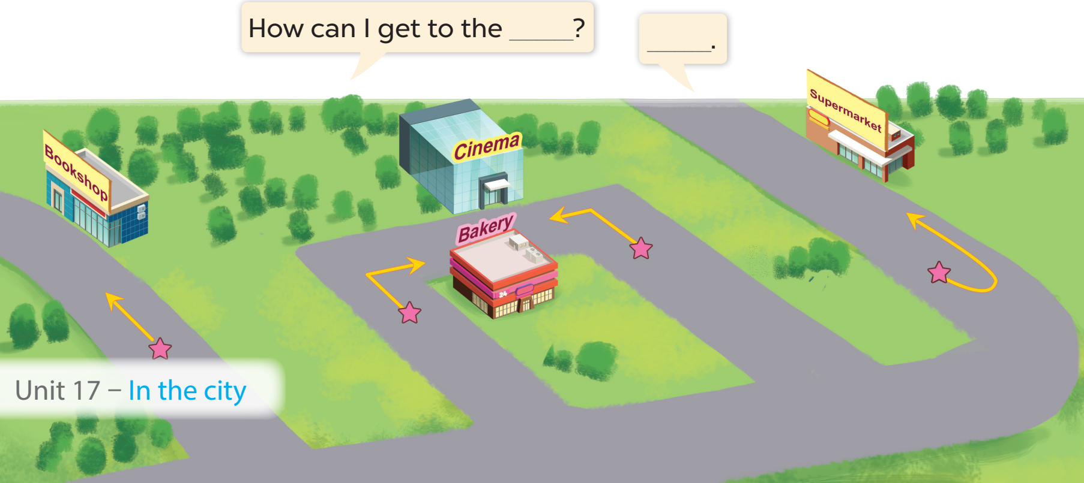
Work in pairs. Ask and answer.

Slide 25
Fun corner
05
Let’s play!

Slide 26
Let’s play

Slide 27
RACING CAR
Questions
Finish line
Notes:
Chọn hình người cầm cờ để trở về slide câu hỏi

Slide 29
How can I get to the cinema?
Turn left.

Slide 30
How can I get to the bookshop?
Turn round.

Slide 31
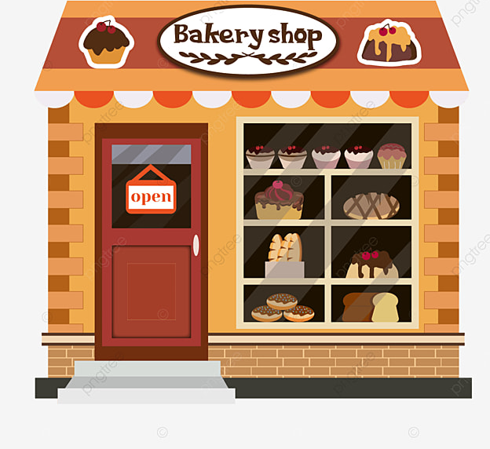
How can I get to the bakery?
Go straight.

Slide 32
How can I get to the supermarket?
Go straight.

Slide 33
How can I get to the bookshop?
Turn round.

Slide 34
How can I get to the supermarket?
Turn left.

Slide 35
How can I get to the bookshop?
Turn right.

Slide 36
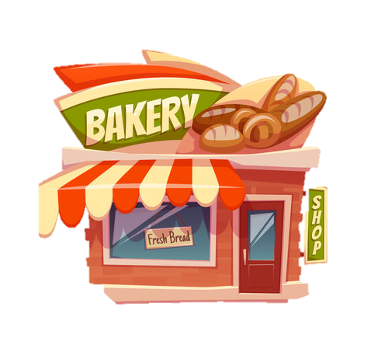
How can I get to the bakery?
Turn right.

Slide 37
How can I get to the cinema?
Turn left.

Slide 38
THANK YOU
Website: hoclieu.vn
Fanpage: facebook.com/www.tienganhglobalsuccess.vn
Website: sachmem.vn; hoclieu.vn
Fanpage: www.facebook.com/sachmem.vn

