Slide 1





Slide 2

At the shopping centre
Lesson 1- period 2

Slide 3
Table of contents
01
Warm-up and review
02
Listen and tick.
03
04
Look, complete and read.
Let’s sing.
05
Fun corner and wrap-up

Slide 4
01
Warm-up

Slide 5

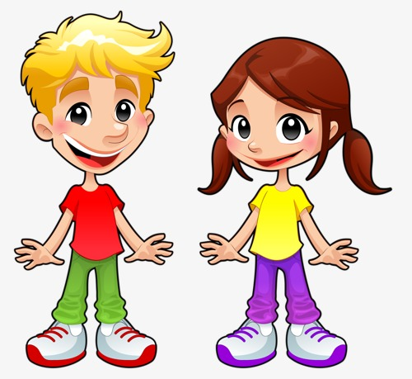











1
2
3
4
A
Choose 1 box to open. Beware of bombs or dynamites.
Green Gem +1pt
Purple Gem +5pts
Trophy +10pts
Crying face -3 pts
B
-1
-5
C
D
-2

Slide 6
02
Listen and tick.

Slide 7

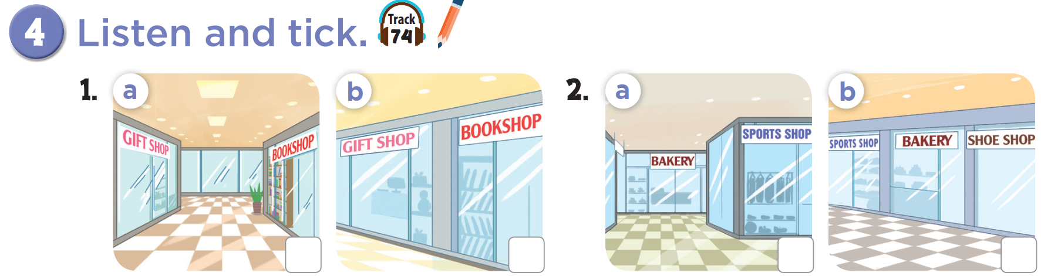


Slide 8
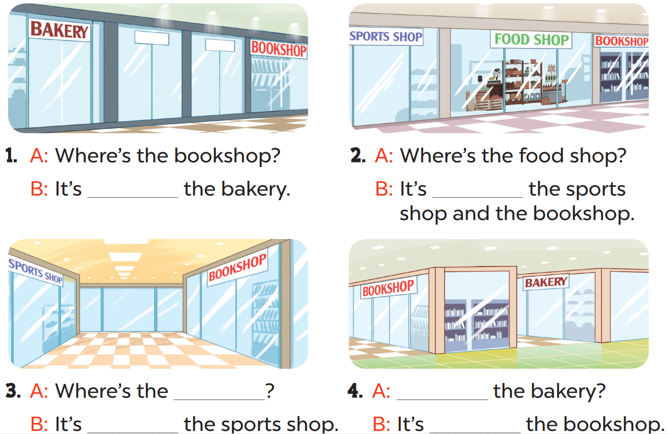
03
Look, complete and read.

Slide 9
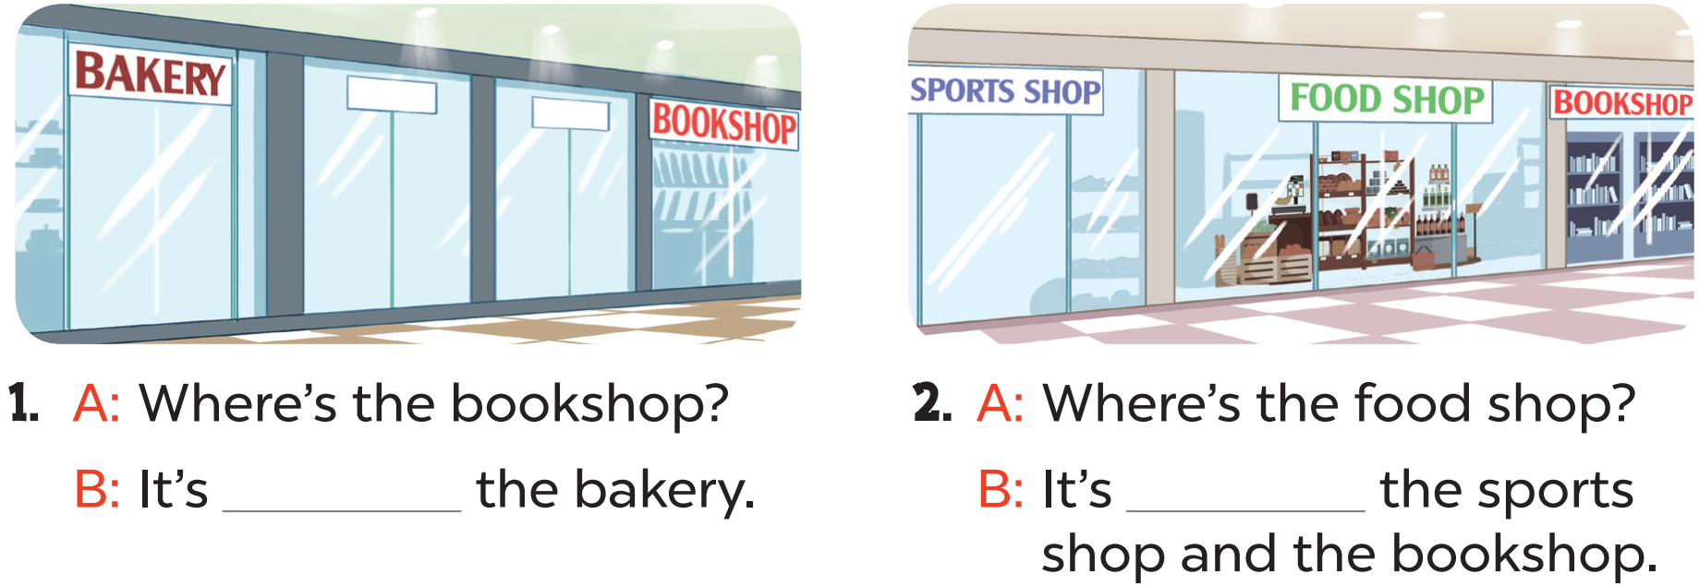
near
between

Slide 10
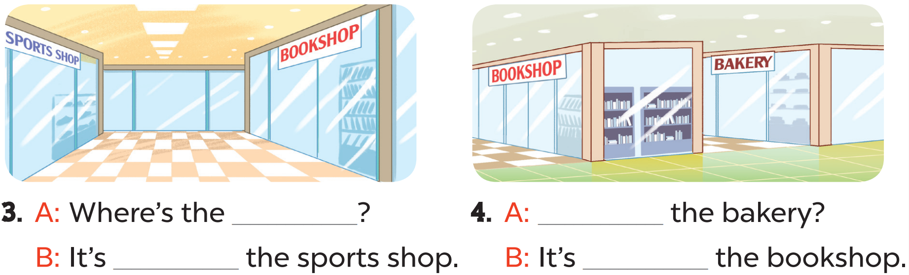
bookshop
Where’s
opposite
behind

Slide 11
04
Let’s sing.

Slide 12
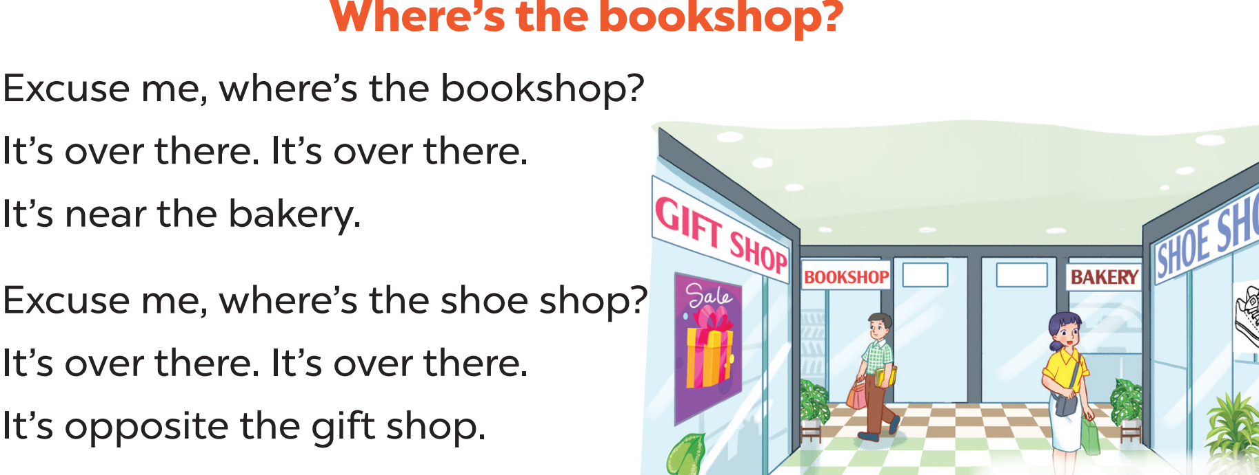
Let’s read the lyrics!

Slide 14
05
Fun corner

Slide 15
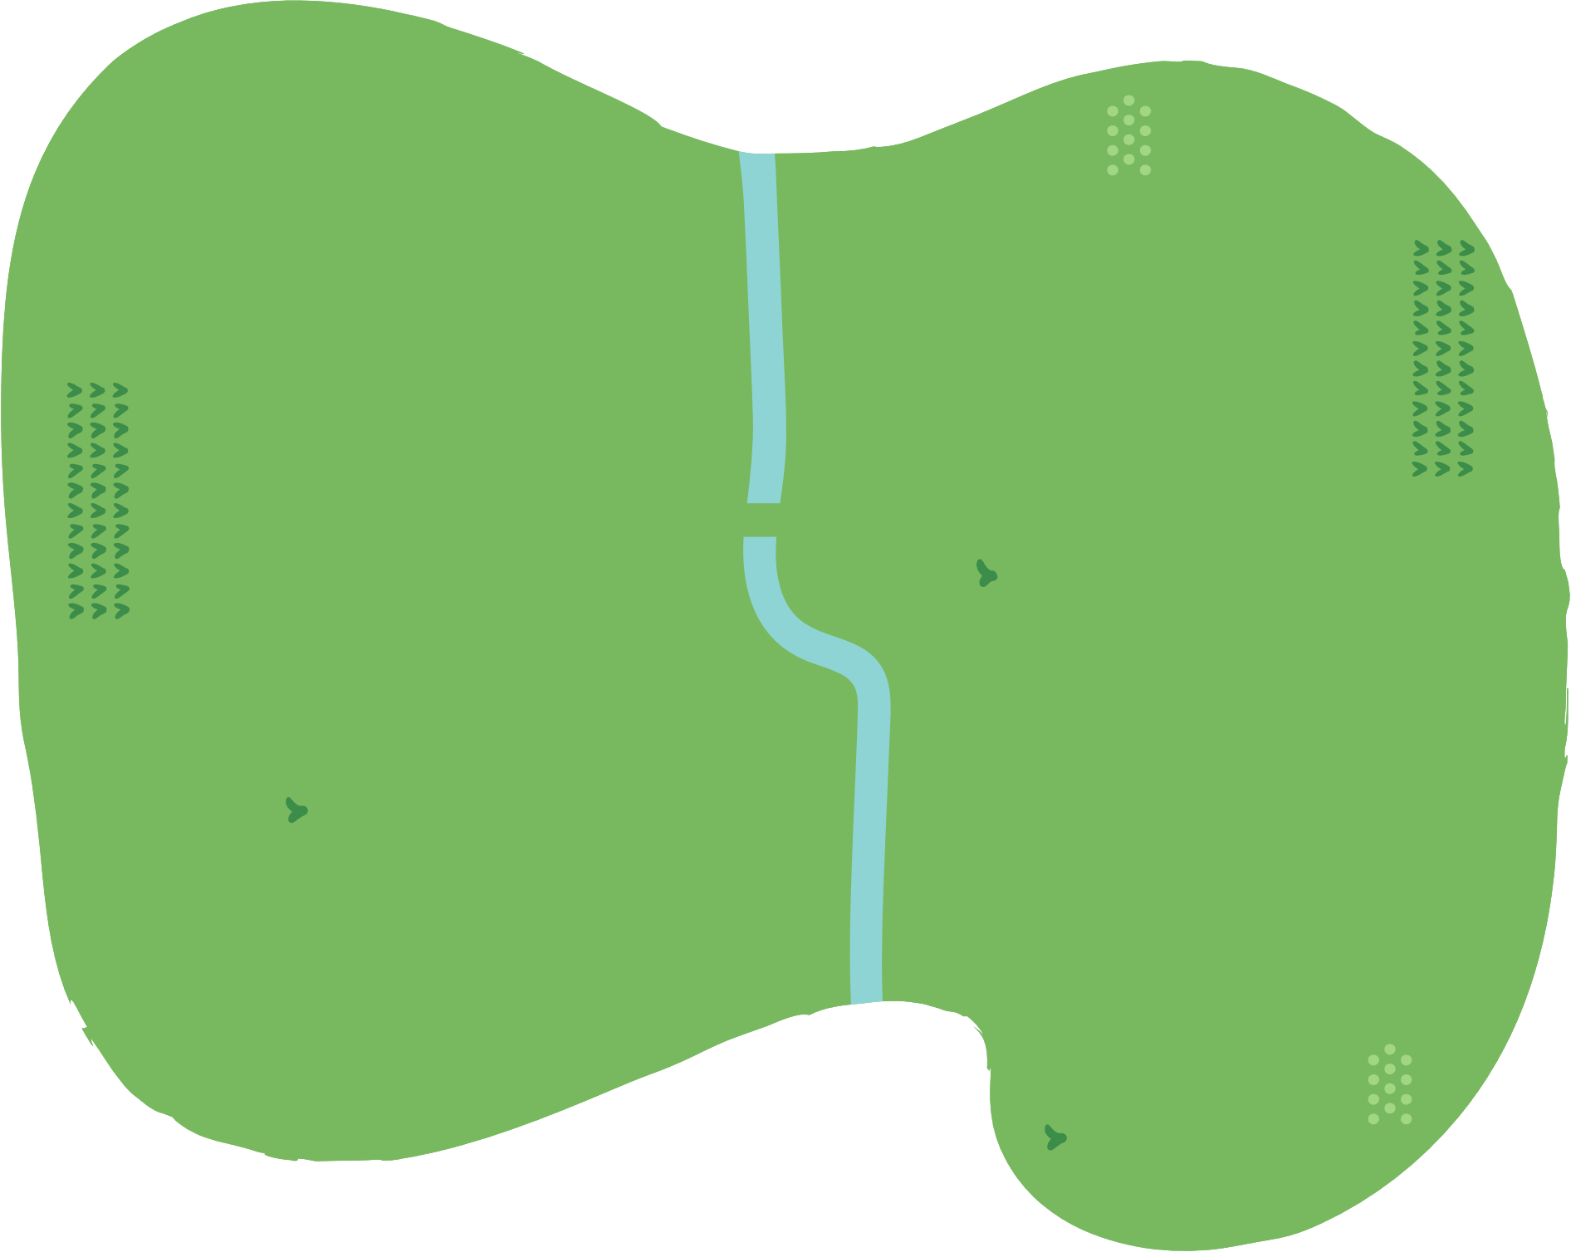































Slide 16
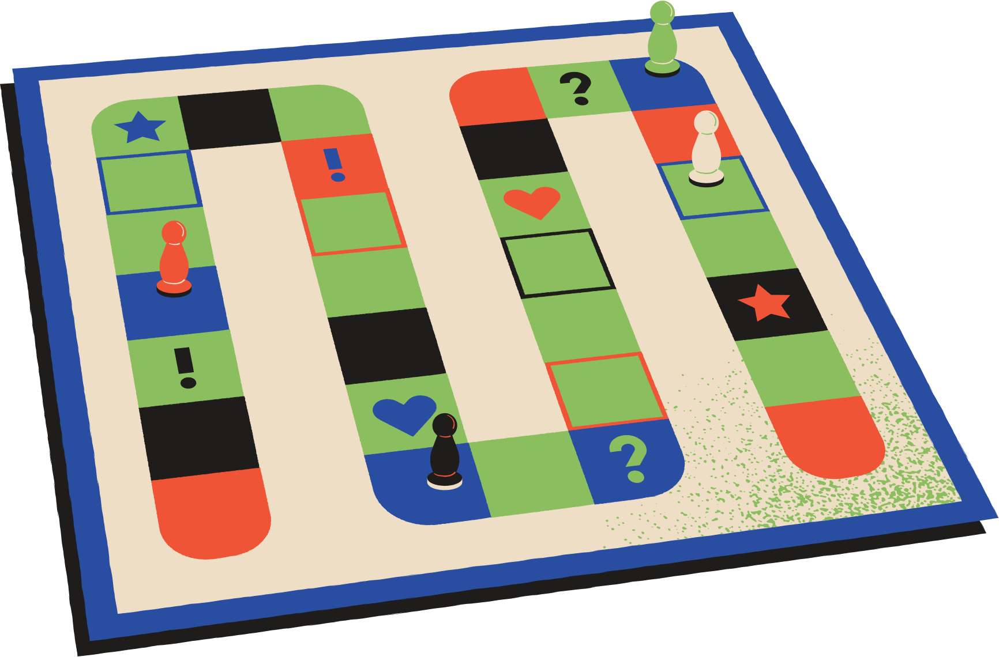


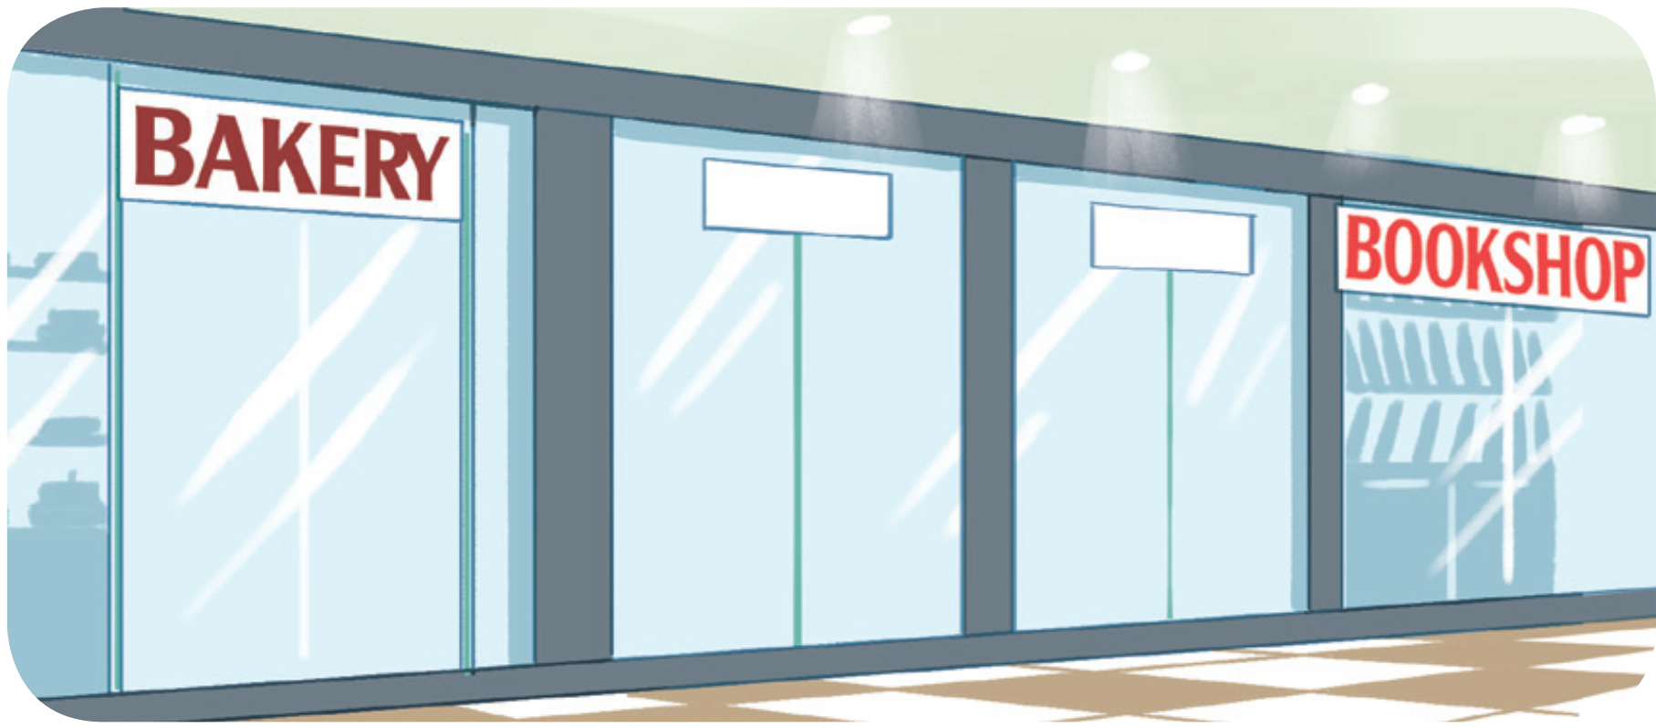
Where is the bookshop?
Insert one question here
It’s near the bakery.

Slide 17
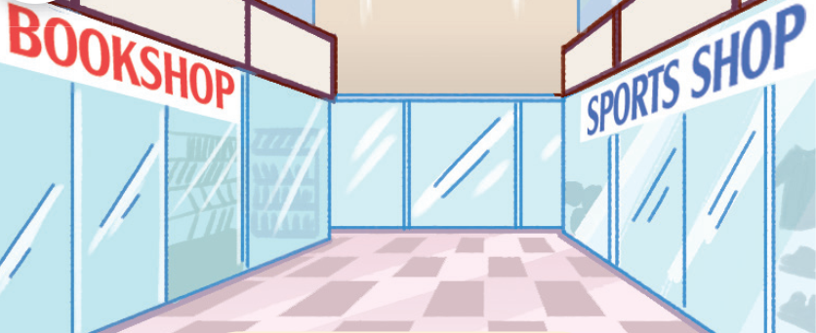
Where is the sports shop?
Insert one question here
Insert one question here
Insert one question here
It’s opposite the bookshop.

Slide 18
Insert one question here
Where is the bakery?
Insert one question here
Insert one question here
It’s near the bookshop.

Slide 19
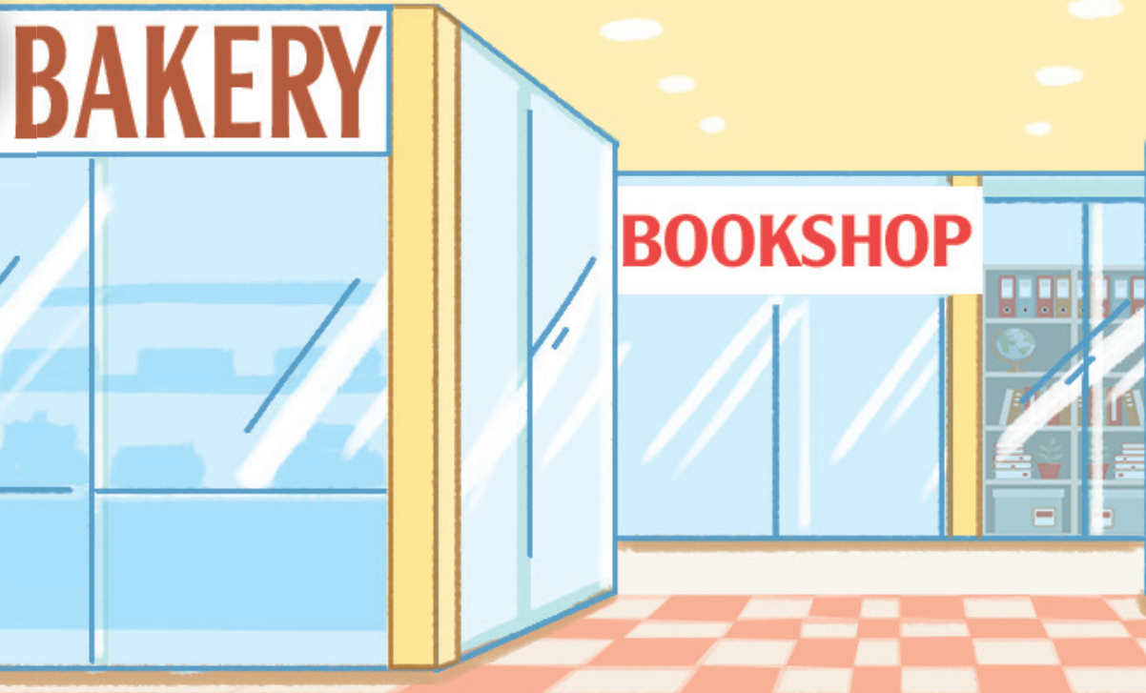
Where is the bookshop?
Insert one question here
Insert one question here
Insert one question here
It’s behind the bakery.

Slide 20
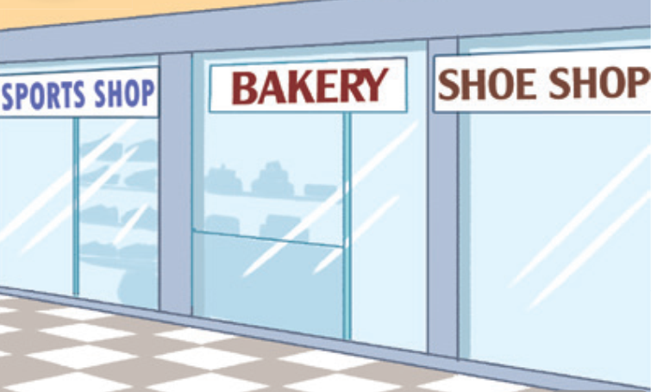
Insert one question here
Where is the bakery?
Insert one question here
It’s between the sports shop and the shoe shop.
Insert one question here

Slide 21
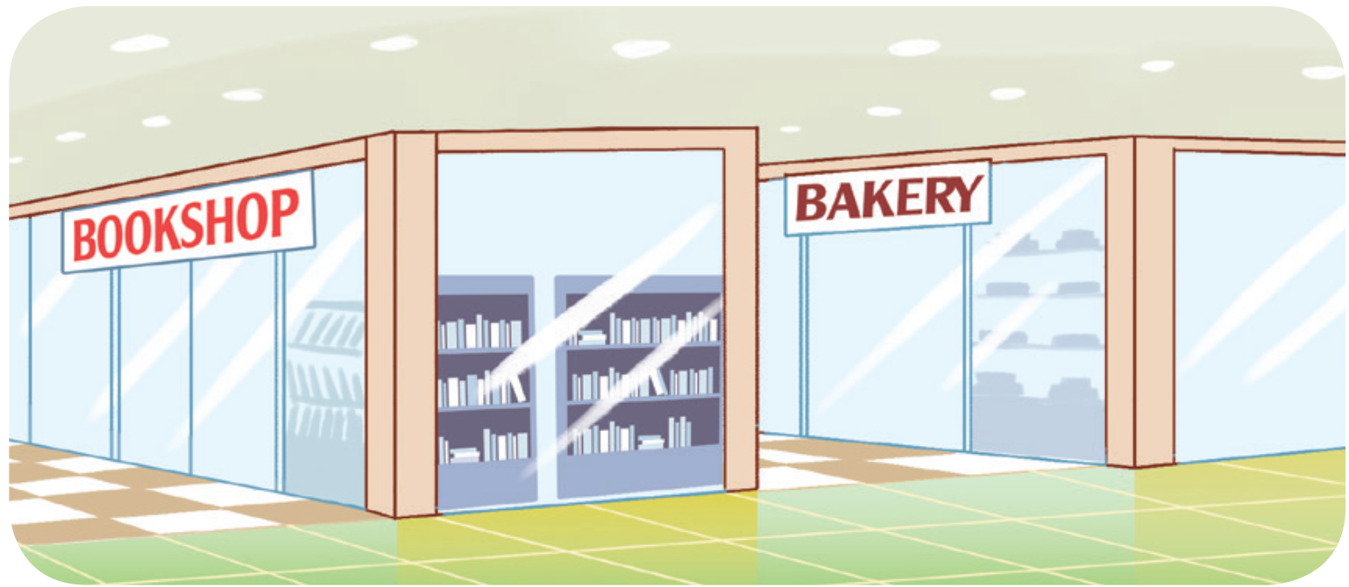
Insert one question here
Where is the bookshop?
Insert one question here
Insert one question here
It’s in front of the bakery.

Slide 22
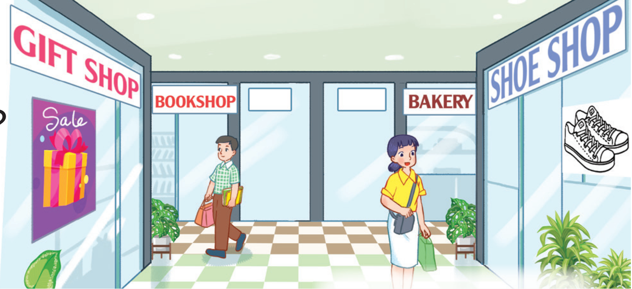
Insert one question here
Where is the gift shop?
Insert one question here
Insert one question here
It’s opposite the shoe shop.

Slide 23
Where is the shoe shop?
Insert one question here
Insert one question here
Insert one question here
It’s opposite the gift shop.

Slide 24
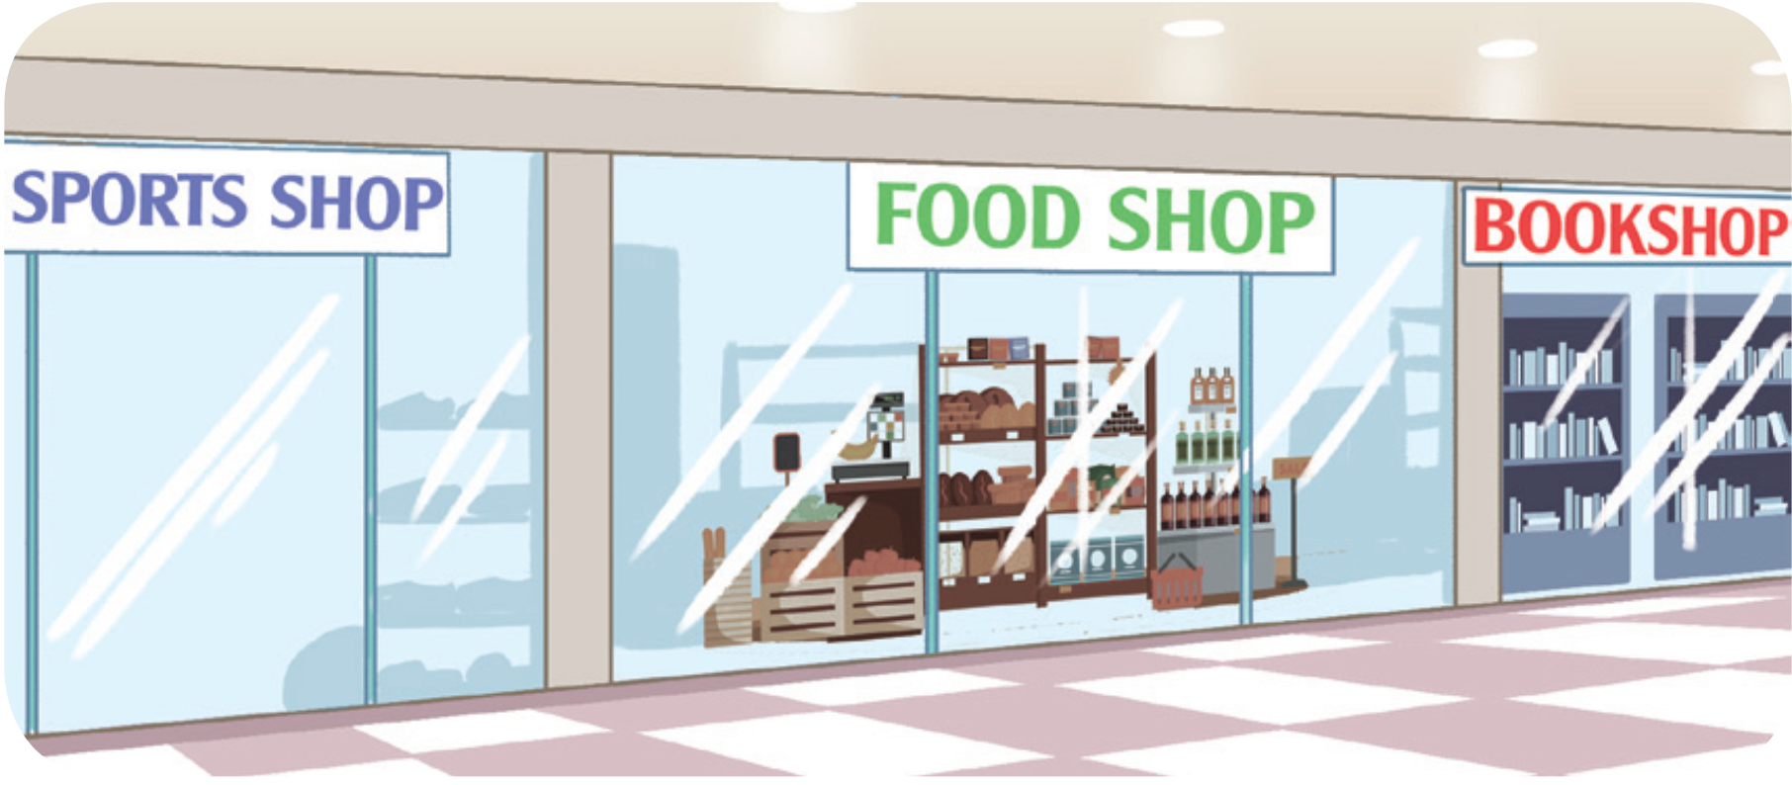
Where is the food shop?
Insert one question here
Insert one question here
It’s between the sports shop and the bookshop.
Insert one question here

Slide 25








THANK YOU
Website: hoclieu.vn
Fanpage: facebook.com/www.tienganhglobalsuccess.vn
Website: sachmem.vn; hoclieu.vn
Fanpage: www.facebook.com/sachmem.vn

