Slide 1





Slide 2

At the shopping centre
Lesson 2 - Period 3

Slide 3
Table of contents
02
01
Warm-up and review
03
Look, listen and repeat.
Listen, point and say.
04
Let’s talk.
05
05
Fun corner and wrap-up

Slide 4
01
Warm-up

Slide 5




Let’s review!
Look and read.
Choose Yes or No.
15 seconds

Slide 6

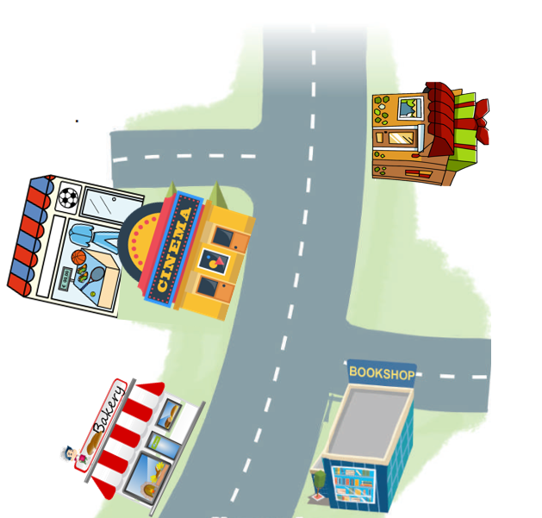
15
1
2
3
4
5
6
7
8
9
10
11
12
13
14
The sports shop is behind the cinema.

Slide 7
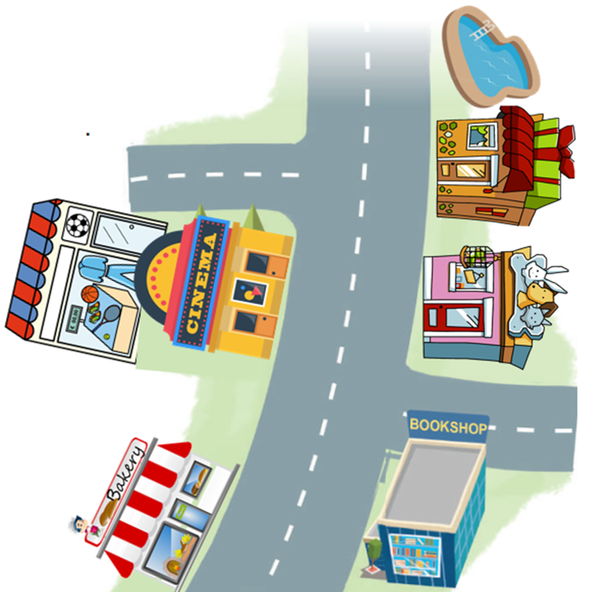
15
1
2
3
4
5
6
7
8
9
10
11
12
13
14
The bakery is near the swimming pool.

Slide 8
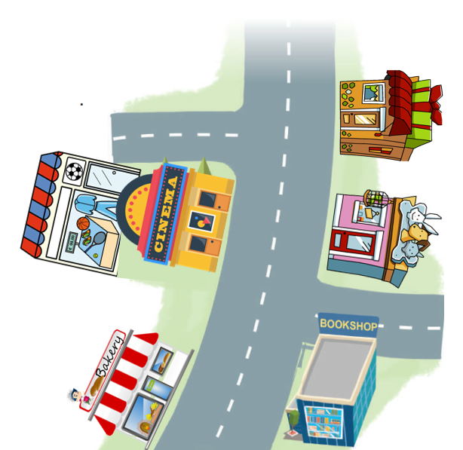
15
1
2
3
4
5
6
7
8
9
10
11
12
13
14
The pet shop is opposite the cinema.

Slide 9

15
1
2
3
4
5
6
7
8
9
10
11
12
13
14
The cinema is behind the sports shop.

Slide 10

15
1
2
3
4
5
6
7
8
9
10
11
12
13
14
The gift shop is between the swimming pool and the pet shop.

Slide 11
15
1
2
3
4
5
6
7
8
9
10
11
12
13
14
The gift shop is opposite the pet shop.

Slide 12
15
1
2
3
4
5
6
7
8
9
10
11
12
13
14
The bakery is near the sports shop.

Slide 13
02
Look, listen and repeat.

Slide 14
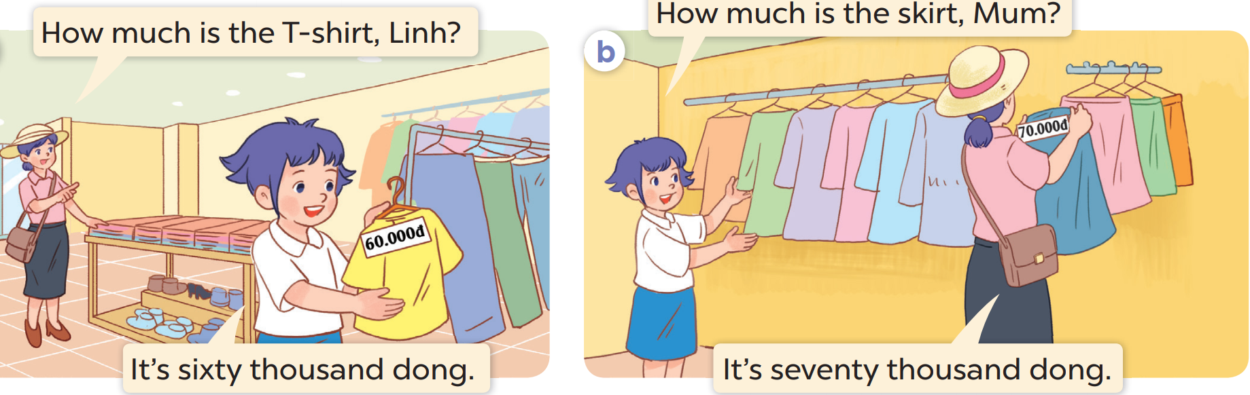
Who are they?
Where are they?
What do they buy?

Slide 15

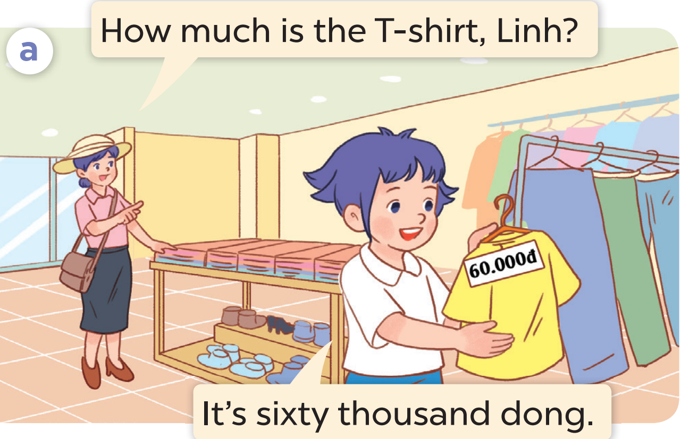
Listen and repeat.

Slide 16
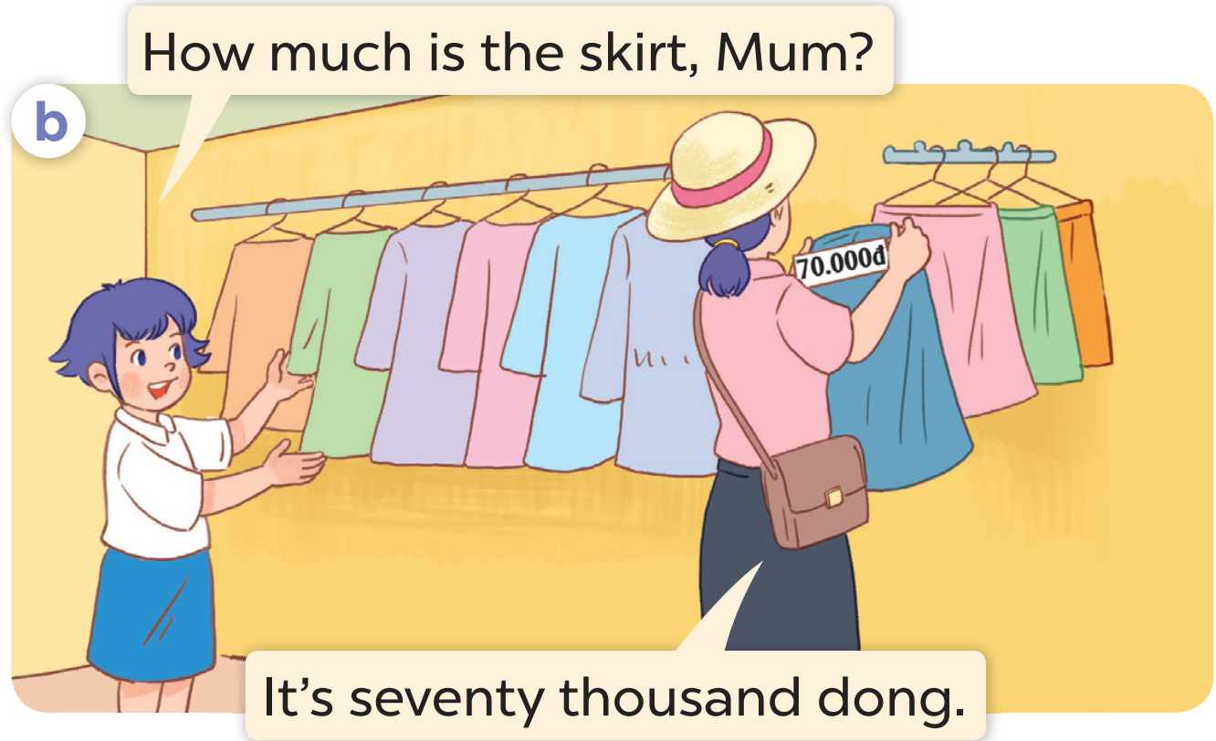
Listen and repeat.

Slide 17
Work in pairs. Practise.

Slide 18
03
Listen, point and say.

Slide 19
Look and think.

Slide 20



How much is the pen?
It's twenty thousand dong.

Slide 21
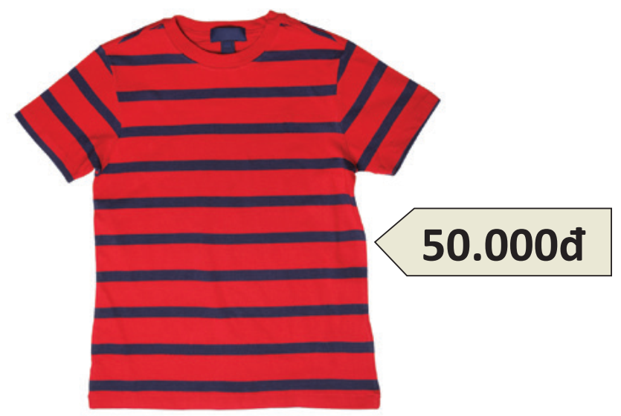
How much is the pen?
It's fifty thousand dong.

Slide 22
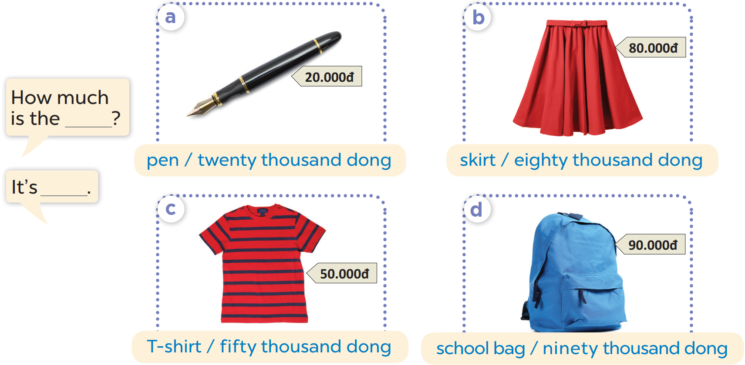
Work in pairs. Practise.
Listen, point and say

Slide 23
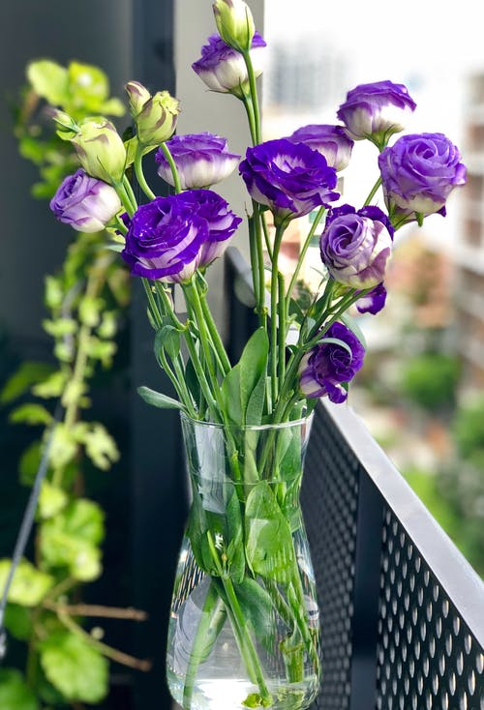

04
Let's talk!

Slide 24
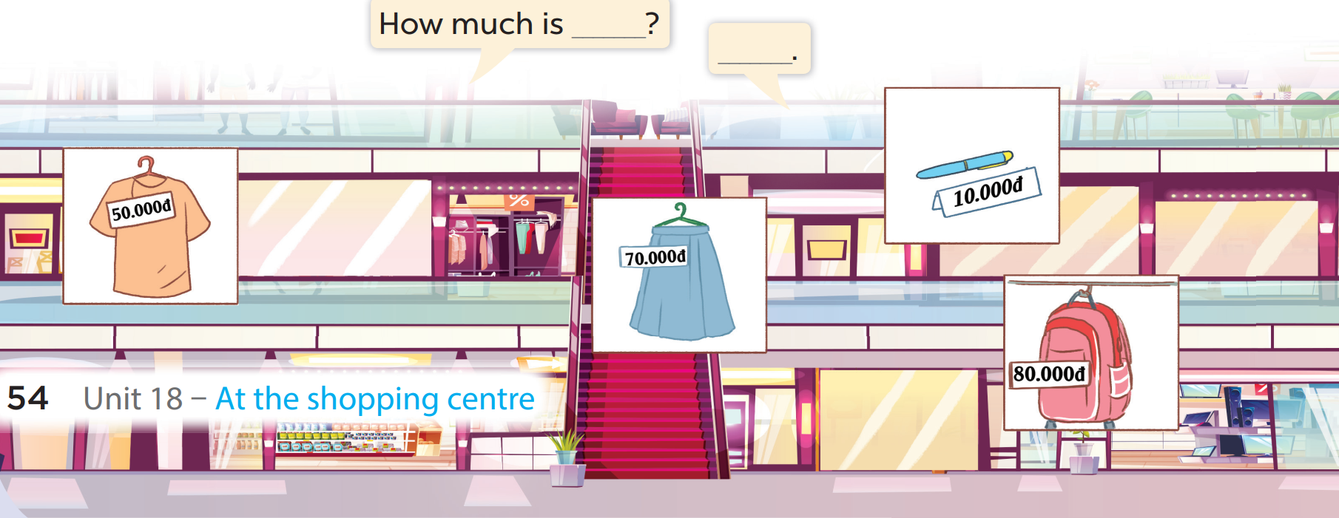

Slide 25
Fun corner
05

Slide 26



Let’s go shopping!

Slide 27

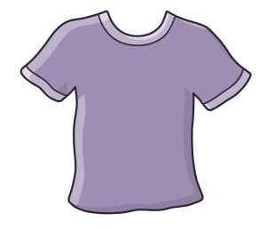



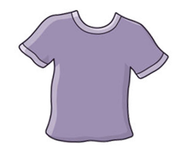







Boys
Girls

Slide 28



How much is the T-shirt?
It's ninety thousand dong.

Slide 29



How much is the skirt?
It's seventy thousand dong.

Slide 30



How much is the backpack?
It's eighty thousand dong.

Slide 31



How much is the pen?
It's twenty thousand dong.

Slide 32


How much is the book?
It's fifty thousand dong.

Slide 33


How much is the bread?
It's ten thousand dong.

Slide 34








THANK YOU
Website: hoclieu.vn
Fanpage: facebook.com/www.tienganhglobalsuccess.vn
Website: sachmem.vn; hoclieu.vn
Fanpage: www.facebook.com/sachmem.vn

