Slide 1


Slide 2



19
The animal world
LESSON 1 - PERIOD 1

Slide 3
Table of Contents
01
02
Look, listen and repeat.
Warm-up
03
Listen, point and say.
04
Let’s talk.
05
Game

Slide 4
1
Warm-up

Slide 5

Notes:
https://youtu.be/yS1zl4g7HLA

Slide 6
2
Look, listen and repeat.

Slide 7

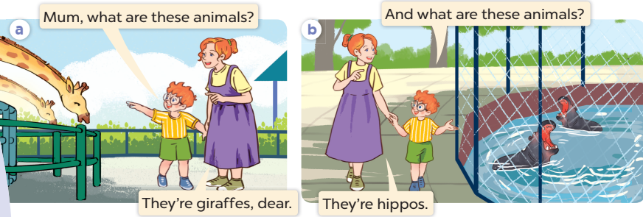
Listen and repeat.

Slide 8
3
Listen, point and say.

Slide 9
New words

Slide 10
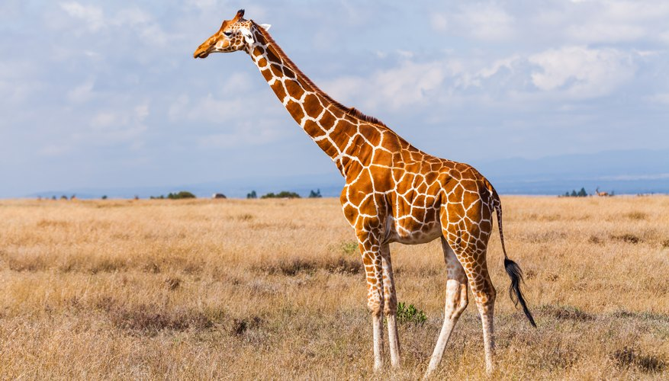
a giraffe

Slide 11
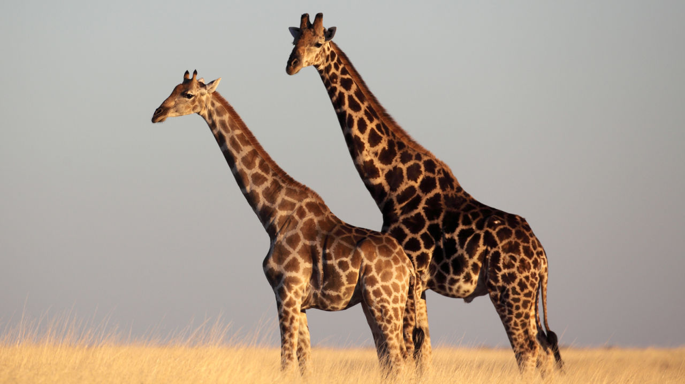
giraffes

Slide 12
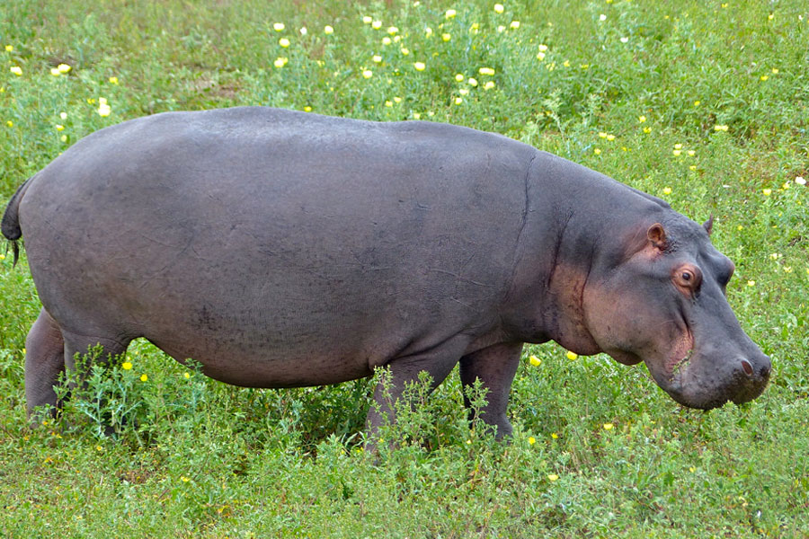
a hippo

Slide 13
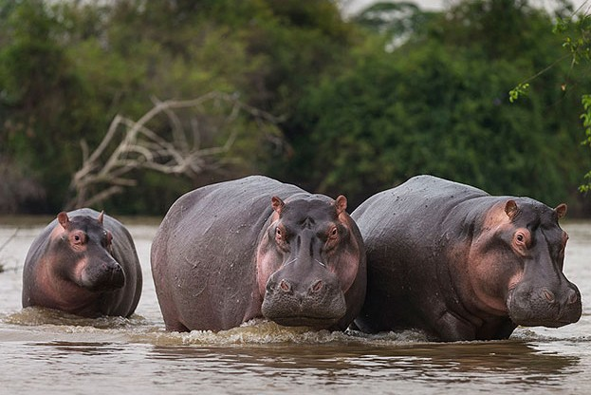
hippos

Slide 14
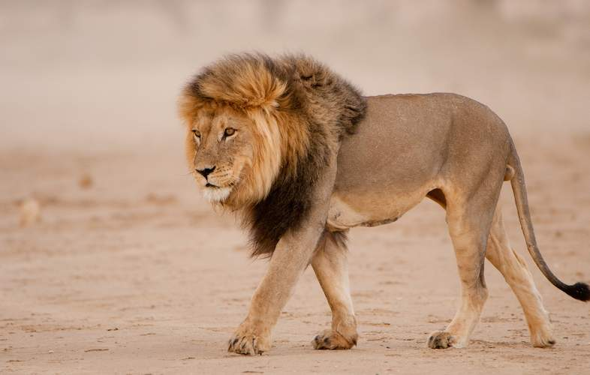
a lion

Slide 15
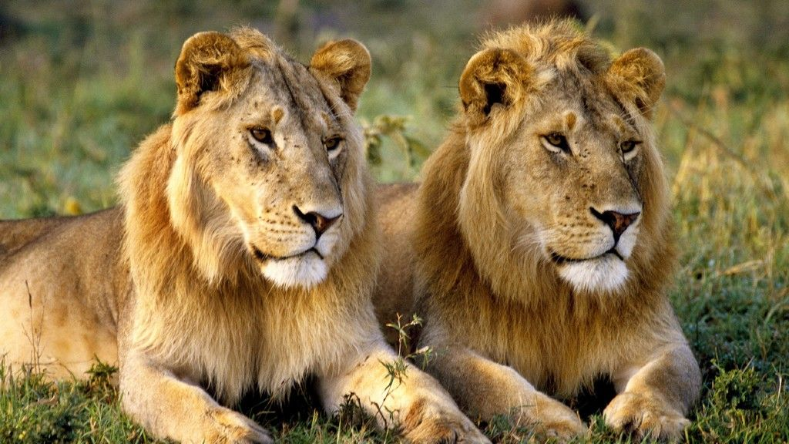
lions

Slide 16
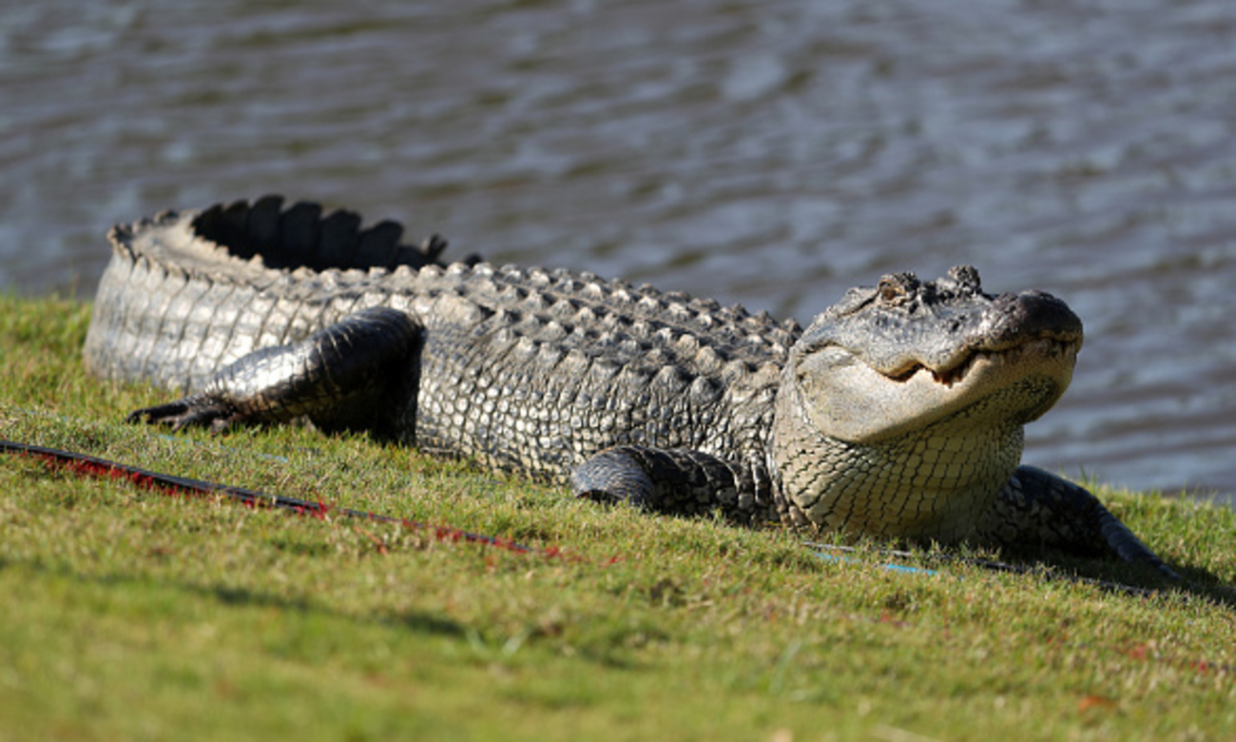
a crocodile

Slide 17
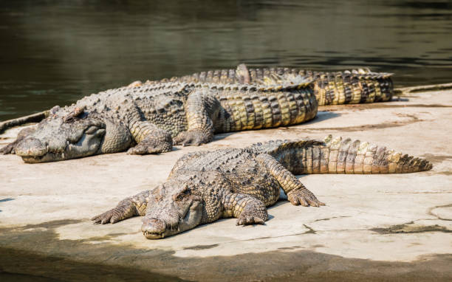
crocodiles

Slide 18
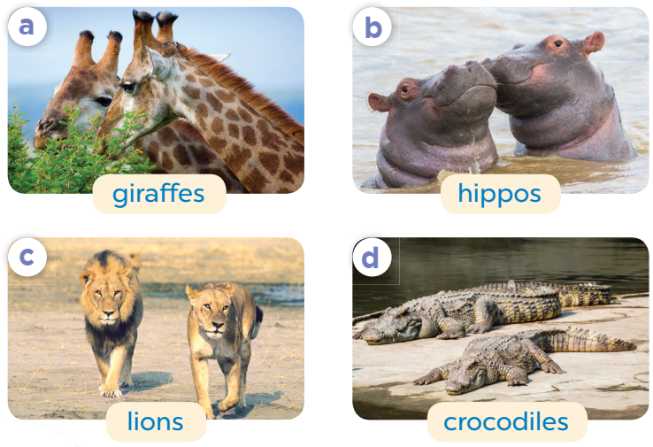
Listen, point and say.
What are these animals?
They’re ___.

Slide 19
What are these animals?
They’re giraffes.

Slide 20
What are these animals?
They’re hippos.

Slide 21
What are these animals?
They’re lions.

Slide 22
What are these animals?
They’re crocodiles.

Slide 23
4
Let’s talk.

Slide 24
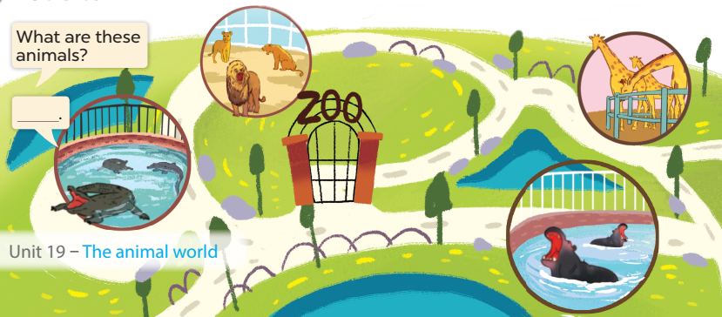
They’re lions.
They’re giraffes.
Look and answer.
They’re crocodiles.
They’re hippos.

Slide 25
Work in pairs. Ask and answer.

Slide 26
5
Game

Slide 27







Collect some cookies.
GIRLS
BOYS
Notes:
- Divide the class into 2 teams (boys & girls)
- Each team takes turns to choose a number and answer the question.
- Click the numbers to choose questions.
- Click Play symbol to give 2 teams the number of cookies they get for each correct answer.

Slide 28
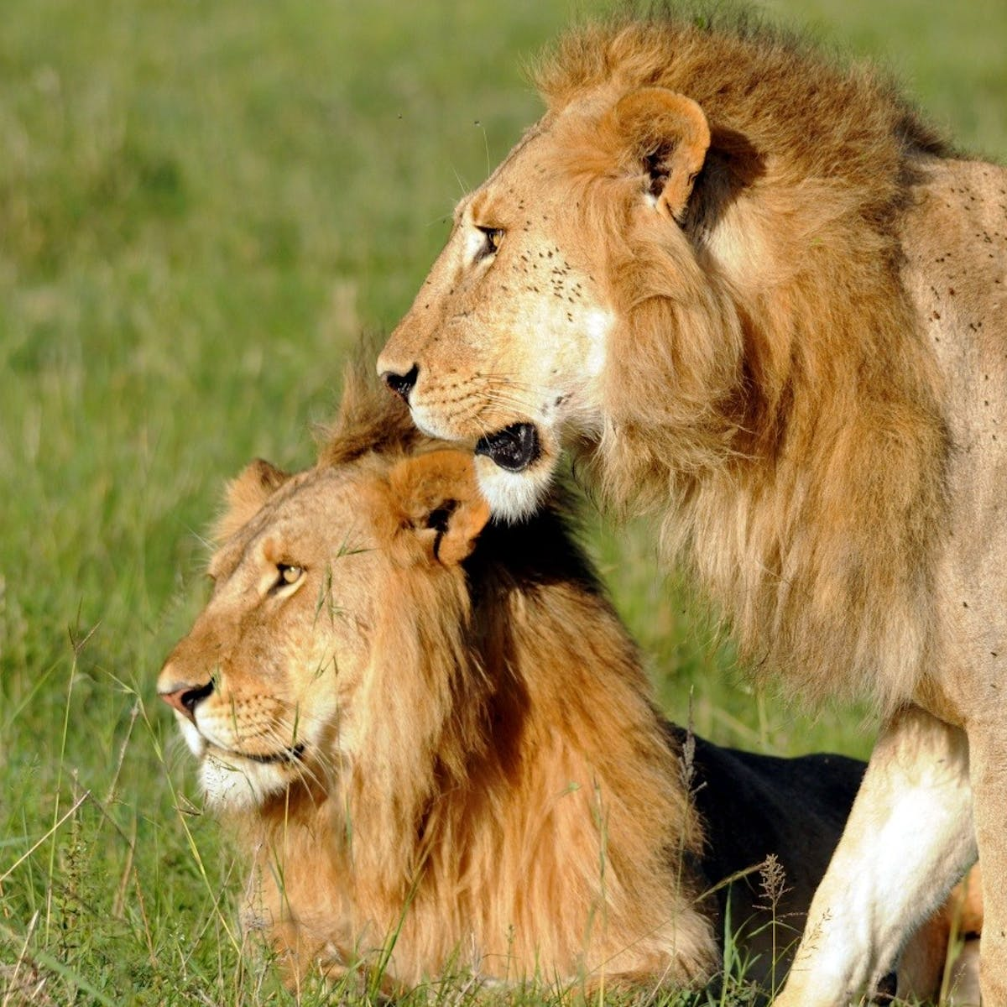

What are these animals?
They’re ………….
lions
Notes:
- Click to show question and answer
- Click again to show the amount of the cookies
- Click Home to get back to the menu

Slide 29
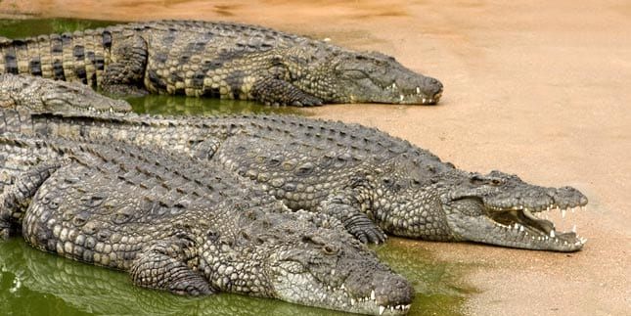
…………………………………………?
What are these animals
They’re crocodiles.

Slide 30
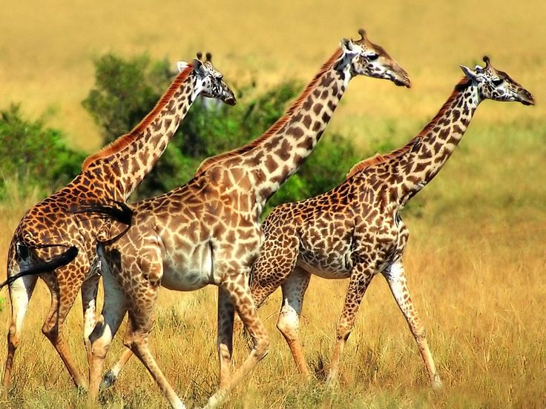
What are these animals?
They’re ……………..... .
giraffes

Slide 31
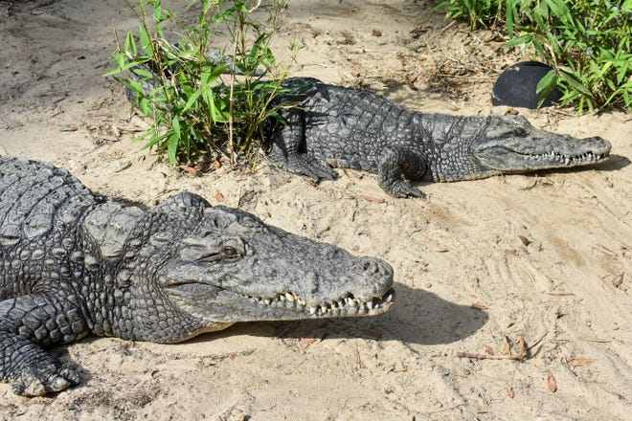
What are these animals?
crocodiles
They’re ……………….. .

Slide 32
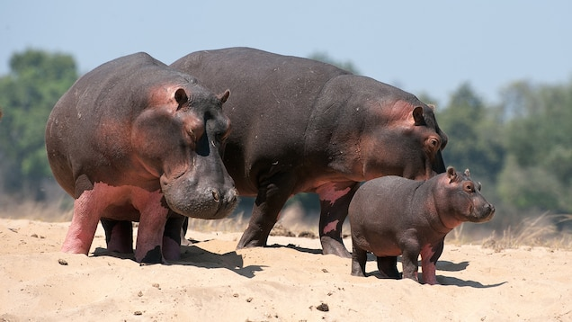
What are these animals?
They’re …………..... .
hippos

Slide 33
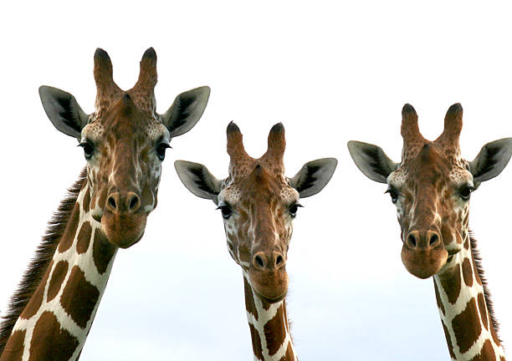
animals
……….… are these ……………..?
What
They’re giraffes.

Slide 34

Website: hoclieu.vn
Fanpage: facebook.com/www.tienganhglobalsuccess.vn
Website: sachmem.vn; hoclieu.vn
Fanpage: www.facebook.com/sachmem.vn

