Slide 2
19
The animal world
LESSON 1 - PERIOD 2

Slide 3
Table of Contents
01
02
Listen and number.
Warm-up
Look, complete and read.
Let's sing.
03
04
05
Game

Slide 4
Warm-up
1
Guess the animals.

Slide 5
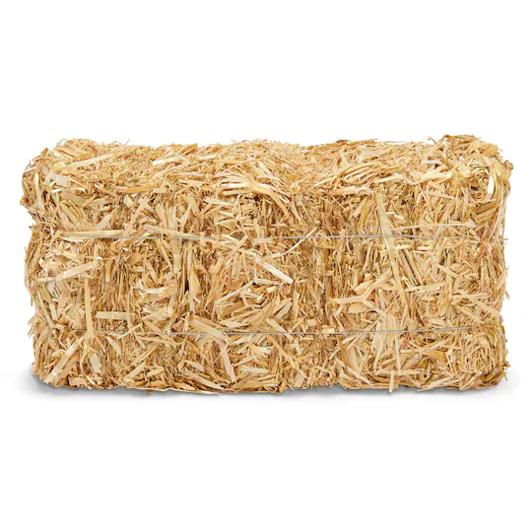
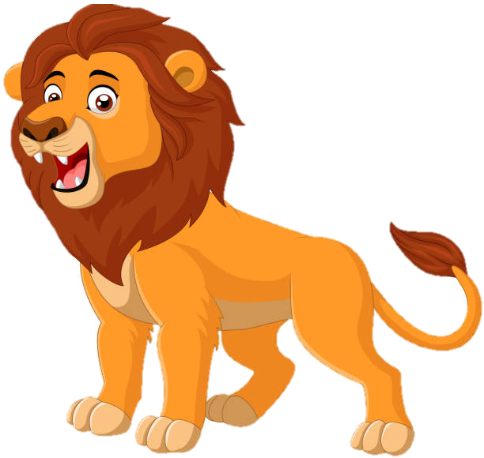
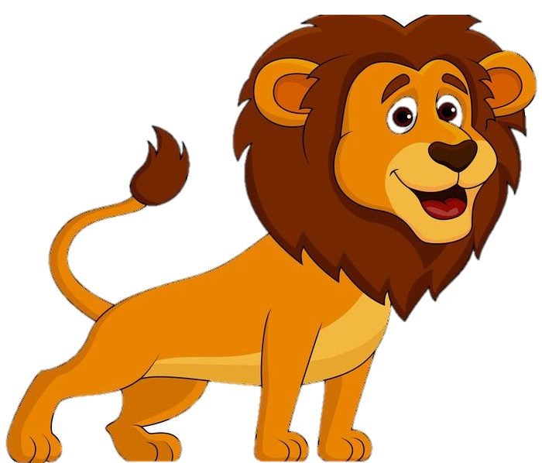
lions

Slide 6
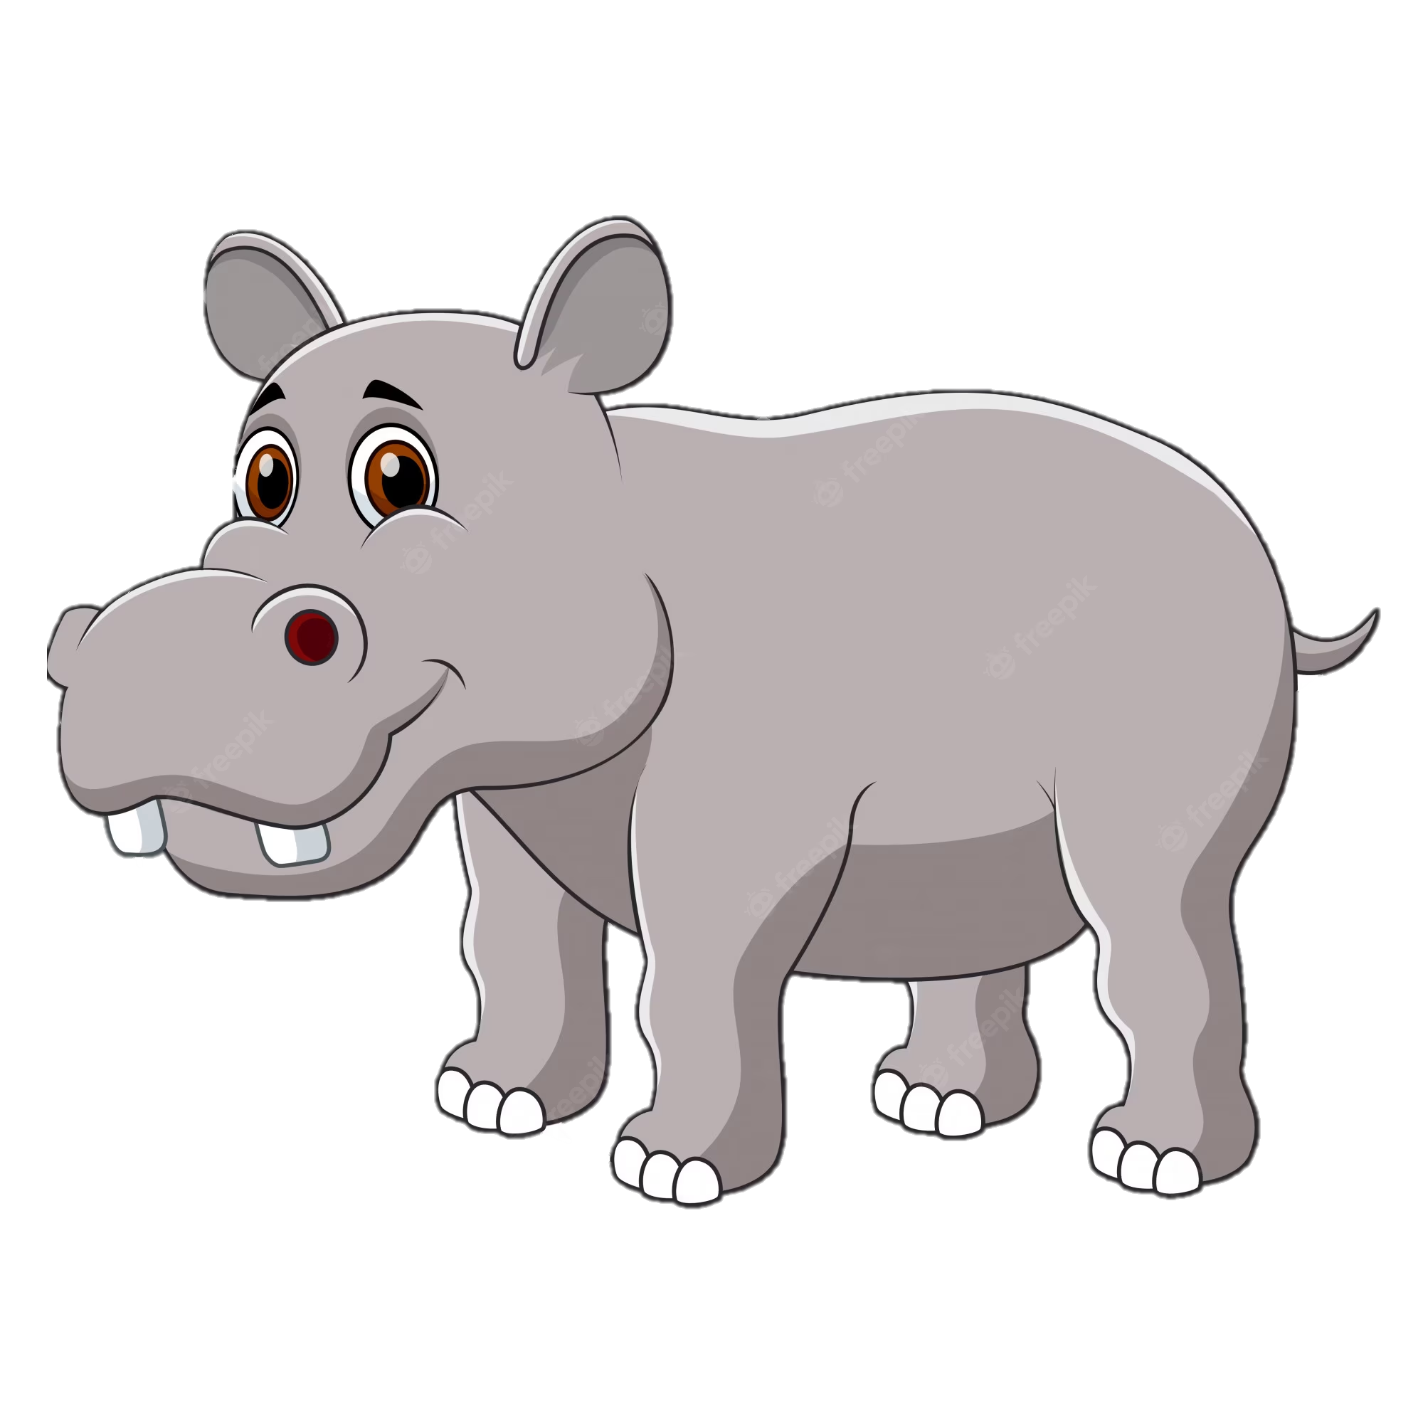
hippos

Slide 7
crocodiles

Slide 8
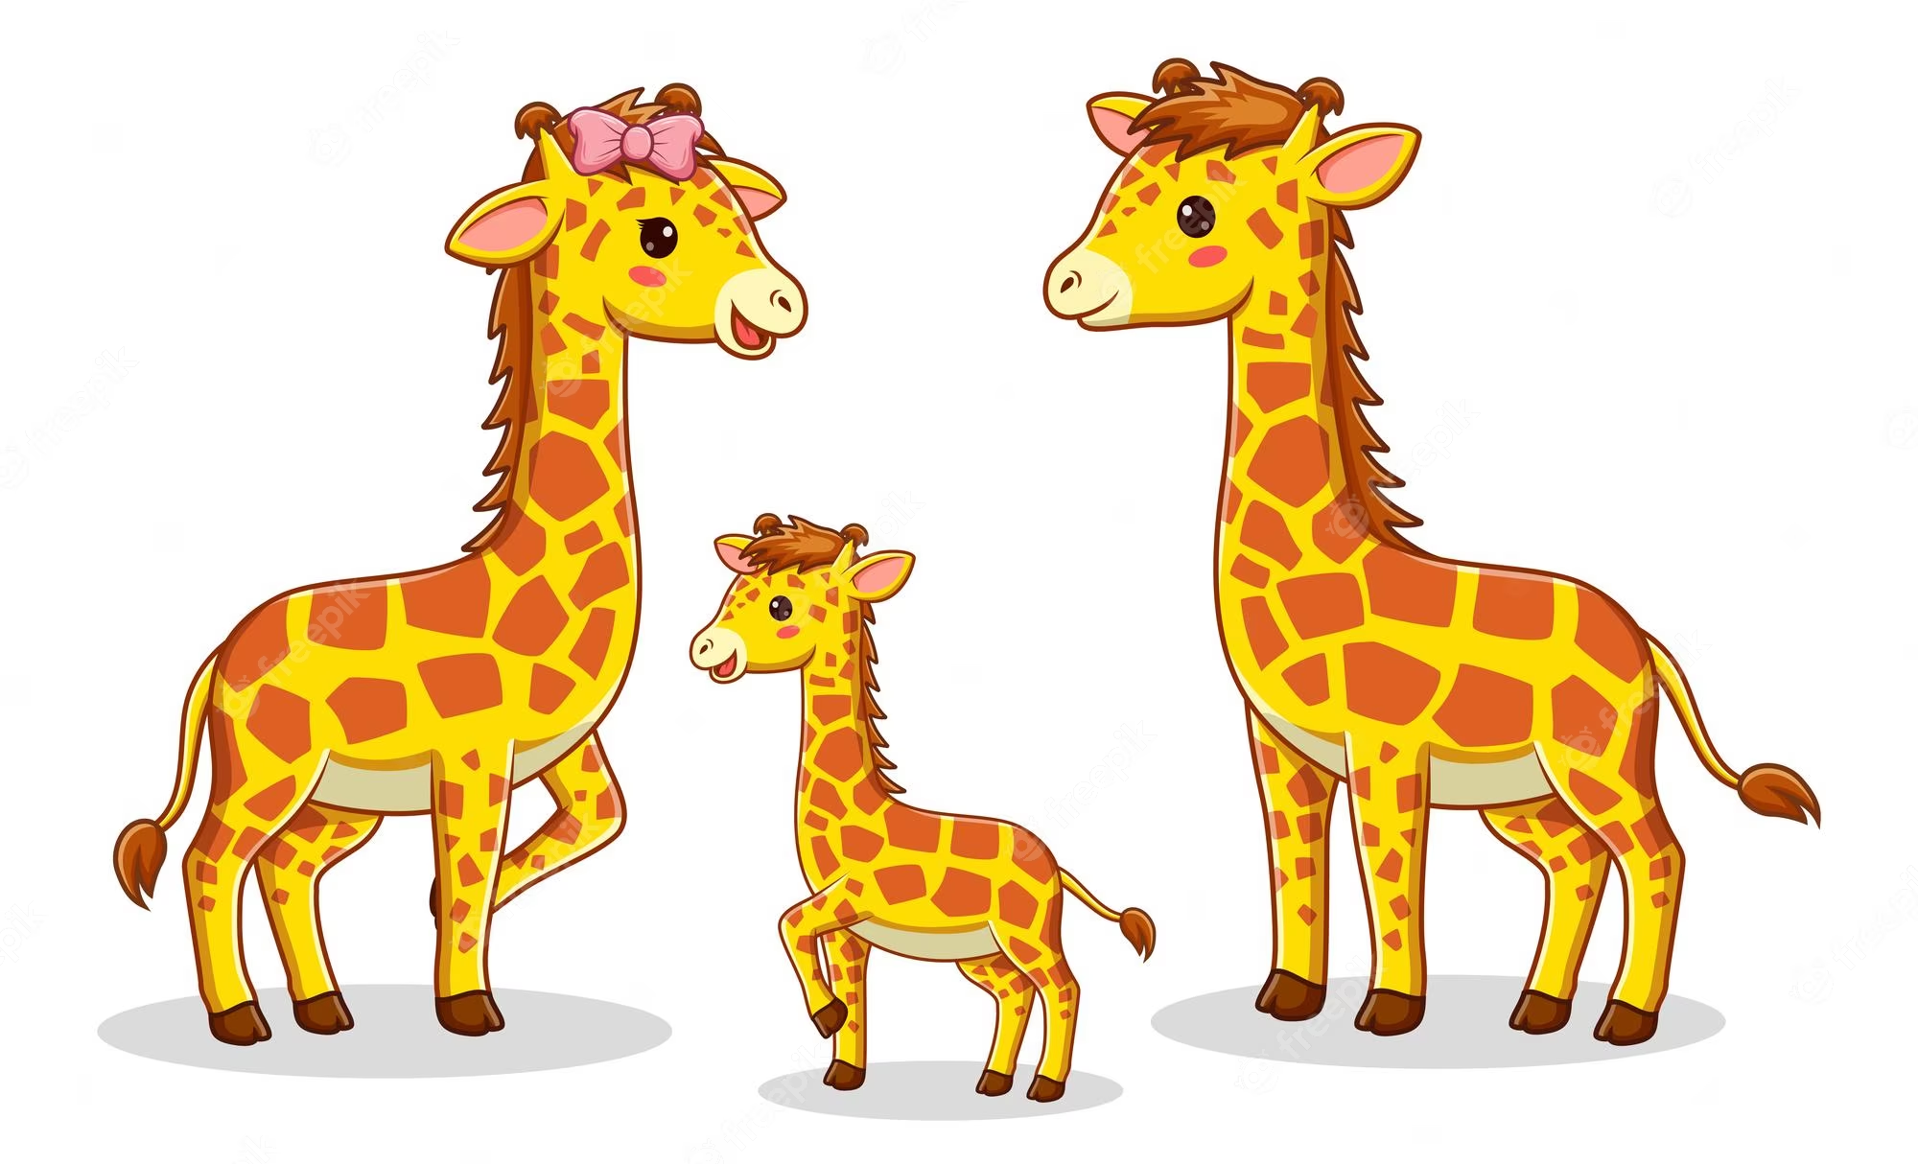
giraffes

Slide 9
Listen and number.
2

Slide 10
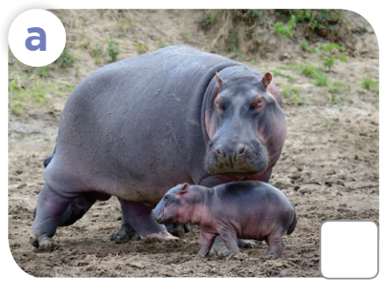
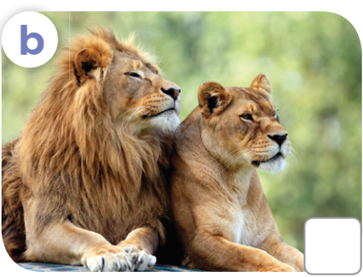
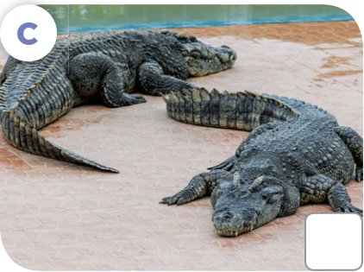
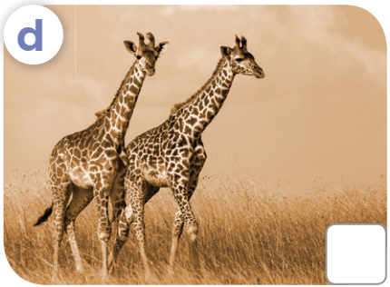
Look and answer.
What are these animals?

Slide 11
Listen and number.
Let's check!
2
3
4
1

Slide 12
Look, complete and read.
3

Slide 13
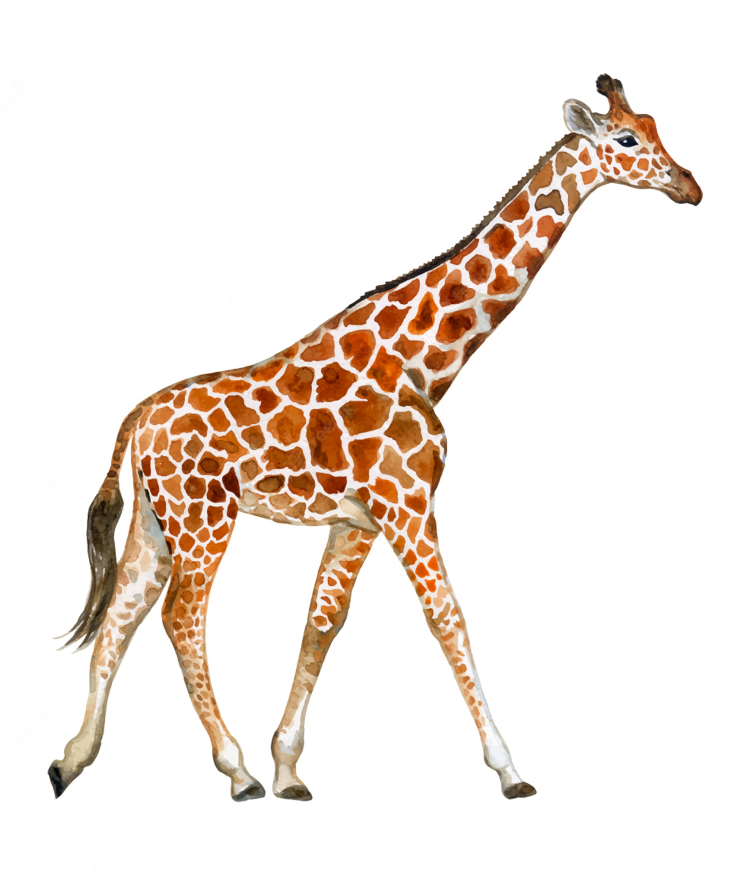
long neck
long legs

Slide 14
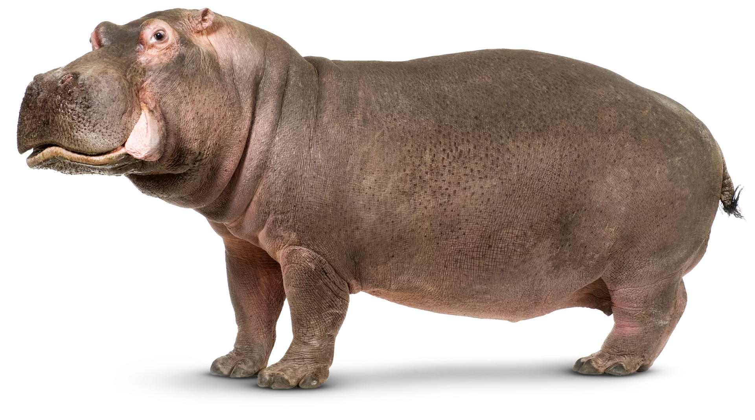
short legs

Slide 15
What's the missing word?
A: What are these animals?
B: They’re ______.
lions

Slide 16
What's the missing word?
A: What are these animals?
B: They’re ___________.
crocodiles

Slide 17
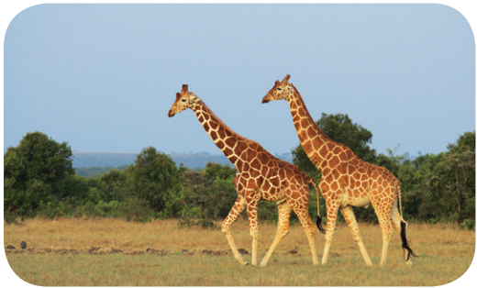
What's the missing word?
A: These animals have long necks and legs. _______ are they?
B: ________ giraffes.
What
They’re

Slide 18
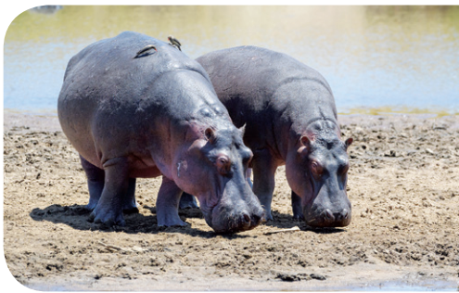
What's the missing word?
A: These animals have short legs. What _________?
B: They’re _______.
are they
hippos

Slide 19
4
Let's sing.

Slide 20
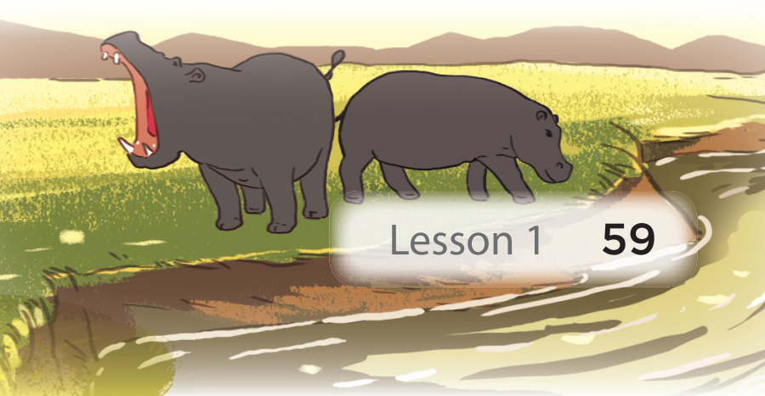
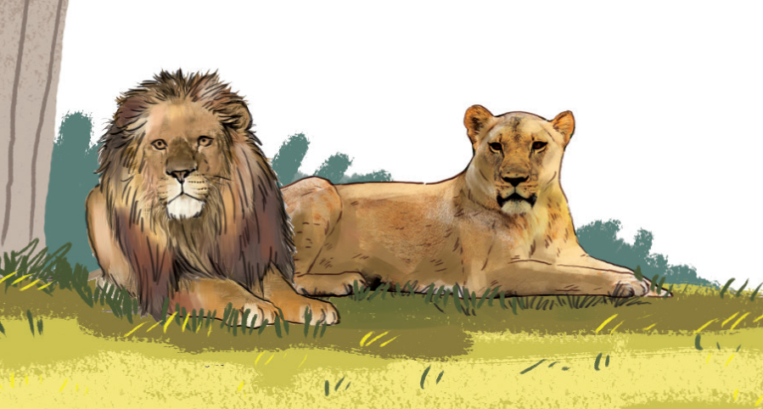
What are these animals?
Look! Look! Look!
What are these animals?
They are lions.
They look brave.
Look! Look! Look!
What are these animals?
They are hippos.
They look strong.

Slide 21
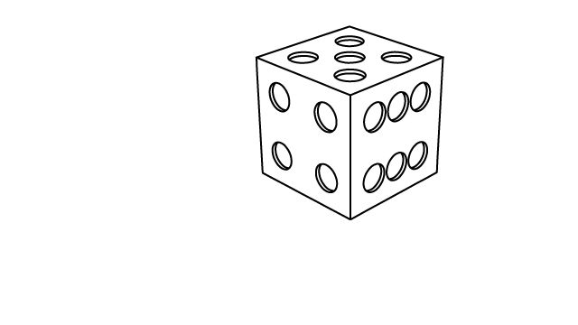
5
Game

Slide 22
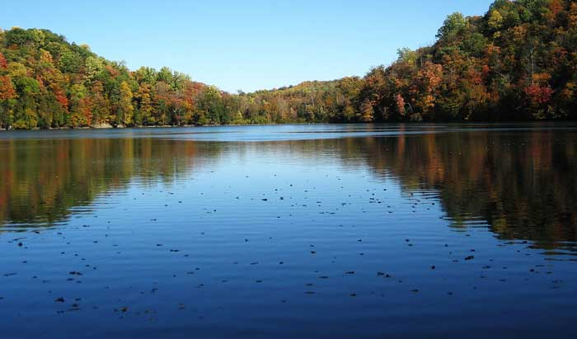
What are these animals?
A. It is a hippo.
B. They're a hippo.
C. They're hippos.
Notes:
Click 3 times to show choices
Click the object to reveal the hidden animals

Slide 23
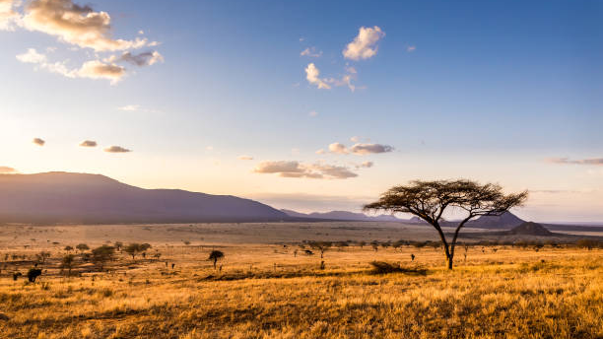
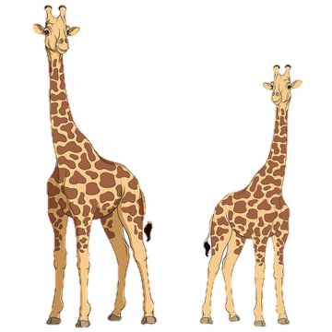
What are these animals?
A. It's a giraffe.
B. They're giraffes.
C. They're a giraffe.
Notes:
Click 3 times to show choices
Click the tree to reveal the hidden animals

Slide 24
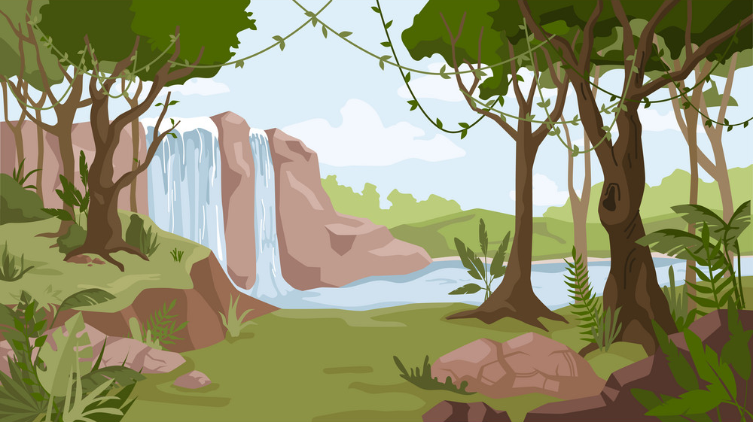
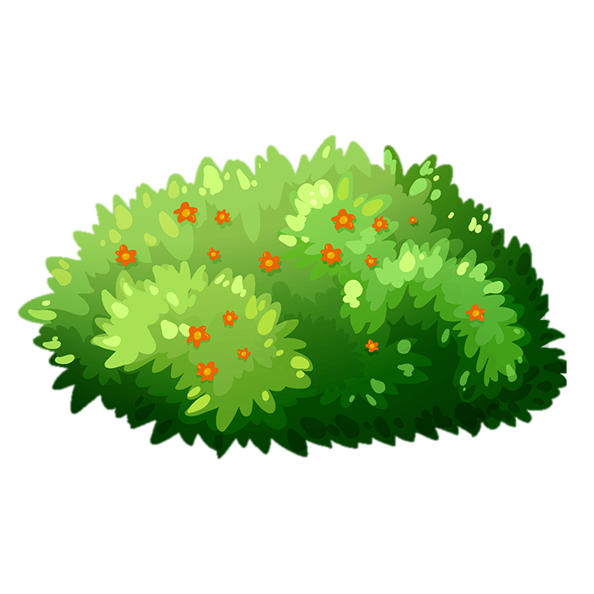
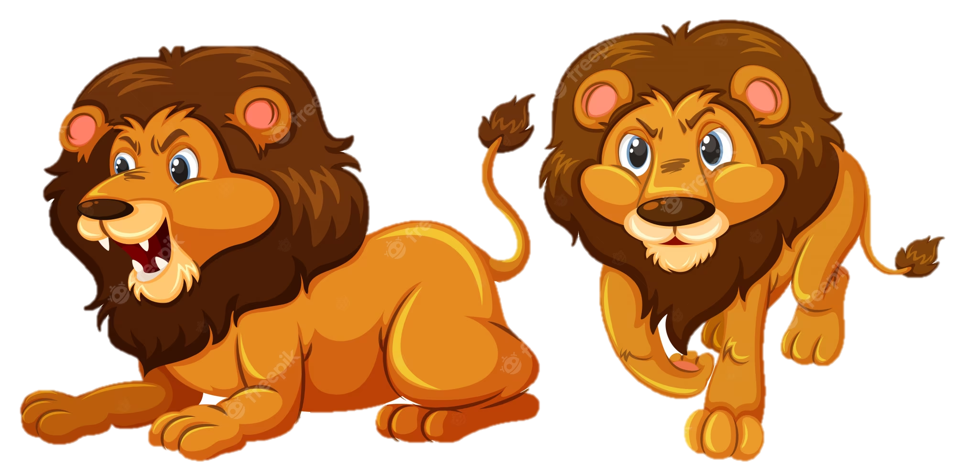
What _____ these animals?
- They are ______.
A. are
B. is
A. am
Notes:
Click 3 times to show choices
Click the bush to reveal the hidden animals
If pupils can fill in the second blank, give them bonus points.

Slide 25
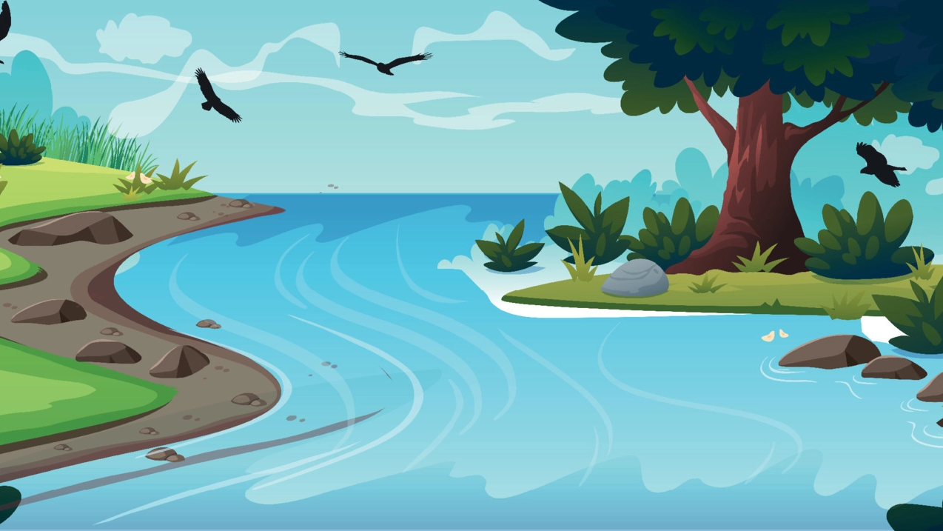
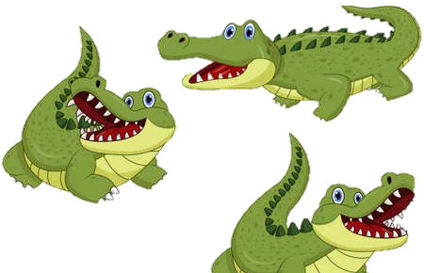
What are these animals?
A. They're hippos.
B. They're crocodiles.
C. It's a crocodile.
Notes:
Click 3 times to show choices
Click the water splash to reveal the hidden animals

Slide 26
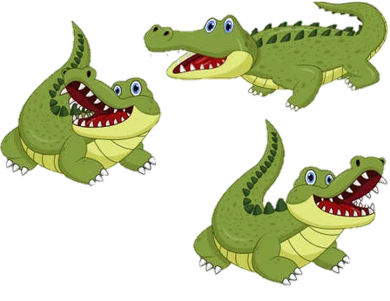
_____ are these animals?
A. Who
B. How
C. What

Slide 27
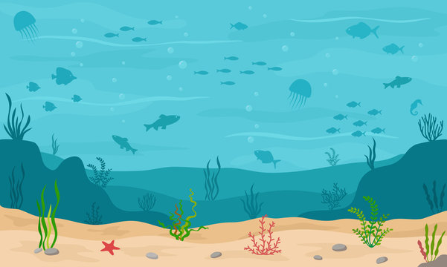
What are these _____?
- They are _____.
A. animals
B. animal
C. they
Notes:
Click 3 times to show choices
Click the seaweed to reveal the hidden animals
If pupils can fill in the second blank, give them bonus points.

Slide 28
Website: hoclieu.vn
Fanpage: facebook.com/www.tienganhglobalsuccess.vn
Website: sachmem.vn; hoclieu.vn
Fanpage: www.facebook.com/sachmem.vn

