Slide 1
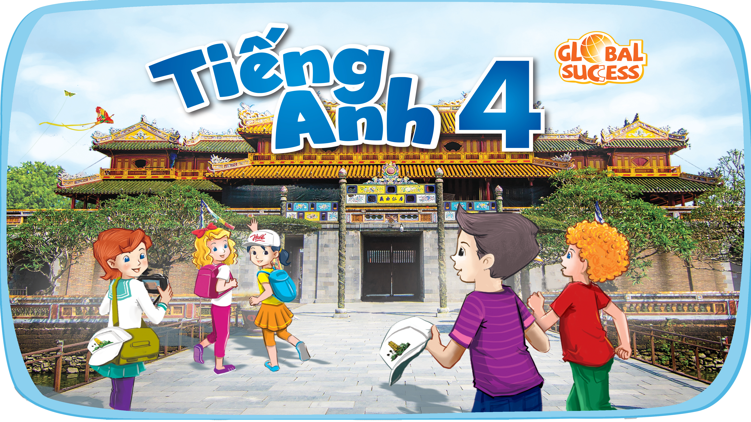

Slide 2



19
The animal world
LESSON 2 - PERIOD 3

Slide 3
Table of Contents
01
02
Look, listen and repeat.
Warm-up
Listen, point and say.
03
04
Let’s talk.
05
Fun corner

Slide 4
1
Warm-up

Slide 5
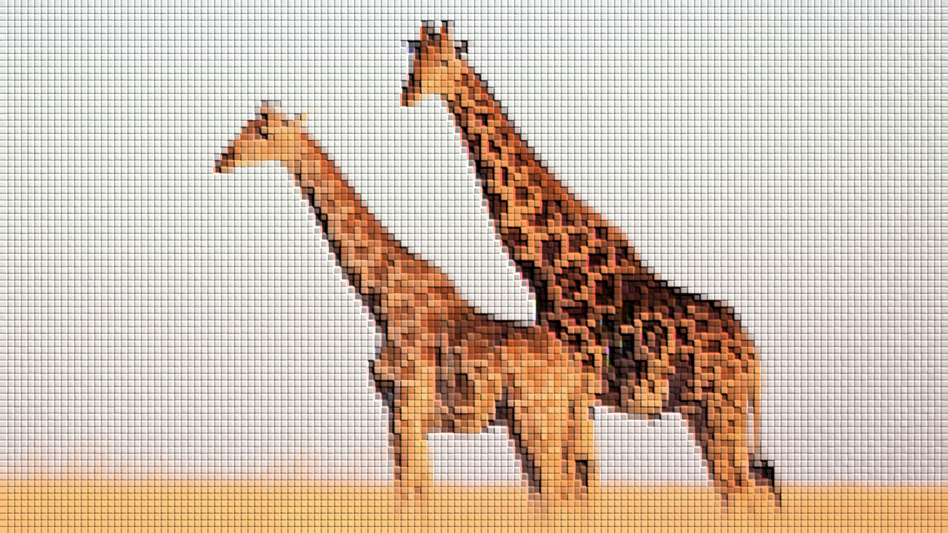
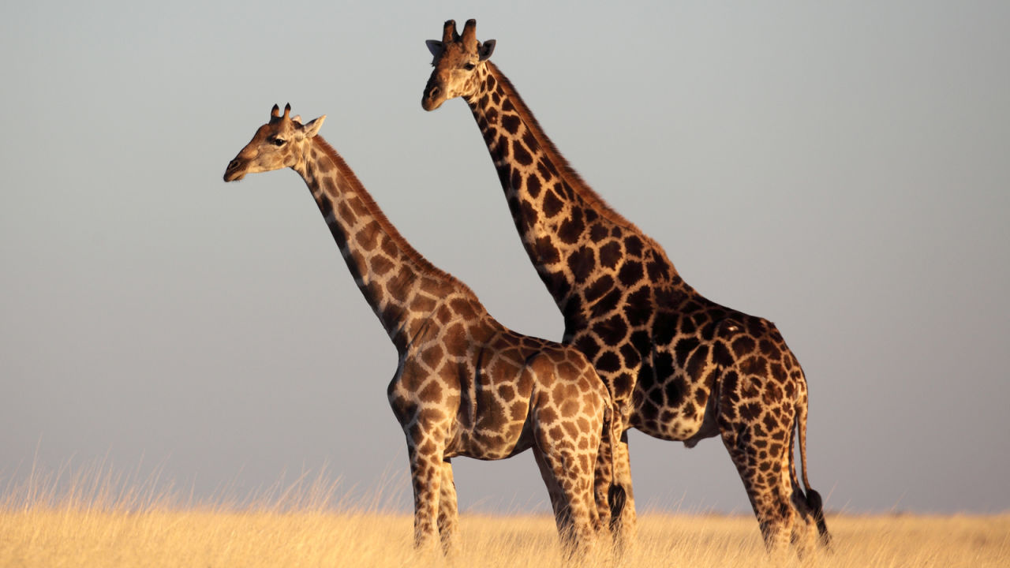
giraffes

Slide 6
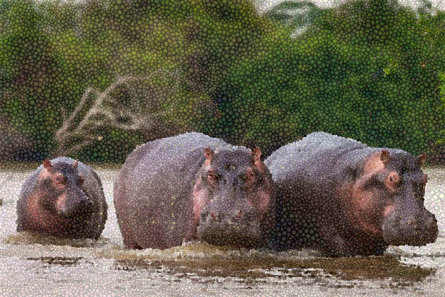
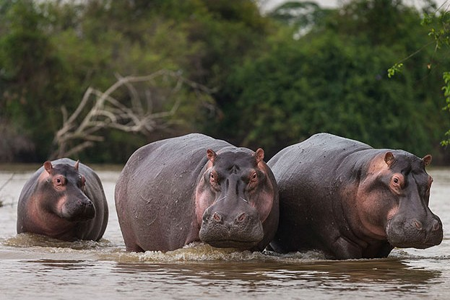
hippos

Slide 7
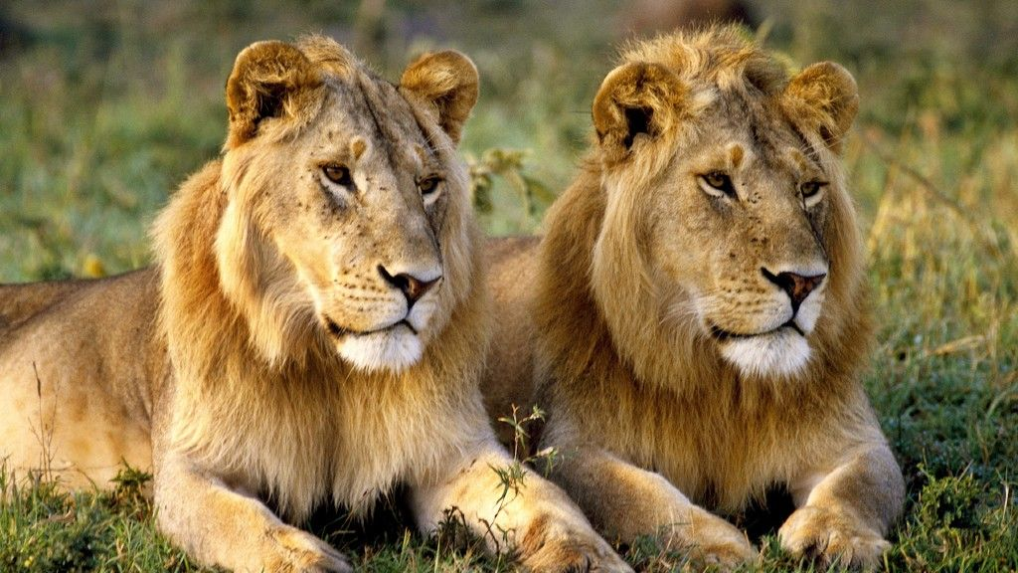
lions

Slide 8
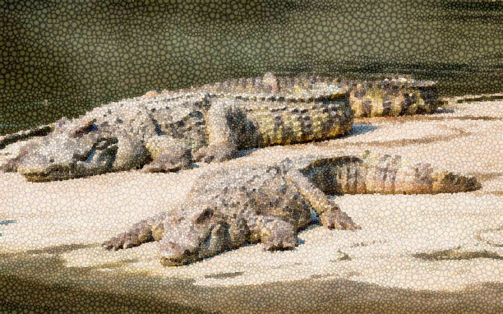
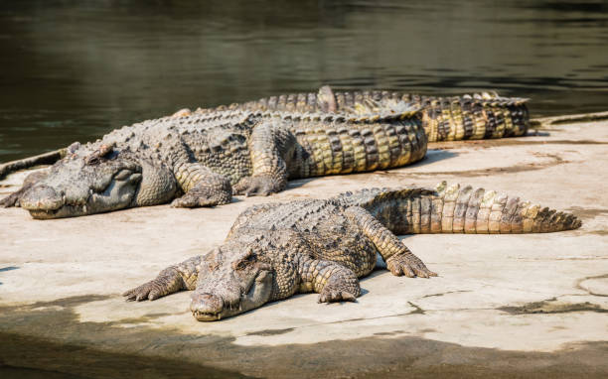
crocodiles

Slide 9
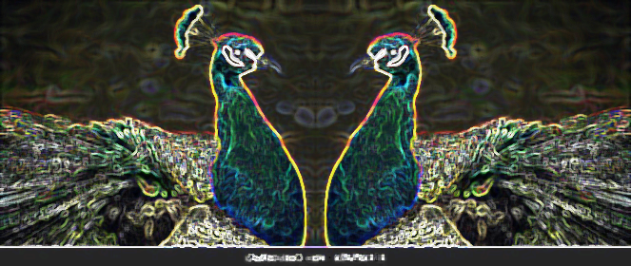
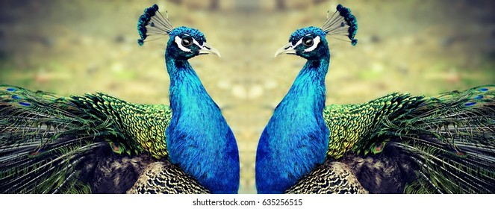
peacocks

Slide 10
Look, listen and repeat.
2

Slide 11

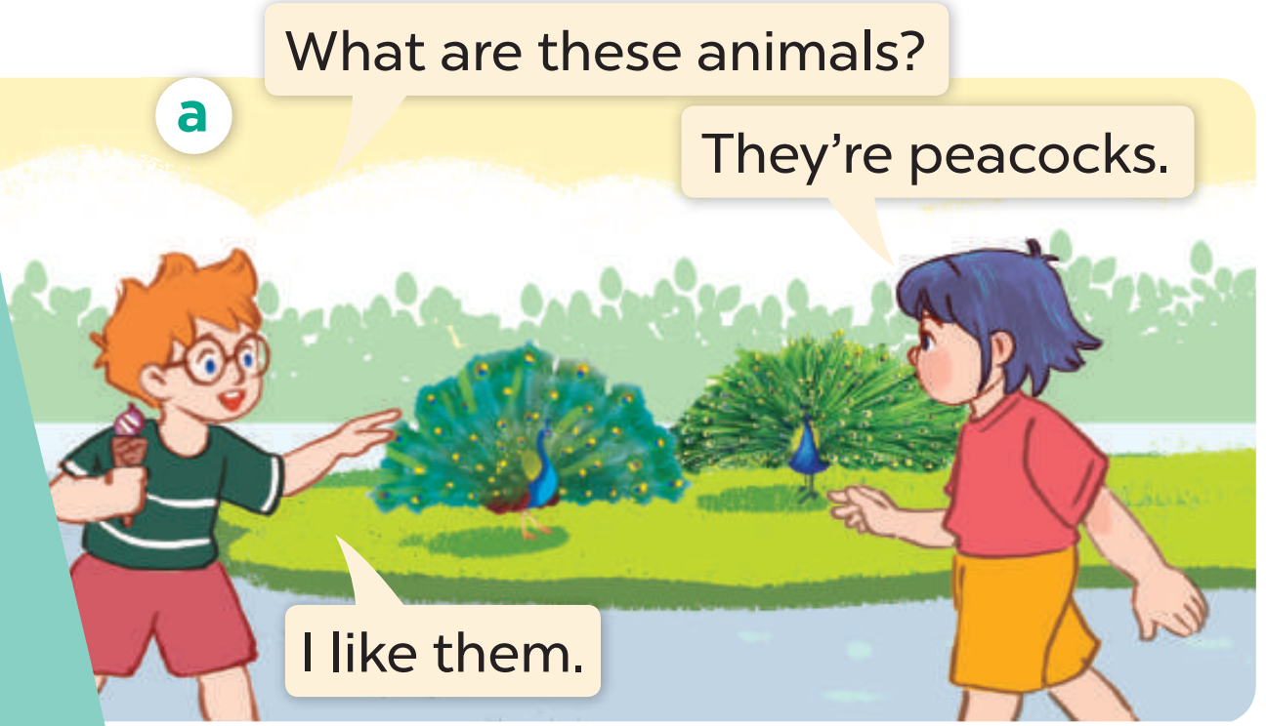
Look, listen and repeat.

Slide 12
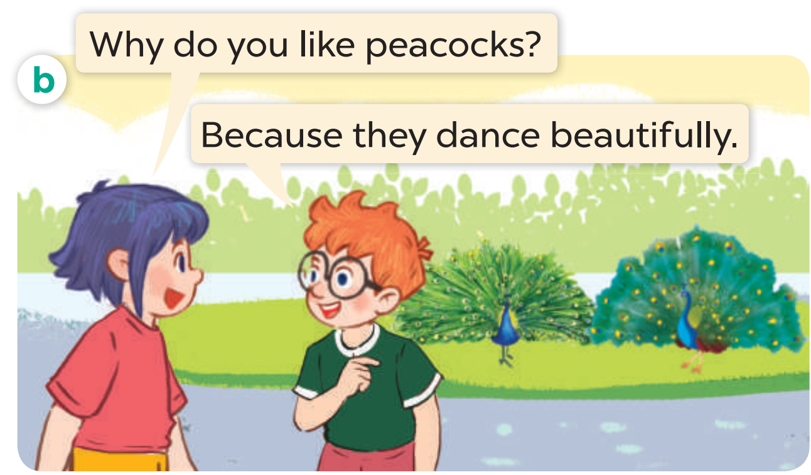
Look, listen and repeat.

Slide 13
Look, listen and repeat.

Slide 14
Listen, point and say.
3

Slide 15
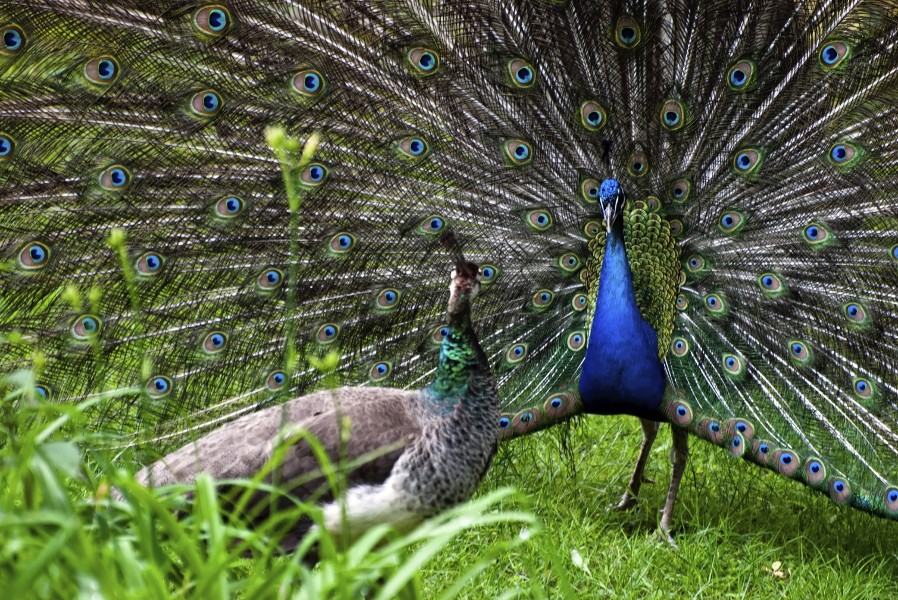
dance beautifully

Slide 16
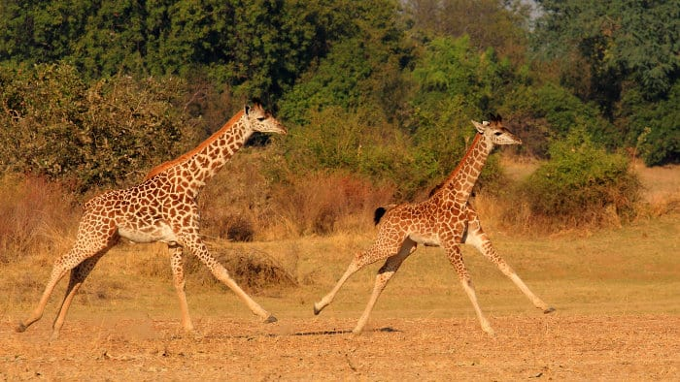
run quickly

Slide 17
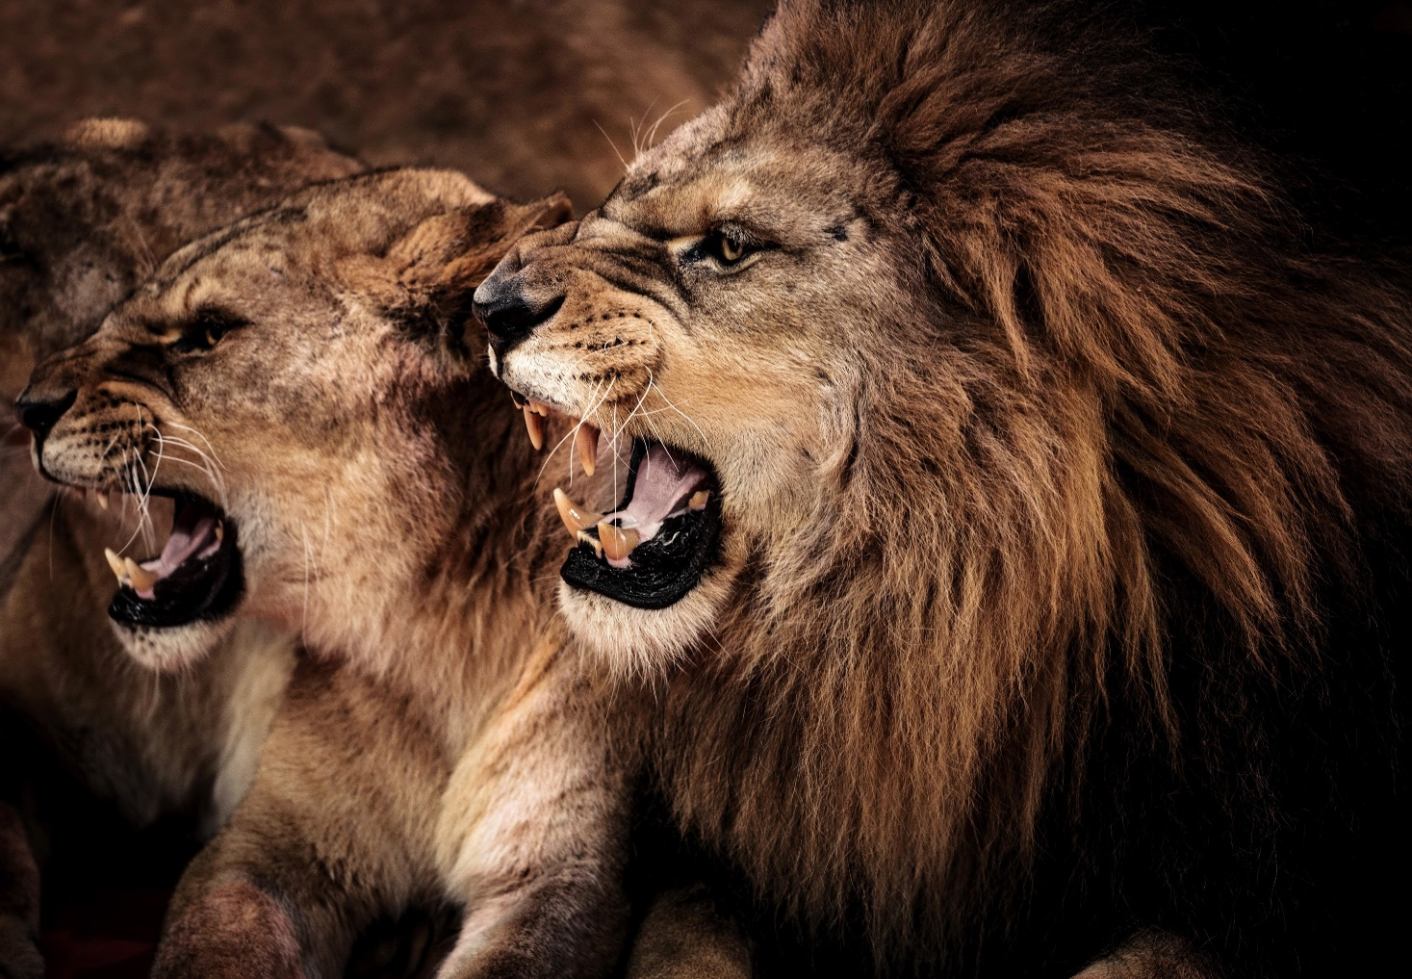
roar loudly

Slide 18
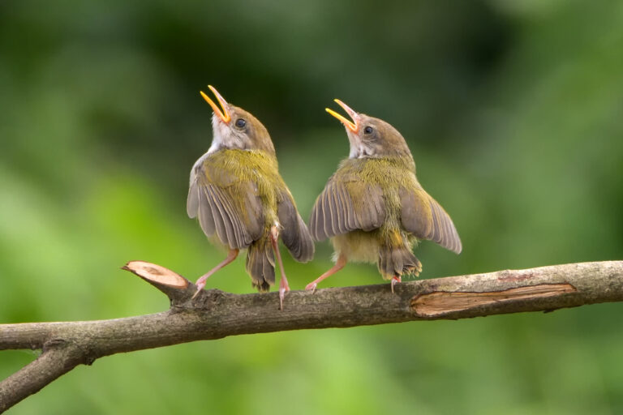
sing merrily

Slide 19
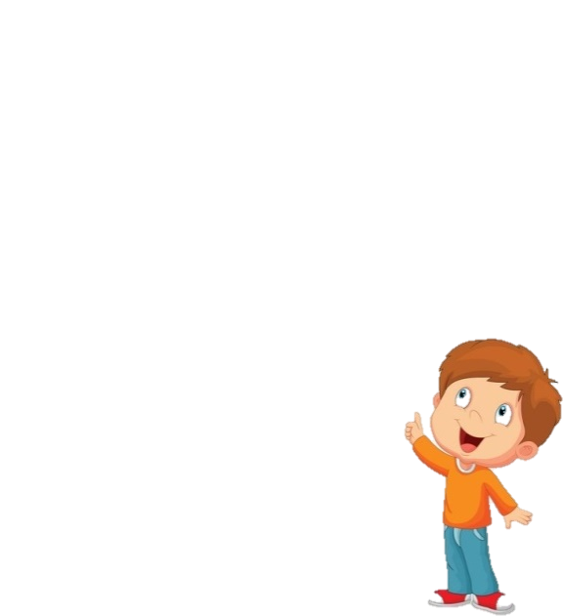

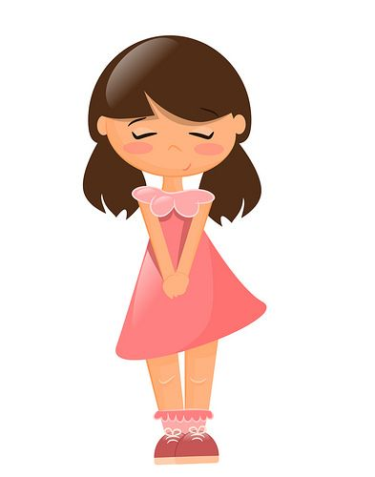
What are these animals?
They’re peacocks.

Slide 20
Why do you like peacocks?
Because they dance beautifully.

Slide 21
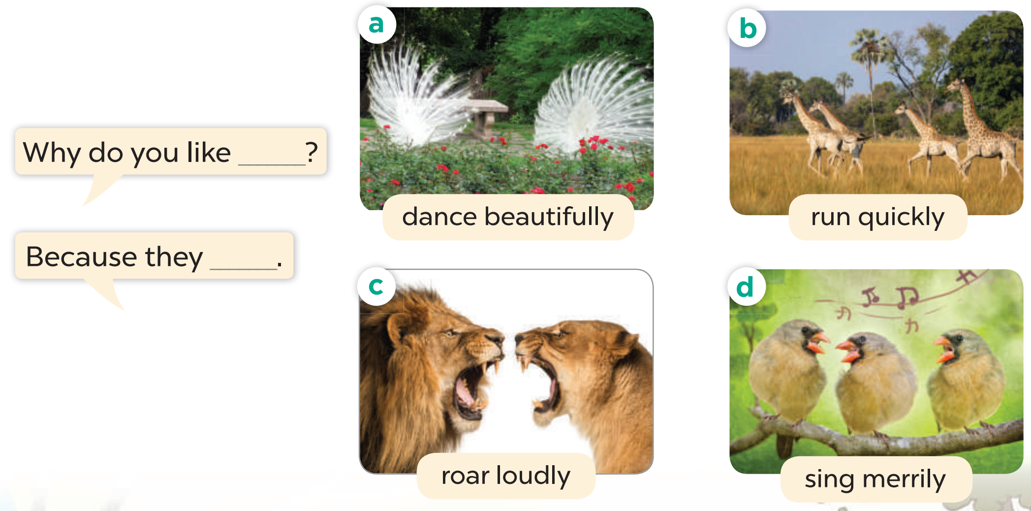
Listen, point and say.

Slide 22
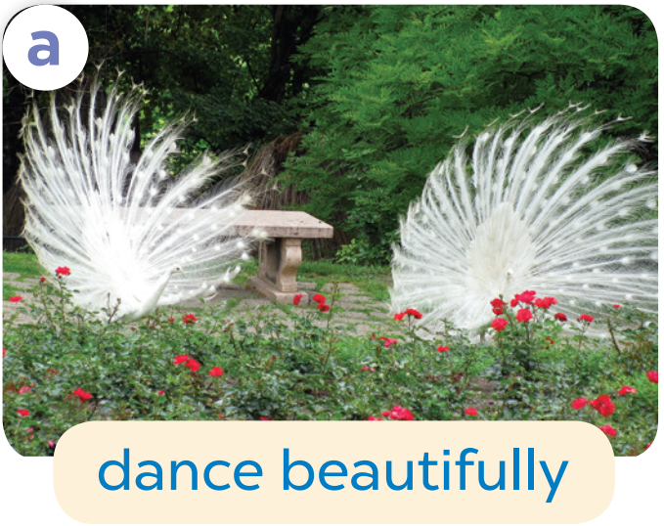
Why do you like ______?
Because they________.

Slide 23
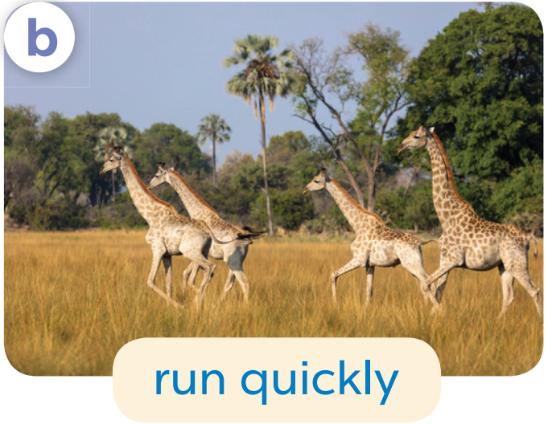
Why do you like ______?
Because they________.

Slide 24
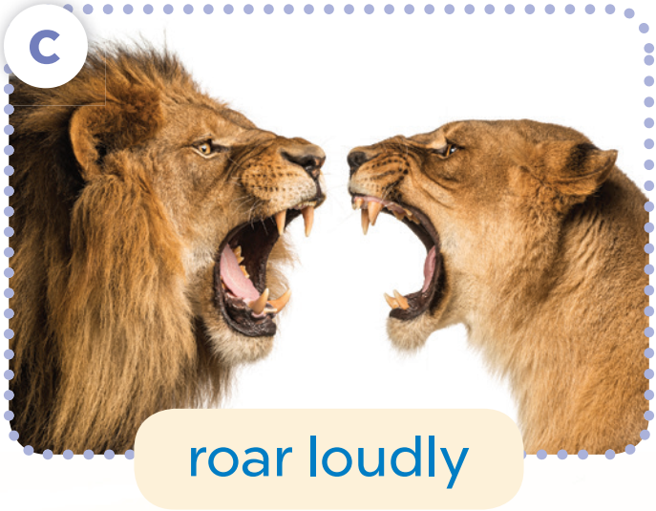
Why do you like ______?
Because they________.

Slide 25
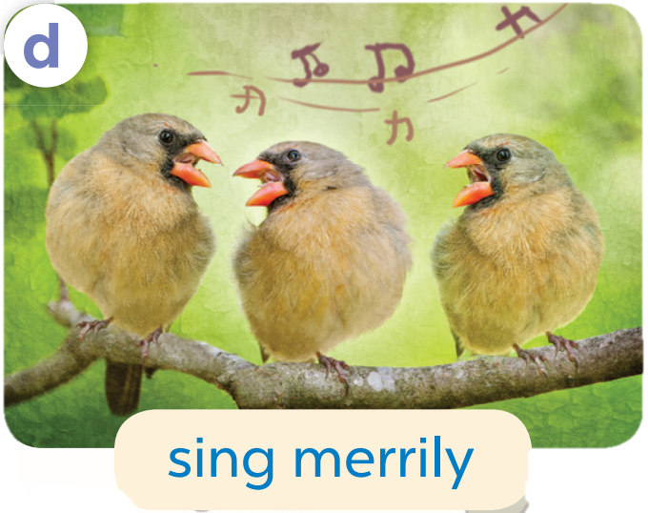
Why do you like ______?
Because they________.

Slide 26
4
Let’s talk.

Slide 27
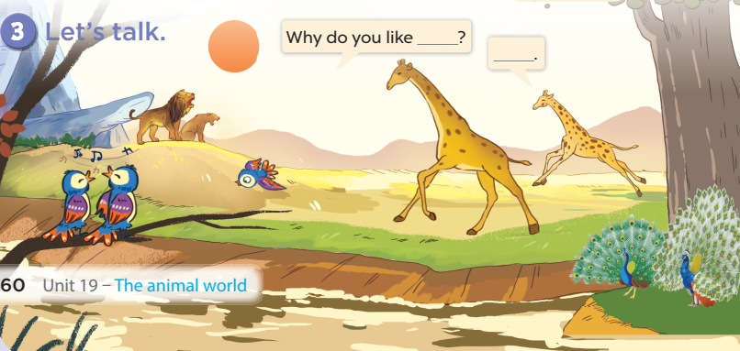

Slide 28
5
Fun corner

Slide 29

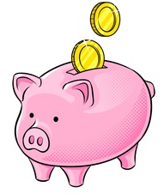
Piggy Bank

Slide 30
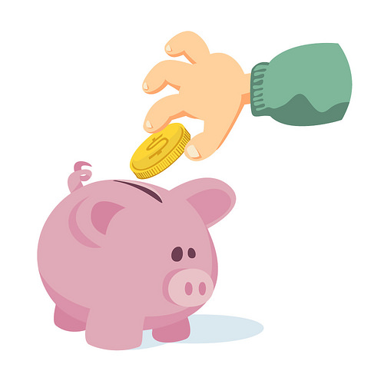


TEAM 1
TEAM 2
TEAM 3
Notes:
Click the piggy bank to show questions.
Click team names to give pupils the number of coins they get for each correct answer.

Slide 31
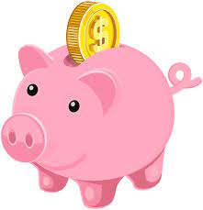
Choose the pig!
1
2
3
4
5
6
7
8

Slide 32
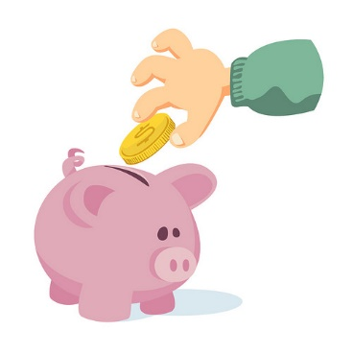
What are these animals?
They’re peacocks.
Notes:
Click once to show the question, twice to show the answer.
Click one last time to show the number of coins they’ll get if the answer is correct.
Click the piggy bank to get back to the menu

Slide 33
Why do you like peacocks?
Because they dance beautifully.
Notes:
Click once to show the question, twice to show the answer.
Click one last time to show the number of coins they’ll get if the answer is correct.
Click the piggy bank to get back to the menu

Slide 34
What are these animals?
They’re giraffes.
Notes:
Click once to show the question, twice to show the answer.
Click one last time to show the number of coins they’ll get if the answer is correct.
Click the piggy bank to get back to the menu

Slide 35
Why do you like giraffes?
Because they run quickly.
Notes:
Click once to show the question, twice to show the answer.
Click one last time to show the number of coins they’ll get if the answer is correct.
Click the piggy bank to get back to the menu

Slide 36

What are these animals?
They’re lions.
Notes:
Click once to show the question, twice to show the answer.
Click one last time to show the number of coins they’ll get if the answer is correct.
Click the piggy bank to get back to the menu

Slide 37
Why do you like lions?
Because they roar loudly.
Notes:
Click once to show the question, twice to show the answer.
Click one last time to show the number of coins they’ll get if the answer is correct.
Click the piggy bank to get back to the menu

Slide 38
What are these animals?
They’re birds.
Notes:
Click once to show the question, twice to show the answer.
Click one last time to show the number of coins they’ll get if the answer is correct.
Click the piggy bank to get back to the menu

Slide 39
Why do you like birds?
Because they sing merrily.
Notes:
Click once to show the question, twice to show the answer.
Click one last time to show the number of coins they’ll get if the answer is correct.
Click the piggy bank to get back to the menu

Slide 40
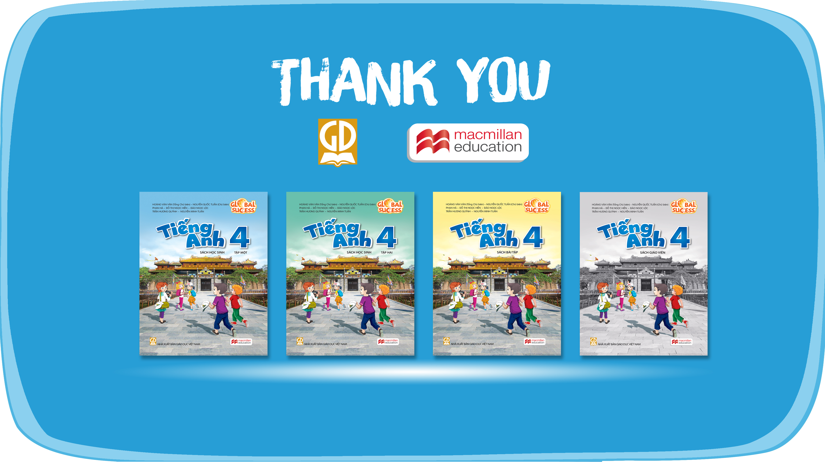
Website: hoclieu.vn
Fanpage: facebook.com/www.tienganhglobalsuccess.vn
Website: sachmem.vn; hoclieu.vn
Fanpage: www.facebook.com/sachmem.vn

