Slide 3
Table of contents
01
02
03
Warm-up
Look, listen and repeat.
Listen, point and say.
04
Let’s talk.
05
Fun corner

Slide 4
01
Warm-up
Let’s chant.

Slide 5
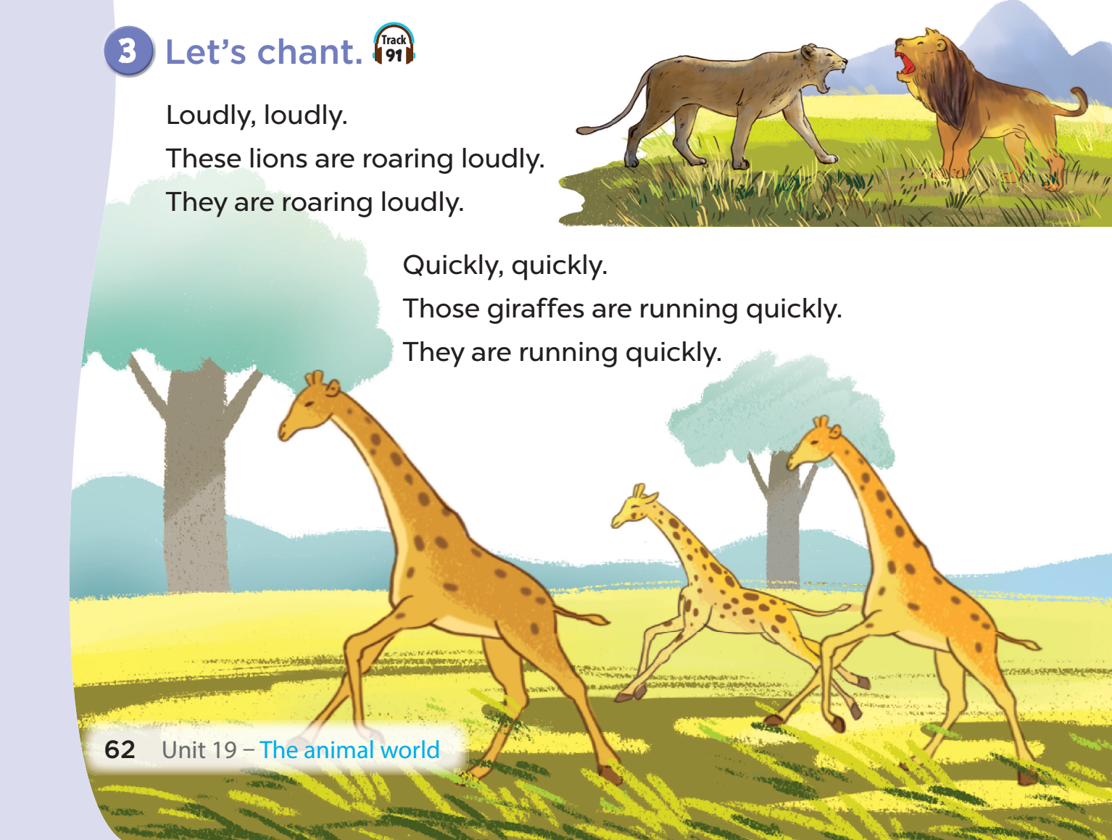

Slide 6
02
Activity 1
Look, listen and repeat.

Slide 7
Look and listen.

Slide 9
03
activity 2
Listen, point and say

Slide 10
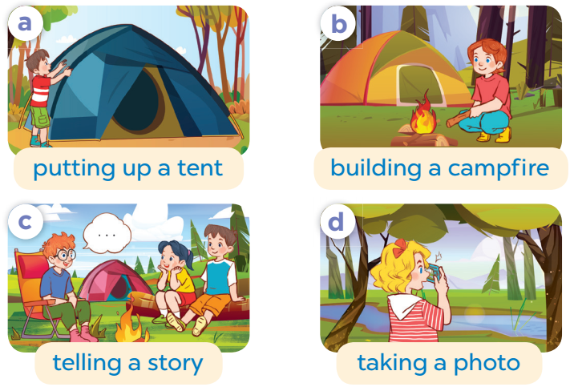
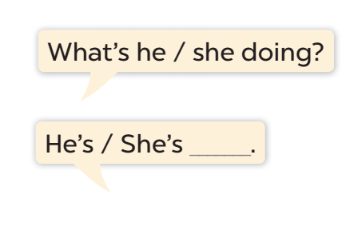

Slide 11
WHAT’S HE/ SHE DOING?

Slide 12
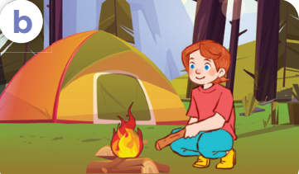
What’s she doing?
She’s building a campfire.

Slide 13
What’s he doing?
He’s telling a story.

Slide 14
What’s she doing?
She’s taking a photo.

Slide 15
What’s he doing?
He’s putting up a tent

Slide 16
04
Activity 3
Let’s talk

Slide 17
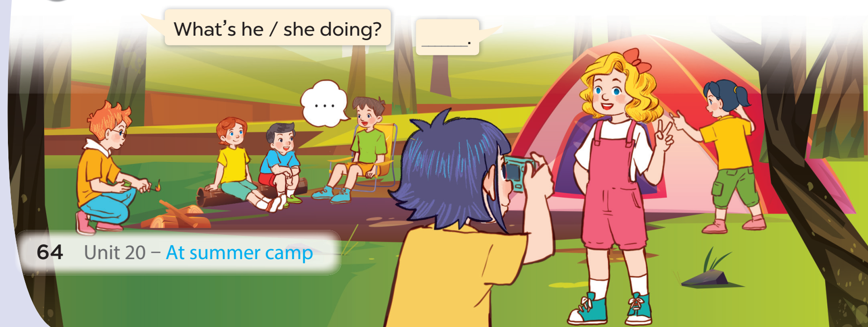

Slide 18
05
FUN CORNER

Slide 19
CROSS THE EXTRA LETTER

Slide 20
PUTTING UP A THENT
PUTTING UP A TENT

Slide 21
TELLING A SSTORY
TELLING A STORY

Slide 22
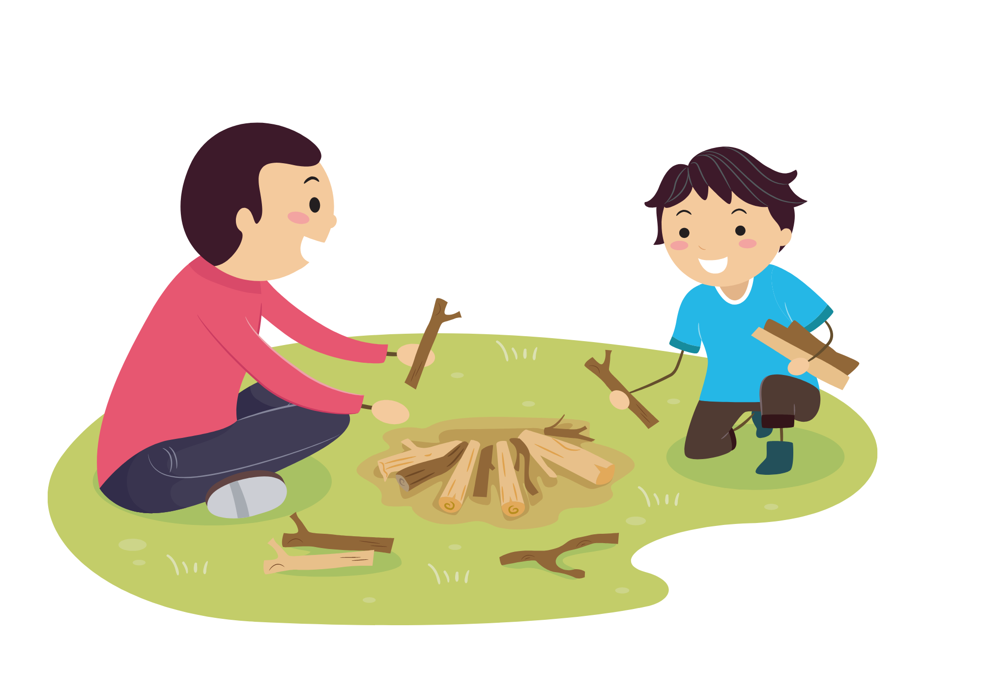
BUILDING A CAMPPFIRE
BUILDING A CAMPFIRE

Slide 23
TAKING A PHOTTO
TAKING A PHOTO

Slide 24
Website: hoclieu.vn
Fanpage: facebook.com/www.tienganhglobalsuccess.vn

