Slide 3
Table of contents
Look, listen and repeat.
Listen, point and say.
01
Warm-up
02
03
04
Let’s talk.
05
Fun corner

Slide 4
01
Warm-up

Slide 5
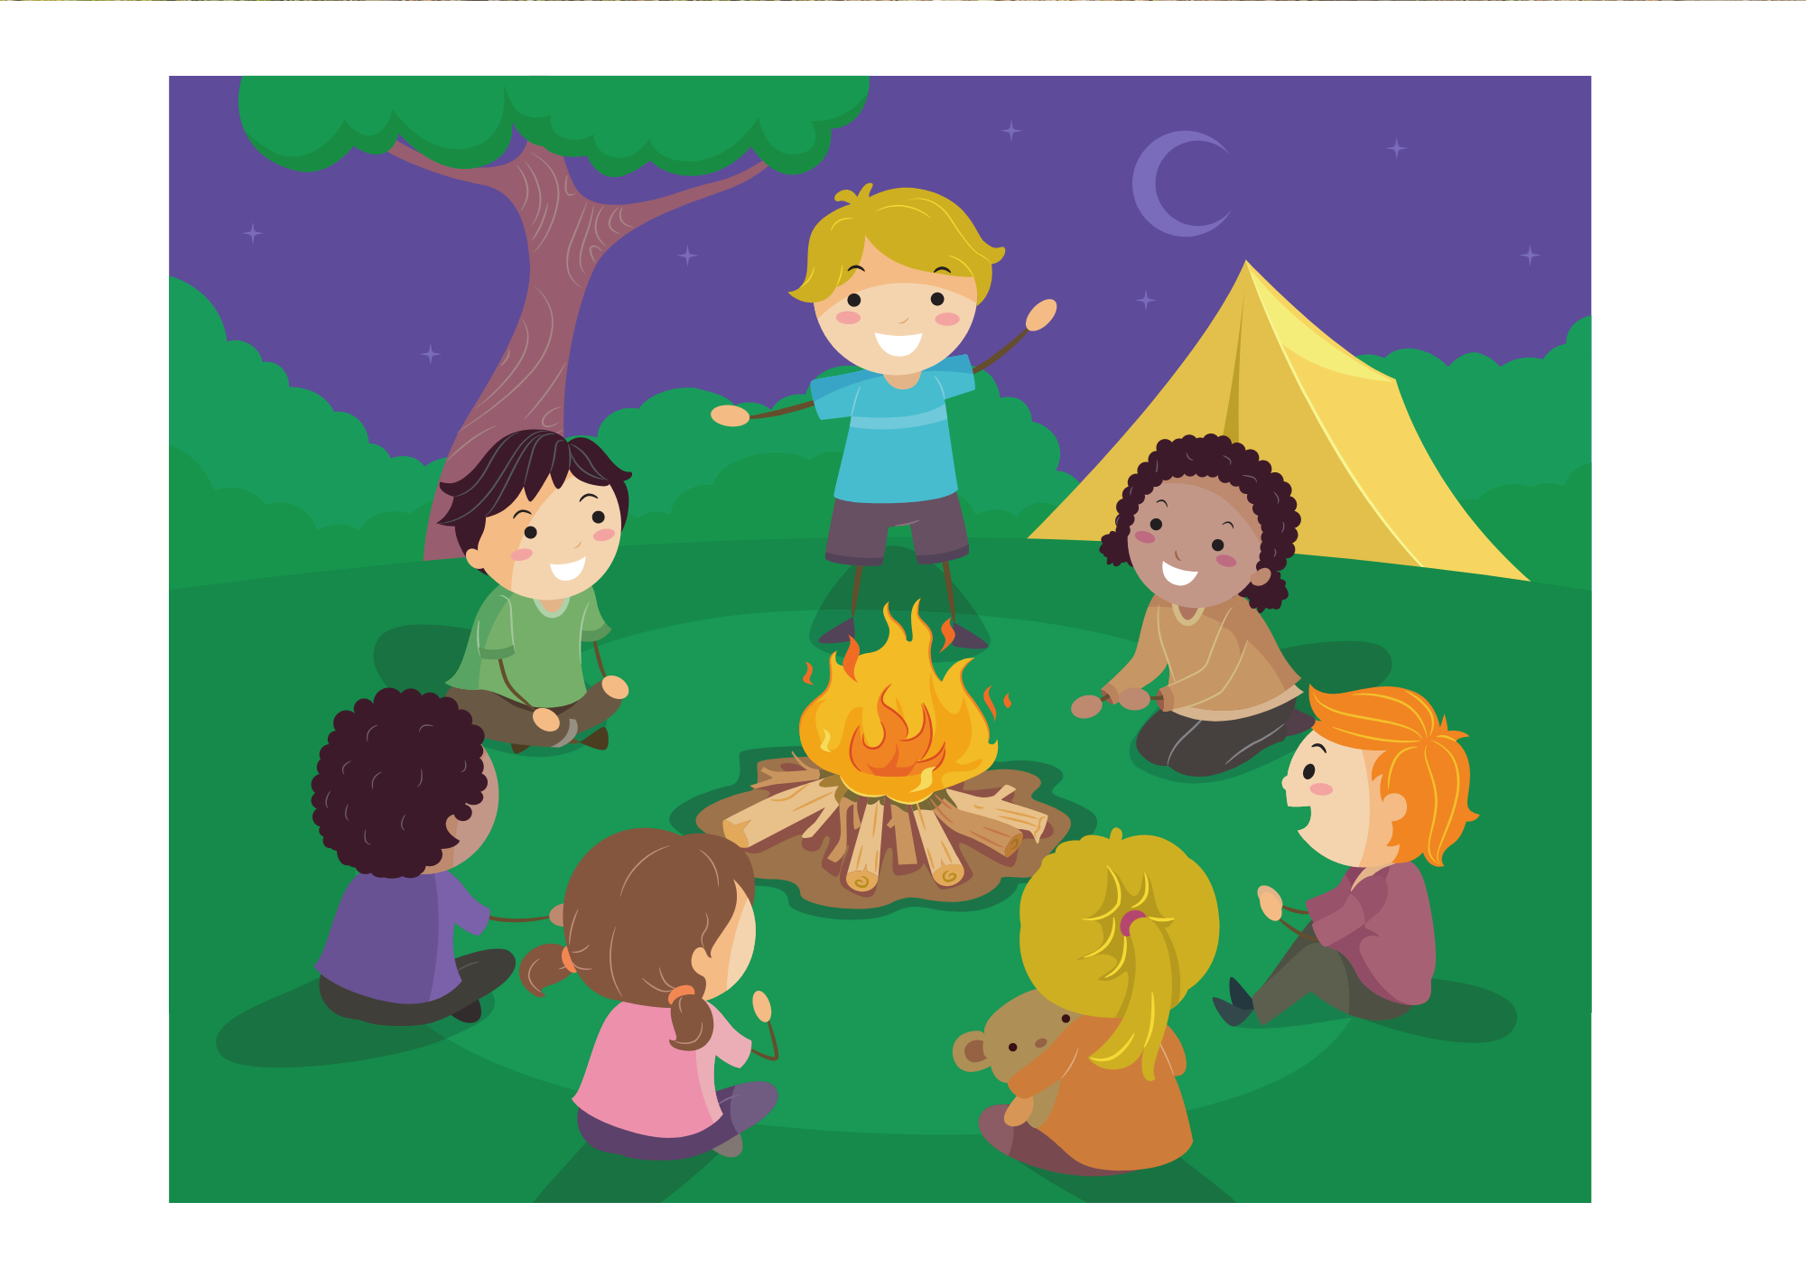
What’s he doing?
He’s telling a story.

Slide 6
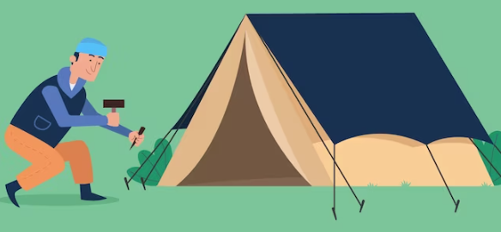
What’s he doing?
He’s putting up a tent.

Slide 7
What’s she doing?
She’s taking a photo.

Slide 8
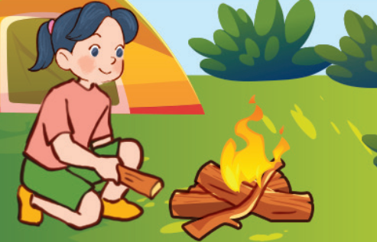
What’s she doing?
She’s building a campfire.

Slide 9
02
Activity 1
Look, listen and repeat.

Slide 10
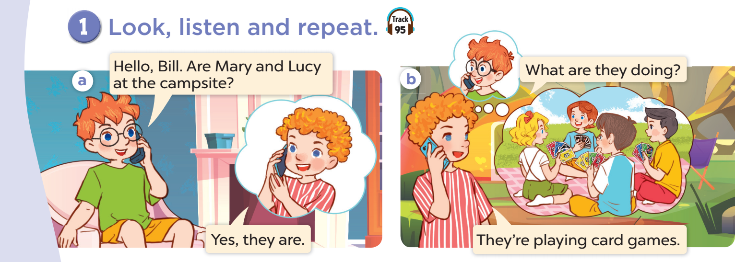

Slide 11
03
Activity 2
Listen, point and say.

Slide 12
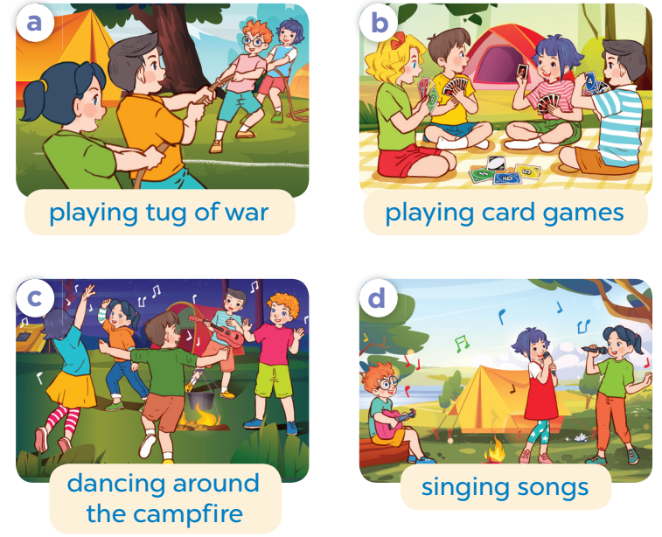
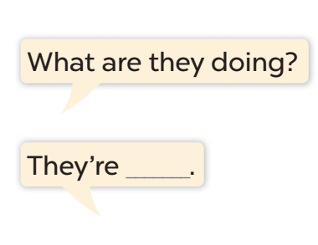

Slide 13
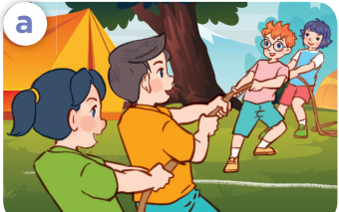
Work in pairs. Role-play.
What are they doing?
They are playing tug of war.

Slide 14
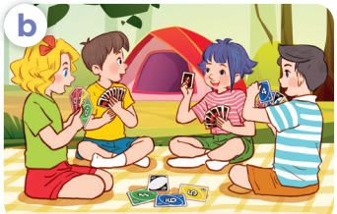
Work in pairs. Role-play.
What are they doing?
They are playing card games.

Slide 15
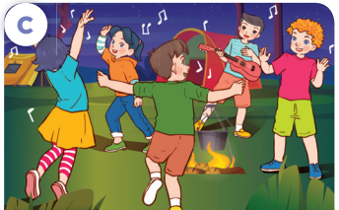
Work in pairs. Role-play.
What are they doing?
They are dancing around the campfire.

Slide 16
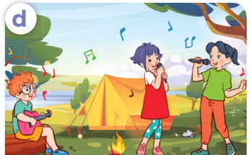
Work in pairs. Role-play.
What are they doing?
They are singing songs.

Slide 17
04
Activity 3
Let’s talk.

Slide 19
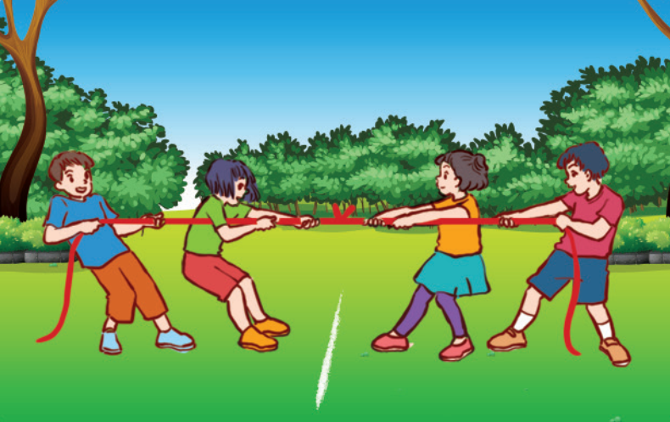

Slide 20
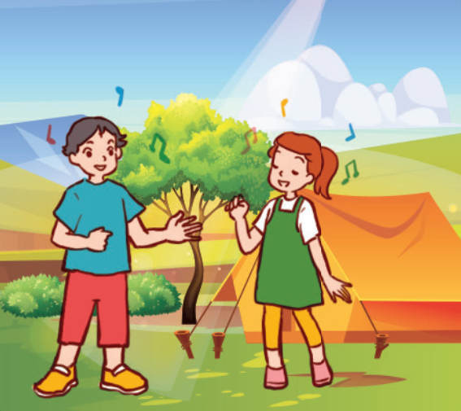

Slide 21
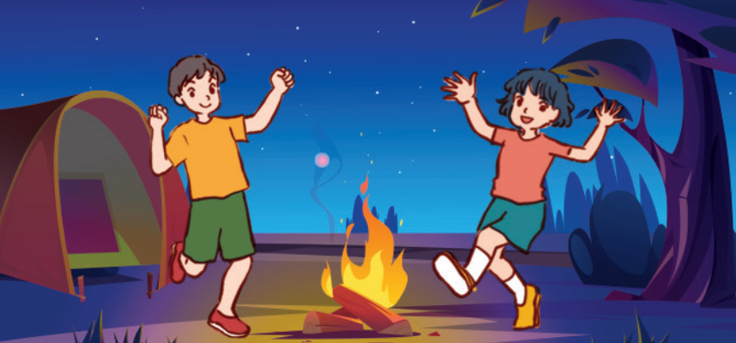

Slide 22
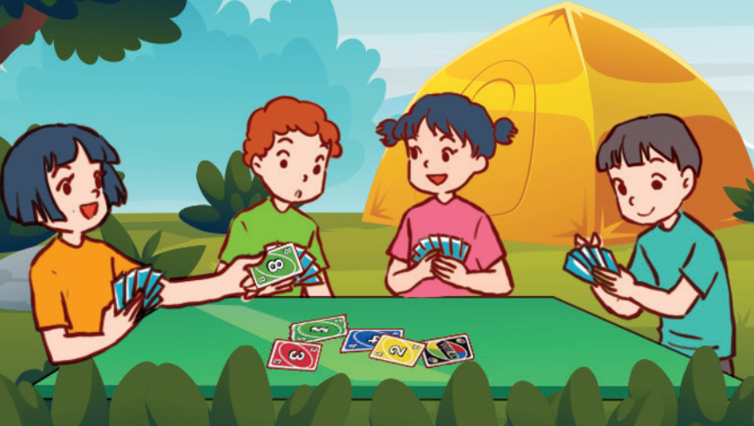

Slide 23
05
FUN CORNER

Slide 24
MIMING GAME
Notes:
Pick up some pupils to look at the pictures, then they mime in their own way to express the action.
Teacher asks What are they doing?
The rest say: They are …

Slide 25
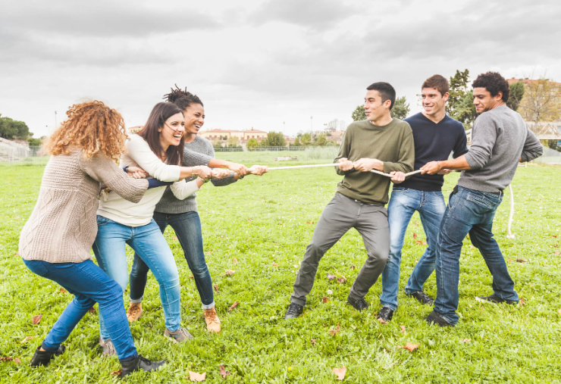
playing tug of war

Slide 26
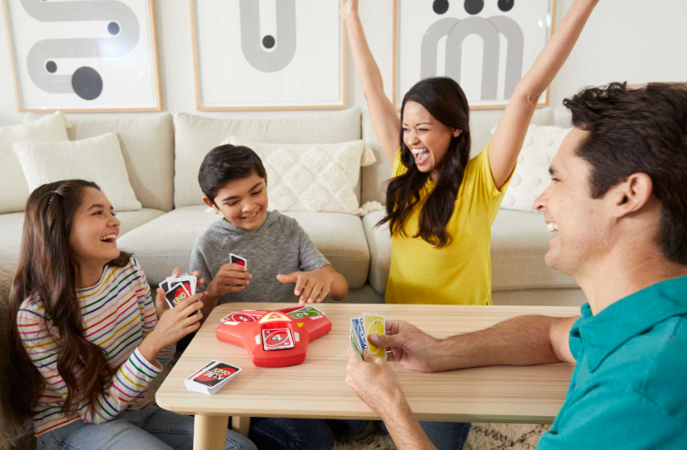
playing card games

Slide 27
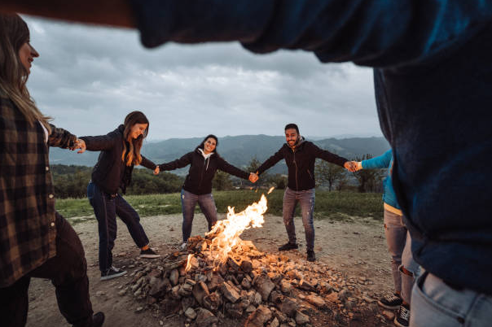
dancing around the campfire

Slide 28
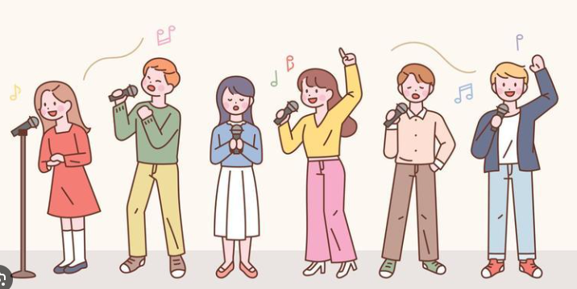
singing songs

Slide 29
Website: hoclieu.vn
Fanpage: facebook.com/www.tienganhglobalsuccess.vn

