Slide 3
Table of Contents
Listen and repeat.
Listen and circle.
01
Warm-up
02
03
04
Let’s chant.
05
Fun corner

Slide 4
01
Warm-up
Singing competition

Slide 6
SINGING COMPETION!

Slide 7
02
Activity 1
Listen and repeat.

Slide 9
03
Activity 2
Listen and circle.

Slide 11
04
Activity 3
Let’s chant.

Slide 12
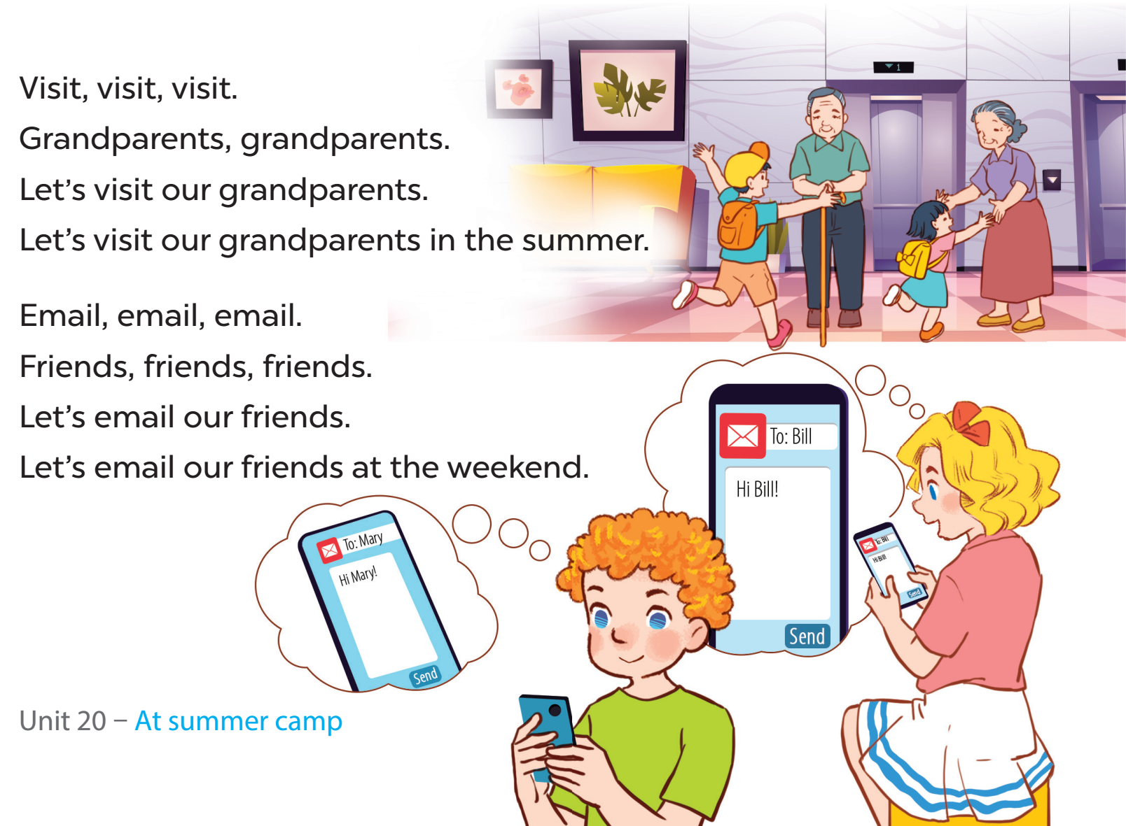

Slide 13
05
FUN CORNER

Slide 14
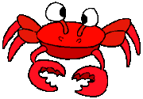
Fishing Game
Let’s go !!

Slide 15
We ____ our grandparents at the weekend.
D. visit
A. email
B. sing
C. welcome
D. visit

Slide 16
Linh and Nam ___ their friends on Sundays.
C. email
A. play
D. go
C. email
B. do

Slide 17
They are ___ card games.
D. playing
A. dancing
B. singing
C. emailing
D. playing

Slide 18
He’s putting up ___ at the campsite.
A. a tent
A. a tent
D. a chair
C. a song
C. a photo

Slide 19
Website: hoclieu.vn
Fanpage: facebook.com/www.tienganhglobalsuccess.vn

