Slide 5
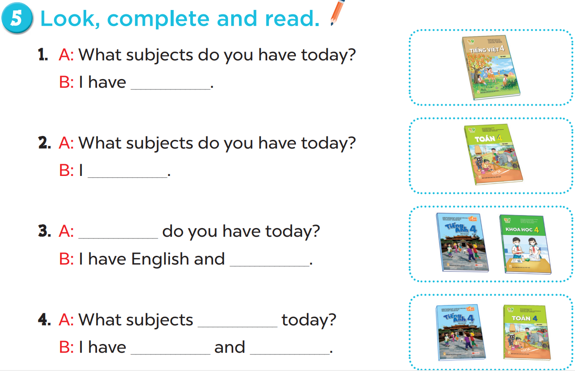

Slide 6
Vietnamese.
maths
What subjects
science
do you have
English
maths

Slide 7
c
e
c
e
l
i
i
n
e
e
a
h

Slide 9
What ______do you have today?
subjects
subject
Ms Huyền Phạm
0936.082.789

Slide 10
_____subjects do you have today?
What
How
Ms Huyền Phạm
0936.082.789

Slide 11
I have________.
Viet Nam
Vietnamese
Ms Huyền Phạm
0936.082.789

Slide 12
I have________.
England
English
Ms Huyền Phạm
0936.082.789

Slide 13
I have Maths and ______.
scienec
science
Ms Huyền Phạm
0936.082.789

Slide 14
I have________.
matht
maths
Ms Huyền Phạm
0936.082.789

