Slide 3
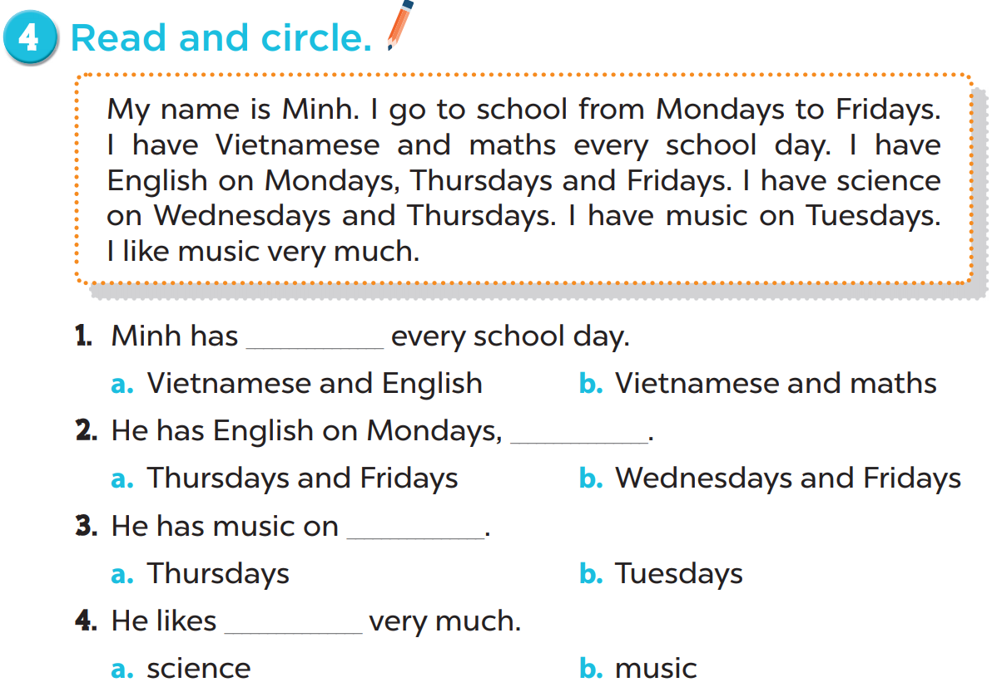

Slide 5
Lucy
English
science
Tuesdays
music
Fridays
music

Slide 8
Reorder the words.
Fridays./ Mondays/ I/ to/
school/ go/ from
I go to school from Mondays to Fridays.

Slide 9
Reorder the words.
every/ day./ I/ maths/ have
I have maths every day.

Slide 10
Reorder the words.
Fridays./ and/ have/ science
Mondays/ I/ on
I have science on Mondays and Fridays.

Slide 11
Reorder the words.
much./ like/ I/ science/ very
I like science very much.

